Slide 1
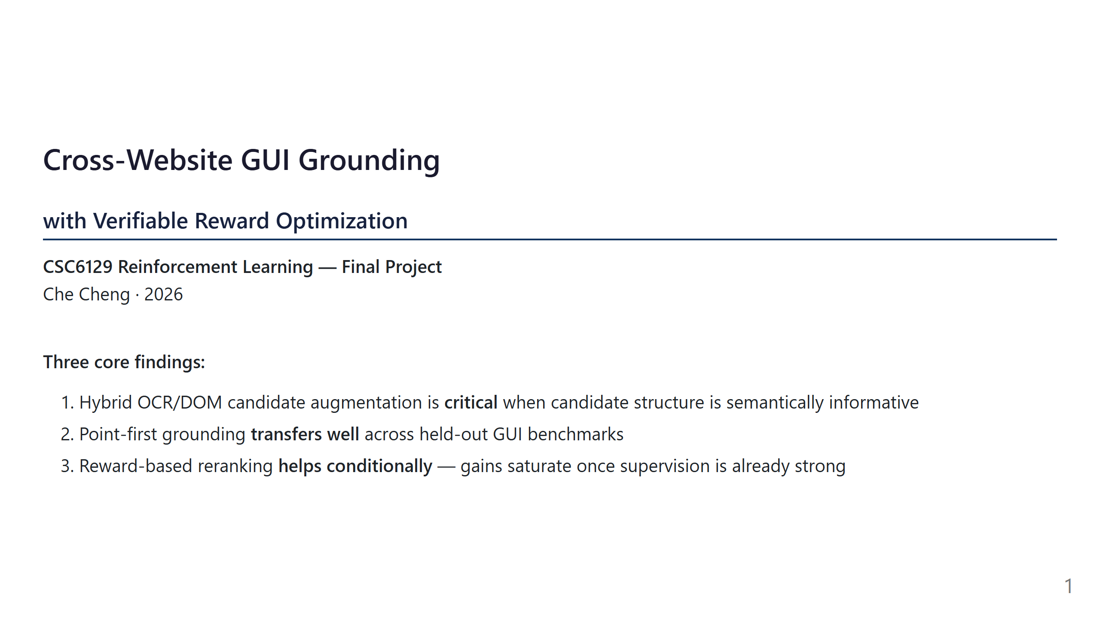
Notes:
Slide 1: Title

Slide 2
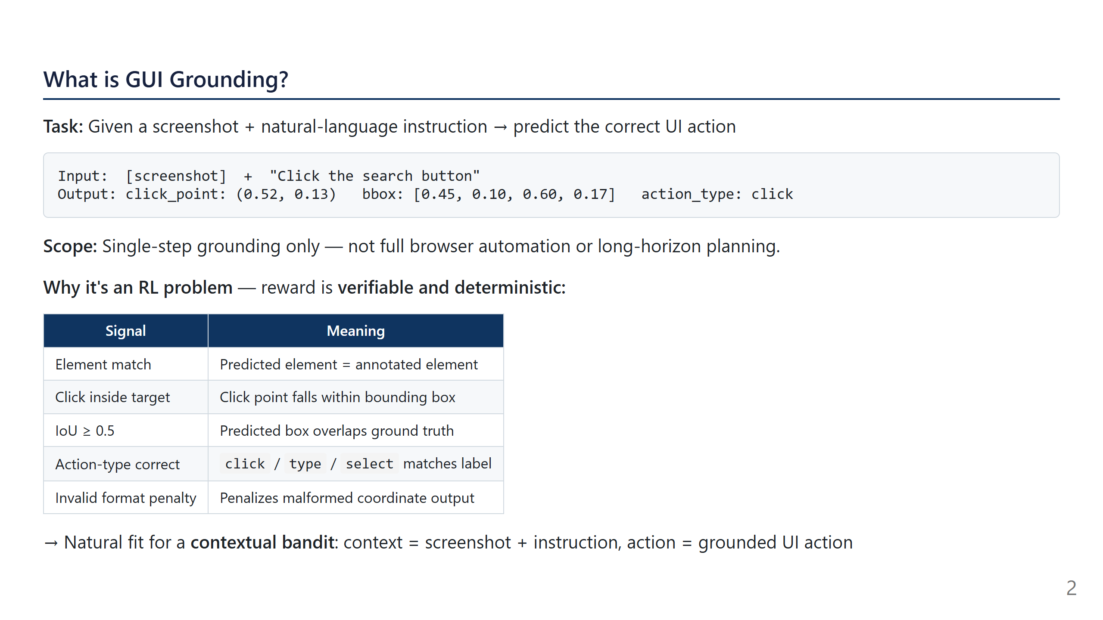
Notes:
Slide 2: Problem Framing

Slide 3
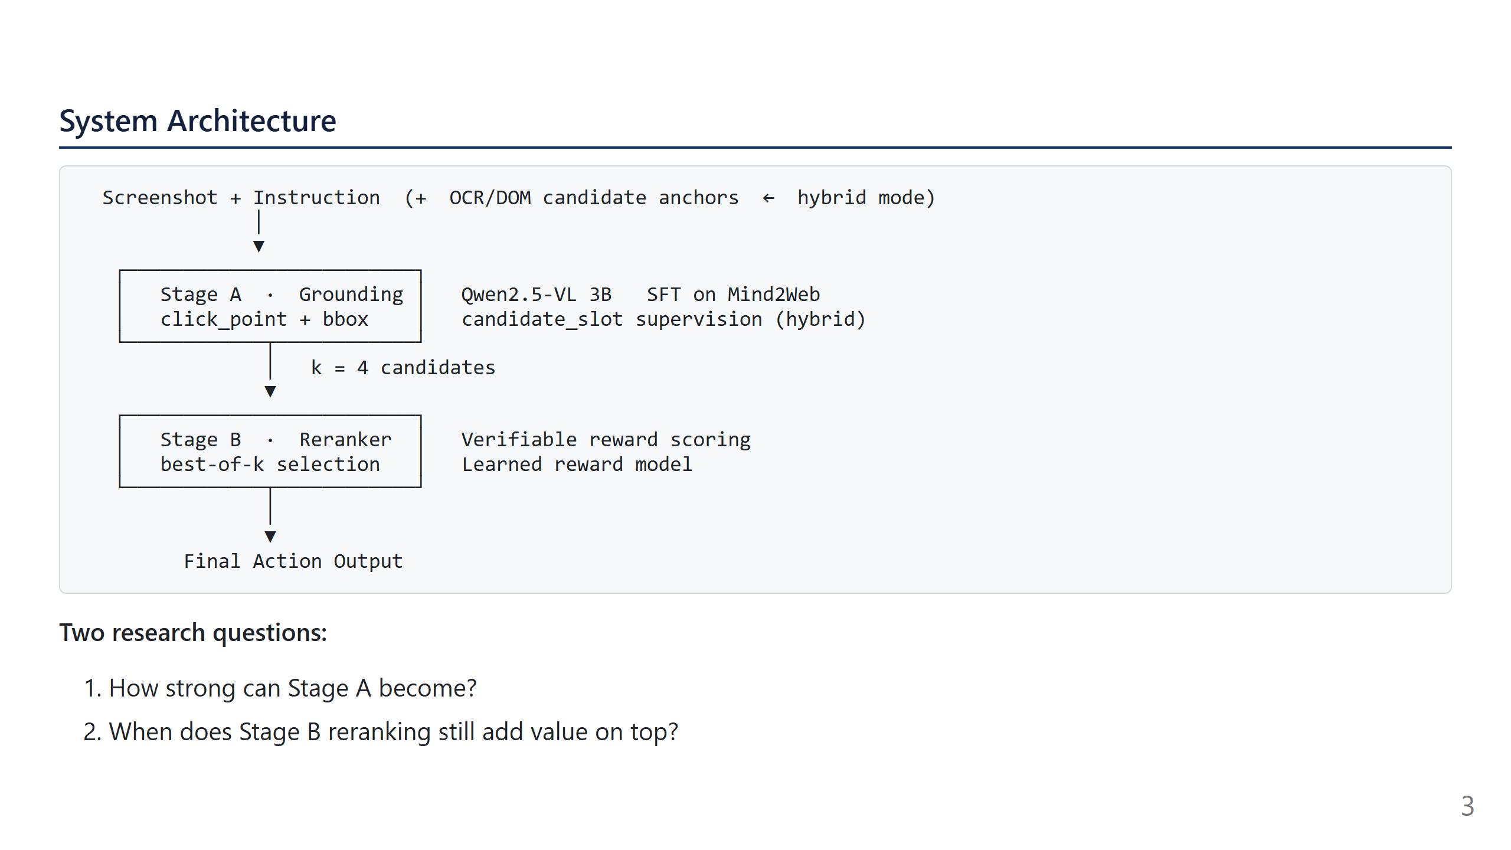
Notes:
Slide 3: System Architecture

Slide 4
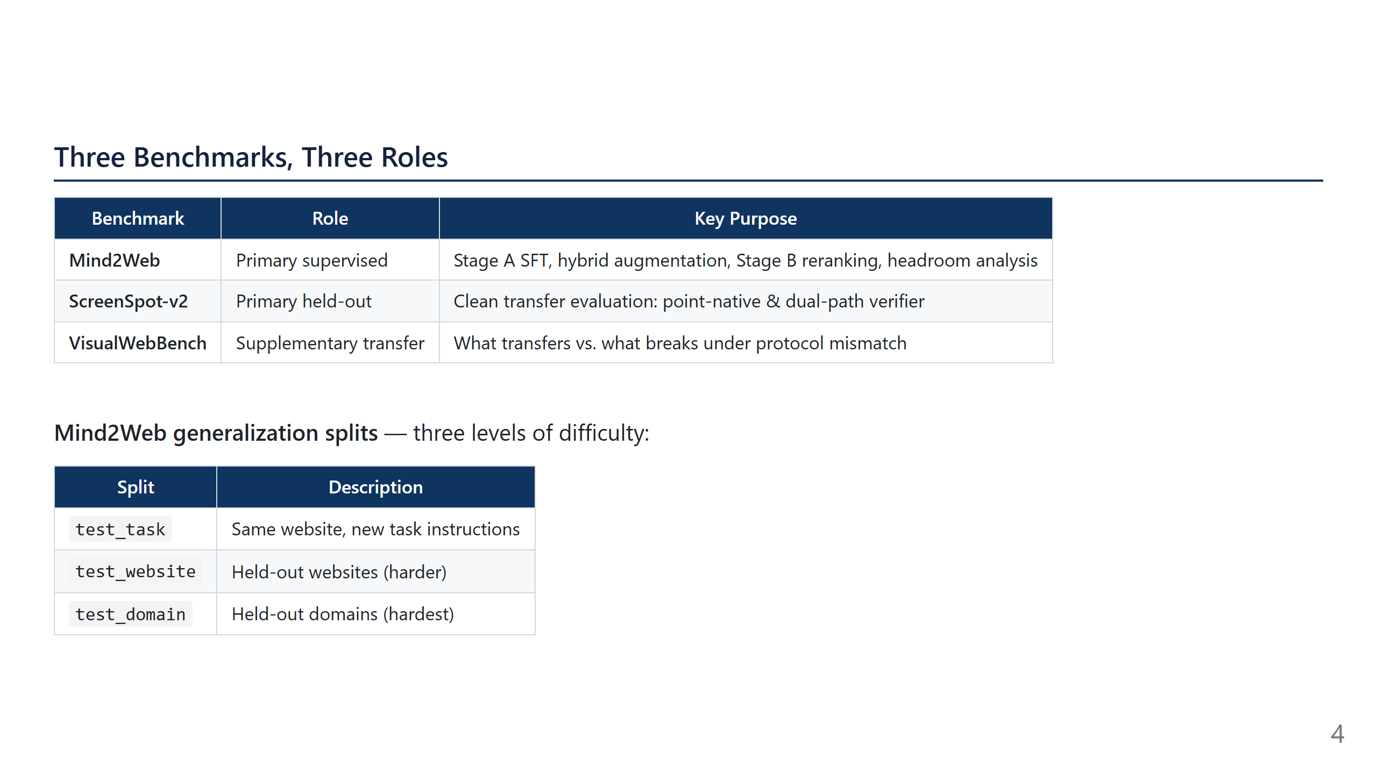
Notes:
Slide 4: Benchmarks

Slide 5
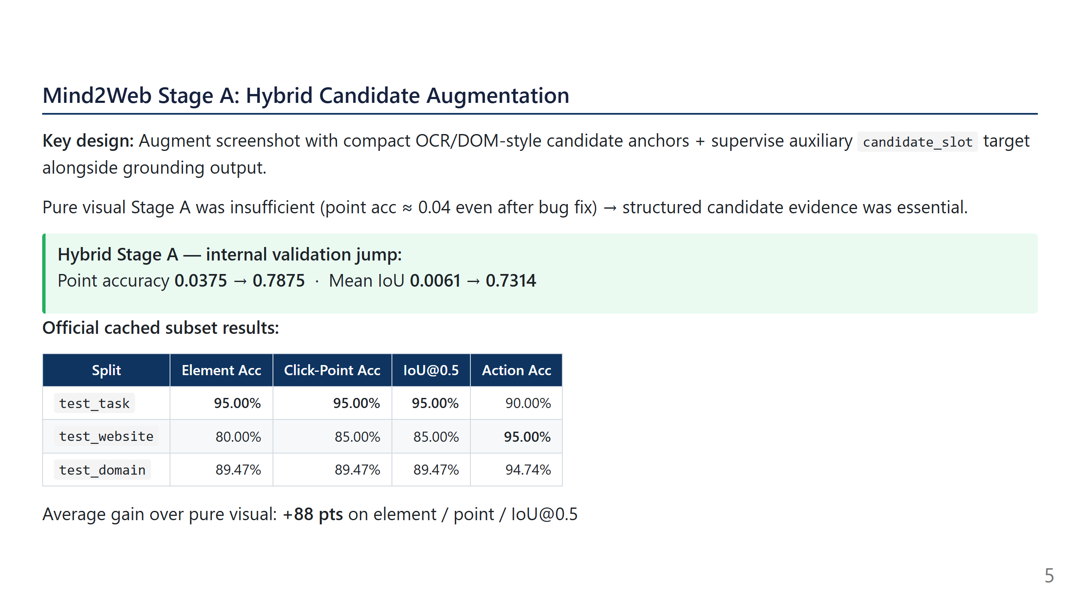
Notes:
Slide 5: Mind2Web Hybrid Stage A

Slide 6
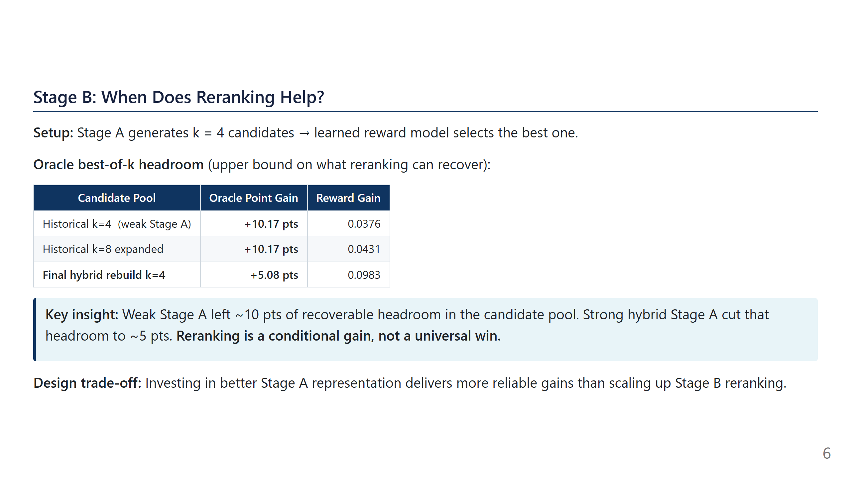
Notes:
Slide 6: Stage B Reranking

Slide 7
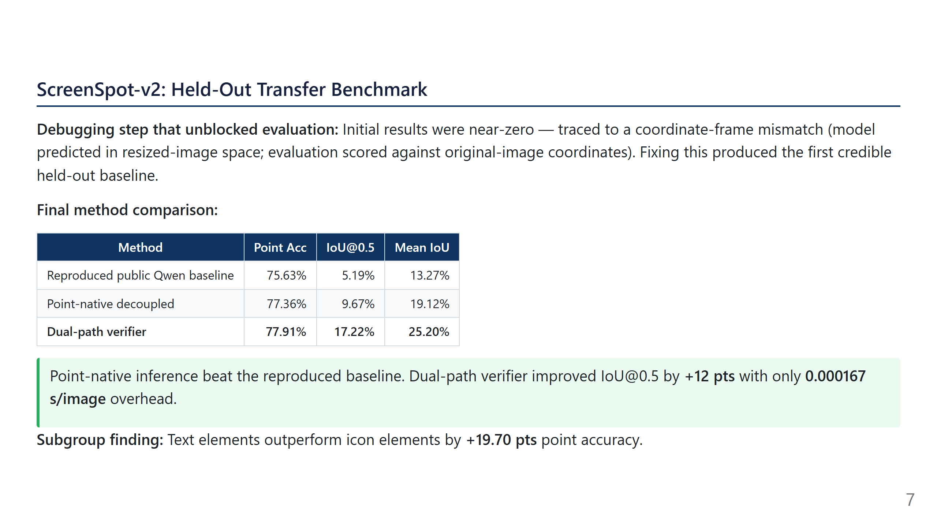
Notes:
Slide 7: ScreenSpot-v2

Slide 8
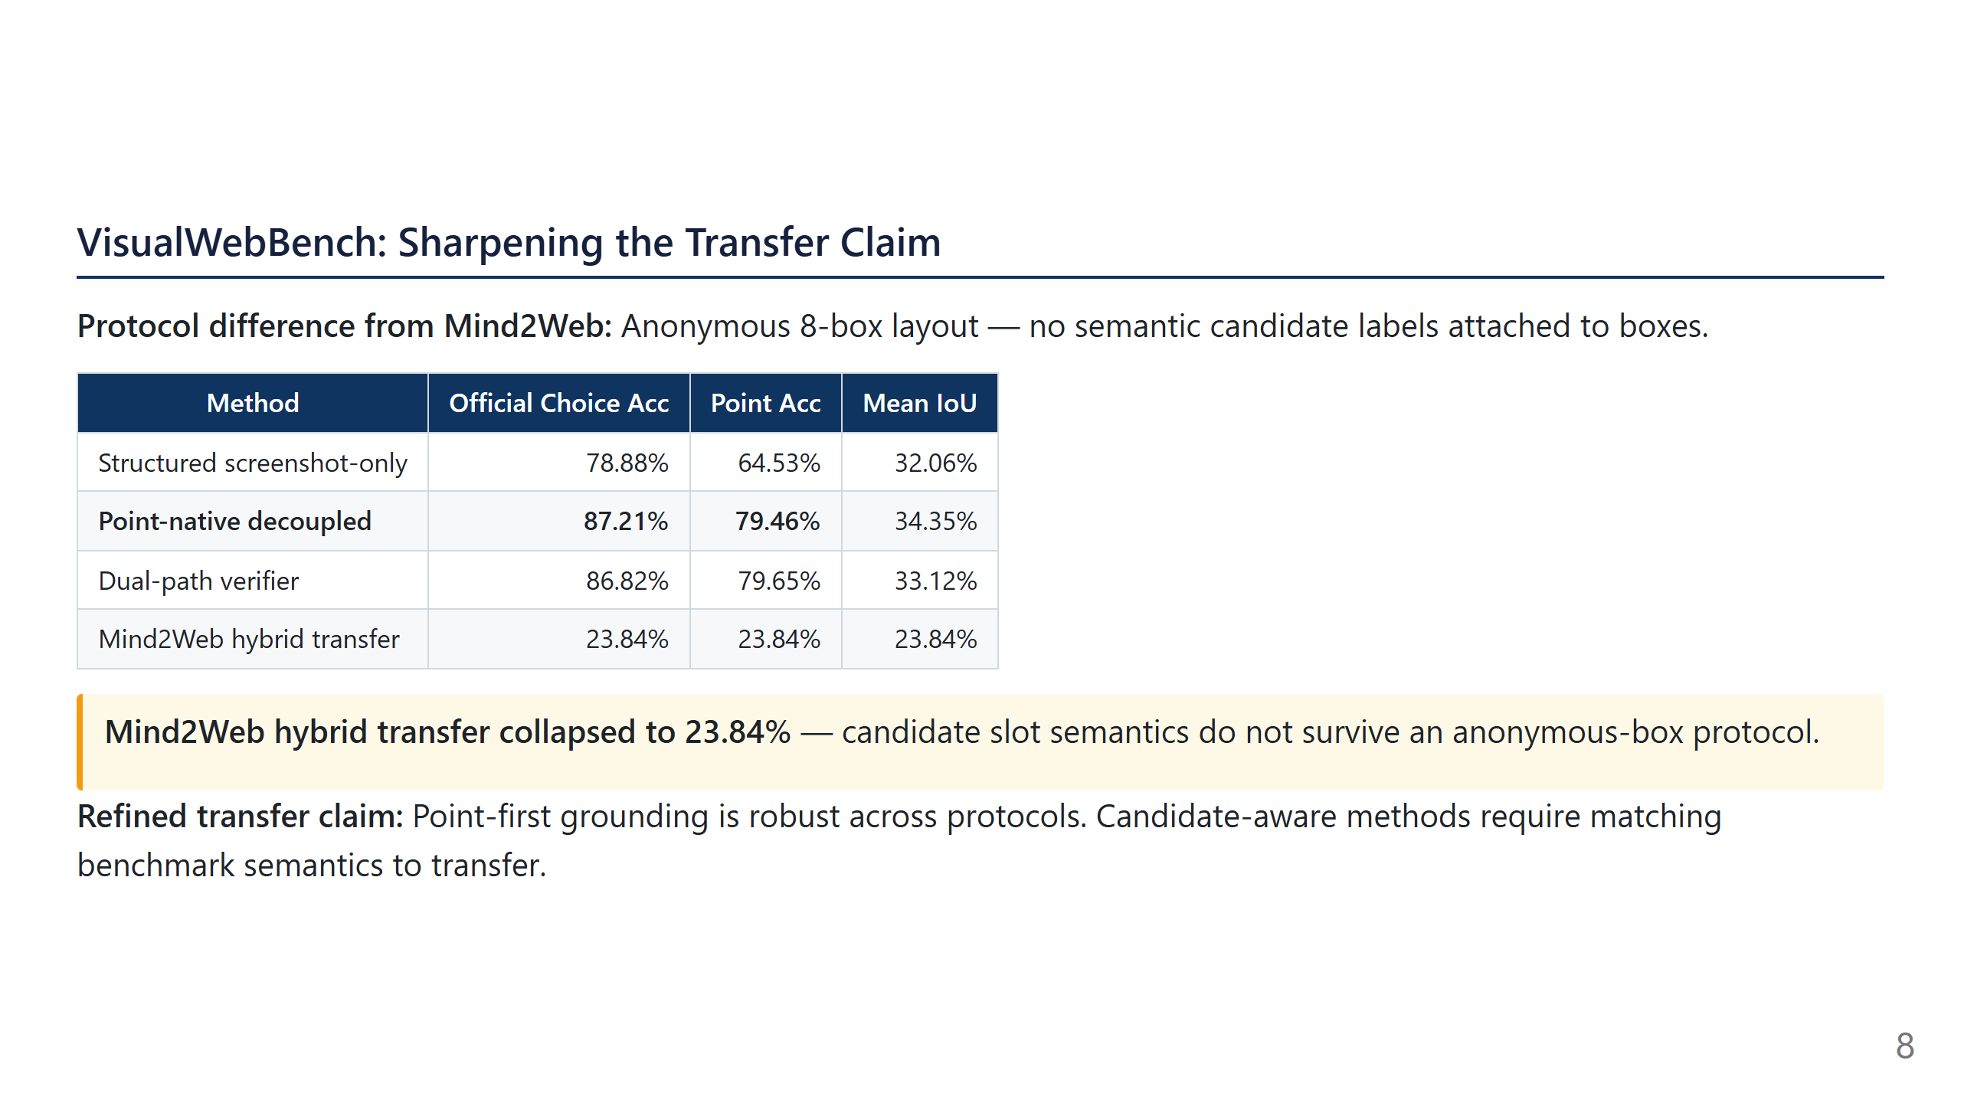
Notes:
Slide 8: VisualWebBench

Slide 9
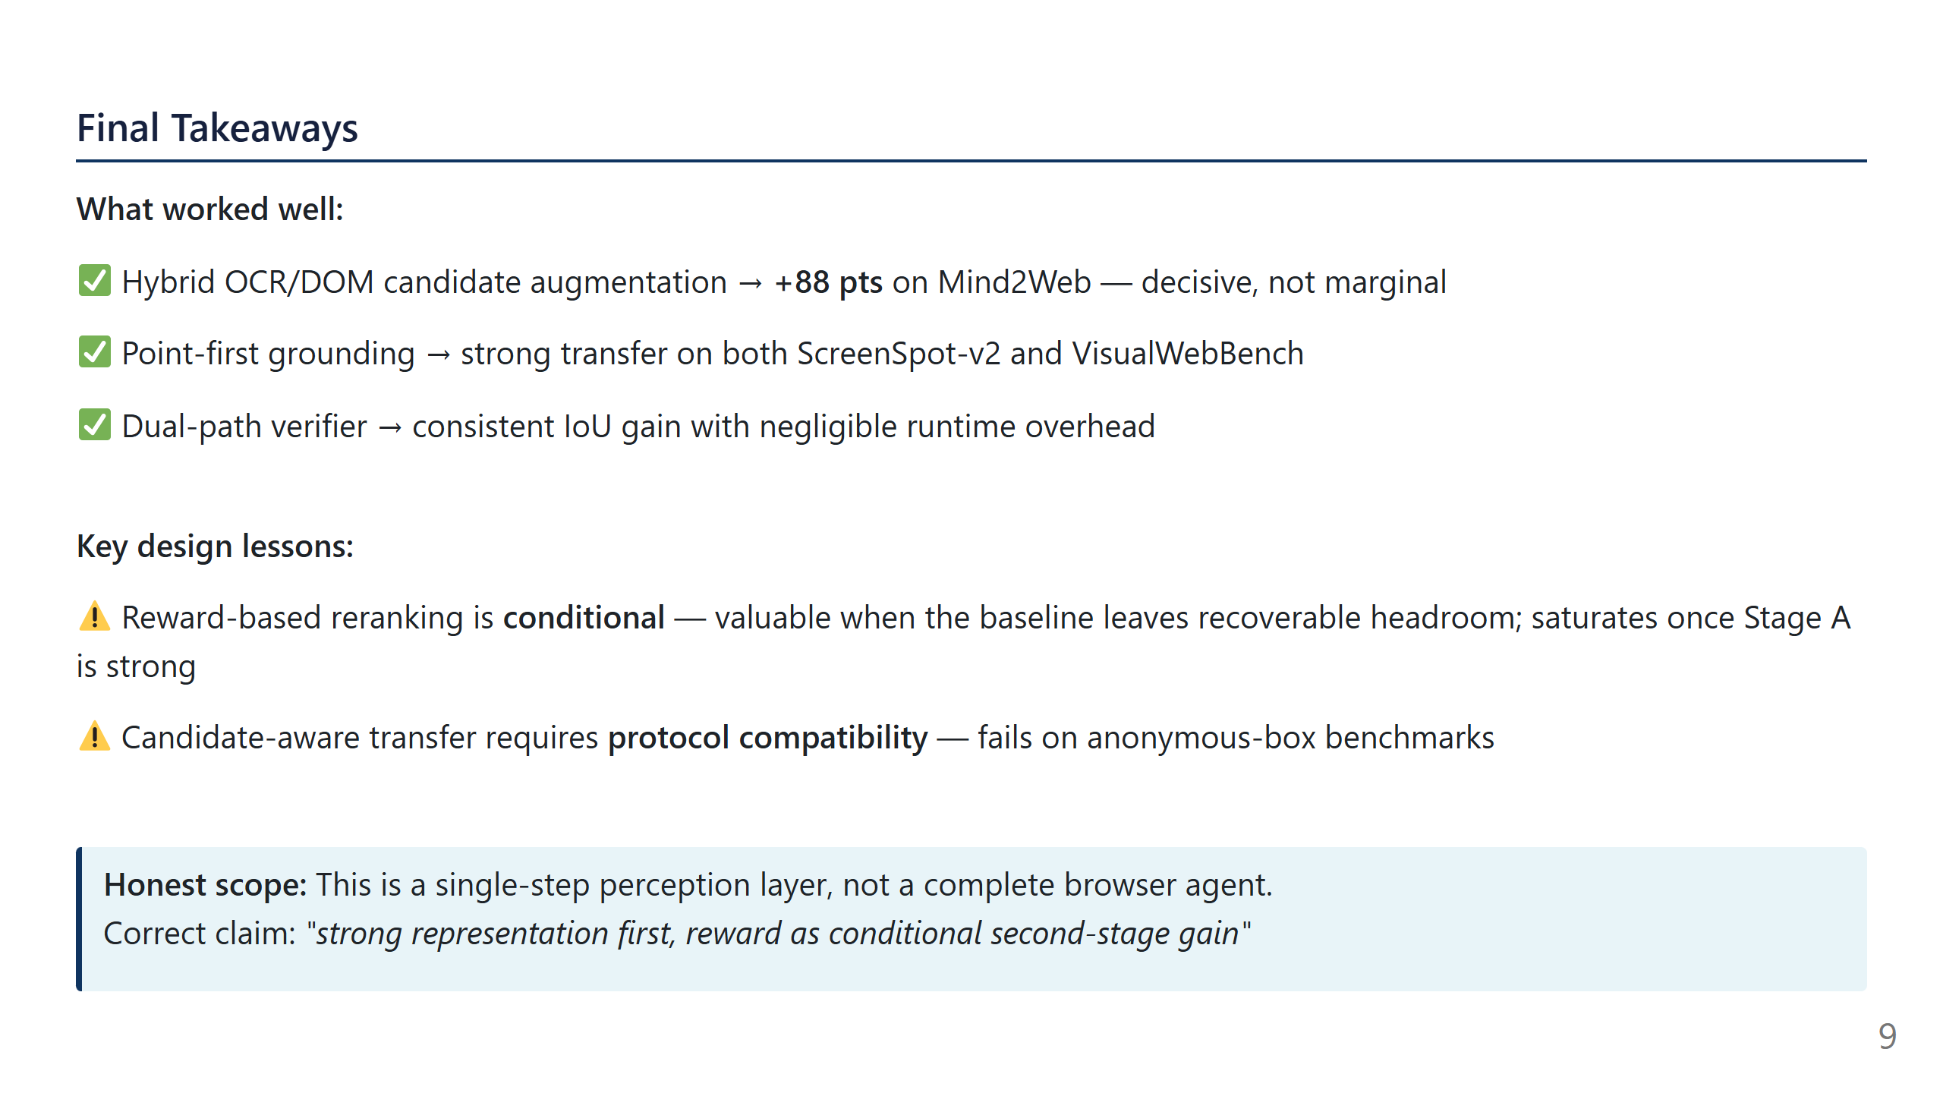
Notes:
Slide 9: Final Takeaways

