Slide 1
Kubernetes Networks
How kubernetes networks work

Slide 2

David Chang
Linkernetworks
BackEnd, DevOps,
Docker, Kubernetes
dchang@linkernetworks.com

Slide 3
Outline
Docker containers networks
Containers communication in a Pod
Pods cross different nodes
Pod to Service
https://kubernetes.io/docs/concepts/cluster-administration/networking/

Slide 4
Docker Container Networks
Bridge networks communicate namespaces through bridge
Host networks use host’s port, ip…
Container networks
https://docs.docker.com/network/
Notes:
Bridge
Host
Overlay

Slide 5
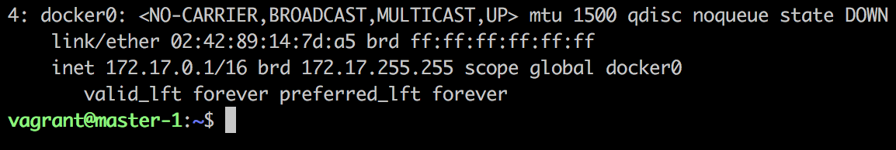
Docker Bridge Networks
Docker daemon added a bridge, docker0 on host
https://docs.docker.com/v17.09/engine/userguide/networking/#default-networks

Slide 6
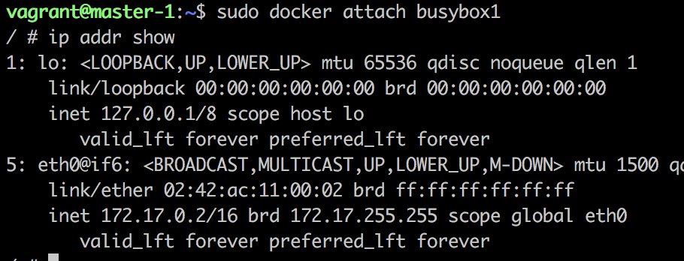
Docker Bridge Networks
$ docker run -itd —name busybox1 busy box
A eth0 inside container
https://docs.docker.com/v17.09/engine/userguide/networking/#default-networks

Slide 7
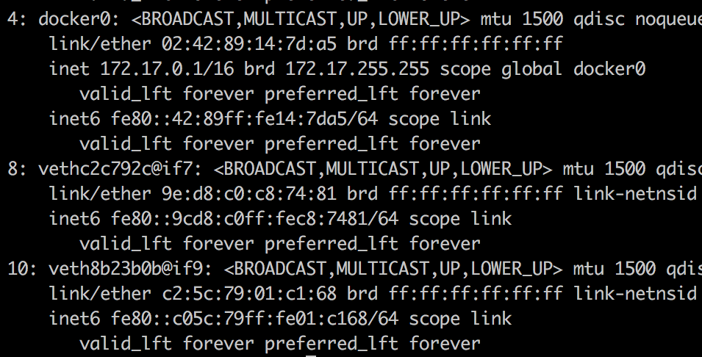
Docker Bridge Networks
eth0@busybox1 - veth2c792c@if7 - docker0
Assign an ip from docker0 to eth@busybox1
https://docs.docker.com/v17.09/engine/userguide/networking/#default-networks

Slide 8
Docker Bridge Networks
Docker Host
busybox1
172.17.0.2
(namespace 1)
busybox2
172.17.0.3
(namespace 2)
eth0
172.17.0.2/16
veth2c79…
eth0
172.17.0.3/16
Docker0
172.17.0.1/16
Container has unique ip on a single docker host
Notes:
Docker deamon
Create a virtual bridge, docker0 with ip range in host
Create a virtual ethernet device pair for each container

Slide 9
Kubernetes Model
Docker container networks
Containers communication in a Pod
Pods cross different nodes
Pod to Service
https://kubernetes.io/docs/concepts/cluster-administration/networking/

Slide 10
Kubernetes Networks
Containers communication in a Pod
How to create a Pod
Assign a Pod a unique IP
Pods on different nodes
Pod to Service
https://kubernetes.io/docs/concepts/cluster-administration/networking/

Slide 11
Containers in a Pod
Kubernetes Node
Pod
172.17.0.2
Container 1
Container 2
eth0
172.17.0.2/16
veth2c79…
Docker0
172.17.0.1/16
How to have many containers into a Pod?

Slide 12
Pause
Kubernete Node
pause
(container)
Container 1
eth0
172.17.0.2/16
veth2c79…
Container 2
Docker0
172.17.0.1/16
Create pause, and “attach” containers to its network

Slide 13
Pod Networking
Container unique IP -> Pod unique IP
The pause container get its IP and then pause
Add containers to pause’s networks
Containers communicate with localhost
Containers share the same IP across cluster
Notes:
The IP from cni

Slide 14
Kubernetes Networks
Containers communication in a Pod
How to create a Pod
Assign a Pod a unique IP
Pods on different nodes
Pod to Service
https://kubernetes.io/docs/concepts/cluster-administration/networking/

Slide 15
Flannel
A flanneld on each host
Flanneld creates a subnet for each host out of a larger address space
Packet forward mechanism: VXLAN
https://github.com/coreos/flannel

Slide 16
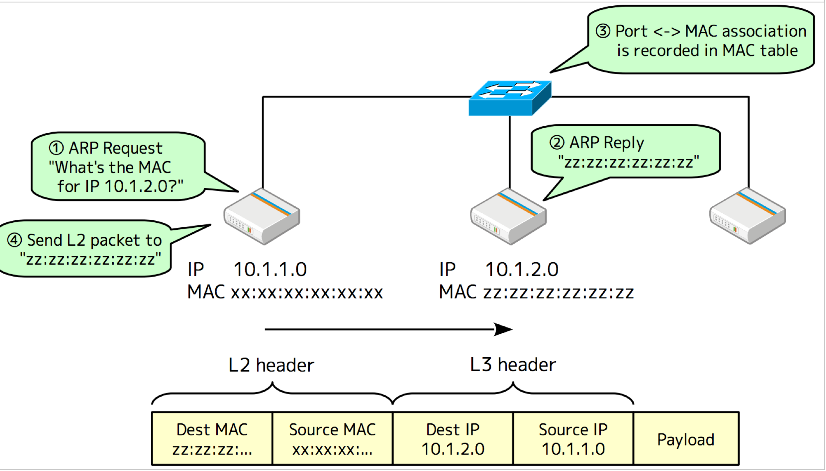
Virtual eXtensible Local Area Network
http://dockone.io/article/2216

Slide 17
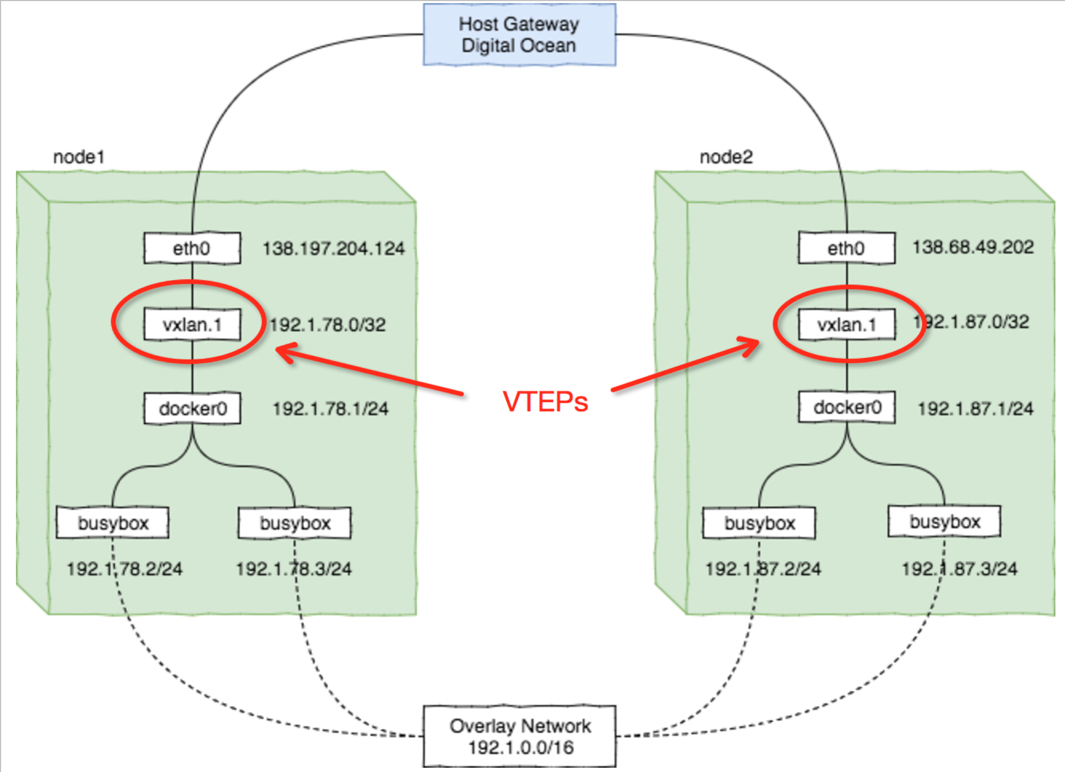
VXLAN
http://dockone.io/article/2216

Slide 18
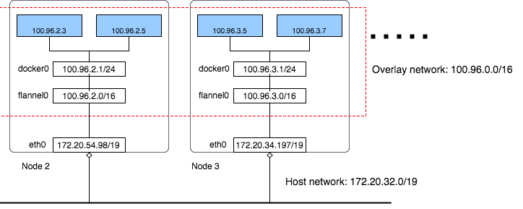
Overlay Network
https://blog.laputa.io/kubernetes-flannel-networking-6a1cb1f8ec7c
Notes:
Flannel create a overlay network across multiple real network devices
Assign each Pod a unique IP
Dispatch packets in the Ip range to different network device by iptables

Slide 19
Kubernetes Networks
Containers communication in a Pod -> localhost
How to create a Pod -> pause
Assign a Pod a unique IP -> flannel address space(CNI)
Pods communicates across different nodes -> flannel (vxlan, overlay networks)
Pod to Service

Slide 20
Kubernetes Networks
Pod has unique IP but hard to access through pure IP
Pod to kubernetes Service
https://kubernetes.io/docs/concepts/services-networking/service/

Slide 21
Pod to Service
Kubernetes Cluster
Node 1
10.10.1.2
Node 2
10.10.1.3
Node 3
10.10.1.4
Pod 3
(Creating)
Pod 2
(Running)
Pod 1 (Terminated)
How to access app instead of access to a specific Pod IP?

Slide 22
Kubernetes Service
Kubernetes Cluster
Node 1
10.10.1.2
Node 2
10.10.1.3
Node 3
10.10.1.4
Pod 3
(Creating)
Pod 2
(Running)
Pod 1 (Terminated)
Service
Access to a set of Pods through a single endpoint

Slide 23
Kubernetes Service
A Kubernetes Service is an abstraction which defines a logical set of Pods and a policy by which to access them - sometimes called a micro-service.
https://kubernetes.io/docs/concepts/services-networking/service/
Notes:
Decouple frontends from backends(Pods)
Highly configurable NodePort, selector, external name,…

Slide 24
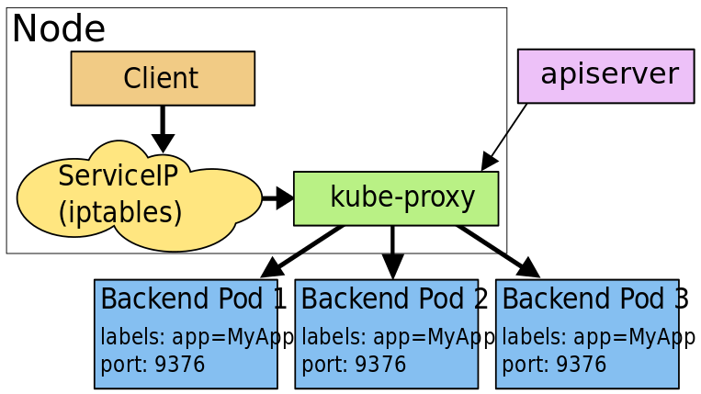
Kube-proxy
https://kubernetes.io/docs/concepts/services-networking/service/
Notes:
Every node in a Kubernetes cluster runs a kube-proxy.
How to make this happened?

Slide 25
Kube-proxy
kube-proxy is responsible for implementing a form of virtual IP for Services of type other than ExternalName.
In short, update iptable rules to nodes for each services
node$ sudo iptables-save -t nat
-A KUBE-SERVICES ! -s 10.233.64.0/18 -d 10.233.0.1/32 -p tcp -m comment --comment "default/kubernetes:https cluster IP" -m tcp --dport 443 -j KUBE-MARK-MASQ
-A KUBE-SERVICES -d 10.233.0.1/32 -p tcp -m comment --comment "default/kubernetes:https cluster IP" -m tcp --dport 443 -j KUBE-SVC-NPX46M4PTMTKRN6Y
https://kubernetes.io/docs/concepts/services-networking/service/
Notes:
Every node in a Kubernetes cluster runs a kube-proxy.
How to make this happened?

Slide 26
Discovering Service
Environment variables injection by kubelet REDIS_MASTER_SERVICE_HOST=10.0.0.11 REDIS_MASTER_SERVICE_PORT=6379
DNS (Recommended) The DNS server watches the Kubernetes API for new Service and creates a set of DNS records for each
https://kubernetes.io/docs/concepts/services-networking/service/
Notes:
Decouple frontends from backends(Pods)
Highly configurable NodePort, selector, external name,…

Slide 27
Kube-dns
Kubernetes DNS schedules a DNS Pod and Service on the cluster, and configures the kubelets to tell individual containers to use the DNS Service’s IP to resolve DNS names.
Service
my-svc.my-namespace.svc.cluster.local -> nginx.default.svc.cluster.local
Pod
pod-ip-address.my-namespace.pod.cluster.local -> nginx-1.default.pod.cluster.local
https://kubernetes.io/docs/concepts/services-networking/service/
Notes:
Every node in a Kubernetes cluster runs a kube-proxy.
How to make this happened?

Slide 28
Kubernetes Networks
Containers communication in a Pod -> localhost
Assign a Pod a unique IP -> flannel address space
Pods on different nodes -> flannel (VXLAN, overlay networks)
Pod to Service -> service, proxy, dns
Thank you

Slide 29
Kubernetes Networks
Thank you

