Slide 1
Kubespray
Deploy Kubernetes Cluster with Ansible

Slide 2

David Chang
Linkernetworks
BackEnd, DevOps, Kubernetes

Slide 3
Headlines
Deploy a K8s cluster on laptop
Talk a little about Vagrant, a VM managing tool
Kubespray & Ansible
Try our localhost K8s cluster

Slide 4
Prerequisite
virtualbox 5.1+ https://www.virtualbox.org/wiki/Downloads
vagrant 2.0.x+ https://www.vagrantup.com/downloads.html

Slide 5
Install Ansible
# Ubuntu
apt-add-repository ppa:ansible/ansible \
&& apt-get update \
&& apt-get install -y python3 ansible
&& pip install netaddr
# Mac
pip install ansible
pip install netaddr
port install py27-netaddr # if you’re using MacPort
# netaddr is required by Kubespray

Slide 6
Let’s Get Started
clone https://github.com/kubernetes-incubator/kubespray.git
cd kubespray
vagrant up
# All done. Let’s get to more details while waiting. (It takes about 20 mins on my Mac lol)

Slide 7
Virtualbox
K8s runs on servers, and Virtualbox is our server virtualizer
Virtualbox come with GUI, but we don’t use it because
Clicking is time-consuming and engineers are lazy
Bad for automation. Manual operation causes mistake.
Lack of scalability. We can click 10 VMs but how about 100+ VMs.

Slide 8
Vagrant
Kubespray provides vagrant for deploy K8s on VMs.
Vagrant create you VMs with Vagrtantfile, a ruby based script.
A script is essential for automation.
Vagrant bring VMs up & down within 1 command.
https://www.vagrantup.com/

Slide 9

Vagrant Operations
vagrant up (already done)
vagrant status
vagrant ssh k8s-01
vagrant destroy

Slide 10
What vagrant do?
After vagrant up, vagrant create VMs with virtual box
Vagrant also make necessary provisions to VMs
Vagrant deploy k8s on to VMs with Kubespray

Slide 11

Vagrant & CICD
Commit Vagrantfile to source code
Bring VMs up & down
Testing app on K8s and VMs
Clean up VMs with vagrant

Slide 12

Ansible
Ansible is a IT automation tools.
Ansible-playbook is a script to modify remote servers
Check components status on each step
Come with lots of handy tools (better than shell script)

Slide 13
Kubespray
Deploy k8s with ansible-playbook
Available on AWS, GCE, or baremetal
High Available cluster
Install K8s components to each servers
https://github.com/kubernetes-incubator/kubespray

Slide 14
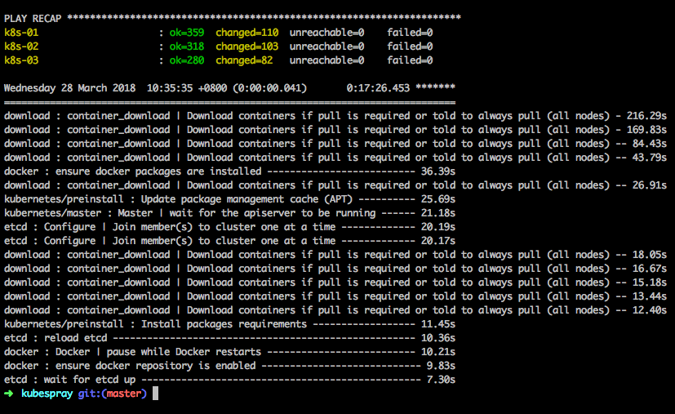
Done!!

Slide 15
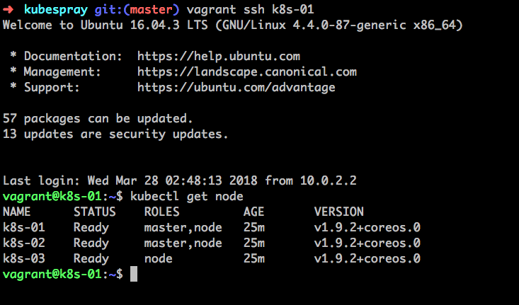
Test with Kubectl

Slide 16
Kubectl
Kubectl is a k8s client tool to control k8s cluster
Kubectl convert commands to API call to k8s cluster API server
Kubectl use authorized context

Slide 17
Deploy to Real Servers
ansible-playbook http://docs.ansible.com/ansible/latest/intro_installation.html
kubectl https://kubernetes.io/docs/tasks/tools/install-kubectl/
Check inventory/mycluster/hosts.ini
playbook -i inventory/myCluster/hosts.ini cluster.yml

Slide 18
Thank you

