Slide 1
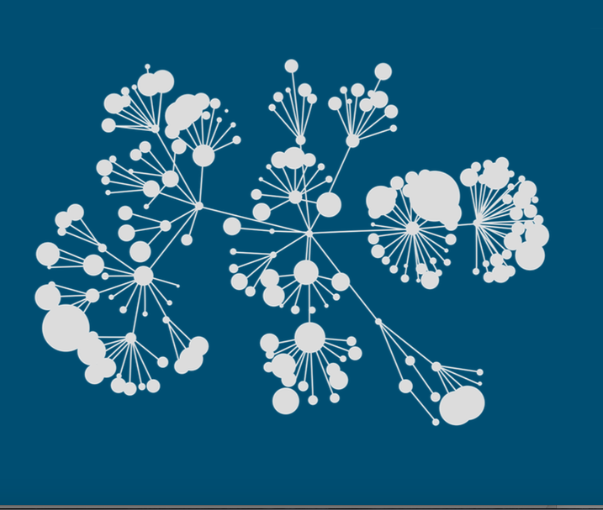

Kaggle
3th Place Solution to the TalkingData Competition
Notes:
Recommending picking out he most interesting and important parts from your documentation.

Slide 2
Agenda
Background
Summary
Feature selection & engineering
Optimization variant
Training methods
Important findings
Simple model

Slide 3
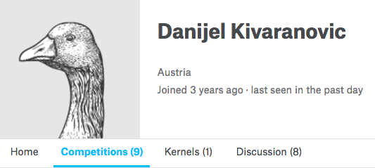
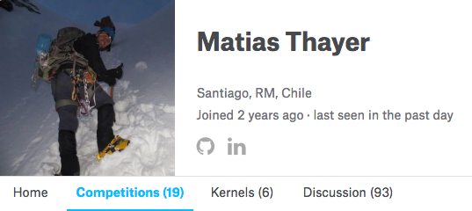
Background

Slide 4
Summary
The success of our team relies mostly on feature engineering and
ensembling. The most important findings:
Feature Engineering
Train and ensemble different models for devices with events /without events
2 stage optimization for mlogloss
Combine different model predictions optimizing mlogloss in 5 folds
ML Algorithms used: XGBoost, NNET (Keras), Regression, Elastic Net
Notes:
Example dot points
Most important classifier was XGBoost
The three most important features were car color, make of the car, number of miles
One of my biggest insights was that building a separate classifier for each brand of car gave me a big performance improvement
Used Python (Pandas and XGBoost)

Slide 5
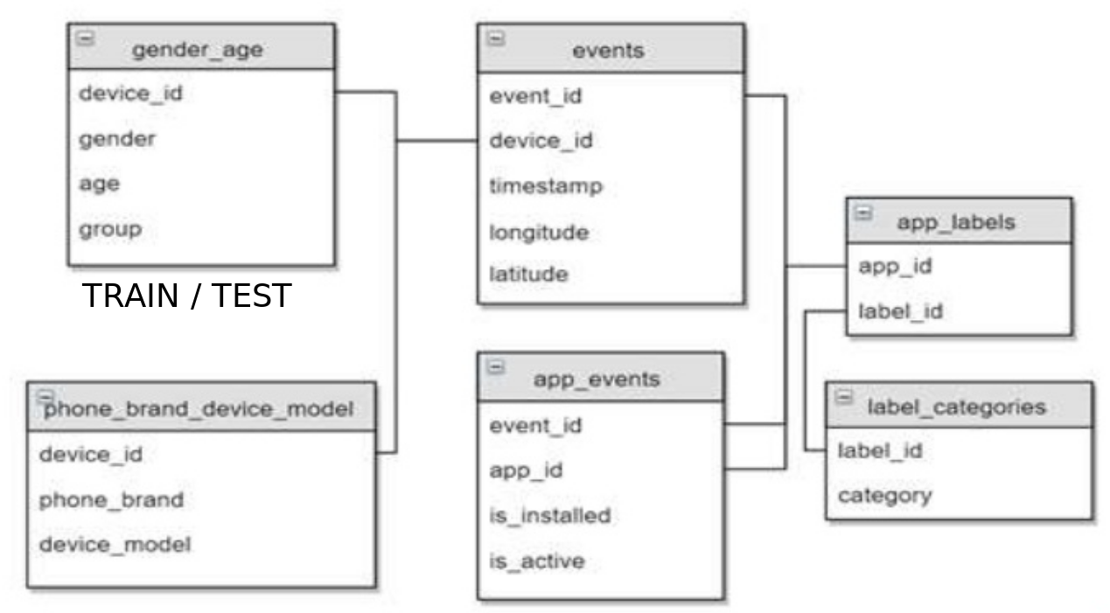
Data Overview
3.252.950
459.943
74.645 /
112.071
186.716
459.943
32.473.067
For 1 device, multiple events.
For 1 event: What apps are installed in the device
Notes:
Example dot points
Most important classifier was XGBoost
The three most important features were car color, make of the car, number of miles
One of my biggest insights was that building a separate classifier for each brand of car gave me a big performance improvement
Used Python (Pandas and XGBoost)

Slide 6
Feature Engineering:
1HE for brands, models, and app_id (sparse matrix)
A sparse matrix of features can be constructed using the csr_matrix constructor (scipi):
Features Selection / Engineering
csr_matrix( (data, (row_ind, col_ind)), [shape=(M, N)])
where "data", "row_ind" and "col_ind" satisfy the
relationship "a[row_ind[k], col_ind[k]] = data[k]

Slide 7
Simple 1 hot encoding with sparse matrix
device_id | brand
234 | Iphone
354 | Iphone
345 | Nokia
876 | Nokia
908 | Samsung
data [1 1 1 1 1]
row_index [0 1 2 3 4]
col index [0 0 1 1 2]
Features Selection / Engineering
M = 3
N = 5
csr_matrix( (data, (row_ind, col_ind)), [shape=(M, N)])
[[1., 0., 0.],
[1., 0., 0.],
[0., 1., 0.],
[0., 1., 0.],
[0., 0., 1.]]

Slide 8
Grouped 1 hot encoding with sparse matrix
device_id | event_id | app
1 | 5 | EDX
1 | 5 | Runtastic
1 | 4 | Runtastic
2 | 3 | EDX
2 | 3 | WeatherApp
data [1 2 1 1 ]
row_index [0 0 1 1]
col index [0 1 0 2]
Features Selection / Engineering
M = 3
N = 5
csr_matrix( (data, (row_ind, col_ind)), [shape=(M, N)])
[[1., 2., 0.],
[1., 0., 1.],
[0., 0., 0.],
[0., 0., 0.],
[0., 0., 0.]]

Slide 9
Simple 1 hot encoding with sparse matrix
device_id | brand
234 | Iphone
354 | Iphone
345 | Nokia
876 | Nokia
908 | Samsung
data [1 1 1 1 1]
row_index [0 1 2 3 4]
col index [0 0 1 1 2]
Features Selection / Engineering
M = 3
N = 5
csr_matrix( (data, (row_ind, col_ind)), [shape=(M, N)])
[[1., 0., 0.],
[1., 0., 0.],
[0., 1., 0.],
[0., 1., 0.],
[0., 0., 1.]]

Slide 10
Applying this for all apps and events, we got:
<74645x19237 sparse matrix of type '<class 'numpy.float64'>' with 915632 stored elements in Compressed Sparse Row format>
Features Selection / Engineering

Slide 11
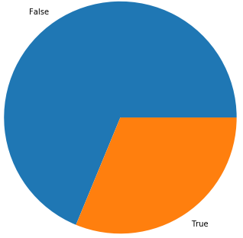
Data Overview
Percentaje of devices with data in events: 31%
Notes:
Example dot points
Most important classifier was XGBoost
The three most important features were car color, make of the car, number of miles
One of my biggest insights was that building a separate classifier for each brand of car gave me a big performance improvement
Used Python (Pandas and XGBoost)

Slide 13
Summary
Notes:
Example dot points
Most important classifier was XGBoost
The three most important features were car color, make of the car, number of miles
One of my biggest insights was that building a separate classifier for each brand of car gave me a big performance improvement
Used Python (Pandas and XGBoost)

Slide 14
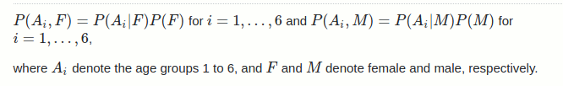
2-Stage optimization for mlogloss:
The following technique was key in improving xgboost performance. It was particularly good for devices with no events:
Predict the probability of gender (Stage 1)
Use gender as additional feature and predict the probability of age groups (Stage 2)
Combine the predictions using the definition of conditional probability:
Logloss optimization variant

Slide 15
Matias / Keras + Regression (1 model)
Matias / Keras (1 model)
Matias / Xgboosts (3 models)
Matias / Elastic net
Danijel / Xgboost 2 stages (1 model)
Danijel / Keras (3 models)
The predictions were optimized using the optim package in R (5 folds)
Independent optimizations for devices with events and devices without events
Training time: ranges from 12 to 2 hours
Training Methods

Slide 16
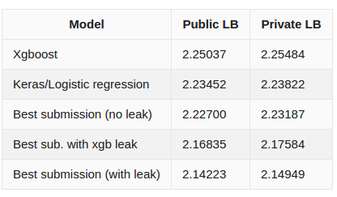
Leaderboard Performance Chart

