Slide 1
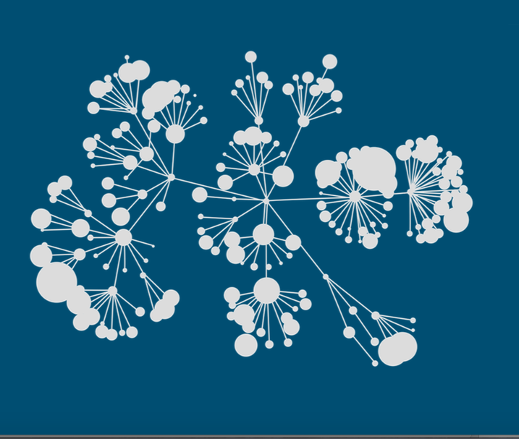

Kaggle 3th Place Solution to the TalkingData Competition
Notes:
Recommending picking out he most interesting and important parts from your documentation.
<number>

Slide 2
Agenda
Background
Summary
Feature selection & engineering
Optimization variant
Training methods
Important findings
Simple model
Notes:
<number>

Slide 3
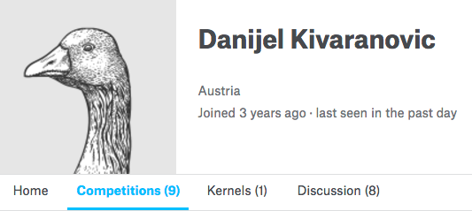
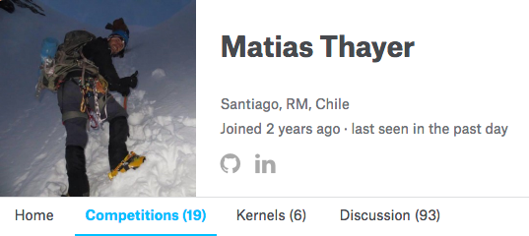
Background
Notes:
<number>

Slide 4
Summary
The success of our team relies mostly on feature engineering and
ensembling. The most important findings:
Train and ensamble different models for devices with events /without events
One hot encoding of categorical features (including app ids)
2 stage optimization for mlogloss
Combine different model predictions optimizing logloss in 5 folds
Algorithms used: XGBoost, NNET (Keras), Regression, Elastic Net
Notes:
Example dot points
Most important classifier was XGBoost
The three most important features were car color, make of the car, number of miles
One of my biggest insights was that building a separate classifier for each brand of car gave me a big performance improvement
Used Python (Pandas and XGBoost)
<number>

Slide 5
Feature Engineering:
Dummies for brands, models, and app_id
TF-IDF of brand and model + labels(with events)
Frequency of brands and model names
Count how often each category appears in the app list (all apps that can be assigned to the device)
Count how often each app appears in the event list
Calculate median latitude and longitude of events.
Count at which hour and at which weekday the events happened.
Ratios of label categories for a given device
Flag indicating if the device has event data
Features Selection / Engineering
Notes:
<number>

Slide 6
2-Stage optimization for mlogloss:
The following technique was key in improving xgboost performance. It was particularly good for devices with no events:
Predict the probability of gender (Stage 1)
Use gender as additional feature and predict the probability of age groups (Stage 2)
Combine the predictions using the definition of conditional probability: P(Ai,F)=P(Ai|F)P(F) for i=1,…,6 and P(Ai,M)=P(Ai|M)P(M) for i=1,…,6, where the Ai denote the age groups 1 to 6, and F and M denote female and male, respectively.
Logloss optimization variant
Notes:
<number>

Slide 7
Matias / Keras + Regression (1 model)
Matias / Keras (1 model)
Matias / Xgboosts (3 models)
Matias / Elastic net
Danijel / Xgboost 2 stages (1 model)
Danijel / Keras (3 models)
The predictions were optimized using the optim package in R (5 folds)
Independent optimizations for devices with events and devices without events
Training time: ranges from 12 to 2 hours
Training Methods
Notes:
<number>

Slide 8
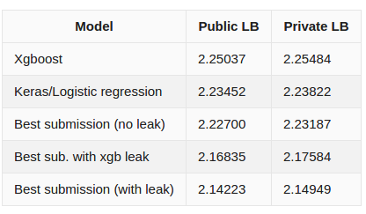
Leaderboard Performance Chart
Notes:
<number>

