Slide 1




Slide 2

Git & Github

Slide 3

Presentation Plan :
1-Identify the problem
4-Install git and link it with github
2-Difference between git & github
5-Collaboration workflow
3-Basics of git
6-Let's apply

Slide 4

1-Identify the problem

Slide 5

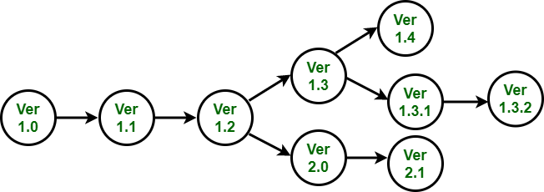
Version control
is the practice of tracking and managing changes to software code

Slide 6

Collaboration
Collaborators can work in parallel and merge their changes automatically, instead of manually comparing the differences between a file

Slide 7
2-Difference between git & github

Slide 8

What is Git?
Git is a Version Control System (VCS) designed to make it easier to have multiple versions of a code base,
It allows you to see changes you make to your code and
easily revert them.
Coordinates work between multiple developers
local & remote repos
Free and open source

Slide 9

What is GitHub?
GitHub is a platform for code collaboration!
GitHub uses Git for version control
Hosting repositories on Github facilitates the sharing of codebases among teams by providing a GUI to easily fork or clone repos to a local machine

Slide 10
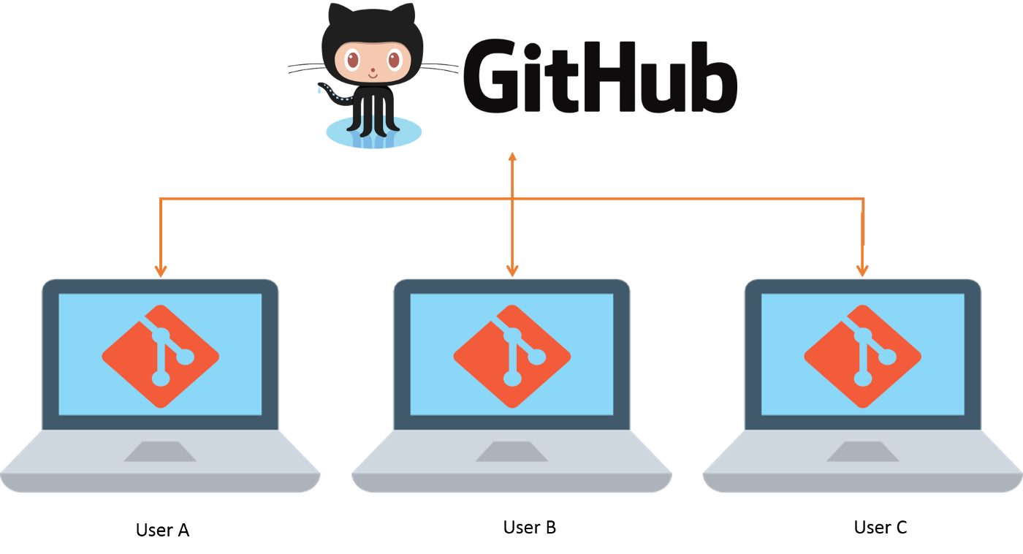

Slide 11
3-Basics of git

Slide 12
How to deal with a repo
Repository : the folder that contains the project( source code , assets …)
From github :
Create the repo ( if it does not exist )
Clone it to your local machine using ‘ git clone <Link> ‘
From local machine :
Create the repo on github
Initialize the local repo using ‘ git init ‘
Commit the files using ‘ git add . ‘ and ‘ git commit -m”init repo” ‘
Configure the remote variables using ‘ git remote add origin <link> ‘
Push using ‘ git push origin master ‘
Push : upload the changes from your computer to your GitHub repository.
Pull : download the changes from your computer to your GitHub repository.

Slide 13
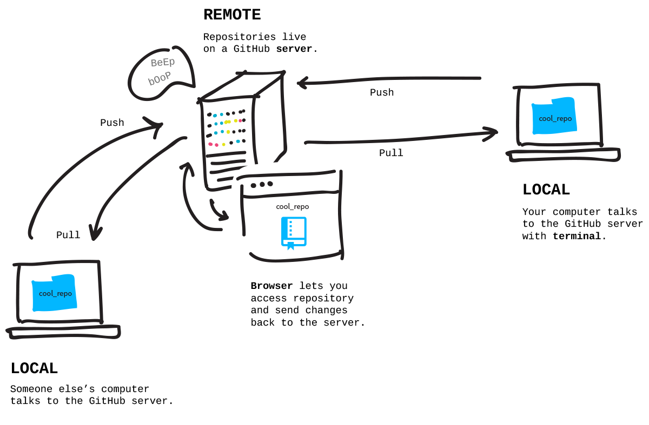
Gitignore file : The . gitignore file is a text file that tells Git which files or folders to ignore in a project.

Slide 14
How to deal with commits
Commit : checkpoint of the state of your repository at a particular time.
Html done
Css done
Js done

Slide 15
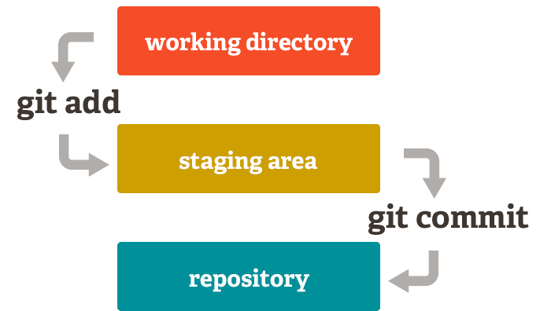
How to deal with commits
To create a commit :
Add files to staging area using ‘ git add . ‘
Commit the changes using ‘git commit -m”name of the commit” ‘

Slide 16
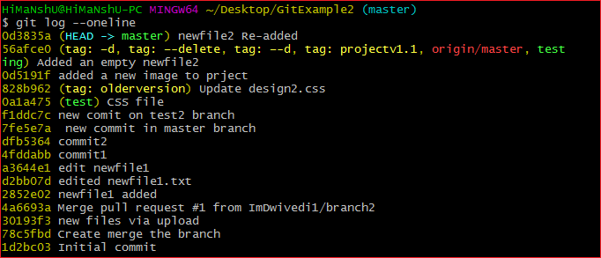
How to deal with commits
To inspect the history of commits ( changes ): use the command
‘ git log –oneline ‘
To return back to previous state : use the command
‘ git checkout <commitId> ‘

Slide 17
How to deal with Branches
Branch: a parallel version of the master copy of a repo. Making a branch allows you to edit code without accidentally breaking a working version
Operations on Branches :
List the branches : ‘git branch’
Create a branch : ‘ git branch <branchName> ‘
Delete a branch : ‘ git branch -d <branchName> ‘
Switch branch : ‘ git checkout <branchName> ‘

Slide 18
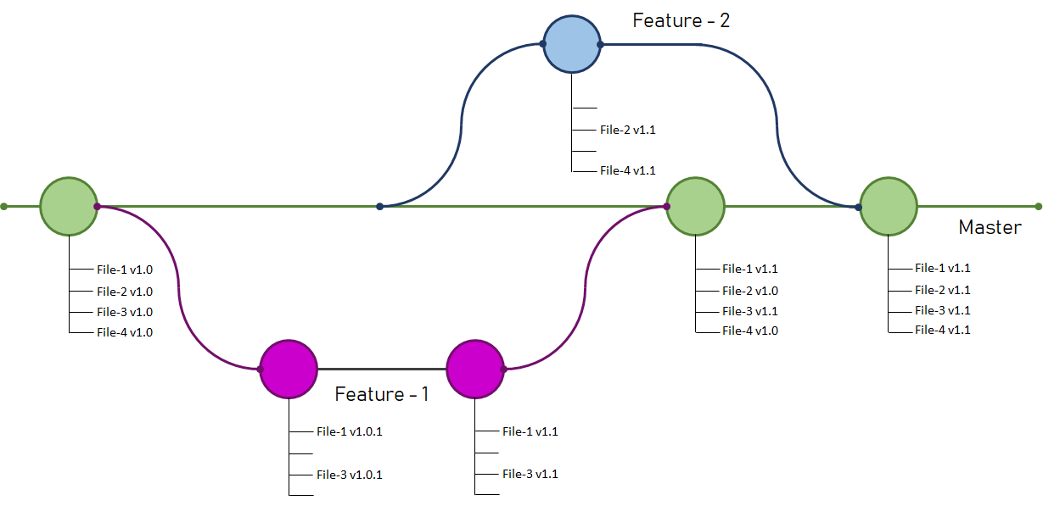
Merging branches
Merge :to officially add the changes from your branch into the master branch (or another branch)

Slide 19
Merging branches
To merge in your local machine :
First switch to the desired branch you want to merge
Perform the following command to merge the whole branch in the active branch ‘ git merge <branchName> ‘
To merge in the github repo :
Push the branch to github
Create a pull request

Slide 20
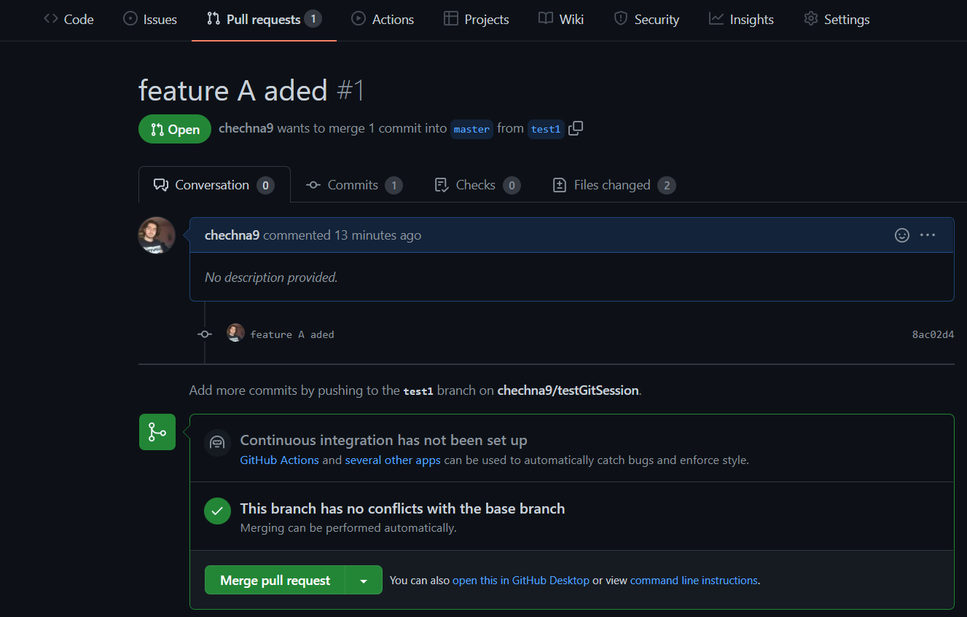
Merging branches
Pull Request : a way to ask to make changes to someone else's code by submitting your own changes for their review

Slide 21
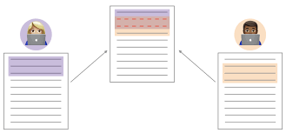
Merging conflicts
Conflict : When a file has multiple edits, it can be unclear which change should be committed. This is a conflict and must be resolved before merging.
In this case we have to resolve them manually

Slide 22
4-Install git and link it with github

Slide 23
https://git-scm.com/downloads
git config --global user.name “Your Name”
git config --global user.email “your email address”
To show the current config : git config --list

Slide 24
5-Collaboration workflow

Slide 25
Working with branches
The contributor work on his own branch ( once done push and make a pull-request)
Remote repo admin merge pull-requests

Slide 26
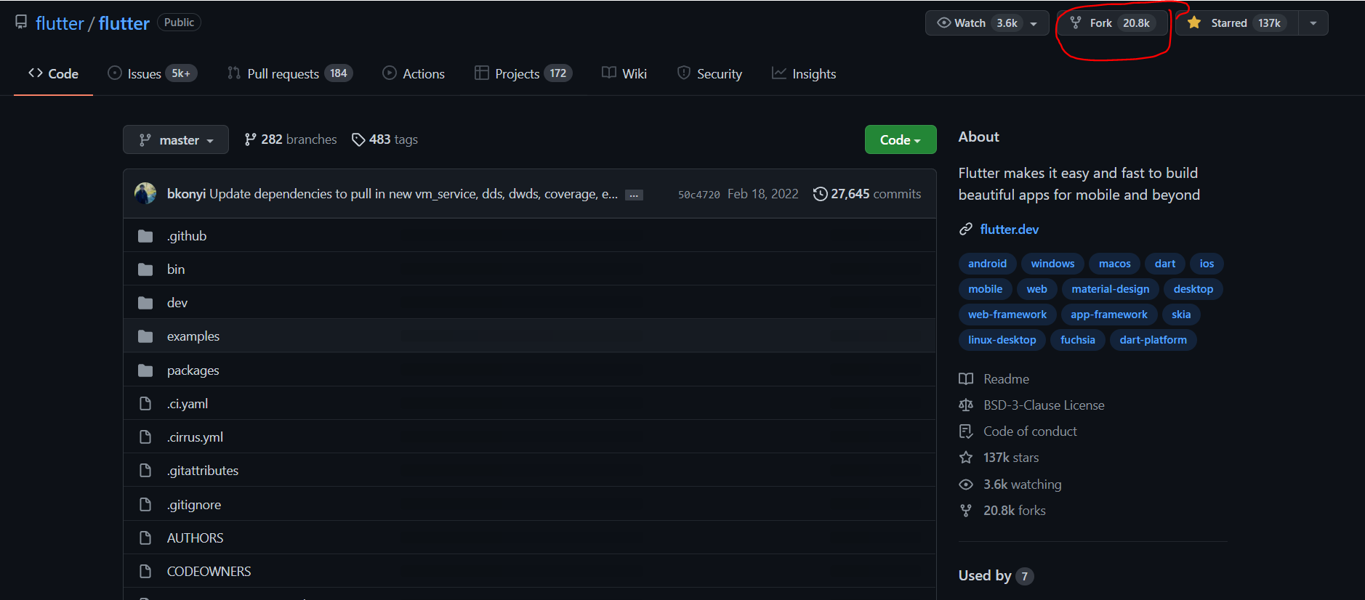
Working with Forks
Fork : your own copy of someone else's repository
When we use fork : Most commonly, forks are used to either propose changes to someone else's project or to use someone else's project as a starting point for your own idea.

Slide 27
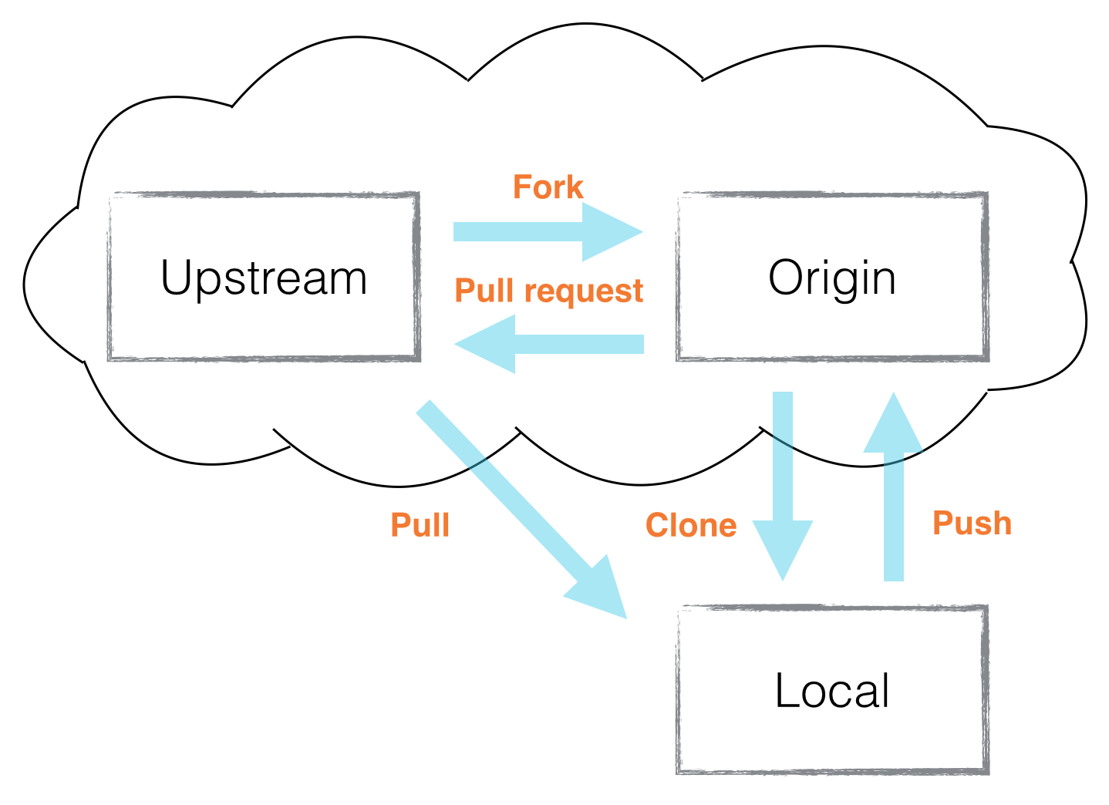

Slide 28
6-Let’s apply

Slide 29
Thank You

