Slide 1
Docker Introduction

Slide 2
What is Docker?
“Docker is an open platform for developers and sysadmins to build, ship, and run distributed applications.
Consisting of Docker Engine, a portable, lightweight runtime and packaging tool, and Docker Hub, a cloud service for sharing applications and automating workflows, Docker enables apps to be quickly assembled from components and eliminates the friction between development, QA, and production environments.
As a result, IT can ship faster and run the same app, unchanged, on laptops, data center VMs, and any cloud.”
source: https://www.docker.com/whatisdocker/

Slide 3
Docker platform also consist in:
Docker Engine
Docker Hub
Docker Machine
Docker Swarm
Docker Compose
Kitmatic

Slide 4
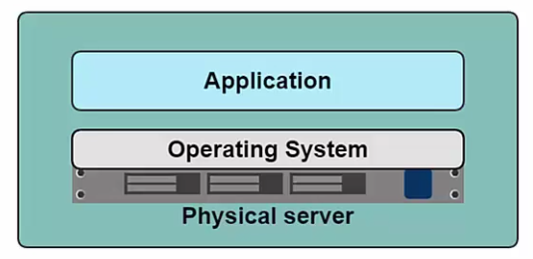
Understanding Docker
The problem
  In the past
    One Application on a physical server
  Problems in the past
    Slow deployment times
    Huge costs
    Wasted resources
    Difficult to scale
    Difficult to migrate
    Vendor lock in
Notes:
One needs to request a server, could be a new server or an existing server with others application (depending on the load this is not fully recomended).
The sysadmin could tell as that there are no more server and a new one will be requested for this app, next mont, totall weist of time

Slide 5
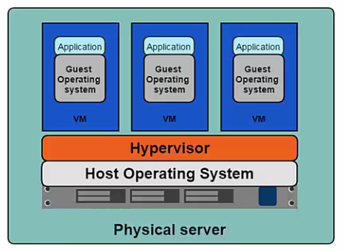
The solution
  Hypervisor
    One physical server containing more than one application running in their own VM
  Benefits
    Better resource pooling
    Easier to scale
    Cloud integration
      Pay as you go model
  Limitations
    CPU Allocation still needed
    Storage
    RAM
    Guest OS
    More VM, more resources

Slide 6
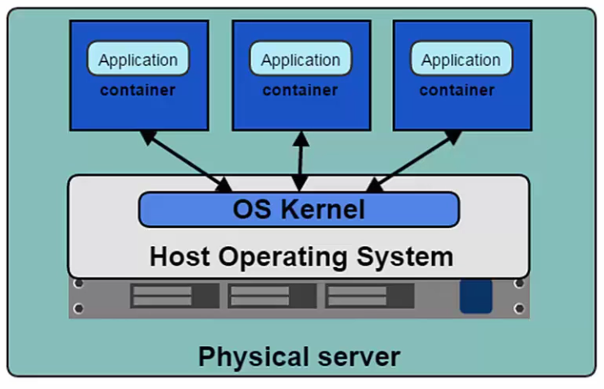
A better solution – Containers based virtualiation
  Uses the kernel on the host’s operating system to run multiple guest instances
    Each instance is a container
    Each containers has it’s own:
      Root filesystem
      Processes
      Memory
      Devices
      Network ports
  Benefits
    No hardware virtualization
    Less CPU, RAM, HD

Slide 7
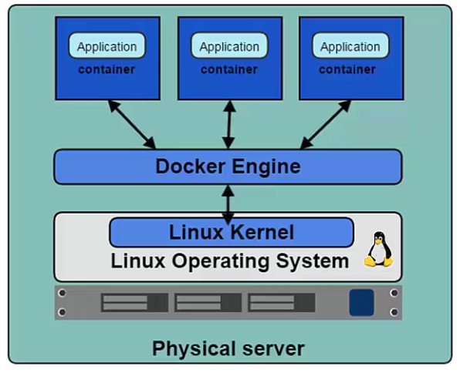
Docker Engine
Is the service that enables containers to be built, shipped and run.
Uses Linux Kernel namespaces and control groups to give us isolation workspaces

Slide 8
Images and Containers
Images
  Template used to create containers
  Can be built by you or other Docker user
  Stored in Docker Hub or a local registry
    https://hub.docker.com/
Containers
  Isolated application platform
  Contains everything needed to run an app
  Based on one or more images

Slide 9
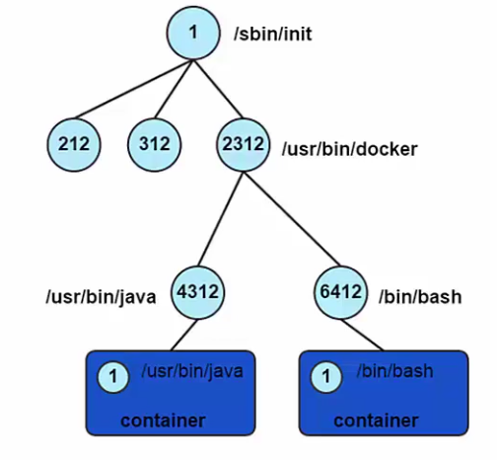
Container Processes
Container only runs as long as the process from the specified docker run command is running
The command process is always PID 1 inside the container

Slide 10
Docker fundamentals
Pulling an image from docker hub
Running an image
Starting and stopping containers
Create images
Useful commands

