Slide 1

Database Viewer
By Checkmate Group

Slide 2
Who are we?
Zakariya Oulhadj (Team Leader)
Bogdan Adascalului (Team Leader)
Taylor Head (Scrum Master)
Notes:
Zakariya Oulhadj (Team Leader 1)
Responsible for managing the group
Bogdan (Team Leader 2)
The second team leader that….
Taylor Head (Scrum Master)
The scrum master which …..

Slide 3
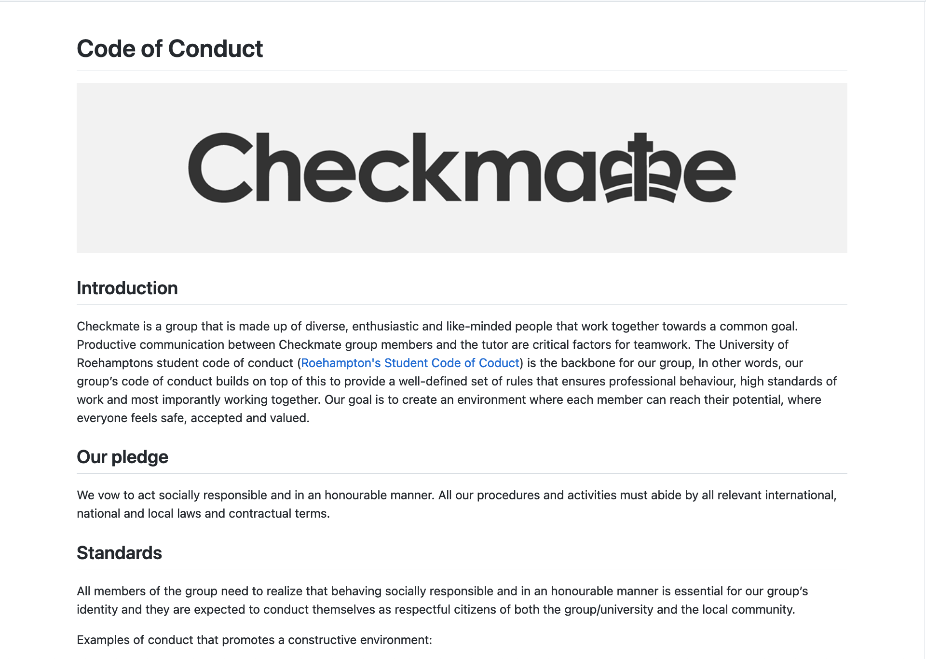
Code of Conduct
Notes:
Bogdan
The code of conduct is a professional document that aims to guide those whom it may concern regarding the team and projects standards, responsibilities, disciplinary actions and technical details. We as a team will refer to this code of conduct throughout the project to ensure all the standards are being followed.
Zakariya Oulhadj (Team Leader 1)
Responsible for managing the group
Bogdan (Team Leader 2)
The second team leader that….
Taylor Head (Scrum Master)
The scrum master which …..

Slide 4
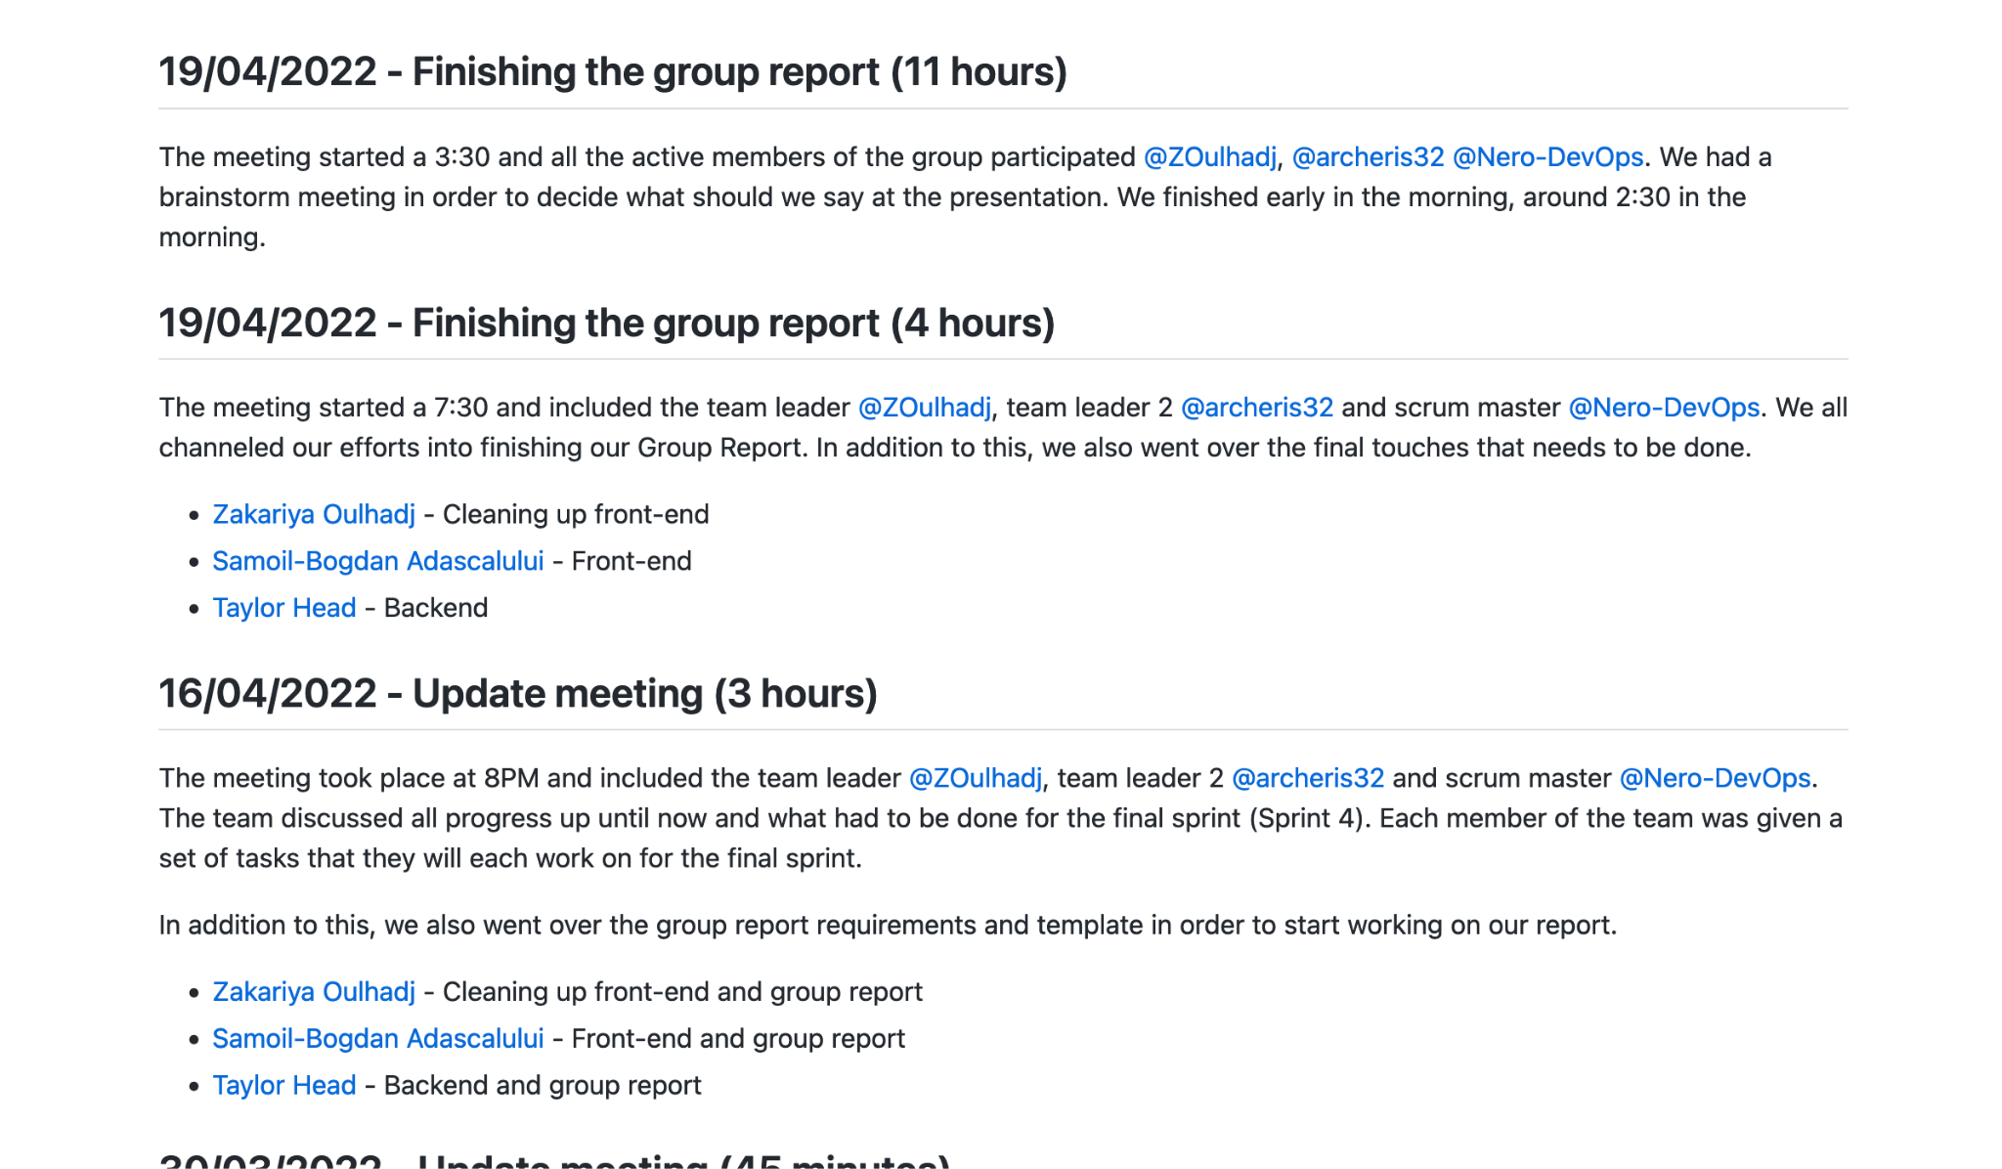
Meeting Minutes
Notes:
Tyler

Slide 5
Our Project
Database Viewer
Easy to use platform
Latest technologies
v0.0.1
v0.0.3
Sprint 2
Sprint 4
Sprint 1
Sprint 3
v0.0.2
v0.0.4
Notes:
Zak
Latest technologies
Node.js, Express.js, Docker, Bootstrap, Pug
Easy to use platform through a website interface
4 Month-long project
600+ total commits
40 Merges
The project is licensed under GPL-3.0 Licence (GNU Public Licence version 3) [3]. This means that the client has:
the freedom to use the software for any purpose,
the freedom to change the software to suit their needs,
the freedom to share the software with their friends and neighbours, and
the freedom to share the changes you make.
We find that this gives us and the client the greatest levels of flexibility during and after the project's development.

Slide 6
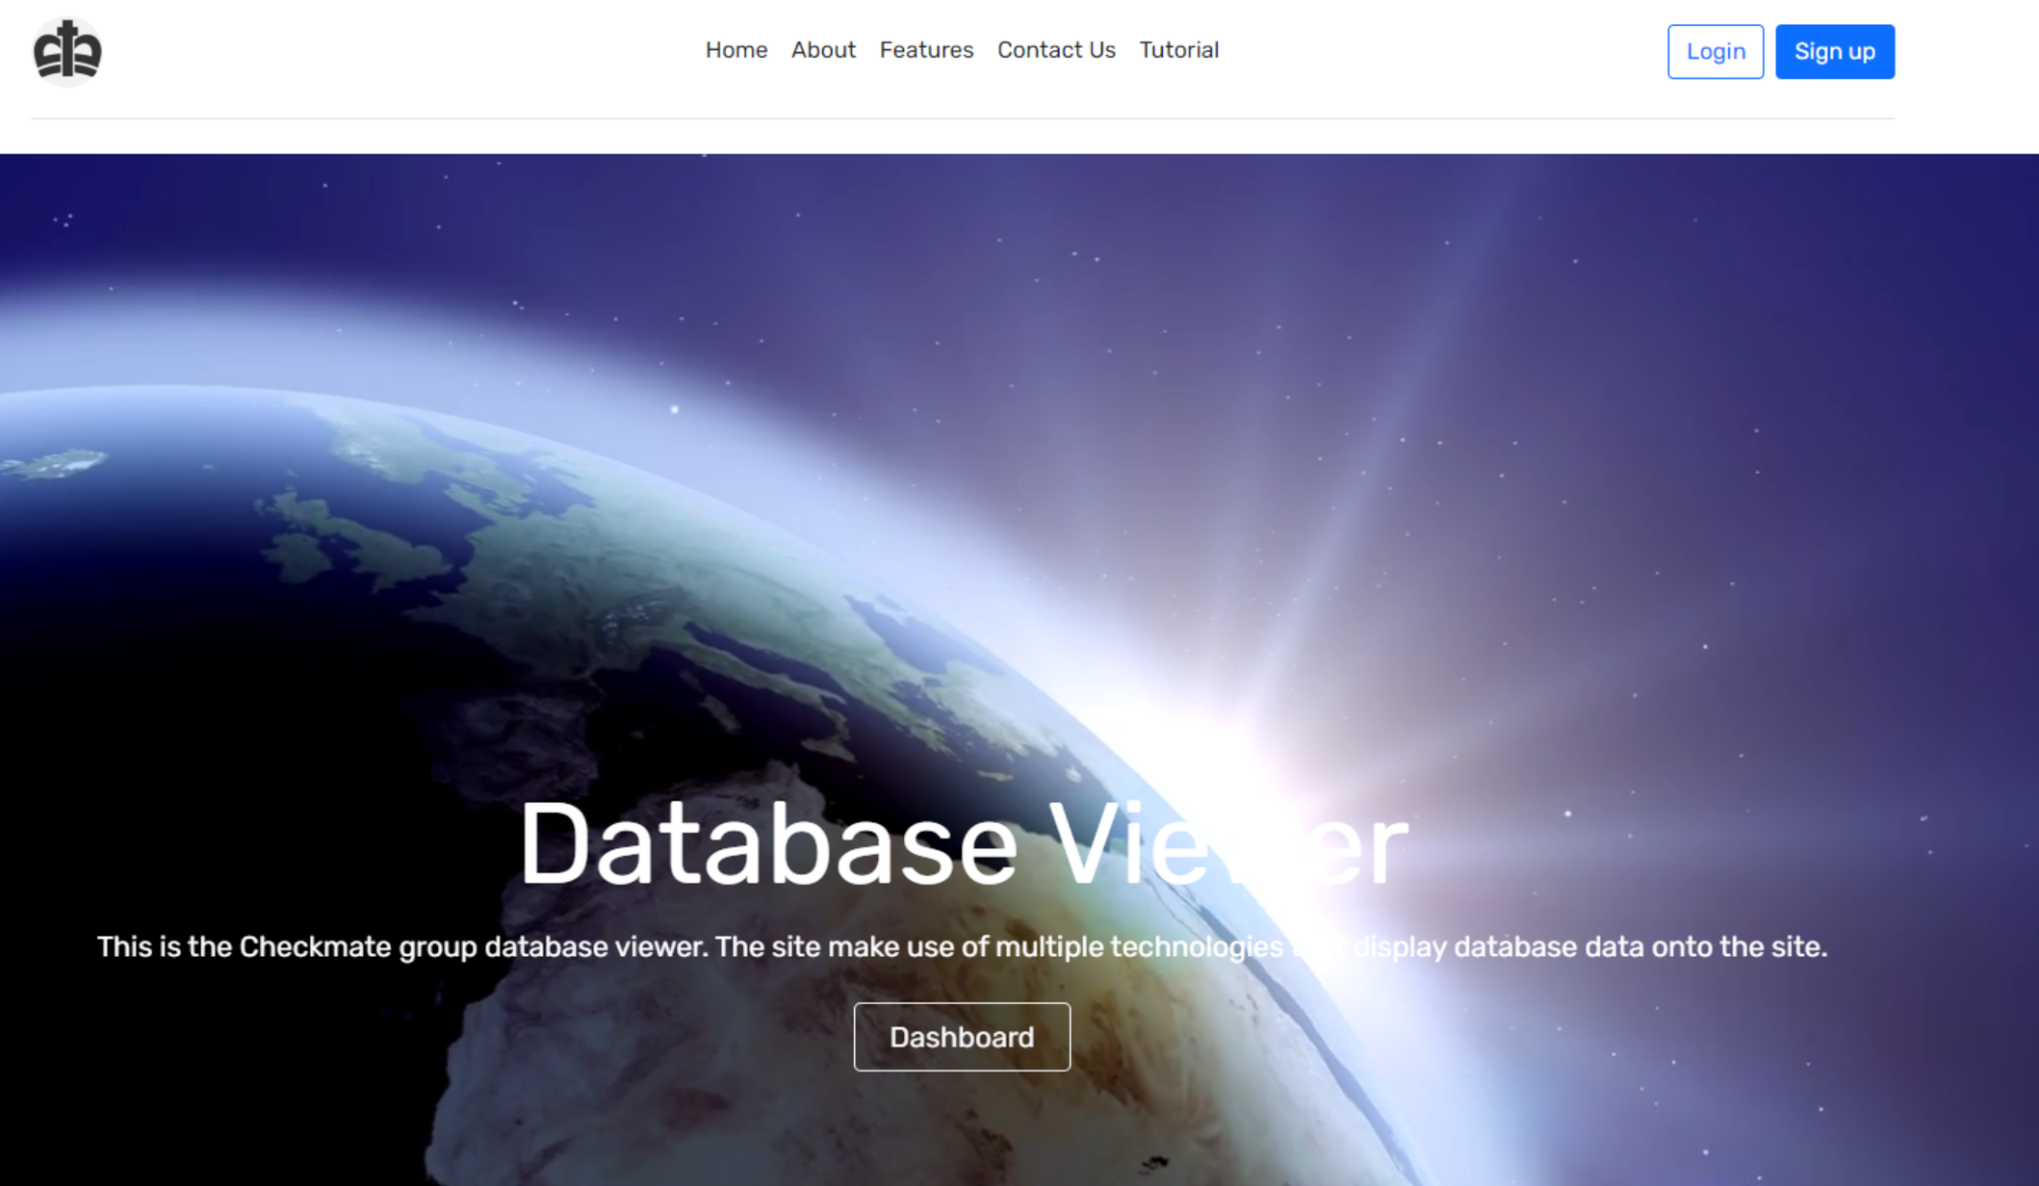
Front end
We started developing the front-end using HTML, but after sprint 2 we decided to convert everything into PUG.We found that Pug is more user friendly, easier to understand and also has a simplified syntax.
Notes:
Bogdan
Front end was done using PUG and CSS. The css file contains the styling for the entire website from font , colours, background, al the way to transitions.

Slide 7









Development Stack
Notes:
Zak
List of technologies that will be used:
Visual Studio Code (1.66.2) - Text Editor used for our team members
GitHub Desktop (2.9.12) - Git project management
Node.js (8.5.5) - Used because of requirements
PUG (3.0.2) - Used because of requirements
Express.js (4.16.1) - Used because of requirements
Bootstrap (5.1.3) - Style sheets
Bootstrap Icons (1.8.1) - SVG icons by Bootstrap
Travis CI - Continuous Integration
Cypress (9.5.4) - Unit testing
Docker (4.5.0) - Container for project
MySQL (2.18.1) - Database language
A full detailed explanation as to how each package will be used can be seen in the Appendix.

Slide 8
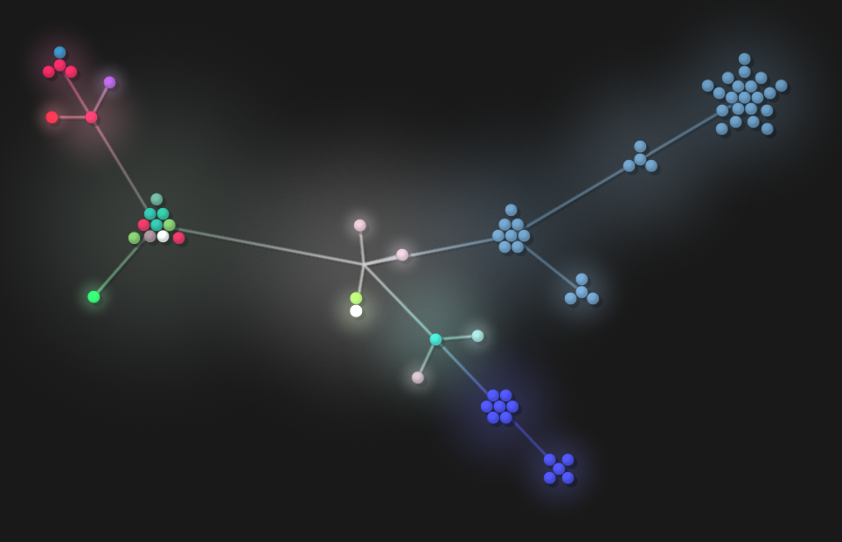
Version Control Visualization
Notes:
Bogdan
Zakariya Oulhadj (Team Leader 1)
Responsible for managing the group
Bogdan (Team Leader 2)
The second team leader that….
Taylor Head (Scrum Master)
The scrum master which …..
Working on the project simultaneously is vital when working as a group and therefore, we had to make an important decision early on regarding which version control system to use.
Options
-GitHub
- BitBucket
- GitLab.
During our first official meeting we discussed and analysed all three options and concluded that we should use GitHub. This was primarily due to the wide range of features that GitHub provides such as GitHub Issues for bug reporting, project management via GitHub’s project boards, repository wiki page and more. In addition to this, two of the group's members already had prior knowledge of GitHub and therefore, it was already a strong candidate.

Slide 9
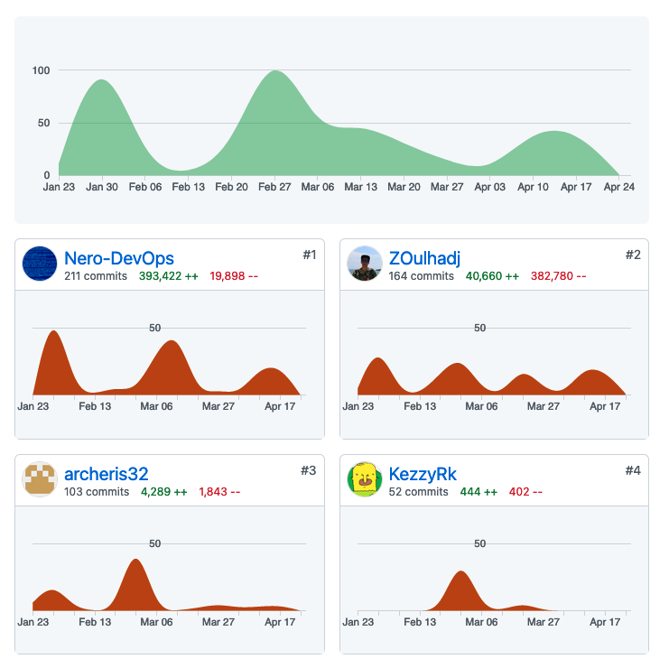
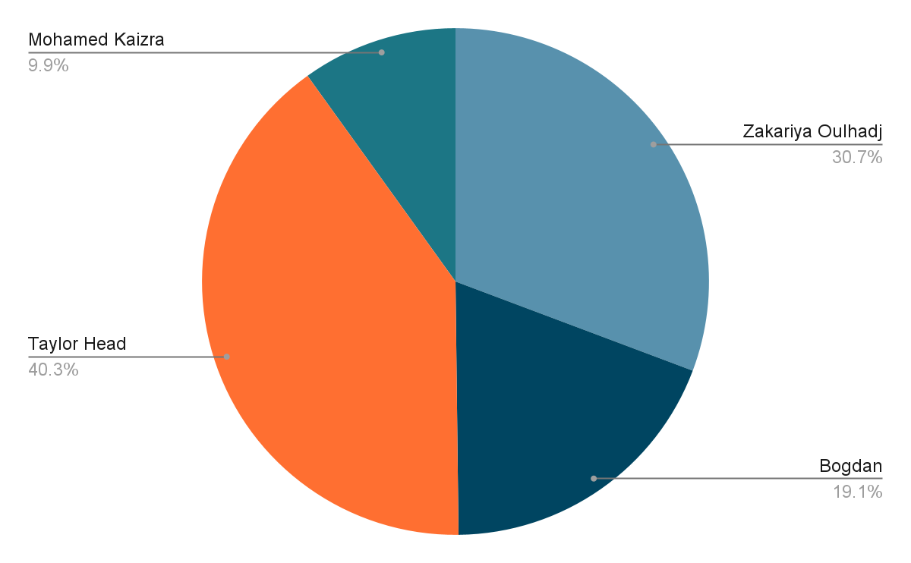
Group Statistics

Slide 10
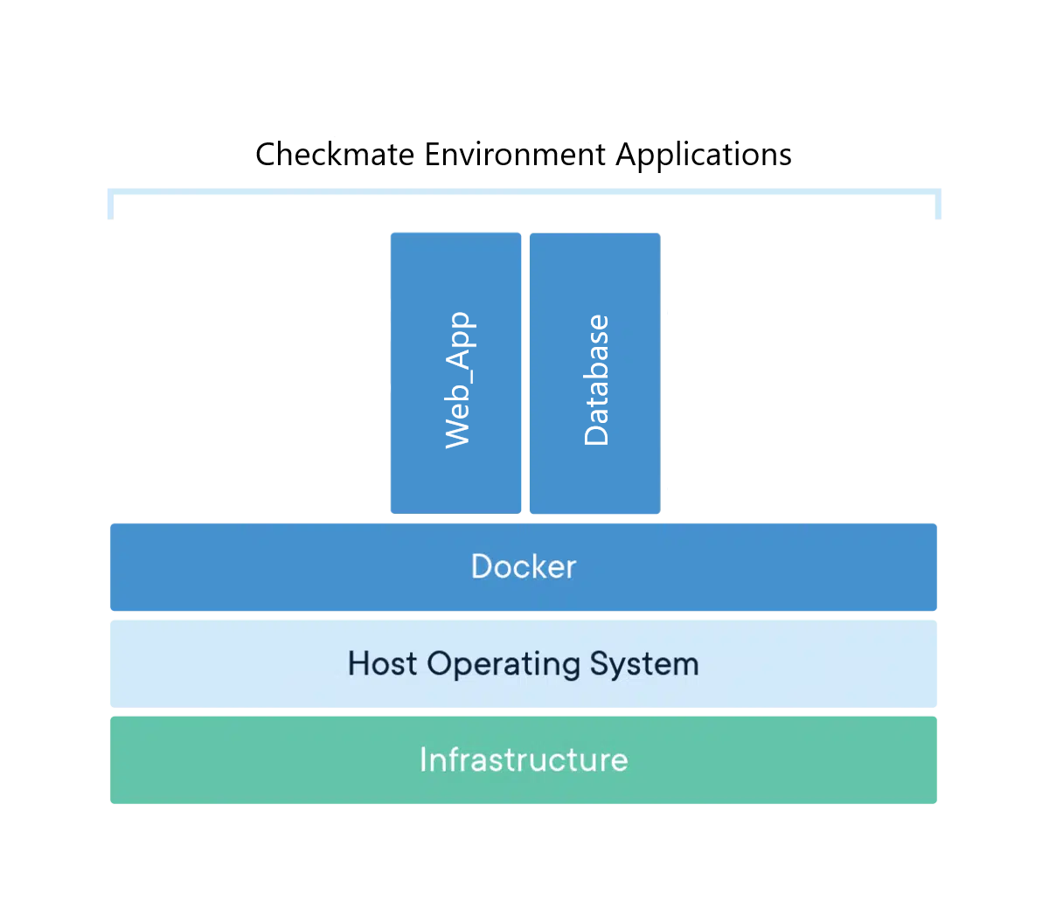
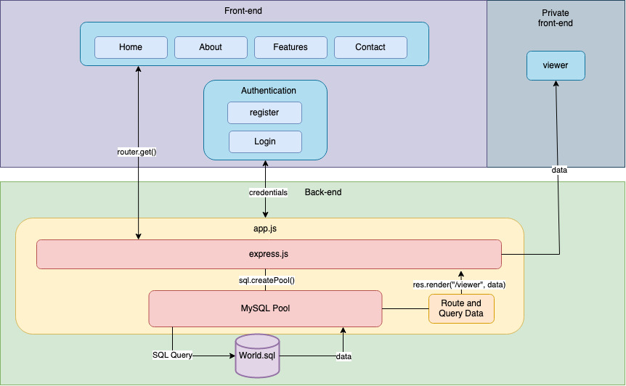
Internal Systems
Notes:
Zak and Tyler
The internal systems have been built within the Docker Engine which would be called a container which can easily deploy and host the environment.
Internal systems build with Docker
Easily deployable
Separate containers to reduce the risk of conflicts

Slide 11
Project Tour
Notes:
We can present our website

Slide 12
Any Questions?

