Slide 1
Checkmate Presentation (Sprint 3)
@ZOulhadj
@Nero-DevOps
@archeris32
@KezzyRk

Slide 2
01
Team Leader
Zakariya Oulhadj
Notes:
Travis CI set up and working with Jest
Re-designed home page
New navigation bar
Designed and implemented the about page
Dashboard button redirects to login if the user is not logged in

Slide 3

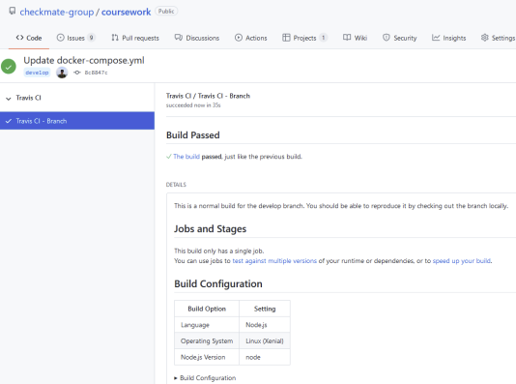
Travis CI
Travis CI is a hosted, distributed continuous integration service used to build and test software projects hosted at GitHub

Slide 4

Home redesign/Navbar
Page redesigned to be ready for when the login system is fully implemented.
New navigation bar so items are centred for increased readability.

Slide 5
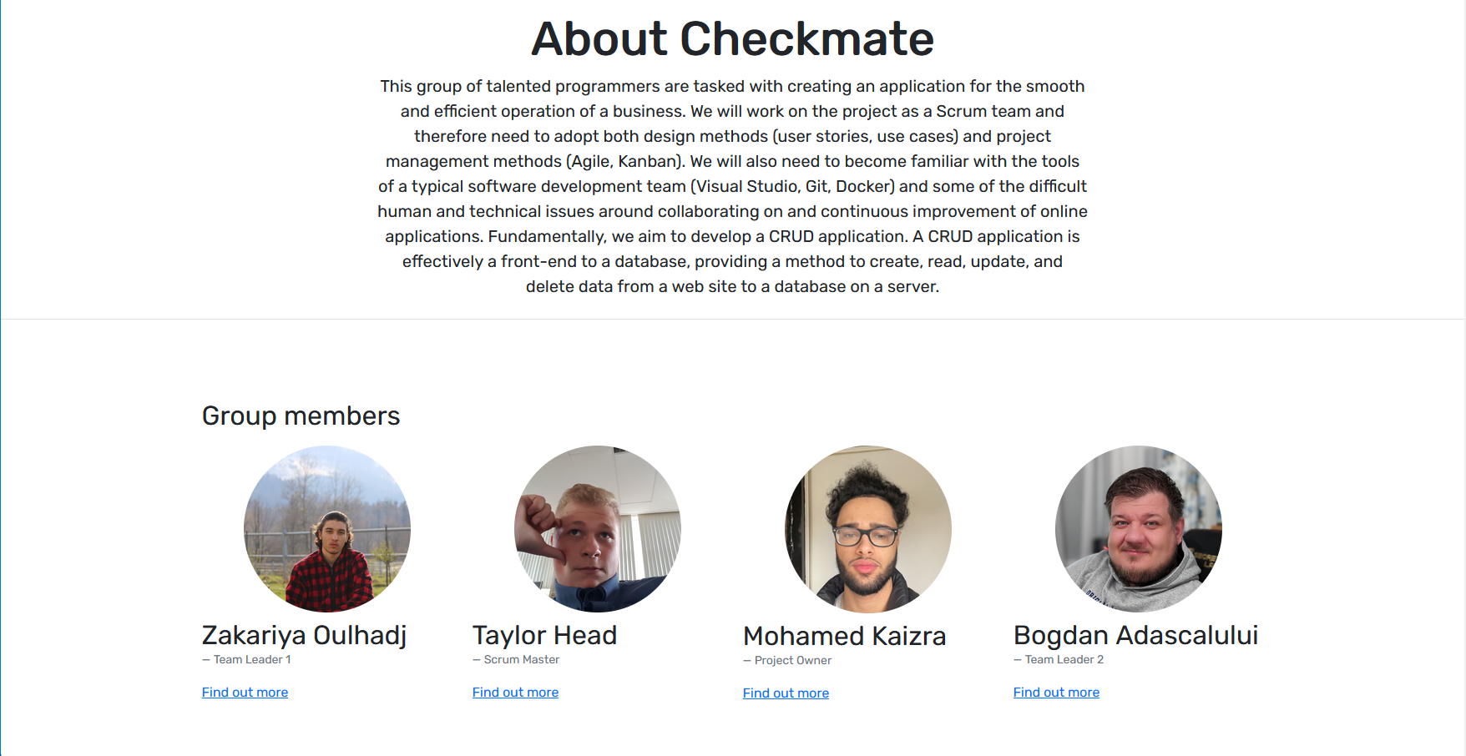
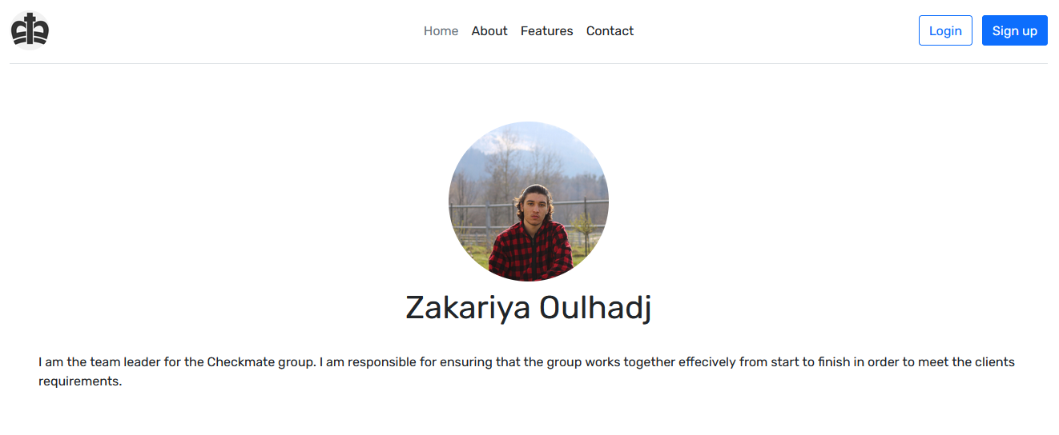
About Page
Newly designed and implemented about page for each of us and the group.

Slide 6
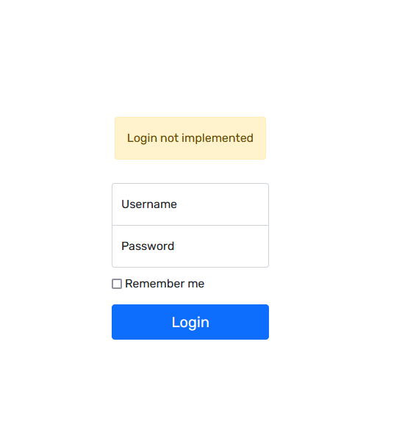
Login Page
Dashboard buttons currently redirect to login page.

Slide 7
02
Team Leader 2
Bogdan Adascalului

Slide 8
03
Scrum Master
Taylor Head

Slide 9
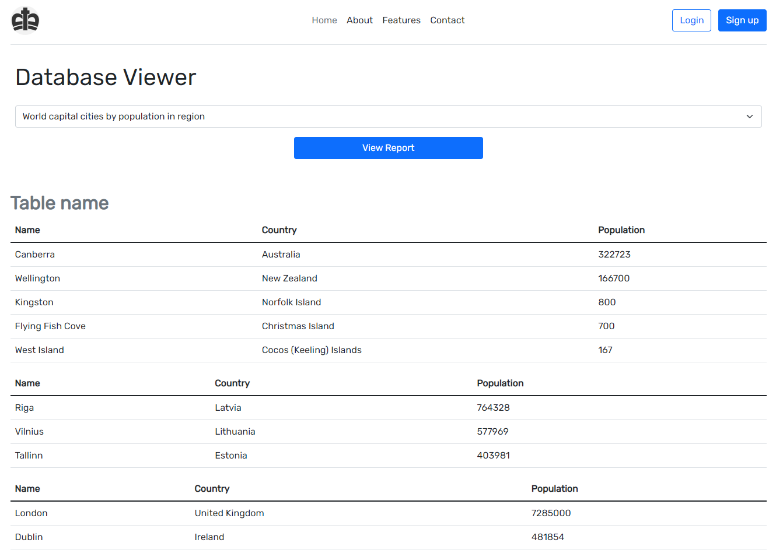
Working Prototype
Progress of the technical deliverables of our project.
Notes:
Implementation progress towards final version of application: o Database design o Database implementation with pre-filled data o HTML pages available generated from PUG, perhaps with some static content o At least some dynamic content being pulled from your database to your templates via Pug - concentrate on views of your data

Slide 10
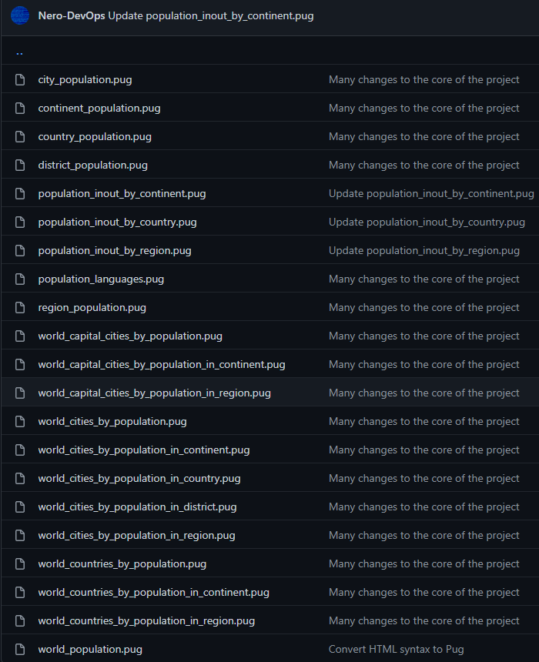
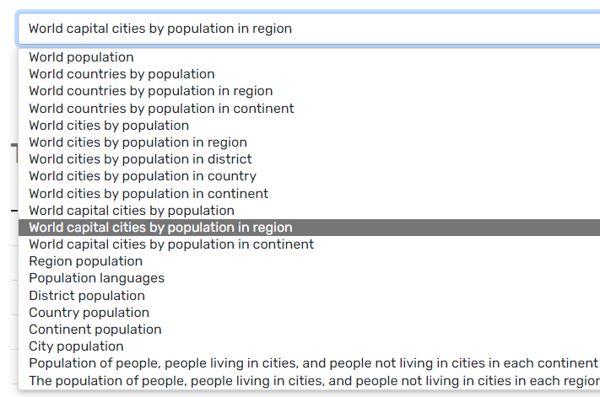
Backend and Reports
Providing proof of progress.
Notes:
Providing proof of progress.
We have finished all reports with just minor adjustments left

Slide 11
04
Project Owner
Mohamed Kaizra

