Slide 1
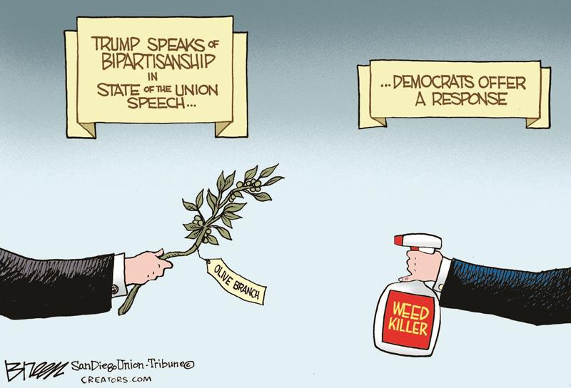

NOT

Slide 2



Design Characteristic
Monetary Policy | Halving Supply Shock | Smooth Regular Reduction
Machine Consensus | Proof-of-Work | Hybrid PoW/PoS
Human Consensus | Rough Consensus | Formalised Off + On-chain
Change Activation | User Node Upgrade | Explicit Vote Approval
Upgrade Social Contract | Soft Forks Only | Controlled Soft/Hard Forks
Dispute Resolution | Chain-split + Market Pricing | 75% Stakeholder Vote
Protocol Funding | Donation / Sponsors | On-chain Treasury

Slide 3






Differentiation Characteristic
Monetary Policy | Fixed Cap, Deterministic Halvings, 100% PoW Miners
Machine Consensus | ASIC Proof-of-Work
Human Consensus | Rough Consensus
Protocol Change Activation | Informal User Node Upgrade
Upgrade Social Contract | Soft Forks Only
Dispute Resolution | Chain-split + Market Pricing
Protocol Funding | Donations / Sponsors
Privacy Implementation | CoinJoin and Derivatives
KEY: Strong Hedge Moderate Hedge Minor/Non-Hedge
Governance Layer
Governance Layer

Slide 4
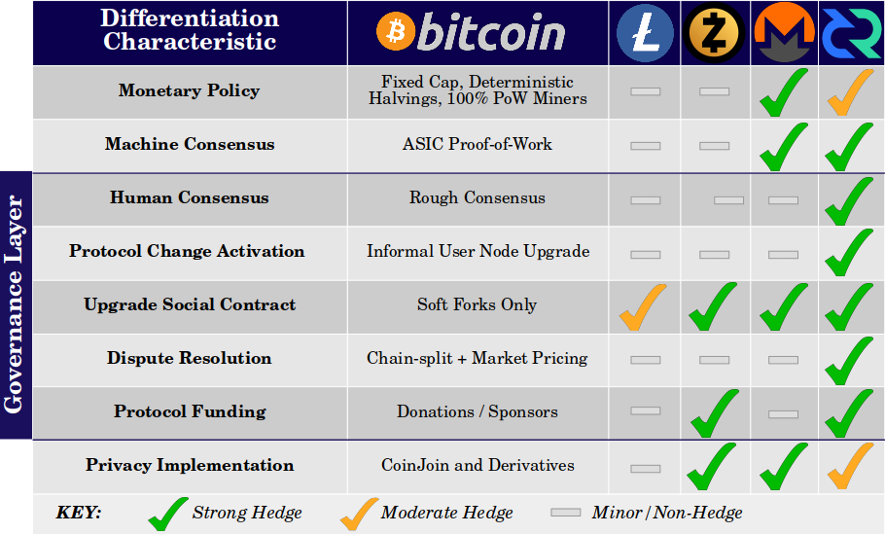

Slide 5

 | Technical | Monetary | Social/Market
 | Integrated Distribution + Transfer | Absolute Deterministic Scarcity | Assurance of 21M by Social Contract
 | Distributed Security, Governance + Nodes | Fair and Open Distribution | Secured by Free Market Incentives
 | Portability + Ease of Storage | Unforgeable Costliness in PoW | Self-deleveraging Difficulty Adjustment
 | Asymmetric Proof, Verification + Audit | Self-sovereign Seizure Resistance | Permission-less Access
 | Centralisation of PoW and Energy | Expensive + Limited Privacy | Opaque + Inefficient Governance
 | Premature Calcification | Reliance on Single Distribution Mechanism | Poor Assurances of Adaptation
 | Encumbered by Technical Debt | Risk of Contentious Chain-splits | Chain-splits Fragments Mind-share
 |  | Reliance on Network Effects | Misalignment of Funding Incentives
Advantages over Gold
Constraints

Slide 6
 | Technical | Monetary | Social/Market
 | Integrated Distribution + Transfer | Absolute Deterministic Scarcity | Assurance of 21M by Social Contract
 | Distributed Security, Governance + Nodes | Fair and Open Distribution | Secured by Free Market Incentives
 | Portability + Ease of Storage | Unforgeable Costliness in PoW | Self-deleveraging Difficulty Adjustment
 | Asymmetric Proof, Verification + Audit | Self-sovereign Seizure Resistance | Permission-less Access
 | Checks + Balance in Security | Strong Affordable Privacy Guarantees | Transparent Governance/Dispute Resolution
 | Capacity to Self-Upgrade | Diversity in Distribution Mechanism | Strong Assurances of Adaptation
 | Unencumbered by Technical Debt | Retention of Singular Consensus Chain | Retention of Mind-share
 | Integrated Stakeholder Ecosystem | Adaptation Builds New Network Effects | Aligned Funding and Workforce
 | Liquidity
 | Reputation
 | Network Effects
Advantages over Gold
Advantages over Bitcoin
Constraints

