Slide 1
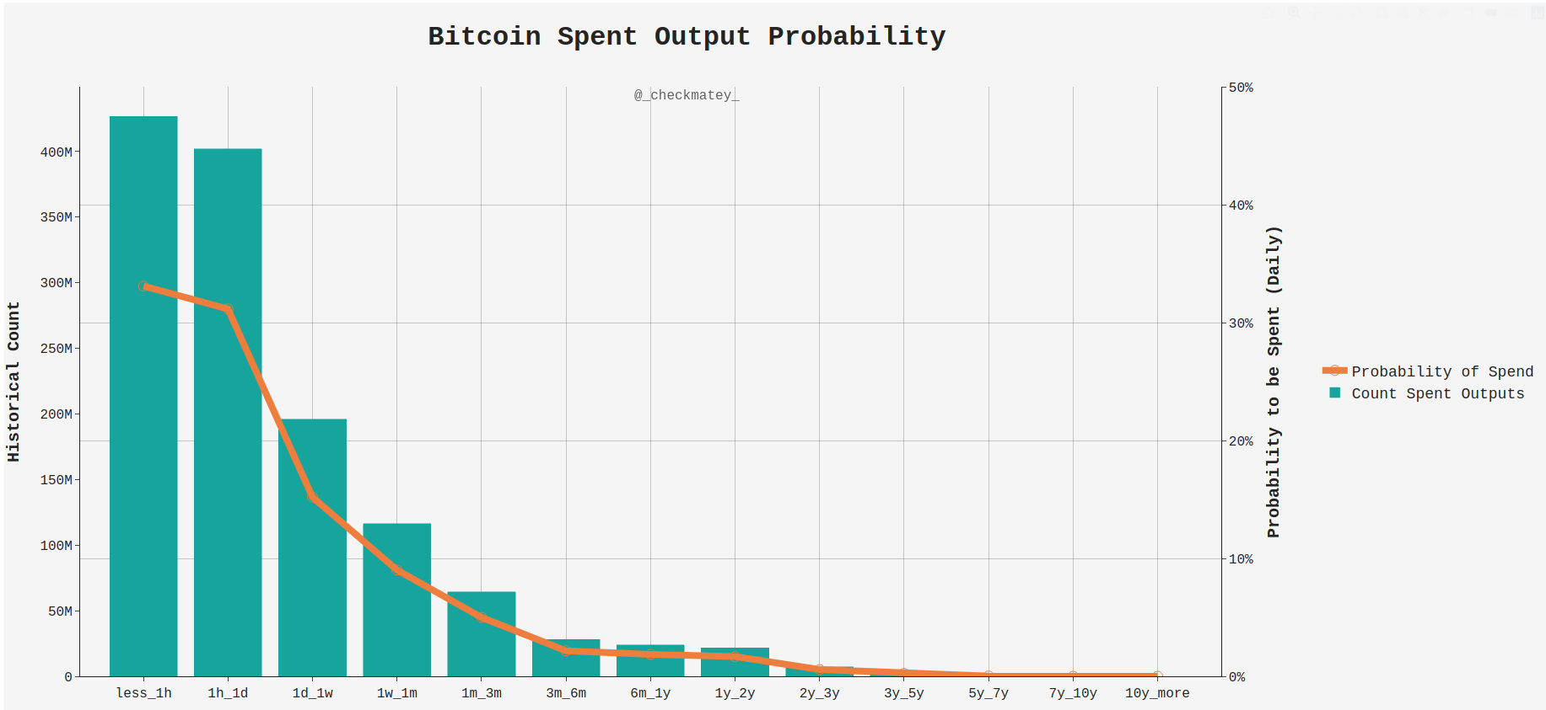
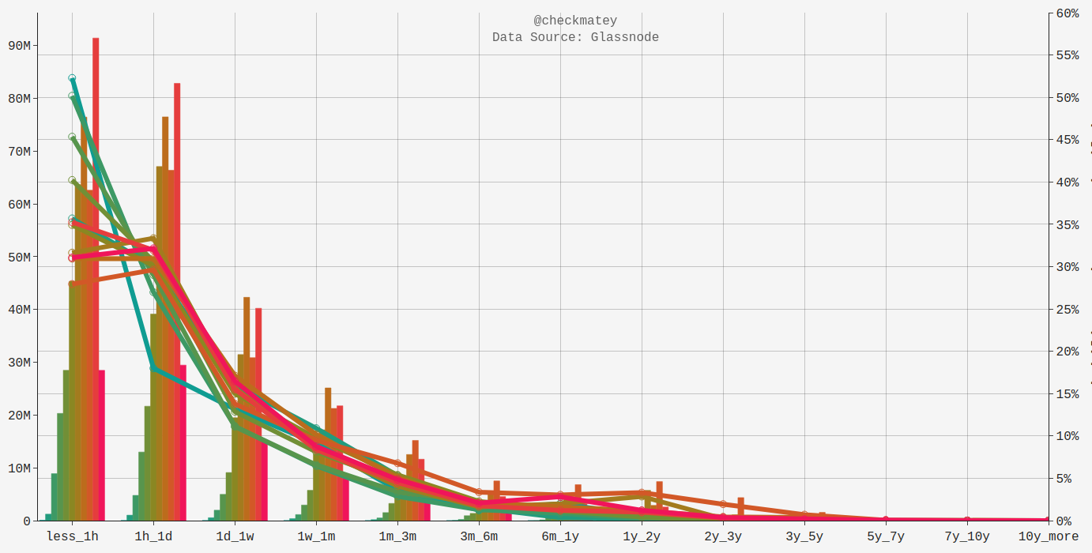
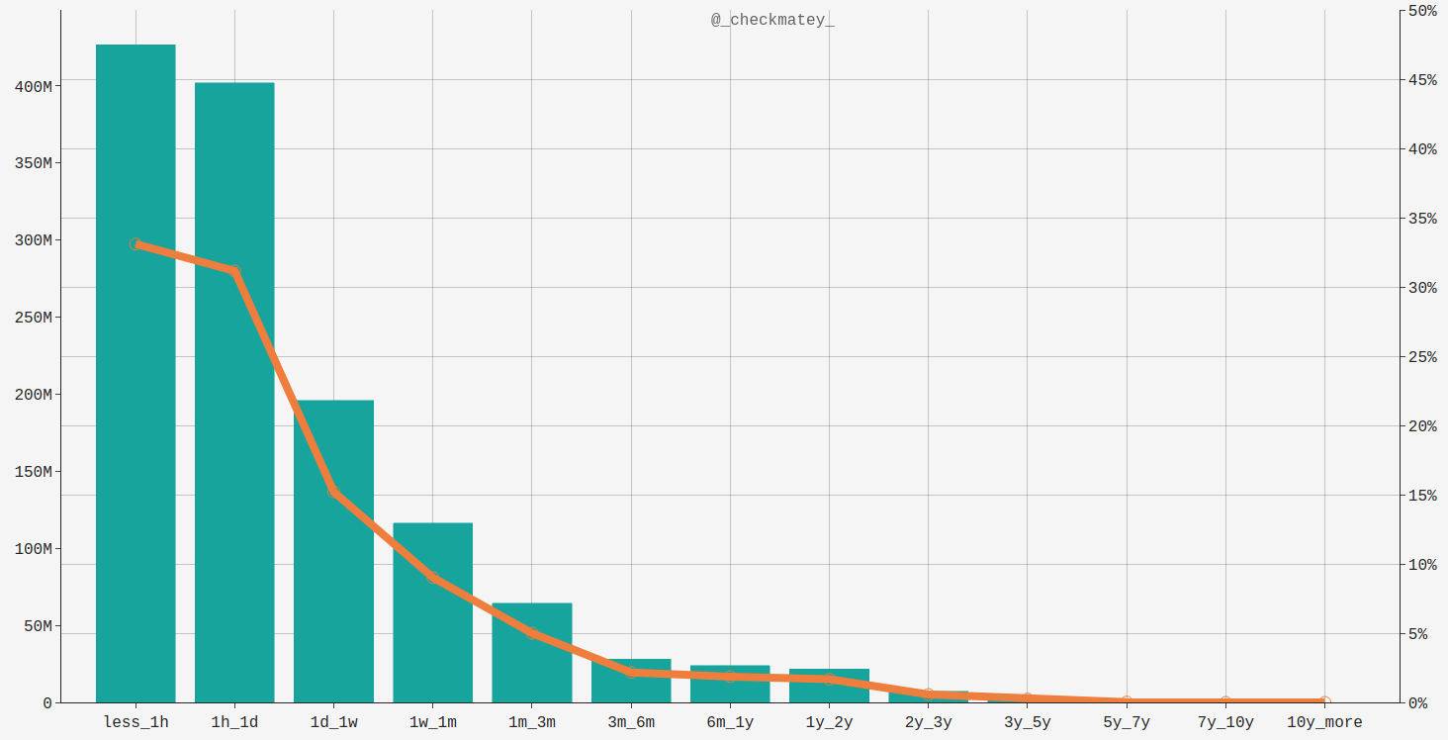
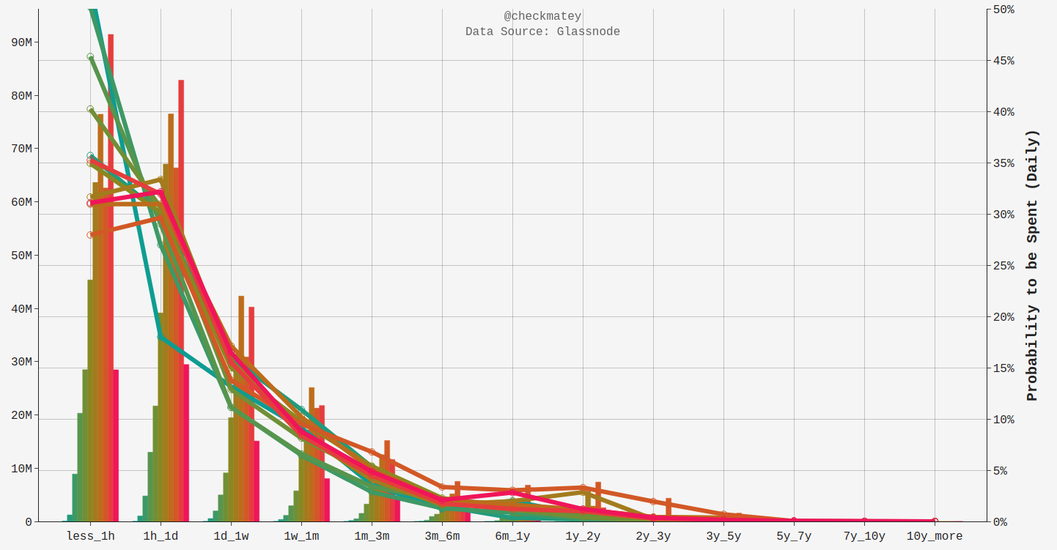
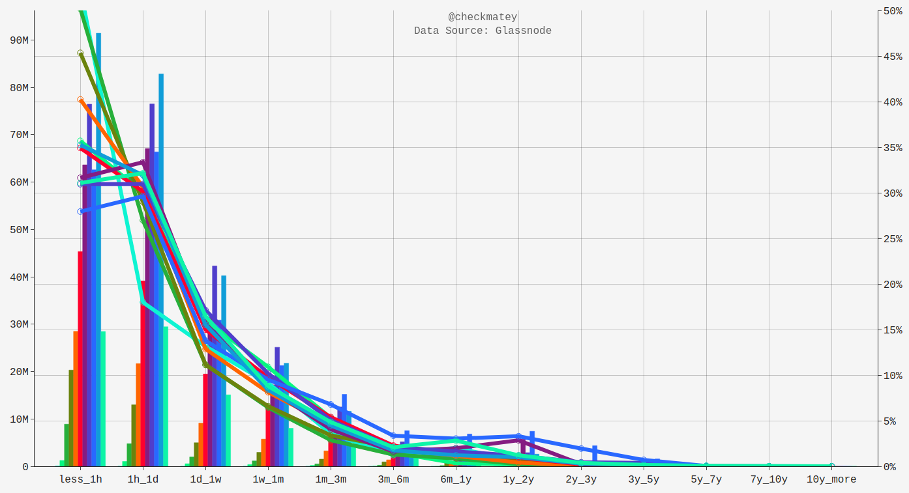
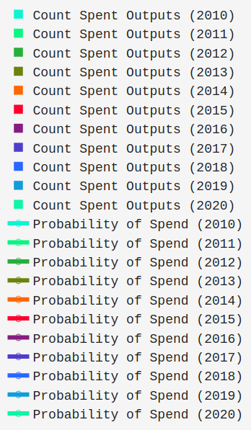

Data Source: Glassnode
Historical Frequency
Probability to be Spent (Daily)
Spent Output Age Range

Slide 2

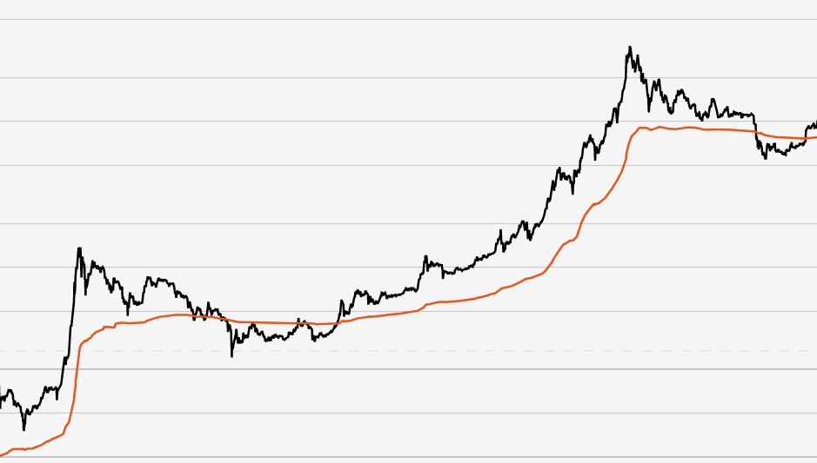
Characteristics
Signals in the Realised Cap can be drawn both from its level (price above/below) and from its rate of change (gradient).
Realised Cap Increasing | Realised Cap Plateau | Realised Cap Declining
Old coins selling into strength New Demand moving coins Bull Market reprices higher Shallow = Early Bull Steep = Strong Bull | Off-chain exchange driven market Low relative on-chain volume Bearish Market Balanced Distribution | Bear Market coins sold at loss Smart money accumulation Capitulation Phase Shallow = Low Volume Steep = Large Volume

Slide 3
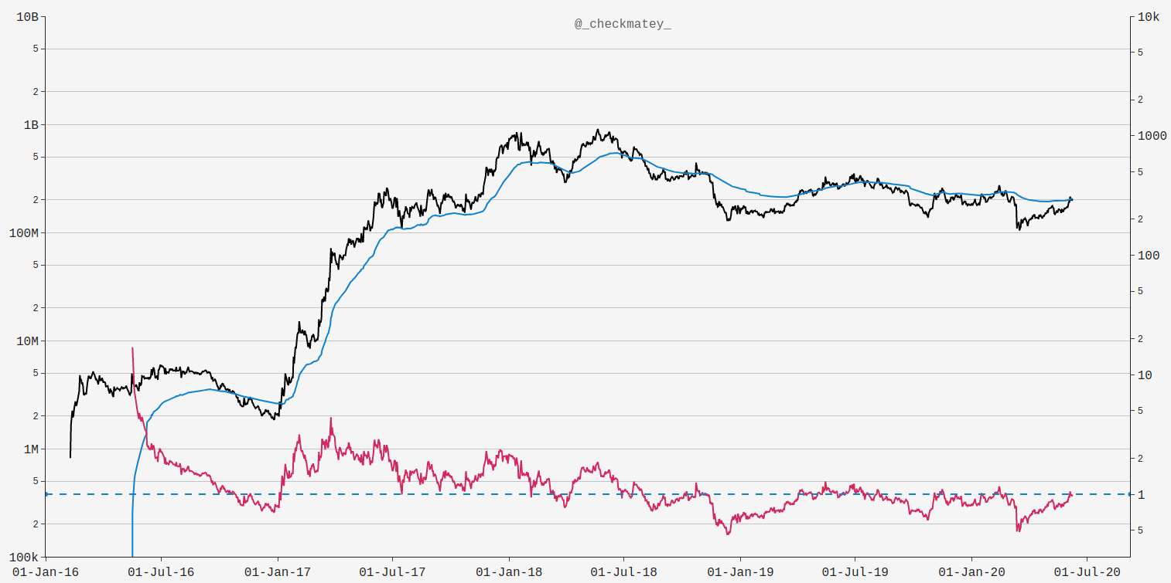

Decred Realised Capitalisation
Realised Cap
(Psychological Mean)
MVRV Ratio
MVRV = 1.0

Slide 4
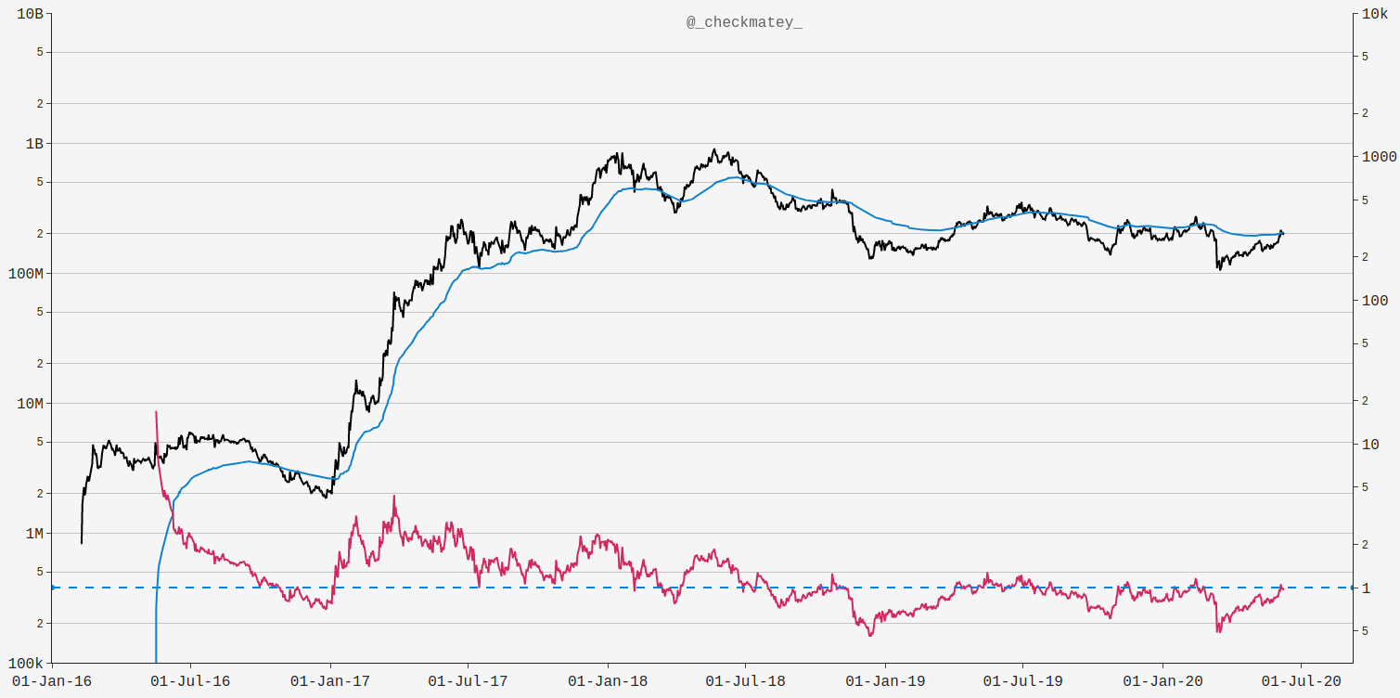
Decred MVRV Ratio
Steep Gradient down
Capitulation <--> Accumulation
Steep Gradient Up
High Tx Demand
2018 Descending Triangle in MVRV
MVRV = 1.0

Slide 5
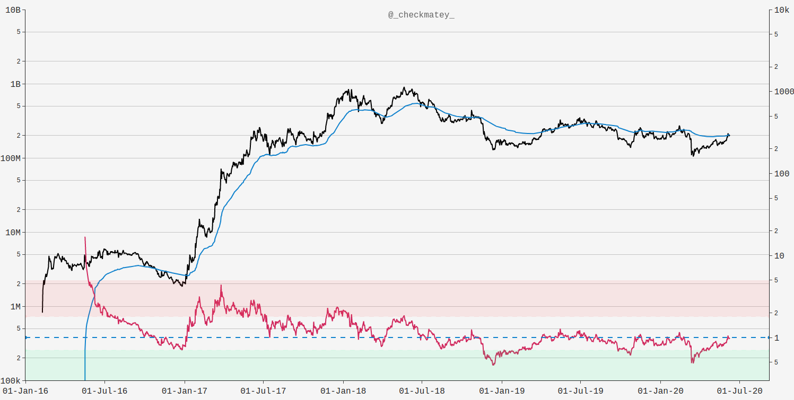
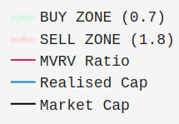
Points of 85% Chance Mean Reversion
Network Valuation (USD)
MVRV Ratio
MVRV > 1.8
MVRV < 0.7

Slide 6
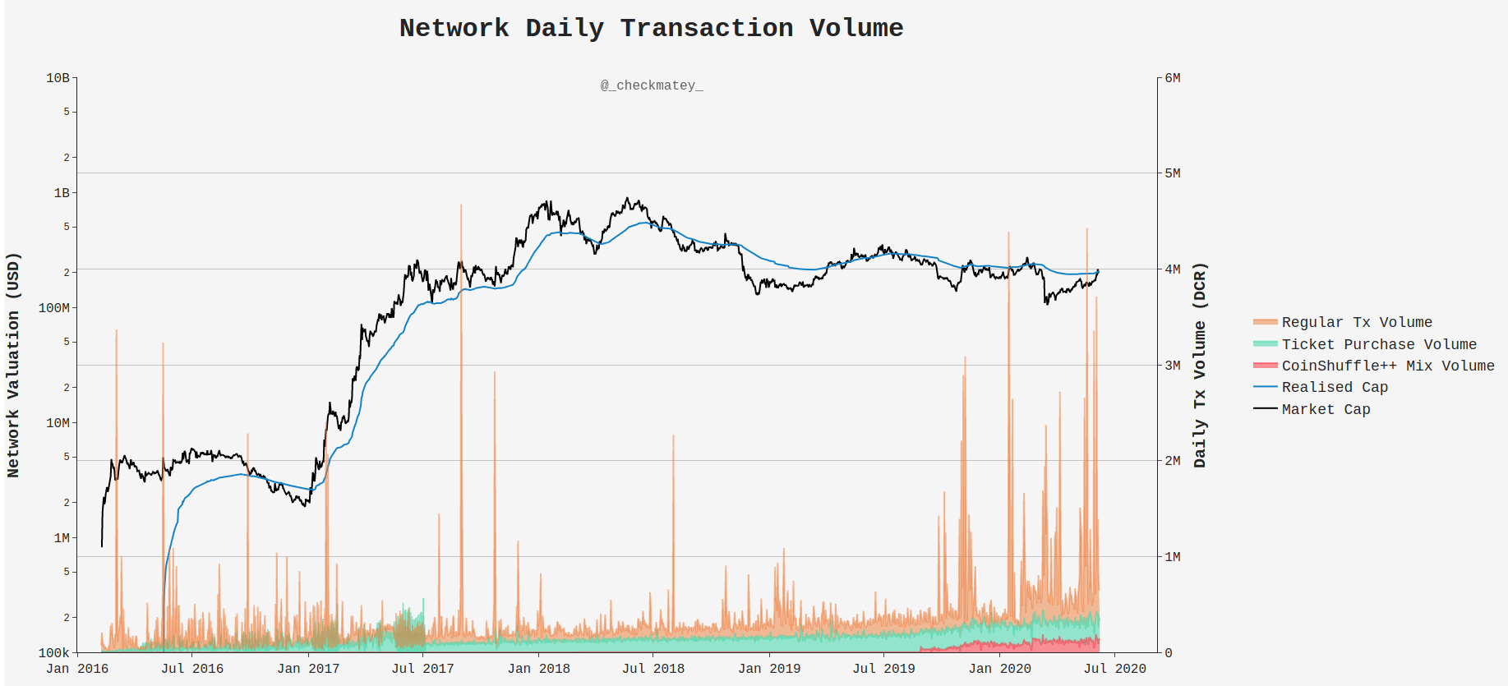

Slide 7
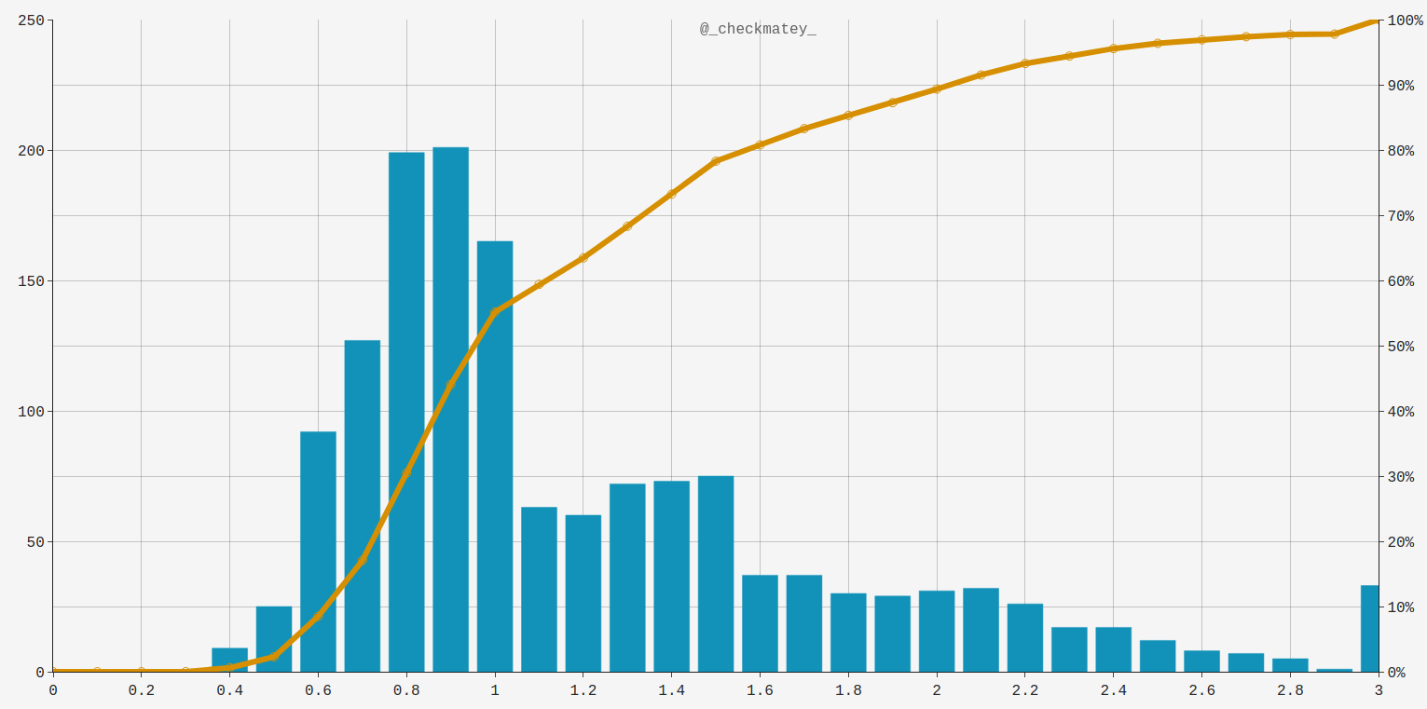
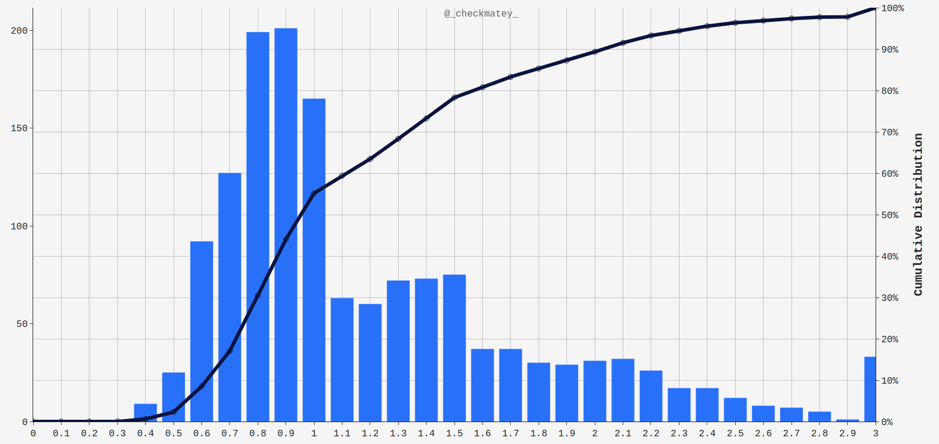
Decred MVRV Frequency Histogram
Daily Frequency
Cumulative Distribution
>
15% Occurrence
MVRV < 0.7
15% Occurrence
MVRV > 1.8
MVRV Value

Slide 8
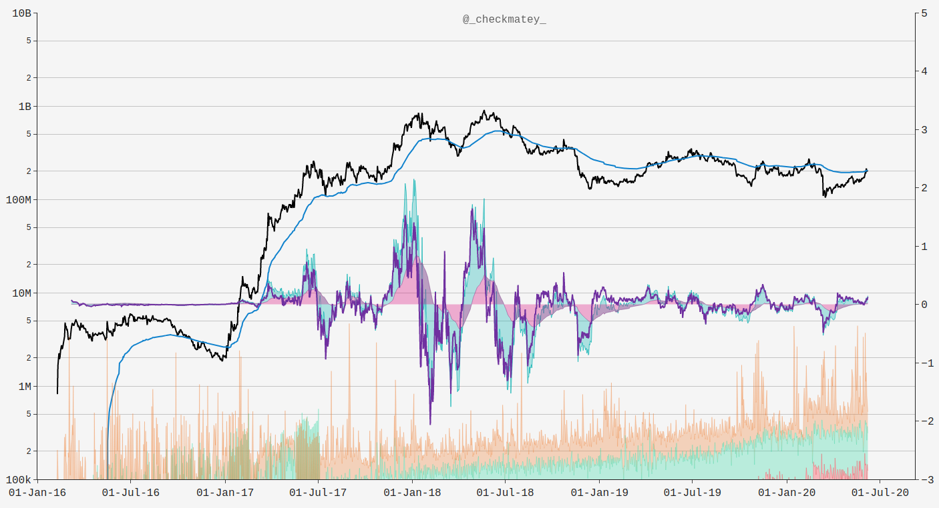
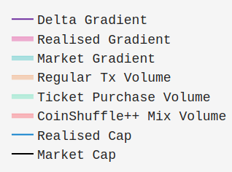
(28-Day)
Network Valuation (USD)
Market-Realised Gradient

Slide 9
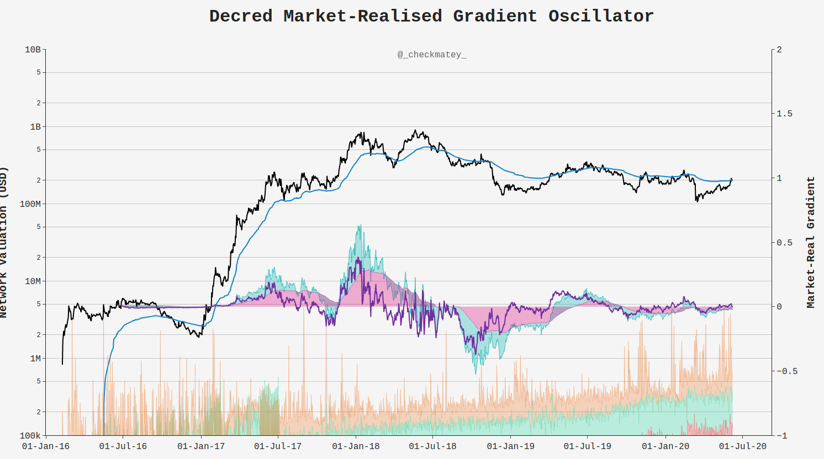
(142-Day)
Gradient Positive
(Uptrend)
Gradient Negative
(Downtrend)
Momentum
Continuation
Network Valuation (USD)
Market-Realised Gradient
Momentum Divergence/Reversal

Slide 10
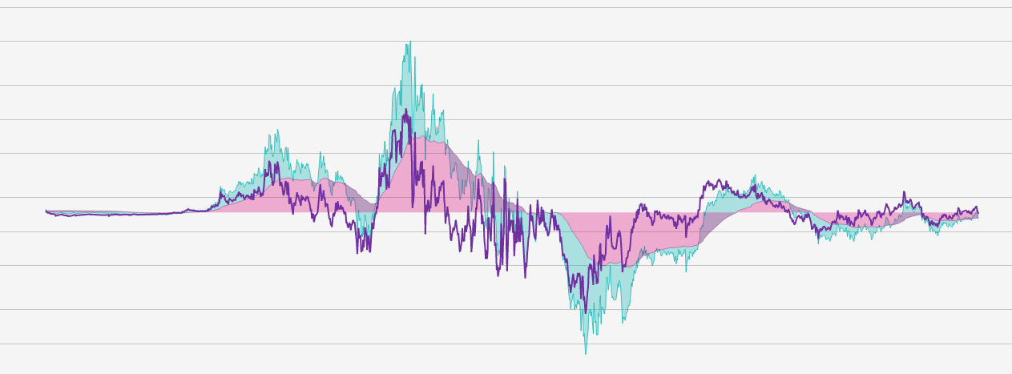
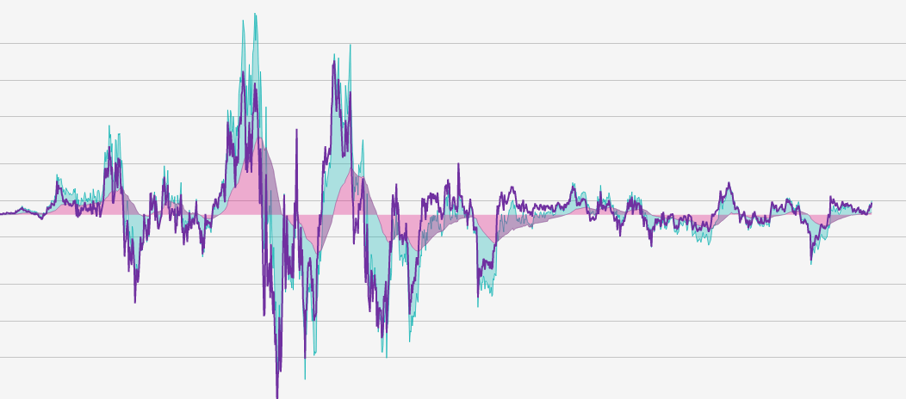
Steepening Gradients
Flattening Gradients
Positive Gradient
Negative Gradient

Slide 11
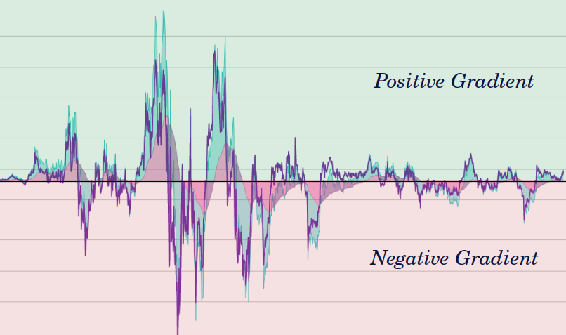
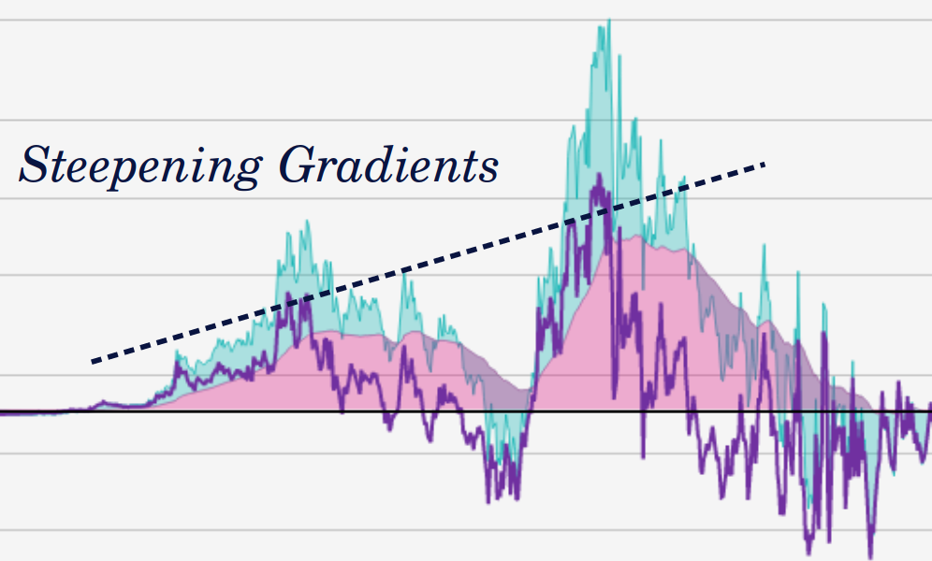
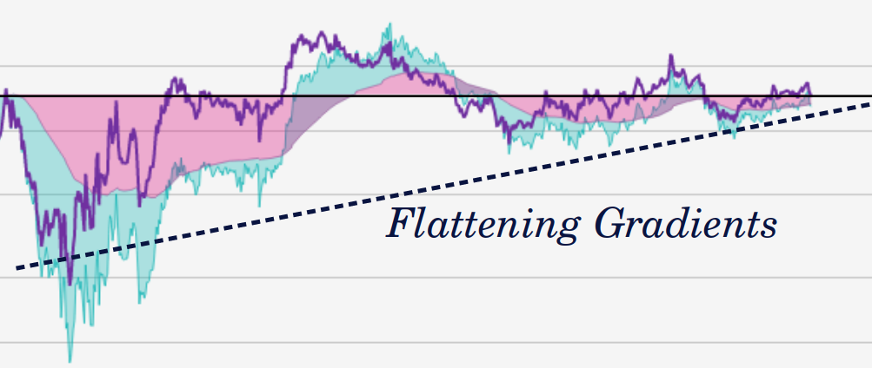
Gradient Character | Visual | Trend Signal | Mechanisms
Positive |  | Uptrend (Bullish) | Coins last spent at lower prices are being spent at higher prices
Negative |  | Downtrend (Bearish) | Coins last spent at higher prices are being spent at lower prices
Magnitude Increasing (Steepening) |  | Momentum Increasing (Continuation) | Coins acquired during trend repriced higher | lower (e.g. miners selling in downtrend, retail buying/staking during bullish hype)
Magnitude Decreasing (Flattening) |  | Momentum Decreasing (Reversal) | Coins acquired counter trend on the move (e.g. accumulated coins being withdrawn or being staked in tickets)

Slide 12



