Slide 1
Year | Monthly Ticket Income (USD) |  |  |  | Brazil Avg Monthly Wage*
 | Min | Max | Average | Median | BRL | USD | Ticket % of Brazil Wage
2016 | $0.61 | $149.85 | $2.82 | $2.55 | 2300 | $676.37 | 0.42%
2017 | $0.73 | $134.03 | $36.72 | $37.88 | 2340 | $742.44 | 4.95%
2018 | $16.37 | $162.23 | $75.30 | $70.73 | 2375 | $660.86 | 11.39%
2019 | $12.80 | $35.96 | $22.86 | $21.87 | 2360 | $605.49 | 3.78%
2020 | $8.50 | $23.27 | $13.54 | $13.25 | 2535 | $519.42 | 2.61%
* Brazil average monthly income in BRL estimated from https://www.ibge.gov.br/ and then converted to $USD at the 365-day moving average of the exchange rate moving on 31 Dec.

Slide 2
Market-Realised Relationship | MVRV Ratio | Aggregate Sentiment | Historical Market Signals
Market above Realised | MVRV > 1.0 | Bullish / In Profit | Support
Market below Realised | MVRV < 1.0 | Bearish / Underwater | Resistance

Slide 3
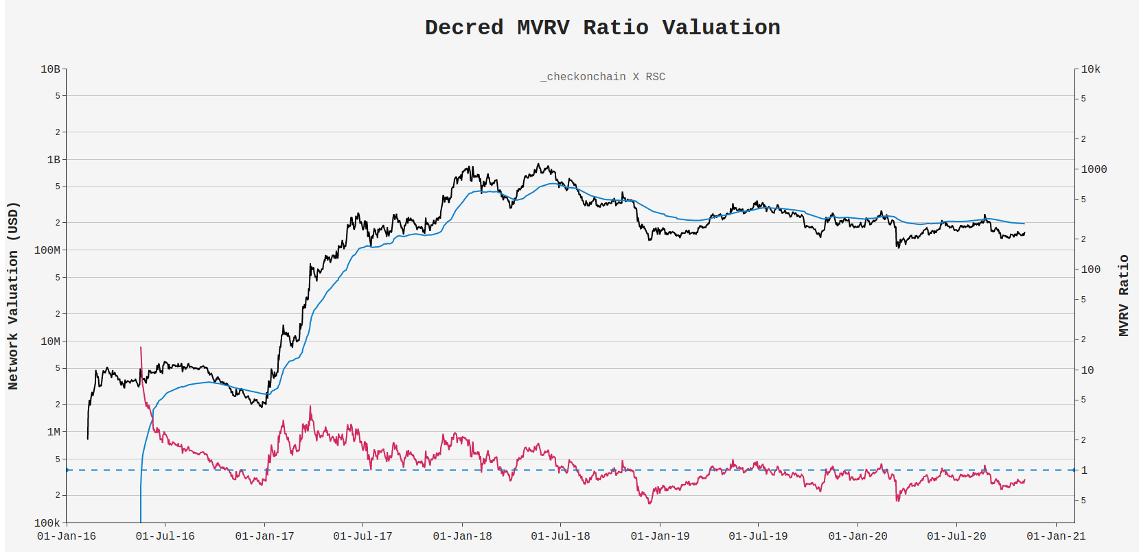

Bull Market
Bear Market

