Slide 1
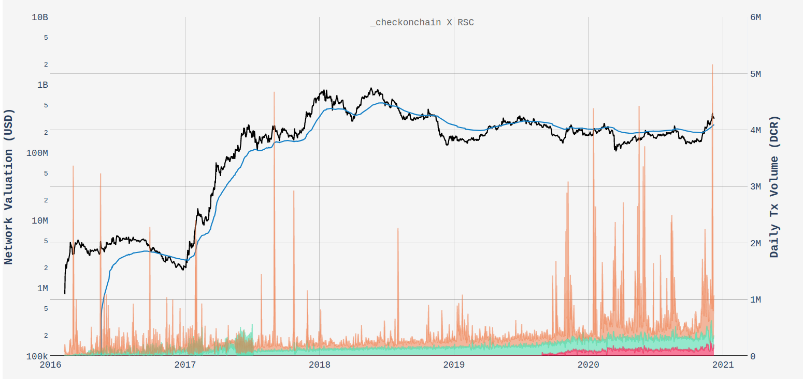
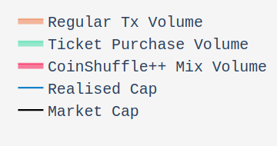
ATH: 5.16M DCR
(40% circ .supply)
Break above Realised Price

Slide 2
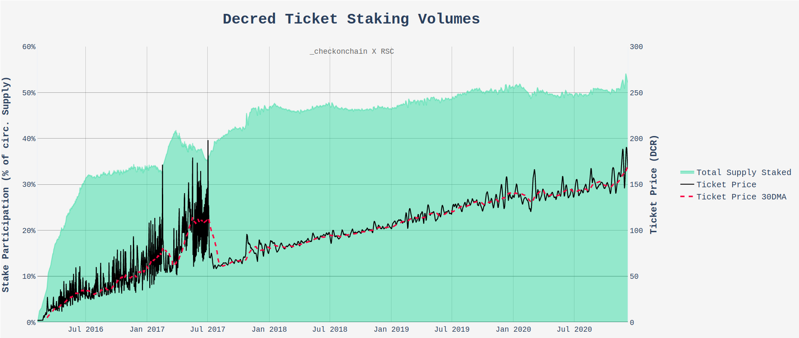
ATH: 54.13% Supply Staked
Total of 6.674M DCR
2x ATH: Ticket Price
188.59 Then 190.64 DCR
(Post-sdiff algo change)
Stake Difficulty Algorithm Changed

Slide 3
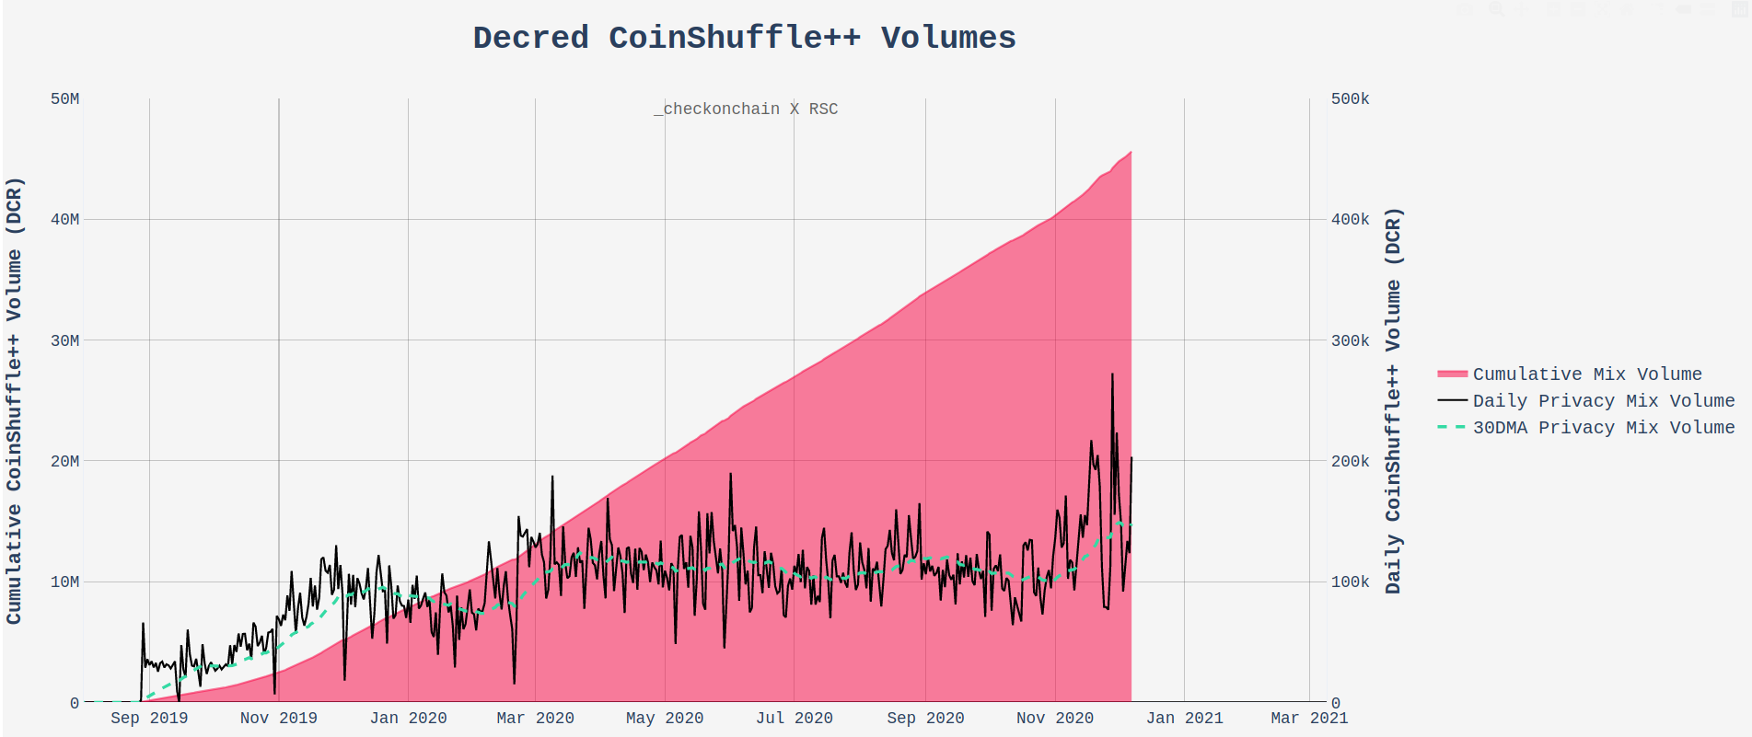
45.6M DCR
Mixed since Aug-19
ATH: 272.6k DCR Mixed in One Day
147k DCR
30-Day Mix Average

Slide 4
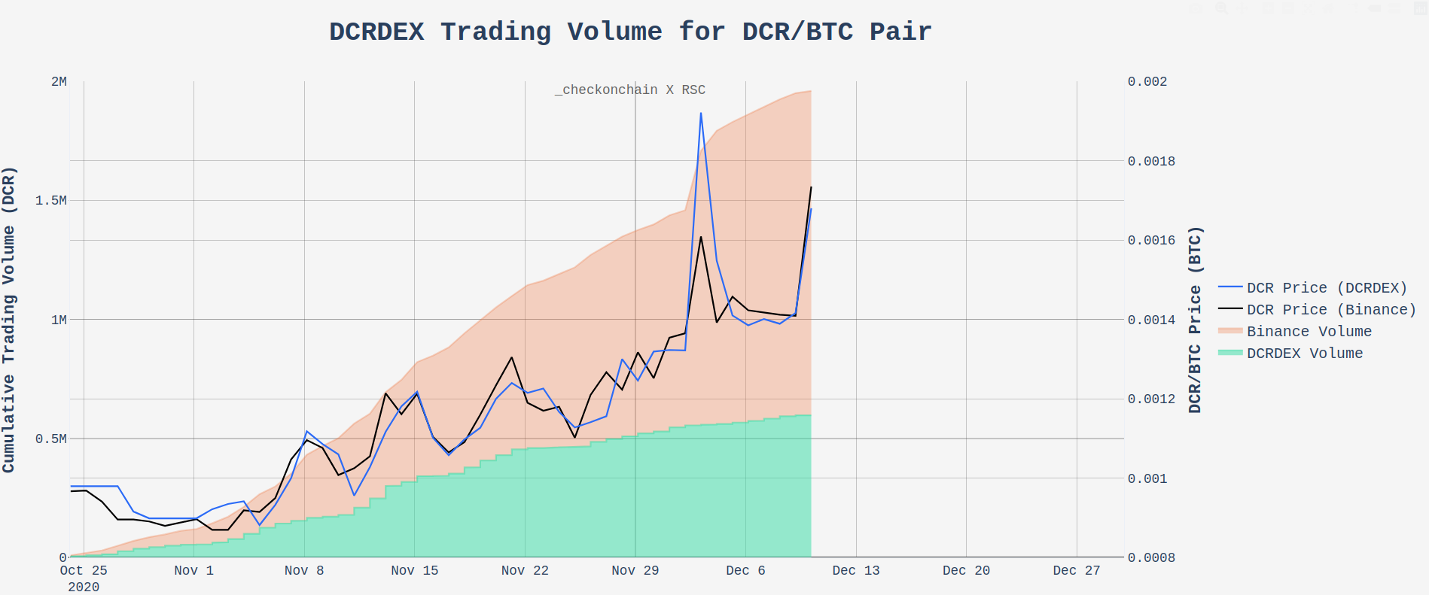
Binance: 1.96M DCR Over 48days
DCRDEX: 597.5k DCR
Over 48days
(30% of Binance)

Slide 5
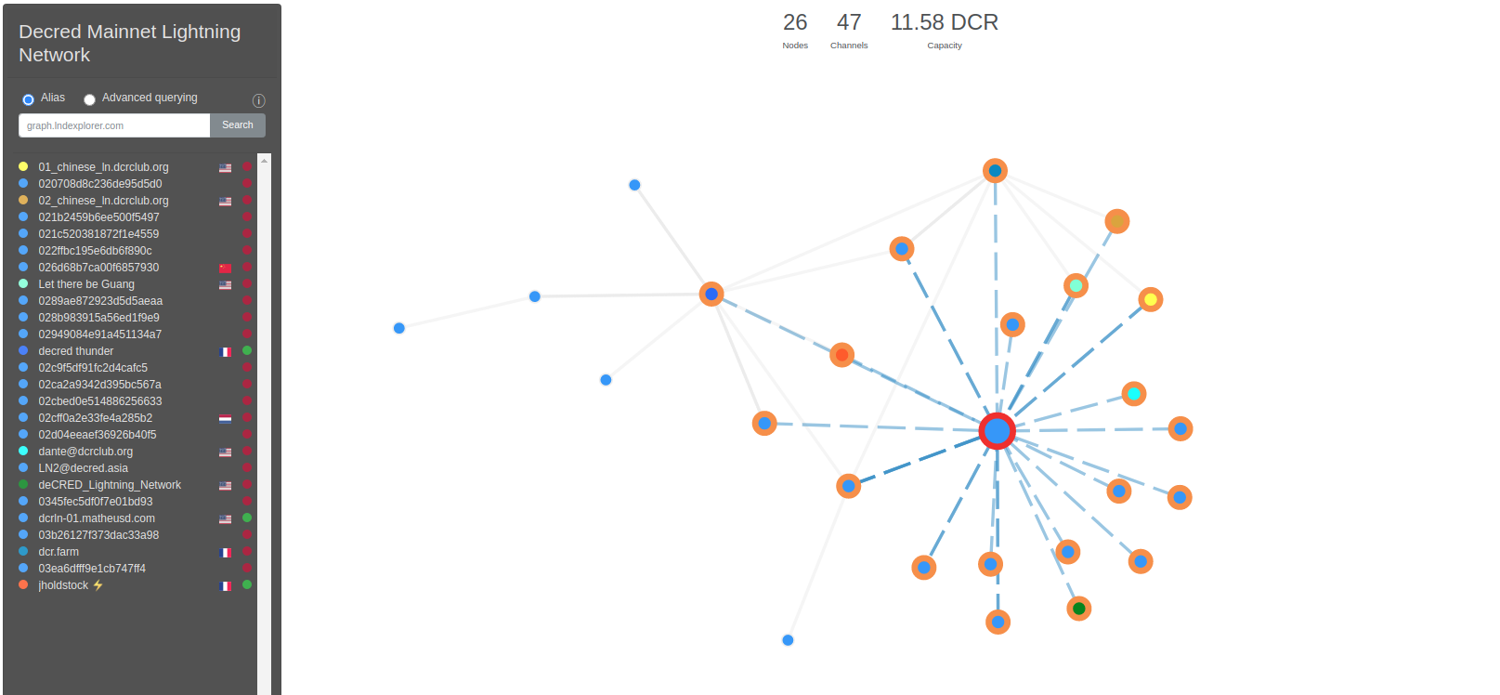
Decred Lightning Network
26 Nodes
47 Channels
11.58DCR Capacity

