Slide 1

Welcome to the CMS App Analytics Dashboard
After checking the user agreement on the Welcome page, you can interact with all the data from the CMS App!
There are four main panels for data analysis and visualization:
Quick Statistics: presents important statistics at a glance;
Data Explorer: allows the user to interact with the data to find the submissions from a specific timeframe, location, and type;
Submissions Map: offers another way to visualize the submissions data using geospatial technologies;
Raw Data: allows the user to download the anonymous submissions data used in the dashboard.

Slide 2
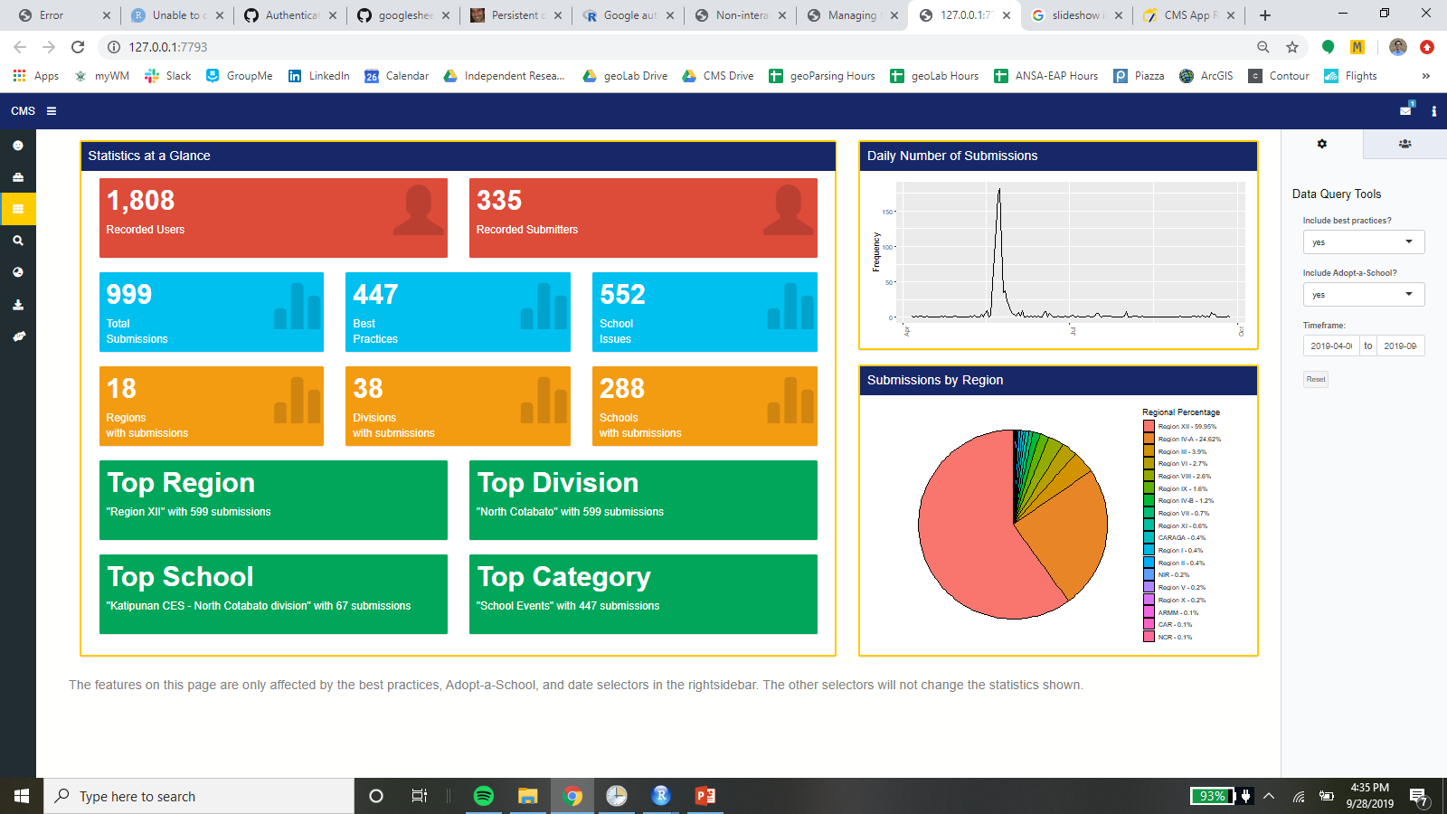
Quick Statistics
This page shows important statistics at a glance. In the right-hand sidebar (which can be opened by clicking on the “i” icon in the top-right of the screen), the user can query the data by date and choose whether to include best practice and Adopt-a-School activities.

Slide 3
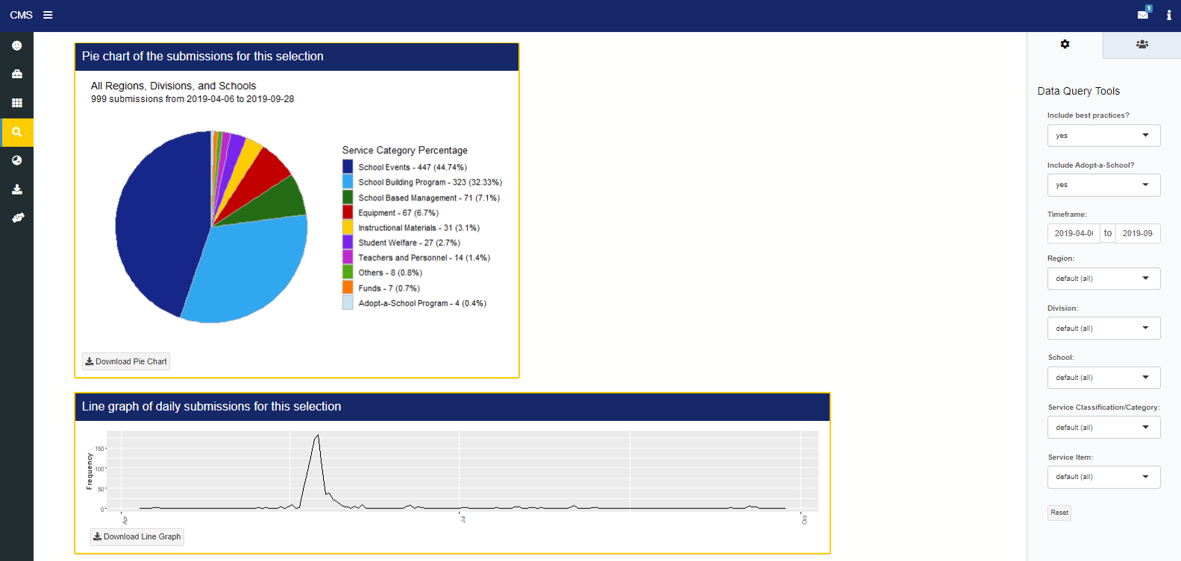
Data Explorer
This page allows users to interact with the submissions data more freely, including more queries by location (region, division, school) and type (category, item). The pie chart and timeline update automatically with the queries. The right-hand sidebar is set to be open on this page.

Slide 4
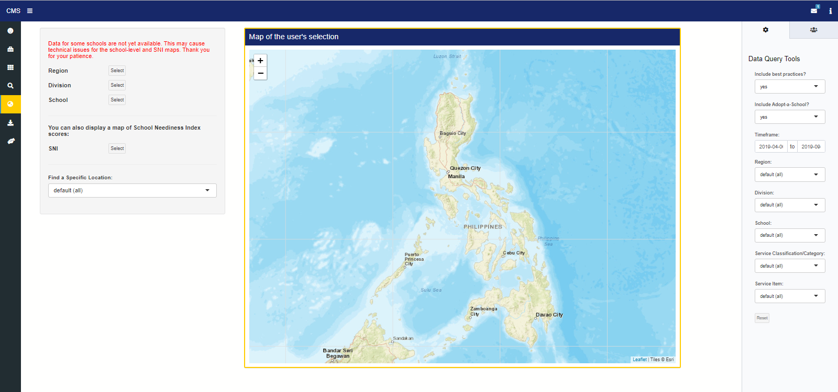
Submissions Map
This page maps the queried submissions data at the regional, divisional, and school-level (see the corresponding buttons). There is also an option to map the corresponding School Neediness Index values for schools. Users can use the drop-down menu on the left to zoom into a specific location once a map has been displayed by clicking on a button. Each time the user’s query is changed, they should re-click the correct map button.

Slide 5
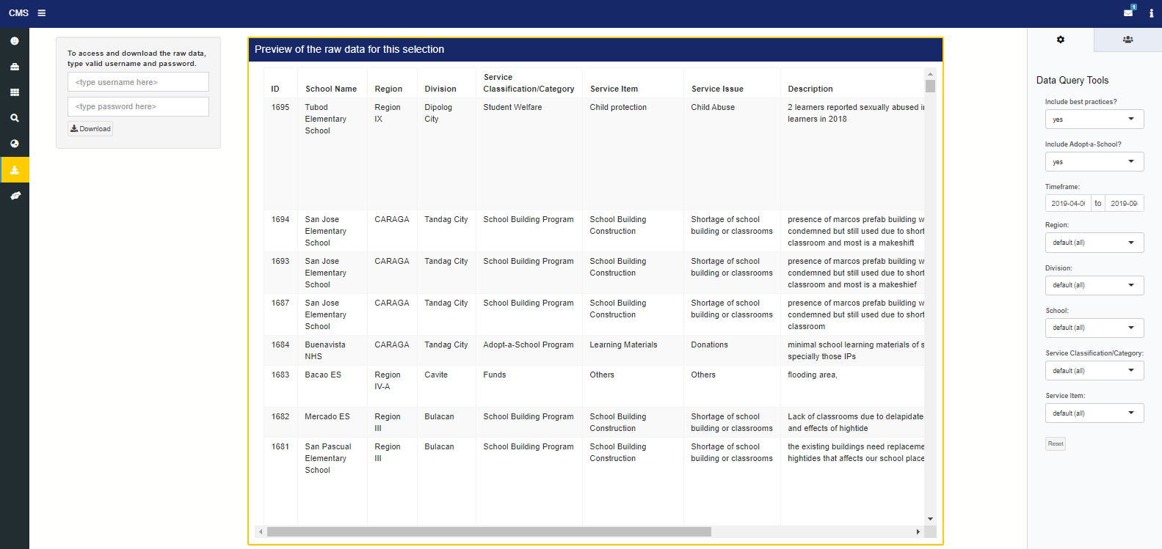
Raw Data
This page displays the queried submissions data. The same selectors are available on the right-hand side. On the left, the user can download the data (still password-protected at this point).

Slide 6
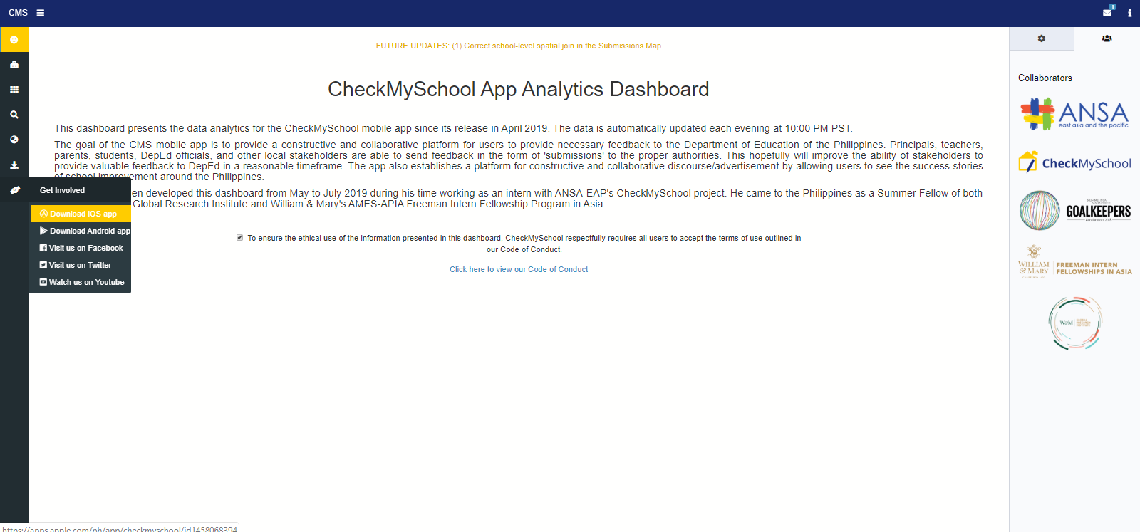
Download the CMS App and Find us on Social Media!
On any page, the bottom icon in the left tab expands to a drop-down menu of links to download our app and our social media websites. The user can also view our sponsors, funders, and collaborators by clicking the second icon (three people) in the right sidebar menu.

