Slide 1


Prototyping Delay-Aware
V2X Safe Communications
Hyunjae Lee
Jihun Lim

Slide 2
Contents
1
1st week
Setting up the environments we are working on
2
2nd week
Understanding basic Linux (Kernels, Network and so on)
3
3rd week
Designing how to evaluate and analyze performances
4
Feedback & Plans

Slide 3
1
1st week
Setting up the environments we are working on

Slide 4


1
1st week
Setting up the environments we are working on
CPU Model name:
Intel(R) Core(TM) i5-2400 CPU @ 3.10GHz
CPU(s) : 4
Architecture : x86_64
RAM : 8GiB System Memory
4GiB DIMM DDR3 Synchronous 1333 MHz
4GiB DIMM DDR3 Synchronous 1333 MHz
HardDisk : 500GB ST500DM002-1BD14
OS : Linux msdebian-pc 4.9.0-8-amd64
#1 SMP Debian 4.9.130-2(2018-10-27) x86_64 GNU/Linux
Host machine
Network card info :
description: Ethernet interface product: I211 Gigabit Network Connection vendor: Intel Corporation serial: 00:0d:b9:4c:c1:5c size: 1Gbit/s capacity: 1Gbit/s width: 32 bits clock: 33MHz
Board

Slide 5
1
1st week
Setting up the environments we are working on
We have two different kernels on the board
4.9.0-8-amd64 : Volunteer (Original one)
: 5.9 GHz + RT
2. 4.9.0-8-rc8-rt+ : Real time
: 5.9 GHz + RT

Slide 6
1
1st week
Setting up the environments we are working on
We created 3rd kernel for this specific model
4.9.0-8-amd64 : Volunteer (Original one)
: 5.9 GHz + RT
2. 4.9.0-8-rc8-rt+ : Real time
: 5.9 GHz + RT
3. 4.9.0-8-rc8-rt+ : Volunteer + 802.11p patched
: 5.9 GHz + RT

Slide 7
1
1st week
Setting up the environments we are working on
3. 4.9.0-8-rc8-rt+ : Volunteer + 802.11p patched
: 5.9 GHz + RT
First, we extracted the configuration file in the board to the host machine.
Then, we applied 802.11p patch and changed some configurations.
: Three features are revised
& in network support, check nl80211
& in network support, check mac option and check OCB
& in kernel hacking, uncheck bug reporting

Slide 8


1
1st week
Setting up the environments we are working on
Then, we transferred the kernel to the board
* Notable command
~/Kernel/linux $ make INSTALL_MOD_STRIP=1 modules_install
It let the compiled file be compressed without debug files
so that the size of .tgz file became small.
All detailed procedures are listed in the file

Slide 9
2
2nd week
Understanding basic Linux (Kernels, Network and so on)

Slide 10





2
2nd week
Understanding basic Linux (Kernels, Network and so on)
Scheduling
Network
Linux and Kernel

Slide 11


2
2nd week
Understanding basic Linux (Kernels, Network and so on)
Linux and Kernels

Slide 12


2
2nd week
Understanding basic Linux (Kernels, Network and so on)
Kernel preemption models
Voluntary Kernel Preemption
Fully Preemptible Kernel (Real time)

Slide 13

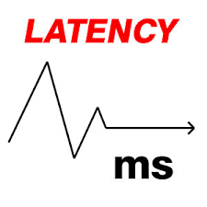

2
2nd week
Understanding basic Linux (Kernels, Network and so on)
Voluntary Kernel Preemption
The choice of preemption model is a balance
between responsiveness (latency) and
scheduler overhead.

Slide 14
2
2nd week
Understanding basic Linux (Kernels, Network and so on)
Voluntary Kernel Preemption
Lower latency requires more frequent
opportunities for task switches which results
in higher overhead

Slide 15
2
2nd week
Understanding basic Linux (Kernels, Network and so on)
2. Fully Preemptible Kernel (Real time)
Real-time model is not only additional
preemption models as they also add a number of
modifications that further improve
the worst-case latency.

Slide 16
2
2nd week
Understanding basic Linux (Kernels, Network and so on)
Scheduling under Linux
Focusing on..
1. SCHED_FIFO
2. SCHED_RR
3. SCHED_OTHER

Slide 17
2
2nd week
Understanding basic Linux (Kernels, Network and so on)
Scheduling under Linux
SCHED_FIFO:
Static priority > 0 : it when SCHED_FIFO threads becomes runnable,
it will always immediately preempt any currently running other threads
by being run through other policies.
No time slicing

Slide 18
2
2nd week
Understanding basic Linux (Kernels, Network and so on)
Scheduling under Linux
SCHED_RR:
A simple adaptation of SCHED_FIFO for lower priority activities.
Each thread is allowed to run only for a maximum time quantum.

Slide 19
2
2nd week
Understanding basic Linux (Kernels, Network and so on)
Scheduling under Linux
In a real-time Linux,
the SCHED_FIFO and SCHED_RR behaviors are more efficient
because of the use of a fully preemptible kernel.

Slide 20
2
2nd week
Understanding basic Linux (Kernels, Network and so on)
Network

Slide 21
2
2nd week
Understanding basic Linux (Kernels, Network and so on)
Ad-hoc
Virtual interface and monitor
Infra
structure
Virtual access point
OCB :
Outside context of a BSS
WLAN : Wireless local area network
Wireless distribution system
Mesh

Slide 22
2
2nd week
Understanding basic Linux (Kernels, Network and so on)
Module
In Moduler Architecture,
We can plug and unplug the modules
That we want to use or not to use
Linux Kernel
Module
Moduler Architecture

Slide 23
2
2nd week
Understanding basic Linux (Kernels, Network and so on)
Module
To use modules in Linux,
We have to follow below steps
Install module
Configure module
Use module
Linux Kernel

Slide 24
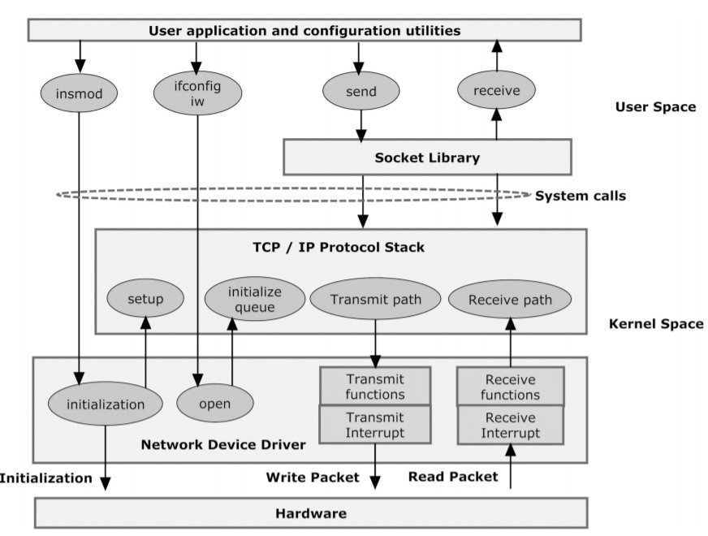
2
2nd week
Understanding basic Linux (Kernels, Network and so on)
1
2
3
To use modules in Linux,
We have to follow below steps
Install module
Configure module
Use module

Slide 25
2
2nd week
Understanding basic Linux (Kernels, Network and so on)
<the WLAN environment>

Slide 26
2
2nd week
Understanding basic Linux (Kernels, Network and so on)
WLAN
(ath9k)
To use WLAN(ath9k) in linux,
We have to follow below steps
Install module
- built-in module
Configure module
Use module
Linux Kernel

Slide 27
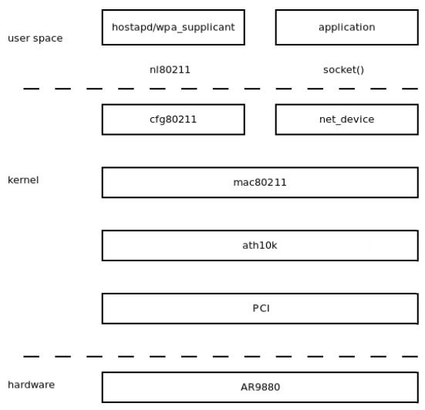
2
2nd week
Understanding basic Linux (Kernels, Network and so on)
2
3
To use WLAN(ath9k) in linux,
We have to follow below step
Install module
- built-in module
Configure module
Use module

Slide 28
2
2nd week
Understanding basic Linux (Kernels, Network and so on)
<Configure module>

Slide 29
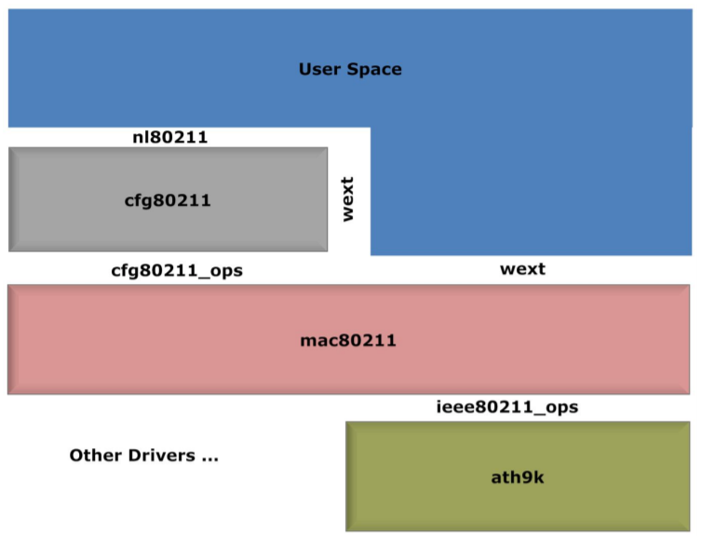
2
2nd week
Understanding basic Linux (Kernels, Network and so on)
In Configure module part,
Nl80211
Cfg80211
Mac80211
Ath9k

Slide 30
2
2nd week
Understanding basic Linux (Kernels, Network and so on)
cfg80211
Device registration
Regularity enforcement
Station management
Key management
Mesh management
Virtual interface management
Scanning

Slide 31
2
2nd week
Understanding basic Linux (Kernels, Network and so on)
cfg80211
Device registration
Registration the device
saving the environment variables
(Band, Channel, Bit rate, High throughput capabilities, Supported interface modes …)

Slide 32
2
2nd week
Understanding basic Linux (Kernels, Network and so on)
cfg80211
Regularity enforcement
Ensure during the registration of cfg80211
That only the specified frequency channels permitted
For that given country will be enabled

Slide 33
2
2nd week
Understanding basic Linux (Kernels, Network and so on)
User
Nl80211 have roles
to help user and cfg80211 to communicate
nl80211
cfg80211

Slide 34
2
2nd week
Understanding basic Linux (Kernels, Network and so on)
<Use module>

Slide 35
2
2nd week
Understanding basic Linux (Kernels, Network and so on)
SoftMAC
(mac80211)
Hardware Dependant
(ath9k)
Protocol module
The developer can access
to modify the code in the area
Hardware Dependant module
The access is not easy
to modify the code in the area

Slide 36
2
2nd week
Understanding basic Linux (Kernels, Network and so on)
Mac 80211’s roles
Change the format to 802.11
Add the buffer and header according to the Protocol
Send the message to lower layer
Ath9k’s roles
Add the buffer and header
Send the message to hardware
Request interrupt

Slide 37
2
2nd week
Understanding basic Linux (Kernels, Network and so on)
Mac 80211’s roles
Change the format to 802.3 + LLC
Using the Protocol header, do Decryption and Defragmentation
Send the message to upper layer
Ath9k’s roles
Take the message
Request interrupt
Send the message and status information to upper layer

Slide 38
3
3rd week
Designing how to evaluate and analyze performances

Slide 39
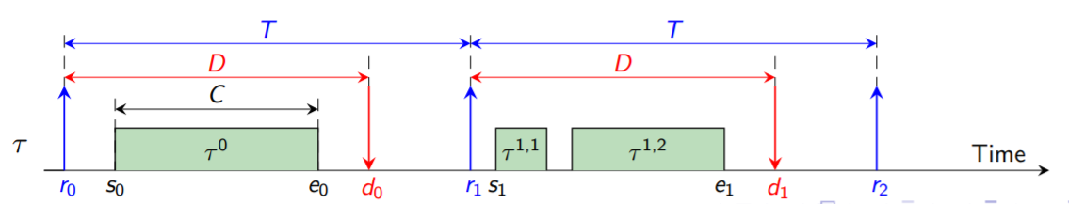
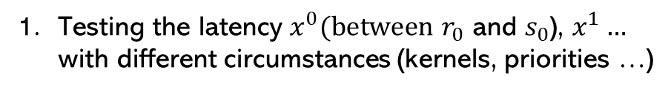
3rd week
3
2nd week
2
Designing how to evaluate and analyze performances
Understanding basic Linux (Kernels, Network and so on)
Testing the latency $x^{0}(between$ $r_{0}$ and $s_{0}$), $x^{1}…$
with different circumstances (kernels, priorities …)
C : worst case execution time
D : relative deadline
T : period

Slide 40
3rd week
3
2nd week
2
Designing how to evaluate and analyze performances
Understanding basic Linux (Kernels, Network and so on)
Testing the latency $x^{0}(between$ $r_{0}$ and $s_{0}$), $x^{1}…$
with different circumstances (kernels, priorities …)
Considerations,
Volunteer or Real time kernel
SCHED_OTHER, SCHED_FIFO and SCHED_RR
Different priority
Stressful situation

Slide 41
3rd week
3
2nd week
2
Designing how to evaluate and analyze performances
Understanding basic Linux (Kernels, Network and so on)
Testing the latency $x^{0}(between$ $r_{0}$ and $s_{0}$), $x^{1}…$
with different circumstances (kernels, priorities …)
<10 scenarios>
SCHED_OTHER
SCHED_FIFO
SCHED_RR
Volunteer
Lower pr, Higher pr
Lower pr, Higher pr
SCHED_OTHER
SCHED_FIFO
SCHED_RR
Real time
Lower pr, Higher pr
Lower pr, Higher pr

Slide 42
3rd week
3
2nd week
2
Designing how to evaluate and analyze performances
Understanding basic Linux (Kernels, Network and so on)
Testing the latency $x^{0}(between$ $r_{0}$ and $s_{0}$), $x^{1}…$
with different circumstances (kernels, priorities …)
Condition : Voluntary Kernel in stressful situation
Voluntary Kernel | Min | Act | Avg | Max
SCHEDULE_OTHER | 61 | 80 | 90 | 4487
SCHEDULE_FIFO_PRIORITY_LAST | 11 | 28 | 160 | 49996
SCHEDULE_FIFO_PRIORITY_FIRST | 1525 | 28413785 | 16469381 | 41141307
SCHEDULE_RR_PRIORITY_LAST | 11 | 41 | 130 | 49734
SCHEDULE_RR_PRIORITY_30 | 1000000 | 70168555 | 70168555 | 70168555

Slide 43
3rd week
3
2nd week
2
Designing how to evaluate and analyze performances
Understanding basic Linux (Kernels, Network and so on)
Testing the latency $x^{0}(between$ $r_{0}$ and $s_{0}$), $x^{1}…$
with different circumstances (kernels, priorities …)
Condition : Real-time Kernel in stressful situation
Real-Time Kernel | Min | Act | Avg | Max
SCHEDULE_OTHER | 17 | 90 | 80 | 4039
SCHEDULE_FIFO_PRIORITY_LAST | 10 | 30 | 28 | 2484
SCHEDULE_FIFO_PRIORITY_FIRST | 10 | 577 | 556 | 52896
SCHEDULE_RR_PRIORITY_LAST | 9 | 20 | 28 | 3822
SCHEDULE_RR_PRIORITY_FIRST | 10 | 191 | 549 | 41364

Slide 44
3rd week
3
2nd week
2
Designing how to evaluate and analyze performances
Understanding basic Linux (Kernels, Network and so on)
Testing the latency $x^{0}(between$ $r_{0}$ and $s_{0}$), $x^{1}…$
with different circumstances (kernels, priorities …)
1
Voluntary Kernel | Avg
SCHEDULE_OTHER | 90
SCHEDULE_FIFO_PRIORITY_LAST | 160
SCHEDULE_FIFO_PRIORITY_FIRST | 16469381
SCHEDULE_RR_PRIORITY_LAST | 130
SCHEDULE_RR_PRIORITY_30 | 70168555
Real-Time Kernel | Avg
SCHEDULE_OTHER | 80
SCHEDULE_FIFO_PRIORITY_LAST | 28
SCHEDULE_FIFO_PRIORITY_FIRST | 556
SCHEDULE_RR_PRIORITY_LAST | 28
SCHEDULE_RR_PRIORITY_FIRST | 549
2
3

Slide 45
3rd week
3
2nd week
2
Designing how to evaluate and analyze performances
Understanding basic Linux (Kernels, Network and so on)
Testing the latency $x^{0}(between$ $r_{0}$ and $s_{0}$), $x^{1}…$
with different circumstances (kernels, priorities …)
1
In No priority situation, there are no big difference
2
In High priority situation, there are big difference
3
In Low priority situation, there are Big difference

Slide 46
3rd week
3
2nd week
2
Designing how to evaluate and analyze performances
Understanding basic Linux (Kernels, Network and so on)
2. Understanding basic knowledge to design
Latency is the speed of traffic on your network and is always expressed
in milliseconds (ms).
The most common measure of latency is called ‘round trip time’ (RTT).
As the name suggests, this is the time it takes for a packet to get from
one point on the network to another.
The alternative measurement is called ‘time to first byte’ (TTFB).
This records the time difference between the moment the first part of
a packet left one point on the network and the time that it arrived
at the destination.
RTT is used more frequently than TTFB because it can be run from one location
and doesn’t require special data collection software to be installed
on the remote destination.

Slide 47
3rd week
3
2nd week
2
Designing how to evaluate and analyze performances
Understanding basic Linux (Kernels, Network and so on)
2. Understanding basic knowledge to design
A typical Ping execution will send 32 bytes of data to a given destination and
record the time that a response arrived back.
The latency is expressed as the round trip time that includes both the transfer time
for the test packet and the response packet. That time is shown in milliseconds.
jitter is a measure of the variation of the arrival rate of packets in a stream

Slide 48
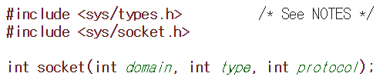
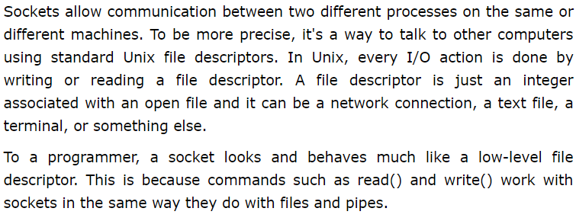
3rd week
3
2nd week
2
Designing how to evaluate and analyze performances
Understanding basic Linux (Kernels, Network and so on)
3. Sockets

Slide 49

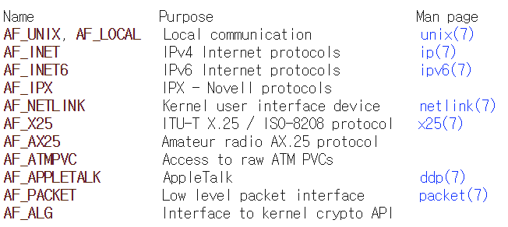
3rd week
3
2nd week
2
Designing how to evaluate and analyze performances
Understanding basic Linux (Kernels, Network and so on)
3. Sockets (int domain, int type, int protocol)

Slide 50
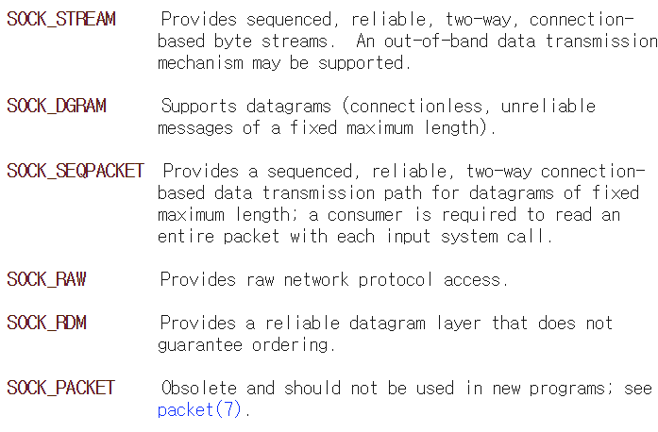
3rd week
3
2nd week
2
Designing how to evaluate and analyze performances
Understanding basic Linux (Kernels, Network and so on)
3. Sockets (int domain, int type, int protocol)

Slide 51
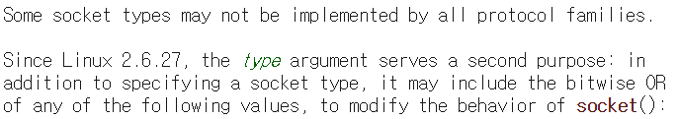
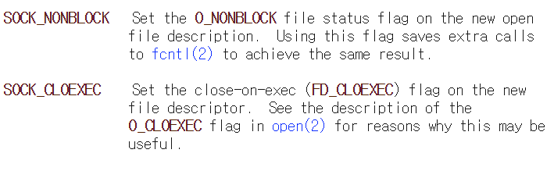
3rd week
3
2nd week
2
Designing how to evaluate and analyze performances
Understanding basic Linux (Kernels, Network and so on)
3. Sockets (int domain, int type, int protocol)

Slide 52
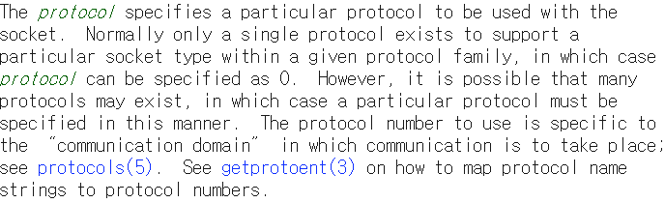
3rd week
3
2nd week
2
Designing how to evaluate and analyze performances
Understanding basic Linux (Kernels, Network and so on)
3. Sockets (int domain, int type, int protocol)

Slide 53
Thank you

