Slide 1


Prototyping Delay-Aware
V2X Safe Communications
Hyunjae Lee
Jihun Lim

Slide 2
Contents
1
4th week
Sockets, Summarizations of some papers
2
5th week
Sockets in wireless network
3
6th week
Testing and analyzing
4
Feedback & Plans

Slide 3
1
4th week
Sockets, Summarizations of some papers

Slide 4

1
4th week
Sockets, Summarizations of some papers
1. Sockets
AF_INET
AF_PACKET
SOCK_DGRAM
SOCK_STREAM
SOCK_RAW
TCP
UDP
ETH_*
AF_INET cases)
AF_PACKET cases)
Low level packet interface

Slide 5
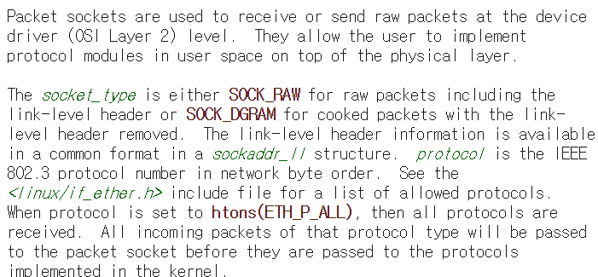
1
4th week
Sockets, Summarizations of some papers
1. Sockets

Slide 6
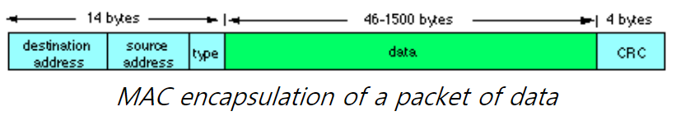
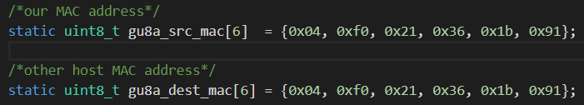
1
4th week
Sockets, Summarizations of some papers
1. Sockets

Slide 7
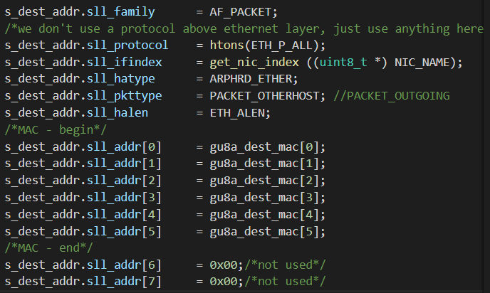
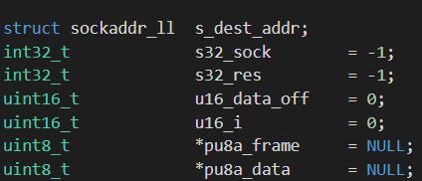
1
4th week
Sockets, Summarizations of some papers
1. Sockets

Slide 8
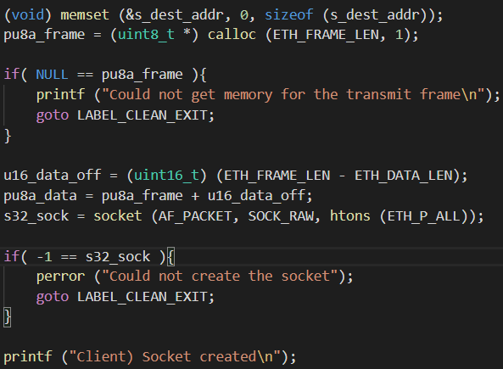
1
4th week
Sockets, Summarizations of some papers
1. Sockets

Slide 9
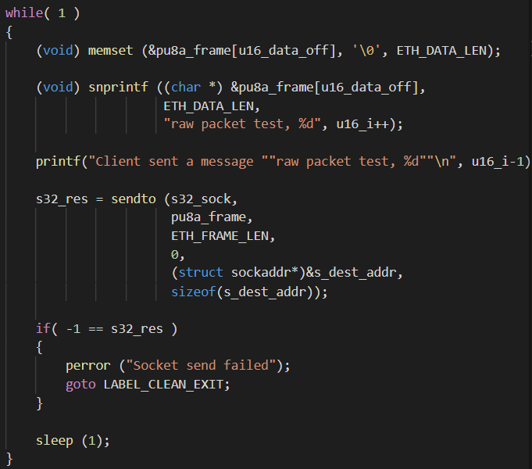
1
4th week
Sockets, Summarizations of some papers
1. Sockets
Client (sender) main function
Initialize the frame
Set up date in the frame
Do ‘Sendto’

Slide 10
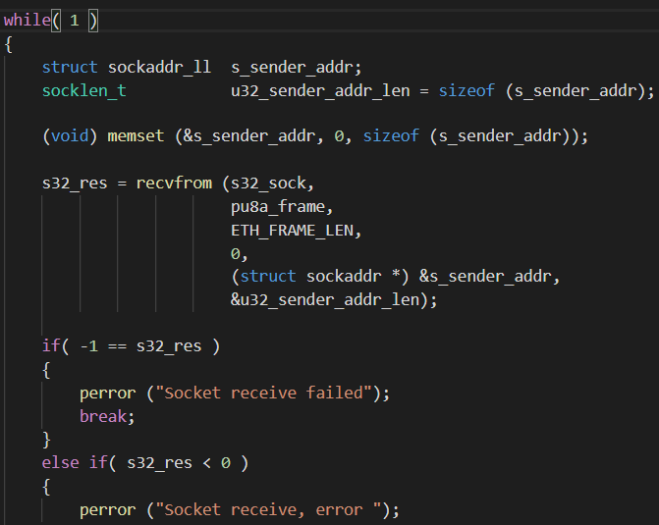
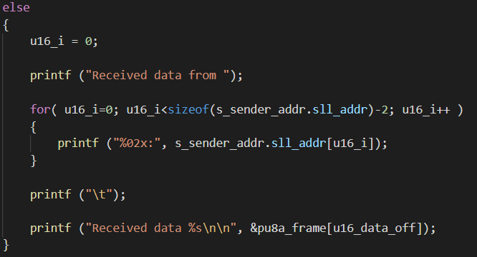
1
4th week
Sockets, Summarizations of some papers
1. Sockets
Server (receiver) main function
Initialize sender’s info by sockaddr_ll
Do ‘recvfrom’
Print out the message (data)

Slide 11
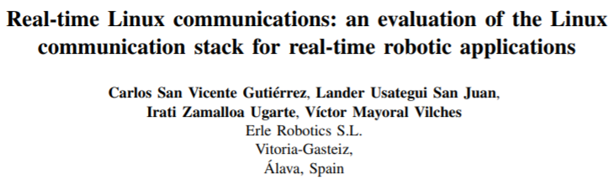
1
4th week
Sockets, Summarizations of some papers
2. 1st paper we summarized

Slide 12
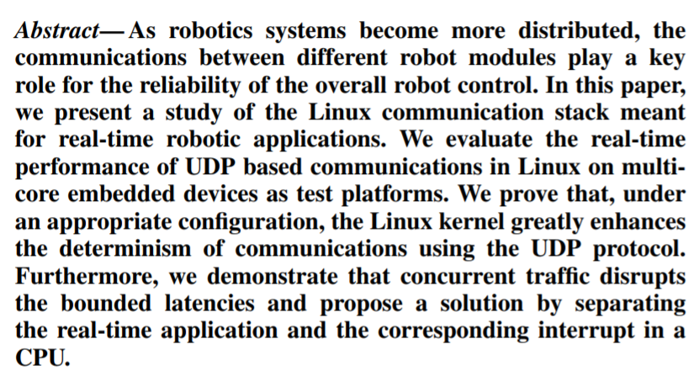
1
4th week
Sockets, Summarizations of some papers
2. [Real-time Linux communications] - Abstract

Slide 13
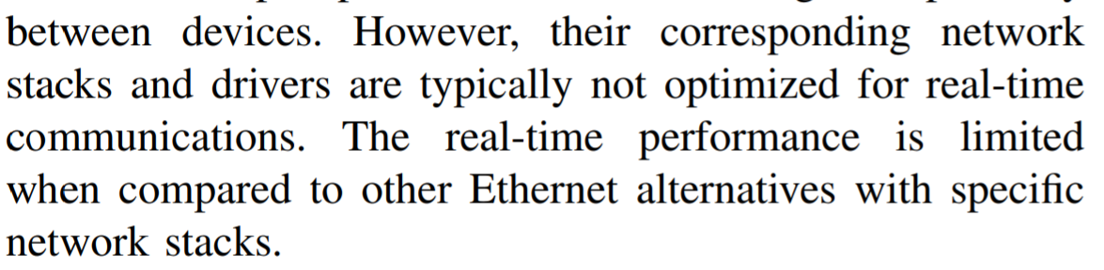
1
4th week
Sockets, Summarizations of some papers
2. [Real-time Linux communications] - Introduction
In real-time communications, manufactures selected field buses instead of Ethernet.
The arrival of TSN(time sensitive networking) Ethernet was enhanced
currently several communications based on Ethernet (RT, DDS and so on)

Slide 14
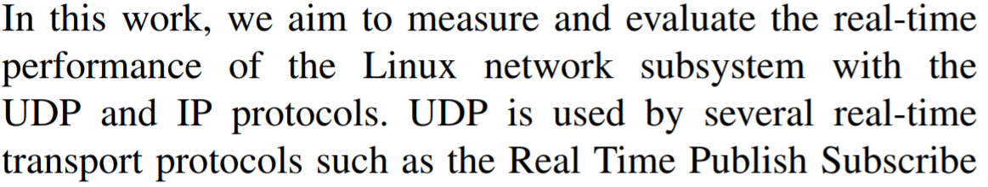
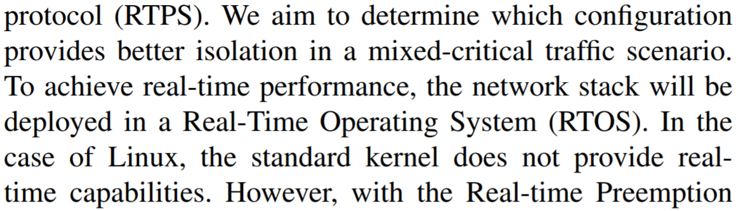
1
4th week
Sockets, Summarizations of some papers
2. [Real-time Linux communications] - Introduction

Slide 15
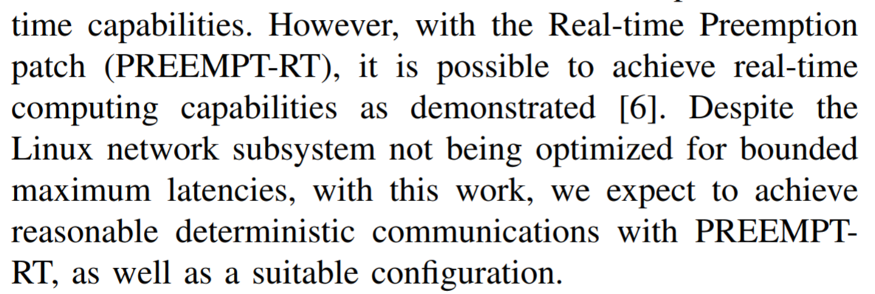
1
4th week
Sockets, Summarizations of some papers
2. [Real-time Linux communications] - Introduction

Slide 16
1
4th week
Sockets, Summarizations of some papers
2. [Real-time Linux communications] – Related work

Slide 17
1
4th week
Sockets, Summarizations of some papers
2. [Real-time Linux communications] – Related work

Slide 18
2
5th week
Sockets in wireless network

Slide 19
2
5th week
Sockets in wireless network
Main goal of this week : Improving the code to evaluate latency
Configuration
Makefile
Client
Server

Slide 20
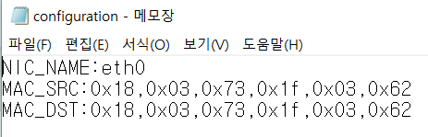
2
5th week
Sockets in wireless network
Configuration
Makefile
Client
Server

Slide 21
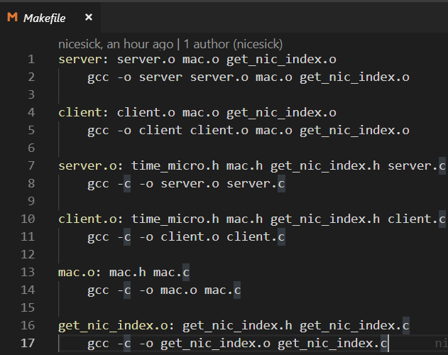
2
5th week
Sockets in wireless network
Configuration
Makefile
Client
Server

Slide 22
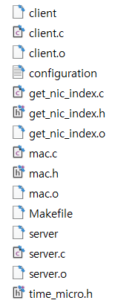
2
5th week
Sockets in wireless network
Configuration
$make client
$make server
$sudo ./client
$sudo ./server
Makefile
Client
Server

Slide 23
2
5th week
Sockets in wireless network
How we evaluate the latency between client and server

Slide 24
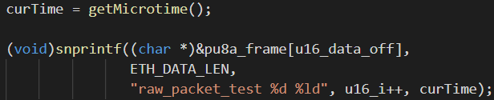
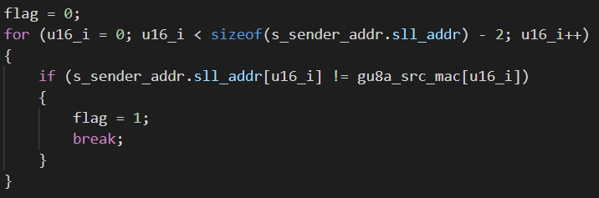
2
5th week
Sockets in wireless network
We sent the data with
the time that checked
just before.
We created a flag to check
if the sender’s MAC addr is
the designated one or not.
If they are different, it means
the sender is another one.

Slide 25
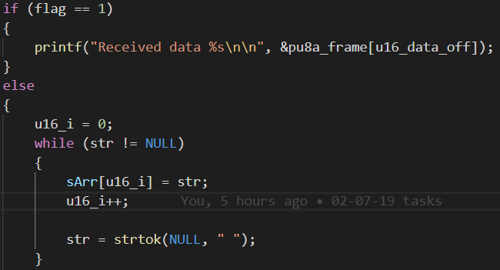
2
5th week
Sockets in wireless network
If flag is 1, we just print out.
Otherwise (flag is 0), we need to split
the data by looking at space.
Then,
sArr[0] = raw_packet_test
sArr[1] = the value of u16_i
sArr[2] = the value of curTime we sent

Slide 26
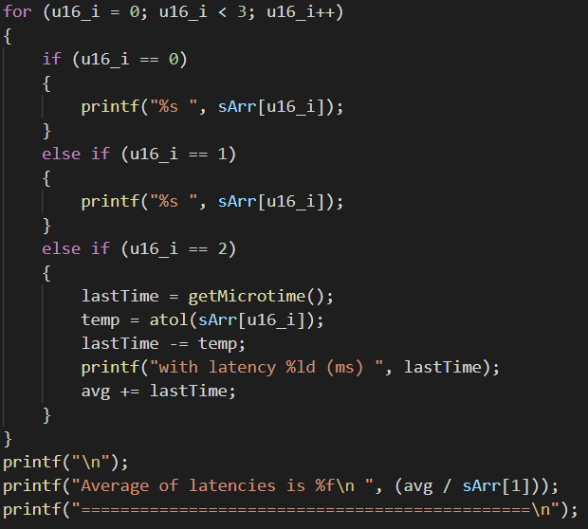
2
5th week
Sockets in wireless network
The last one (sArr[2]) would be a parameter
for our latency.
So, we get another time (lastTime) that
represents the time as soon as the data
decodes.
Then, we just subtract them to get latency
and average of it

Slide 27
2
5th week
Sockets in wireless network
Simple test results

Slide 28
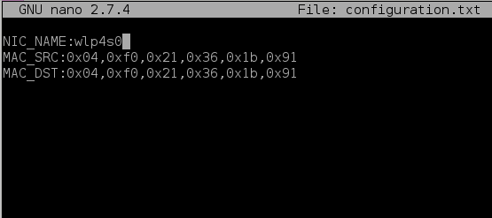
2
5th week
Sockets in wireless network

Slide 29
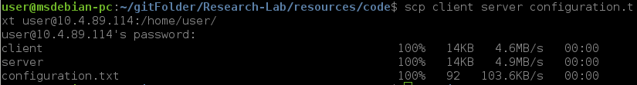
2
5th week
Sockets in wireless network

Slide 30
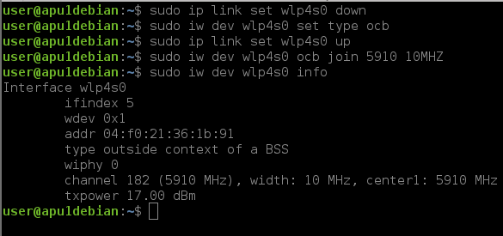
2
5th week
Sockets in wireless network

Slide 31
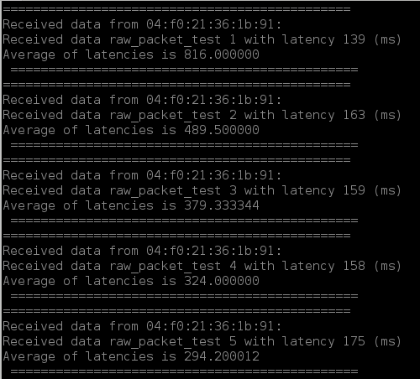
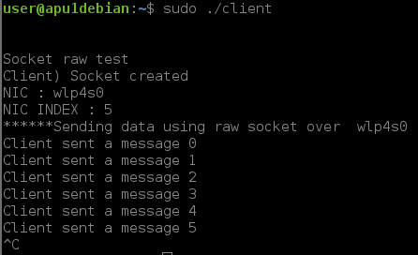
2
5th week
Sockets in wireless network

Slide 32
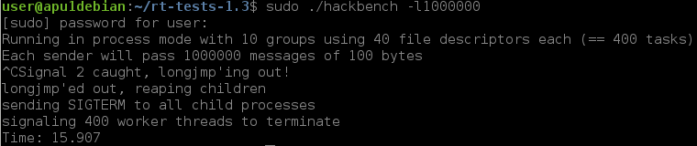
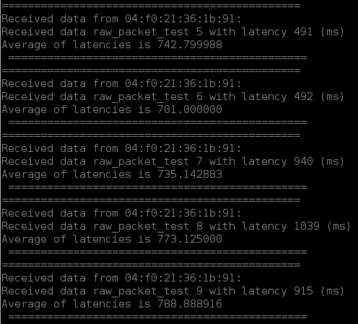
2
5th week
Sockets in wireless network
With a stressful condition

Slide 33
3
6th week
Testing and analyzing

Slide 34
6th week
3
2nd week
2
Testing and analyzing
Understanding basic Linux (Kernels, Network and so on)

Slide 35
Thank you

