Slide 1


Prototyping Delay-Aware
V2X Safe Communications
Hyunjae Lee
Jihun Lim

Slide 2
Contents
1
4th week
Sockets, Summarizations of some papers
2
5th week
Sockets in wireless network
3
6th week
Testing and analyzing
4
Feedback & Plans

Slide 3
1
4th week
Sockets, Summarizations of some papers

Slide 4

1
4th week
Sockets, Summarizations of some papers
1. Sockets
AF_INET
AF_PACKET
SOCK_DGRAM
SOCK_STREAM
SOCK_RAW
TCP
UDP
ETH_*
AF_INET cases)
AF_PACKET cases)
Low level packet interface

Slide 5
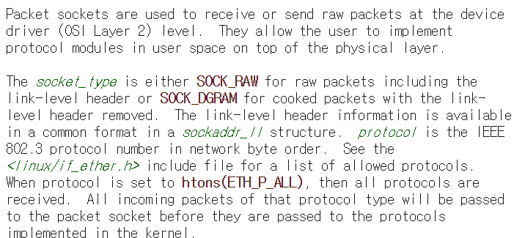
1
4th week
Sockets, Summarizations of some papers
1. Sockets

Slide 6
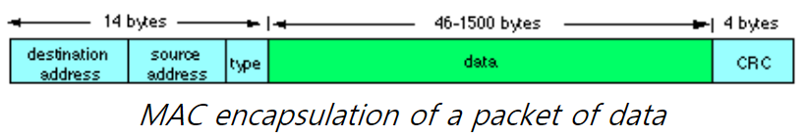
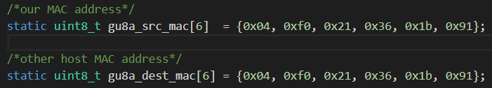
1
4th week
Sockets, Summarizations of some papers
1. Sockets

Slide 7
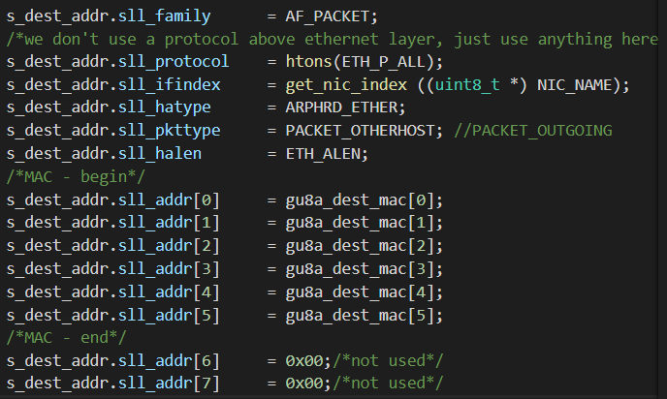
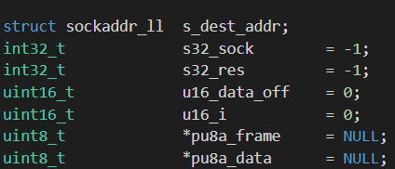
1
4th week
Sockets, Summarizations of some papers
1. Sockets

Slide 8
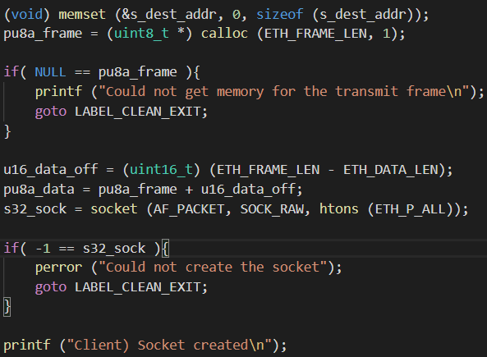
1
4th week
Sockets, Summarizations of some papers
1. Sockets

Slide 9
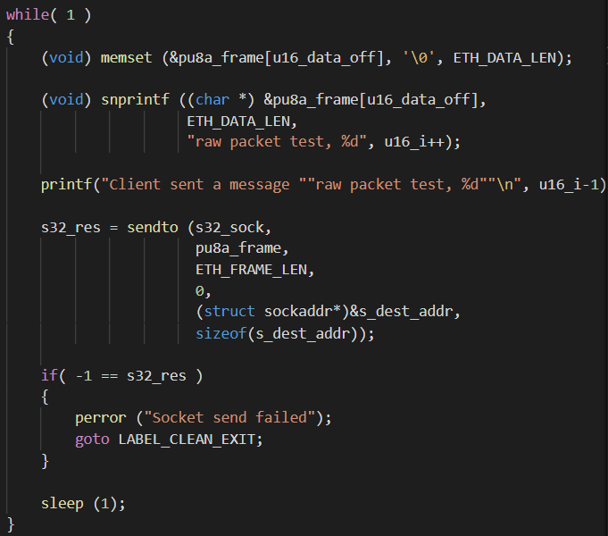
1
4th week
Sockets, Summarizations of some papers
1. Sockets
Client (sender) main function
Initialize the frame
Set up date in the frame
Do ‘Sendto’

Slide 10
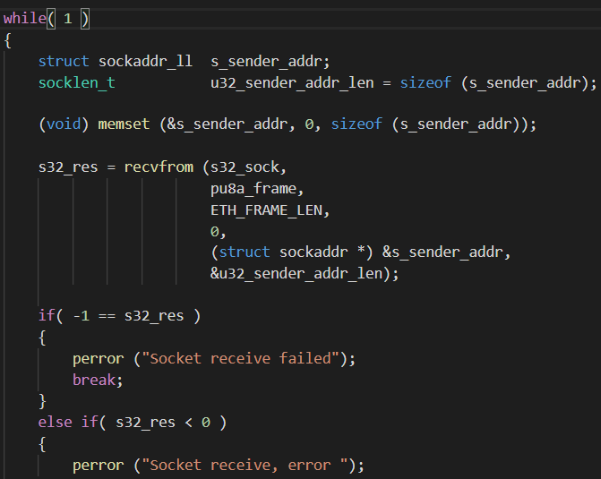
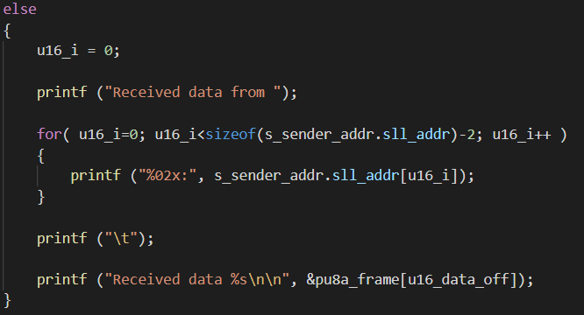
1
4th week
Sockets, Summarizations of some papers
1. Sockets
Server (receiver) main function
Initialize sender’s info by sockaddr_ll
Do ‘recvfrom’
Print out the message (data)

Slide 11
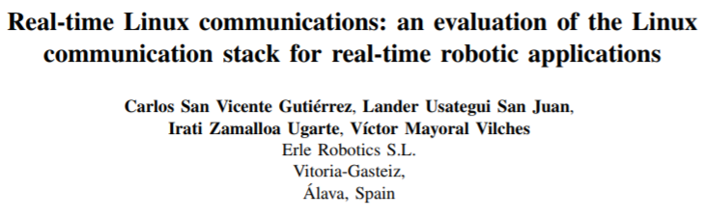
1
4th week
Sockets, Summarizations of some papers
2. 1st paper we summarized

Slide 12
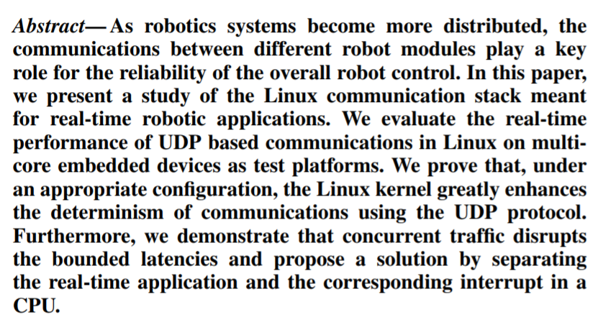
1
4th week
Sockets, Summarizations of some papers
2. [Real-time Linux communications] - Abstract

Slide 13
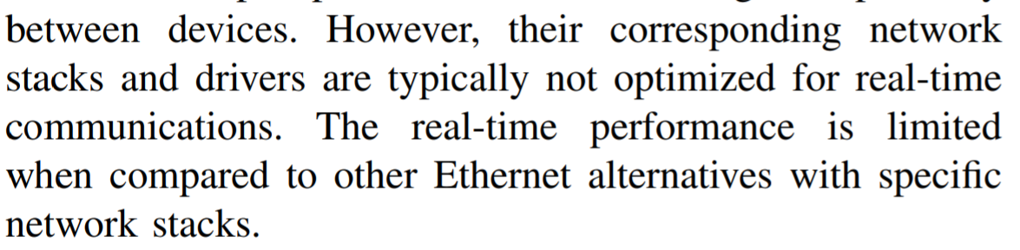
1
4th week
Sockets, Summarizations of some papers
2. [Real-time Linux communications] - Introduction
In real-time communications, manufactures selected field buses instead of Ethernet.
The arrival of TSN(time sensitive networking) Ethernet was enhanced
currently several communications based on Ethernet (RT, DDS and so on)

Slide 14
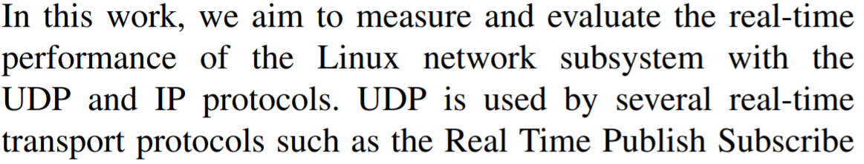
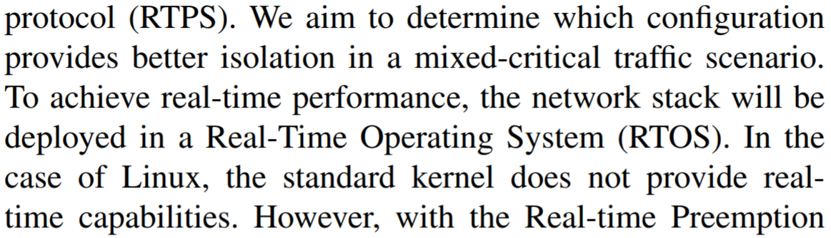
1
4th week
Sockets, Summarizations of some papers
2. [Real-time Linux communications] - Introduction

Slide 15
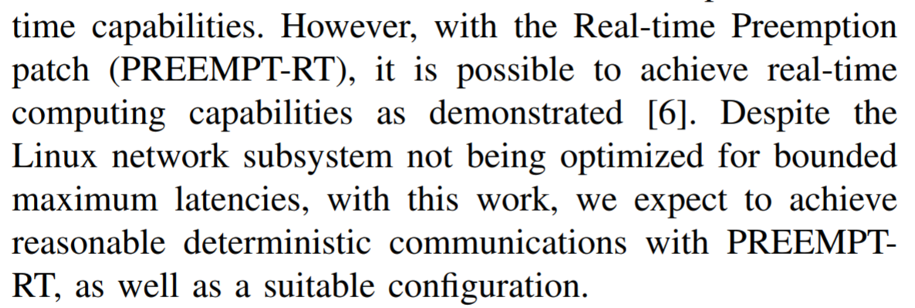
1
4th week
Sockets, Summarizations of some papers
2. [Real-time Linux communications] - Introduction

Slide 16
1
4th week
Sockets, Summarizations of some papers
2. [Real-time Linux communications] - Introduction
Field Bus
Ethernet
Commander
Commander
Point to Point
Ethernet Protocol
Device
Device

Slide 17
1
4th week
Sockets, Summarizations of some papers
2. [Real-time Linux communications] - Introduction
Field Bus
- Strongness
1. Execute RT Performance
Commander
Point to Point
- Weakness
Too many protocol
to share with other device
Device

Slide 18

1
4th week
Sockets, Summarizations of some papers
2. [Real-time Linux communications] - Introduction
Commander
Driver
Because of many protocols,
The more complicated, The more difficulted
Driver

Slide 19
1
4th week
Sockets, Summarizations of some papers
2. [Real-time Linux communications] - Introduction
Ethernet
- Strongness
There is protocols
to share with other device
Commander
Ethernet Protocol
- Weakness
1. Can’t meet the Deterministic
Device

Slide 20
1
4th week
Sockets, Summarizations of some papers
2. [Real-time Linux communications] - Introduction
Ethernet
- Strongness
There is protocols
to share with other device
Commander
Time
Sensitive
Networking
Ethernet Protocol
Time Sensitive Networking(TSN)
- Making Ethernet more deterministic
- Weakness
1. Can’t meet the Deterministic
Device

Slide 21
1
4th week
Sockets, Summarizations of some papers
2. [Real-time Linux communications] - Introduction
RT Kernel
Driver
RT Kernel + Configuration and Ethernet Protocol
might meet the robotics’ requirements
> The Goal : Evaluate and Analysis
RT Kernel and Ethernet Protocol
can meet the robotics’ requirements
Driver

Slide 22
1
4th week
Sockets, Summarizations of some papers
2. [Real-time Linux communications] – Setting up RT communications in linux
To use Linux for RT applications,
Use Tool
Use Library
Use Patch

Slide 23
1
4th week
Sockets, Summarizations of some papers
2. [Real-time Linux communications] – Setting up RT communications in linux
To use Linux for RT applications,
Use Tool
Linux
Embedded RTOS
Highest Level Commands
Critical Tasks

Slide 24
1
4th week
Sockets, Summarizations of some papers
2. [Real-time Linux communications] – Setting up RT communications in linux
To use Linux for RT applications,
2. Use Library
Linux
Tasks that over the deadline
Cobalt

Slide 25
1
4th week
Sockets, Summarizations of some papers
2. [Real-time Linux communications] – Setting up RT communications in linux
To use Linux for RT applications,
3. Use patch
RT Kernel
Without need Tool or Library,
Just using the RT Patch,
We can get RT capabilities

Slide 26
1
4th week
Sockets, Summarizations of some papers
2. [Real-time Linux communications] – Setting up RT communications in linux
Linux Networking Architecture : Linux Traffic Control
Linux Traffic Control
(TC)
Network Protocols Layers
Ingress
Qdisc
Egress
Qdisc
Control Qdisc
Network Interface Ring Buffer??

Slide 27
1
4th week
Sockets, Summarizations of some papers
2. [Real-time Linux communications] – Setting up RT communications in linux
Linux Networking Architecture : Linux Traffic Control
- Roles
Shaping
Scheduling
Filter
Egress
Qdisc

Slide 28
1
4th week
Sockets, Summarizations of some papers
2. [Real-time Linux communications] – Setting up RT communications in linux
Linux Networking Architecture : Linux Traffic Control
- Roles
Shaping
If there are delays of sending the packets,
To avoid traffic congestion, control the traffic
Egress
Qdisc

Slide 29
1
4th week
Sockets, Summarizations of some papers
2. [Real-time Linux communications] – Setting up RT communications in linux
Linux Networking Architecture : Linux Traffic Control
- Roles
2. Scheduling
Select which packet will be sent next
Egress
Qdisc

Slide 30
1
4th week
Sockets, Summarizations of some papers
2. [Real-time Linux communications] – Setting up RT communications in linux
Linux Networking Architecture : Linux Traffic Control
- Roles
3. Filter
Block unauthenticated packets??
Or
Classify the packets to each class
Egress
Qdisc

Slide 31
1
4th week
Sockets, Summarizations of some papers
2. [Real-time Linux communications] – Setting up RT communications in linux
Linux Networking Architecture : Linux Traffic Control
Type
Classless
Classful??
Egress
Qdisc

Slide 32
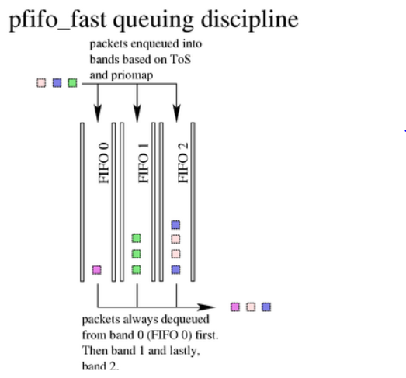
1
4th week
Sockets, Summarizations of some papers
2. [Real-time Linux communications] – Setting up RT communications in linux
Linux Networking Architecture : Linux Traffic Control
Type
Classless
Egress
Qdisc
Reference : http://www.tldp.org/HOWTO/Traffic-Control-HOWTO/

Slide 33
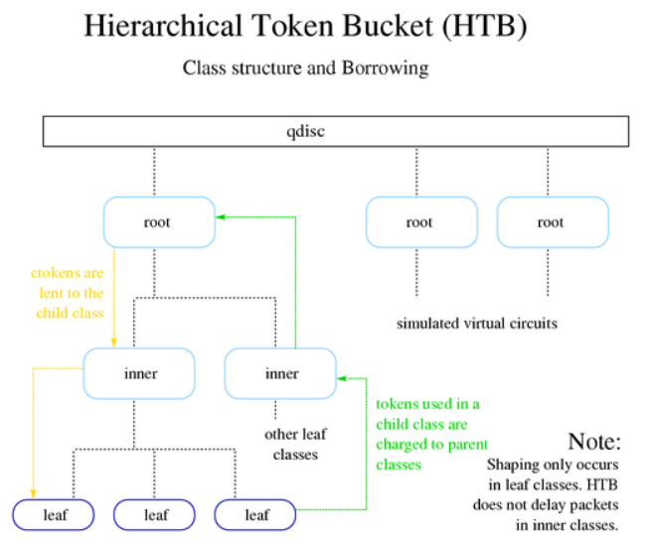
1
4th week
Sockets, Summarizations of some papers
2. [Real-time Linux communications] – Setting up RT communications in linux
Linux Networking Architecture : Linux Traffic Control
Type
2. Classful??
Egress
Qdisc
Reference : http://www.tldp.org/HOWTO/Traffic-Control-HOWTO/

Slide 34
1
4th week
Sockets, Summarizations of some papers
2. [Real-time Linux communications] – Setting up RT communications in linux
Network hard IRQ threads and Softirqs

Slide 35
2
5th week
Sockets in wireless network

Slide 36
2
5th week
Sockets in wireless network
Main goal of this week : Improving the code to evaluate latency
Configuration
Makefile
Client
Server

Slide 37
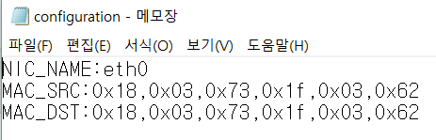
2
5th week
Sockets in wireless network
Configuration
Makefile
Client
Server

Slide 38
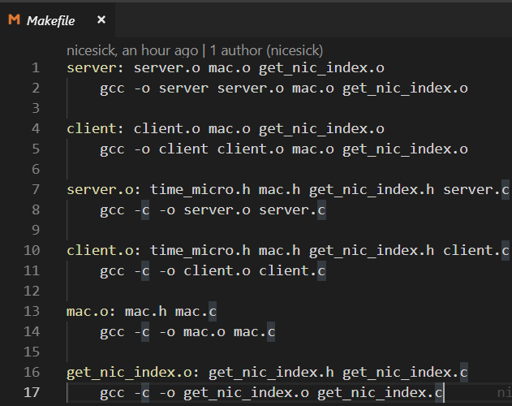
2
5th week
Sockets in wireless network
Configuration
Makefile
Client
Server

Slide 39
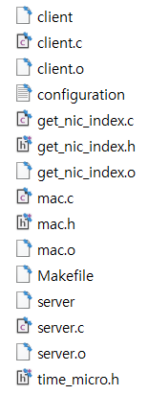
2
5th week
Sockets in wireless network
Configuration
$make client
$make server
$sudo ./client
$sudo ./server
Makefile
Client
Server

Slide 40
2
5th week
Sockets in wireless network
How we evaluate the latency between client and server

Slide 41
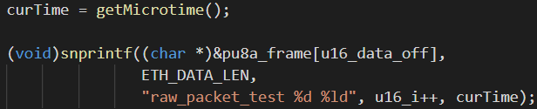
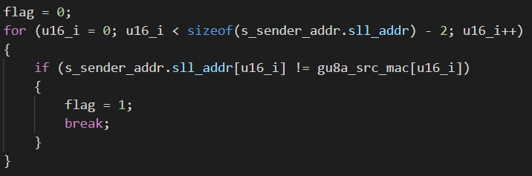
2
5th week
Sockets in wireless network
We sent the data with
the time that checked
just before.
We created a flag to check
if the sender’s MAC addr is
the designated one or not.
If they are different, it means
the sender is another one.

Slide 42
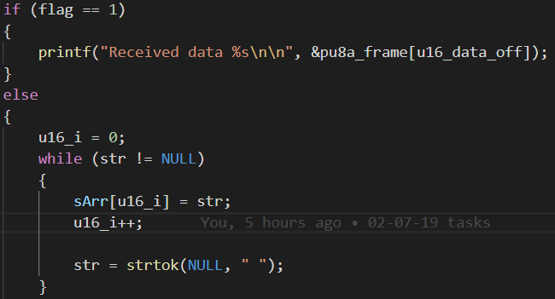
2
5th week
Sockets in wireless network
If flag is 1, we just print out.
Otherwise (flag is 0), we need to split
the data by looking at space.
Then,
sArr[0] = raw_packet_test
sArr[1] = the value of u16_i
sArr[2] = the value of curTime we sent

Slide 43
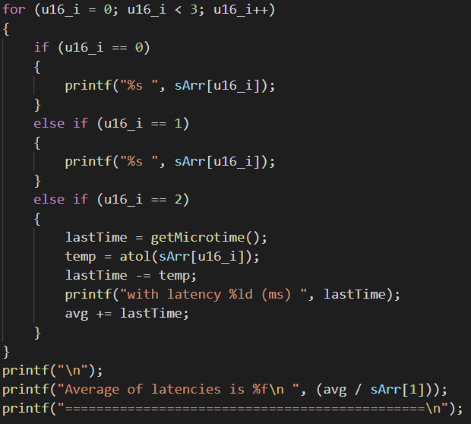
2
5th week
Sockets in wireless network
The last one (sArr[2]) would be a parameter
for our latency.
So, we get another time (lastTime) that
represents the time as soon as the data
decodes.
Then, we just subtract them to get latency
and average of it

Slide 44
2
5th week
Sockets in wireless network
Simple test results

Slide 45
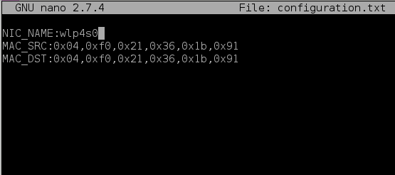
2
5th week
Sockets in wireless network

Slide 46
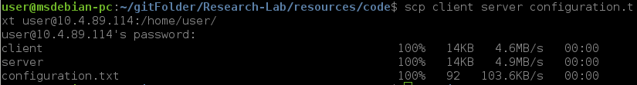
2
5th week
Sockets in wireless network
$make client
$make server
$sudo ./client
$sudo ./server

Slide 47
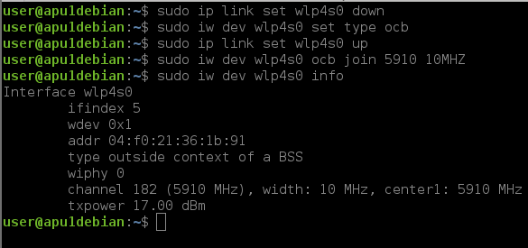
2
5th week
Sockets in wireless network

Slide 48
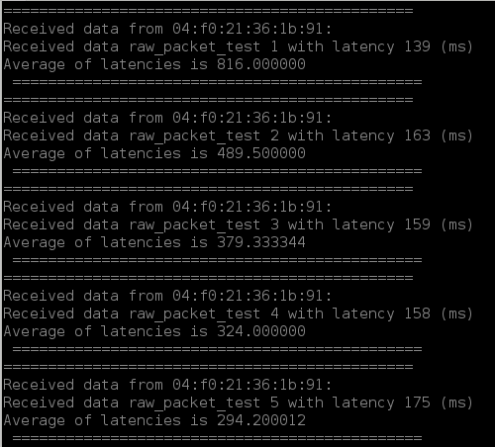
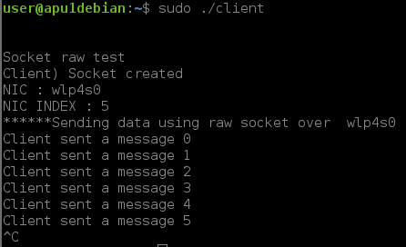
2
5th week
Sockets in wireless network

Slide 49
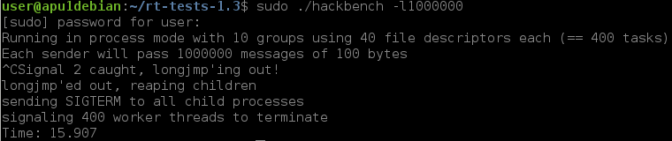
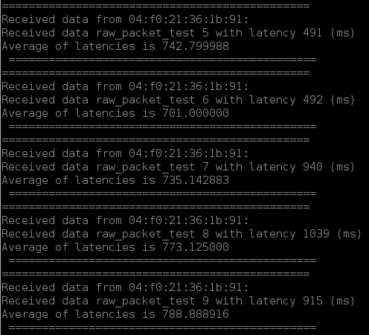
2
5th week
Sockets in wireless network
With a stressful condition

Slide 50
3
6th week
Testing and analyzing

Slide 51
6th week
3
2nd week
2
Testing and analyzing
Understanding basic Linux (Kernels, Network and so on)
Plan,
1. More tests and get some informative results with two boards.
2. Results-visualization (matlab, matplob.. Etc).
3. Dockerization (?)

Slide 52
Thank you

