Slide 1


Prototyping Delay-Aware
V2X Safe Communications
Hyunjae Lee
Jihun Lim

Slide 2
Contents
1
6th week
Revising and Refactoring codes
2
7th week
Testing on two boards and analyzing results
3
8th week (last week)
Organizing Github and documents
4
Feedback & Plans

Slide 3
1
6th week
Revising and Refactoring codes

Slide 4
1
6th week
Revising and Refactoring codes
1. Goals for week
Add setup command into makefile
Use gettime function
Add commands
Test mapping between two boards

Slide 5
1
6th week
Revising and Refactoring codes
A) Add setup command into makefile

Slide 6
1
6th week
Revising and Refactoring codes
A) Add setup command into makefile

Slide 7
1
6th week
Revising and Refactoring codes
B) Use gettime function

Slide 8
1
6th week
Revising and Refactoring codes
B) Use gettime function

Slide 9
1
6th week
Revising and Refactoring codes
C) Add commands

Slide 10
1
6th week
Revising and Refactoring codes
C) Add commands

Slide 11
1
6th week
Revising and Refactoring codes
D) Test mapping between two boards

Slide 12
1
6th week
Revising and Refactoring codes
D) Test mapping between two boards

Slide 13
2
7th week
Testing on two boards and analyzing results

Slide 14
2
5th week
Sockets in wireless network
Main goal of this week : Improving the code to evaluate latency
Configuration
Makefile
Client
Server

Slide 15
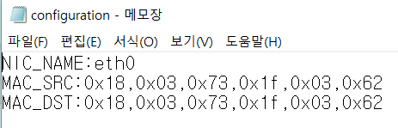
2
5th week
Sockets in wireless network
Configuration
Makefile
Client
Server

Slide 16
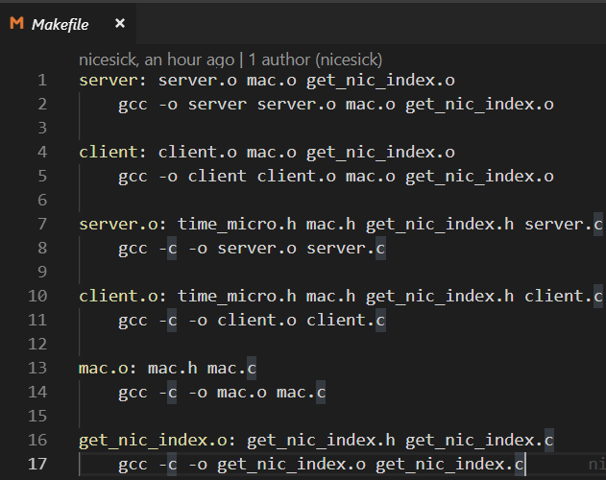
2
5th week
Sockets in wireless network
Configuration
Makefile
Client
Server

Slide 17
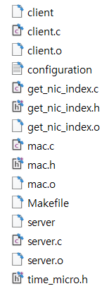
2
5th week
Sockets in wireless network
Configuration
$make client
$make server
$sudo ./client
$sudo ./server
Makefile
Client
Server

Slide 18
2
5th week
Sockets in wireless network
How we evaluate the latency between client and server

Slide 19
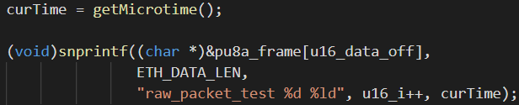
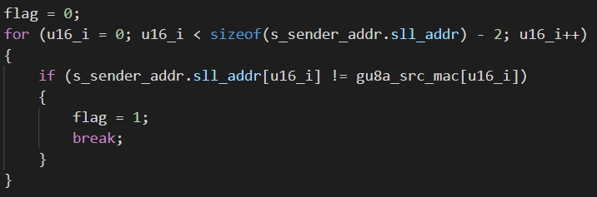
2
5th week
Sockets in wireless network
We sent the data with
the time that checked
just before.
We created a flag to check
if the sender’s MAC addr is
the designated one or not.
If they are different, it means
the sender is another one.

Slide 20
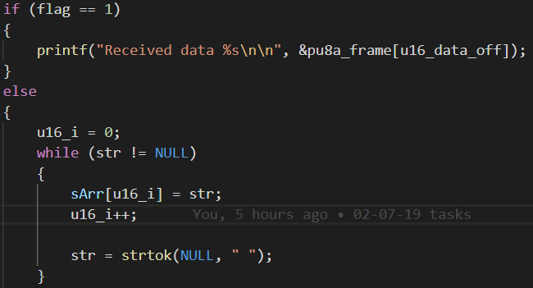
2
5th week
Sockets in wireless network
If flag is 1, we just print out.
Otherwise (flag is 0), we need to split
the data by looking at space.
Then,
sArr[0] = raw_packet_test
sArr[1] = the value of u16_i
sArr[2] = the value of curTime we sent

Slide 21
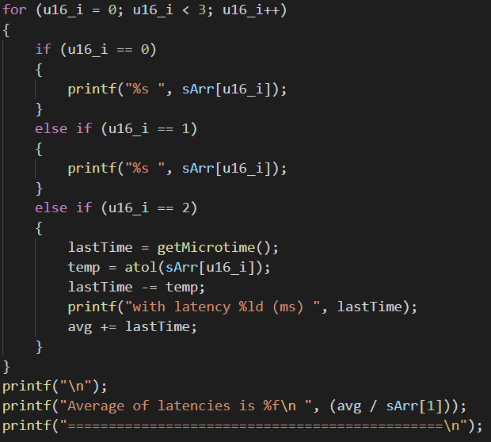
2
5th week
Sockets in wireless network
The last one (sArr[2]) would be a parameter
for our latency.
So, we get another time (lastTime) that
represents the time as soon as the data
decodes.
Then, we just subtract them to get latency
and average of it

Slide 22
2
5th week
Sockets in wireless network
Simple test results

Slide 23
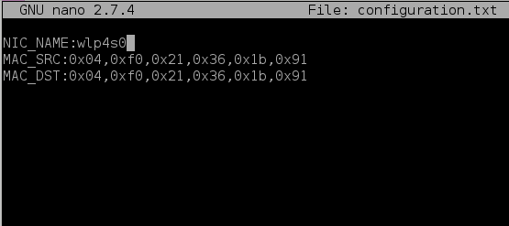
2
5th week
Sockets in wireless network

Slide 24
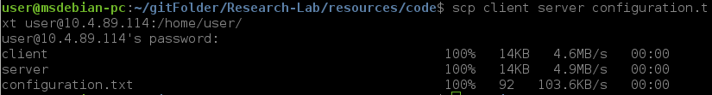
2
5th week
Sockets in wireless network
$make client
$make server
$sudo ./client
$sudo ./server

Slide 25
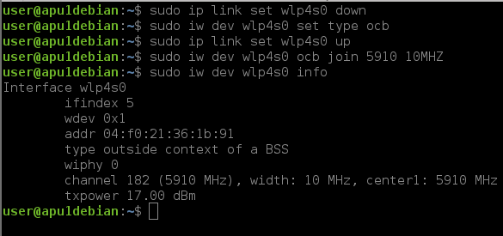
2
5th week
Sockets in wireless network

Slide 26
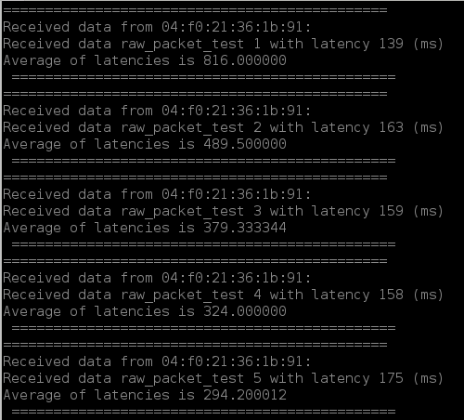
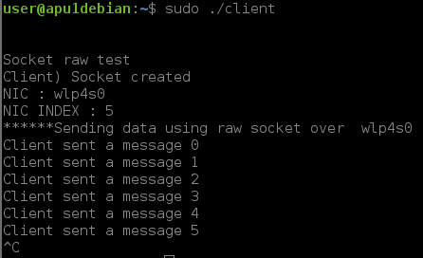
2
5th week
Sockets in wireless network

Slide 27
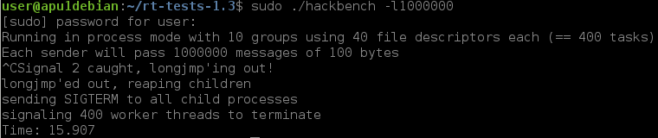
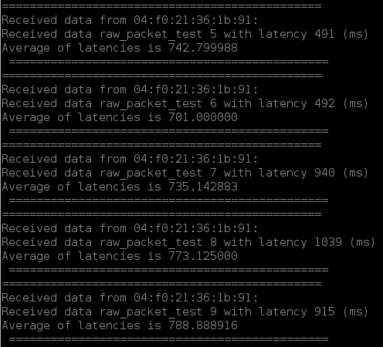
2
5th week
Sockets in wireless network
With a stressful condition

Slide 28
3
6th week
Testing and analyzing

Slide 29
6th week
3
2nd week
2
Testing and analyzing
Understanding basic Linux (Kernels, Network and so on)
Plan,
1. More tests and get some informative results with two boards.
2. Results-visualization (matlab, matplob.. Etc).
3. Dockerization (?)

Slide 30
Thank you

