Slide 1


Prototyping Delay-Aware
V2X Safe Communications
Hyunjae Lee
Jihun Lim

Slide 2
Contents
1
4th week
Sockets, Summarizations of some papers
2
5th week
Sockets in wireless network
3
6th week
Testing and analyzing
4
Feedback & Plans

Slide 3
1
4th week
Sockets, Summarizations of some papers

Slide 4

1
4th week
Sockets, Summarizations of some papers
1. Sockets
AF_INET
AF_PACKET
SOCK_DGRAM
SOCK_STREAM
SOCK_RAW
TCP
UDP
ETH_*
AF_INET cases)
AF_PACKET cases)
Low level packet interface

Slide 5
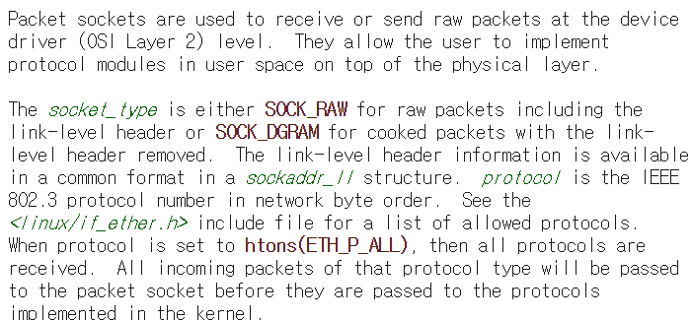
1
4th week
Sockets, Summarizations of some papers
1. Sockets

Slide 6
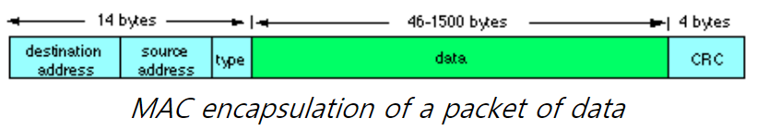
1
4th week
Sockets, Summarizations of some papers
1. Sockets
Unicast
Broadcast
Multicast

Slide 7
1
4th week
Sockets, Summarizations of some papers
1. Sockets

Slide 8
1
4th week
Sockets, Summarizations of some papers
1. Sockets

Slide 9
1
4th week
Sockets, Summarizations of some papers
1. Sockets

Slide 10
1
4th week
Sockets, Summarizations of some papers
1. Sockets

Slide 11
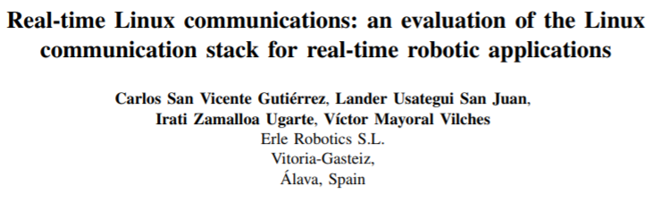
1
4th week
Sockets, Summarizations of some papers
2. 1st paper we summarized

Slide 12
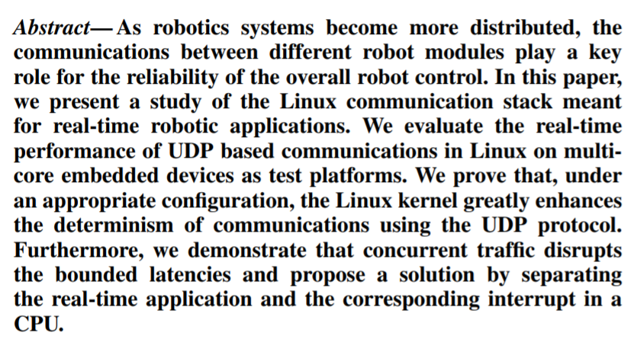
1
4th week
Sockets, Summarizations of some papers
2. [Real-time Linux communications] - Abstract

Slide 13
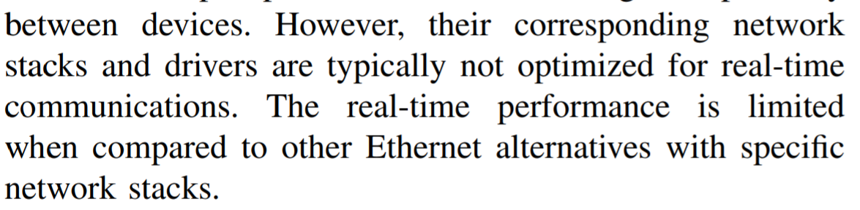
1
4th week
Sockets, Summarizations of some papers
2. [Real-time Linux communications] - Introduction
In real-time communications, manufactures selected field buses instead of Ethernet.
The arrival of TSN(time sensitive networking) Ethernet was enhanced
currently several communications based on Ethernet (RT, DDS and so on)

Slide 14
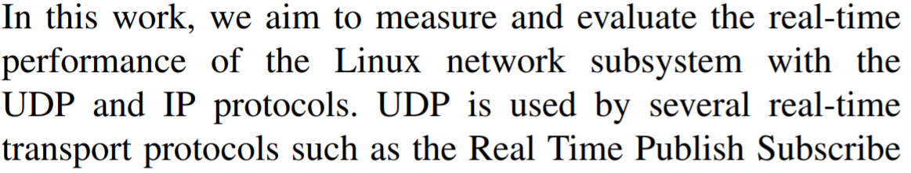
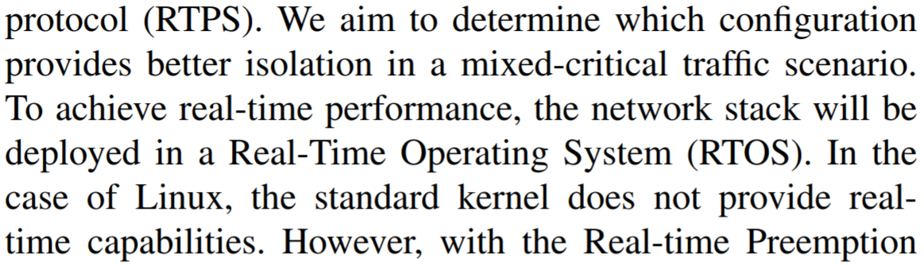
1
4th week
Sockets, Summarizations of some papers
2. [Real-time Linux communications] - Introduction

Slide 15
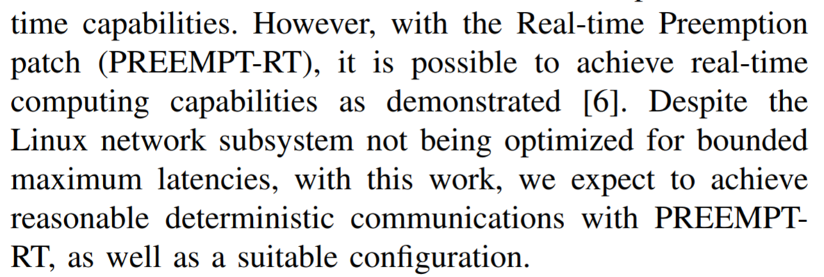
1
4th week
Sockets, Summarizations of some papers
2. [Real-time Linux communications] - Introduction

Slide 16
1
4th week
Sockets, Summarizations of some papers
2. [Real-time Linux communications] – Related work

Slide 17
1
4th week
Sockets, Summarizations of some papers
2. [Real-time Linux communications] – Related work

Slide 18
2
5th week
Sockets in wireless network

Slide 19
2
5th week
Sockets in wireless network

Slide 20
3
3rd week
Designing how to evaluate and analyze performances

Slide 21
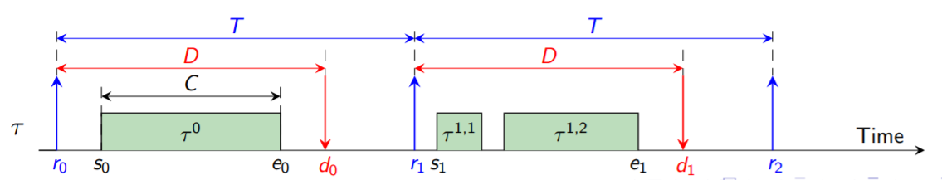
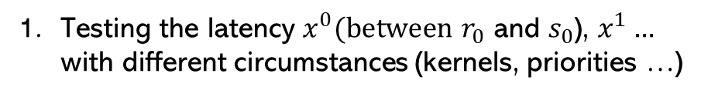
3rd week
3
2nd week
2
Designing how to evaluate and analyze performances
Understanding basic Linux (Kernels, Network and so on)
Testing the latency $x^{0}(between$ $r_{0}$ and $s_{0}$), $x^{1}…$
with different circumstances (kernels, priorities …)
C : worst case execution time
D : relative deadline
T : period

Slide 22
Thank you

Slide 23
Fully Editable Icon Sets : A
You can Resize without losing quality
You can Change Fill Color &
Line Color
FREE
PPT TEMPLATES
www.allppt.com

Slide 24
Fully Editable Icon Sets : B
You can Resize without losing quality
You can Change Fill Color &
Line Color
FREE
PPT TEMPLATES
www.allppt.com

