Slide 1


Prototyping Delay-Aware
V2X Safe Communications
Hyunjae Lee
Jihun Lim

Slide 2
Contents
1
6th week
Revising and Refactoring codes
2
7th week
Testing on two boards and analyzing results
3
8th week (last week)
Organizing Github and documents
4
Feedback & Plans

Slide 3
1
6th week
Revising and Refactoring codes

Slide 4
1
6th week
Revising and Refactoring codes
1. Goals for week
Add setup command into makefile
Use gettime function
Add commands
Test mapping between two boards

Slide 5
1
6th week
Revising and Refactoring codes
A) Add setup command into makefile

Slide 6
1
6th week
Revising and Refactoring codes
A) Add setup command into makefile

Slide 7
1
6th week
Revising and Refactoring codes
B) Use gettime function

Slide 8
1
6th week
Revising and Refactoring codes
B) Use gettime function

Slide 9
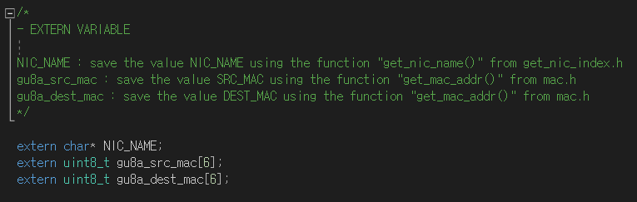
1
6th week
Revising and Refactoring codes
C) Add commands : client.c – EXTERN VARIABLE

Slide 10
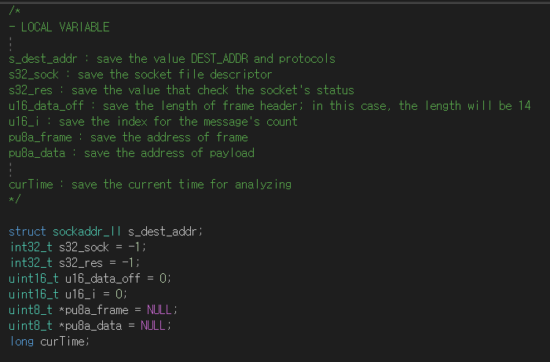
1
6th week
Revising and Refactoring codes
C) Add commands : client.c – LOCAL VARIABLE

Slide 11
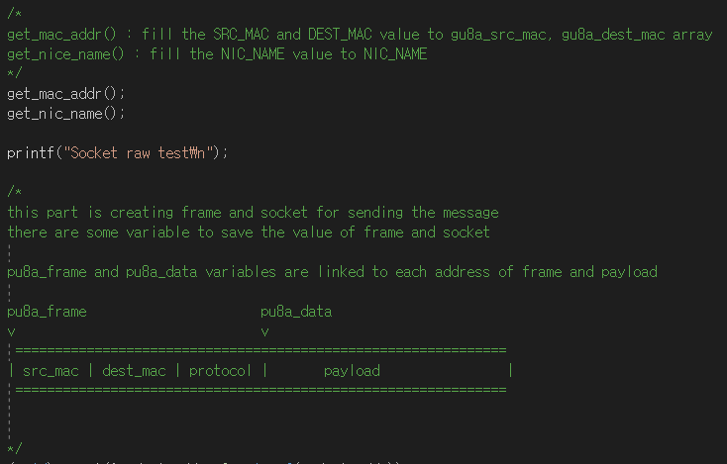
1
6th week
Revising and Refactoring codes
C) Add commands : client.c – Get variables and create frame and socket

Slide 12
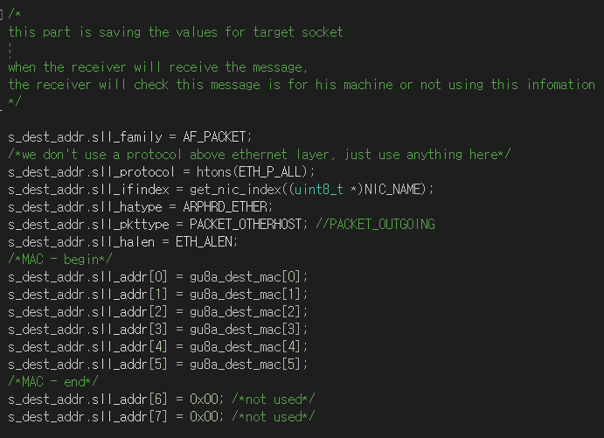
1
6th week
Revising and Refactoring codes
C) Add commands : client.c – Setting socket addr

Slide 13
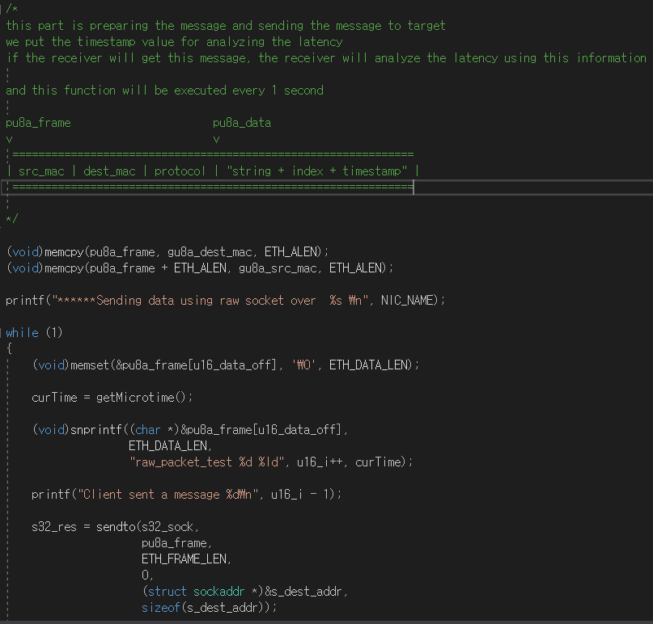
1
6th week
Revising and Refactoring codes
C) Add commands : client.c – Sending the message

Slide 14

1
6th week
Revising and Refactoring codes
C) Add commands : server.c – EXTERN VARIABLE

Slide 15
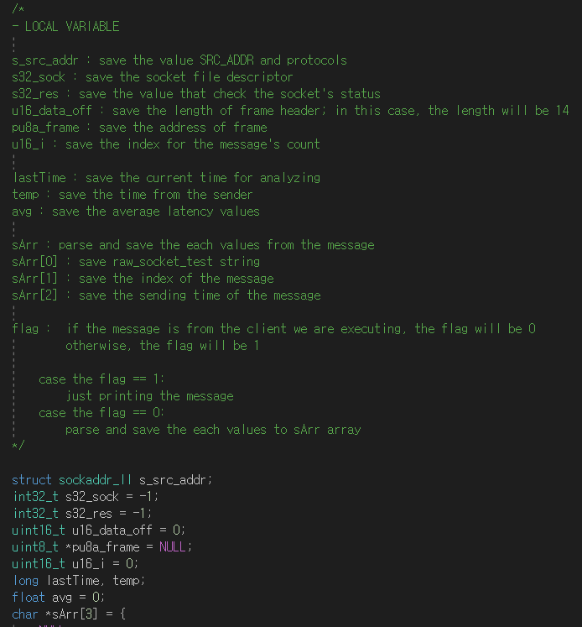
1
6th week
Revising and Refactoring codes
C) Add commands : server.c – LOCAL VARIABLE

Slide 16
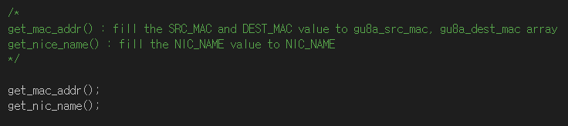
1
6th week
Revising and Refactoring codes
C) Add commands : server.c – Get variables

Slide 17
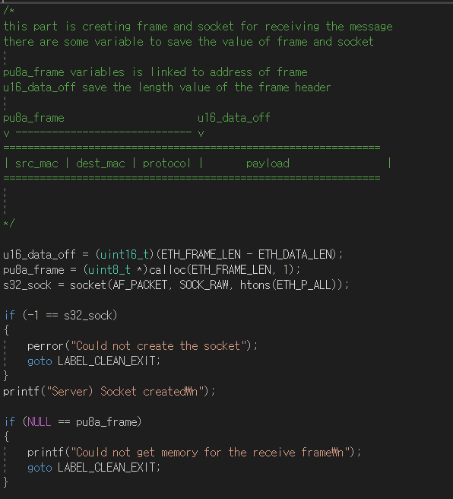
1
6th week
Revising and Refactoring codes
C) Add commands : server.c – Creating the frame and socket

Slide 18
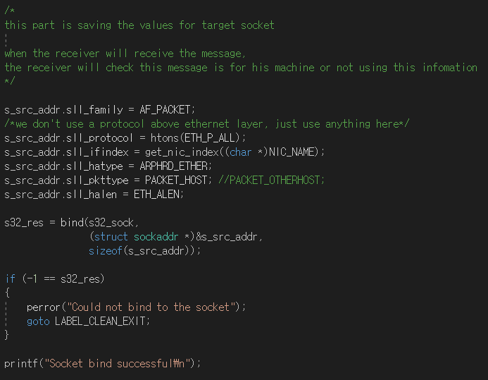
1
6th week
Revising and Refactoring codes
C) Add commands : server.c – Setting socket addr

Slide 19
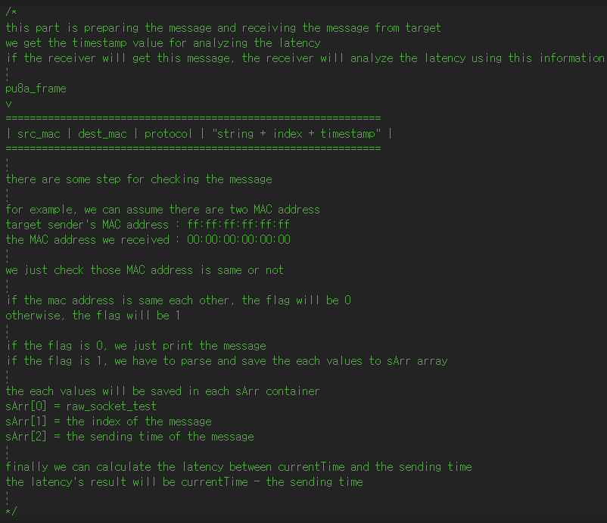
1
6th week
Revising and Refactoring codes
C) Add commands : server.c – Receiving the message

Slide 20
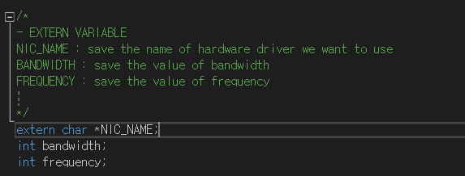
1
6th week
Revising and Refactoring codes
C) Add commands : setup.c – EXTERN VARIABLE

Slide 21
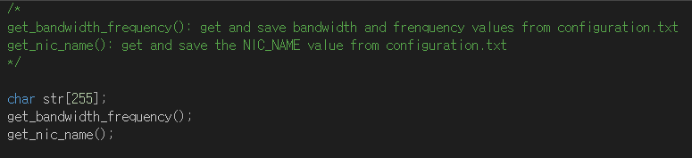
1
6th week
Revising and Refactoring codes
C) Add commands : setup.c – Get variables

Slide 22
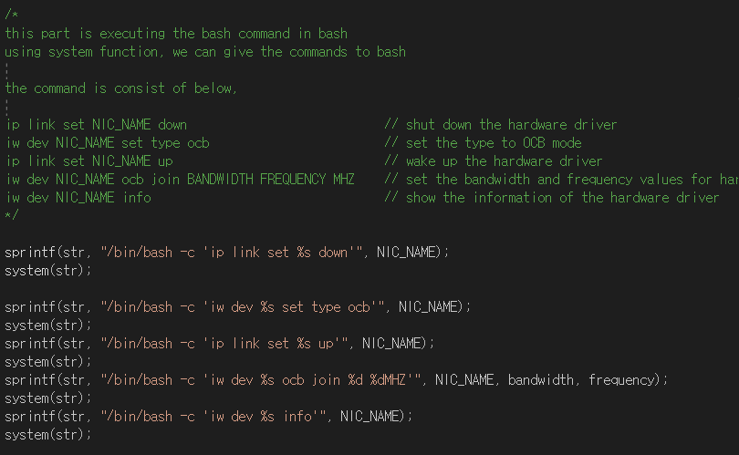
1
6th week
Revising and Refactoring codes
C) Add commands : setup.c – Executing the commands

Slide 23
1
6th week
Revising and Refactoring codes
D) Test mapping between two boards

Slide 24
1
6th week
Revising and Refactoring codes
D) Test mapping between two boards

Slide 25
2
7th week
Testing on two boards and analyzing results

Slide 26
2
5th week
Sockets in wireless network
Main goal of this week : Improving the code to evaluate latency
Configuration
Makefile
Client
Server

Slide 27
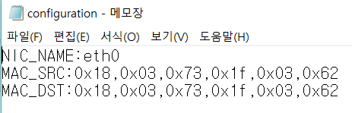
2
5th week
Sockets in wireless network
Configuration
Makefile
Client
Server

Slide 28
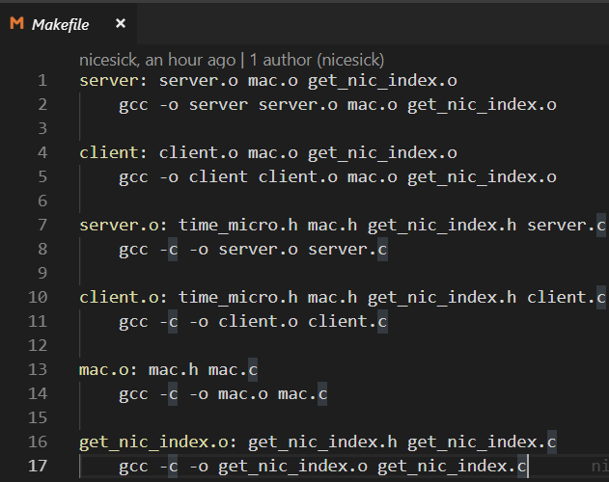
2
5th week
Sockets in wireless network
Configuration
Makefile
Client
Server

Slide 29
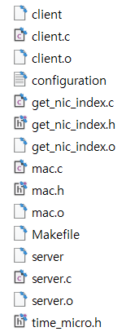
2
5th week
Sockets in wireless network
Configuration
$make client
$make server
$sudo ./client
$sudo ./server
Makefile
Client
Server

Slide 30
2
5th week
Sockets in wireless network
How we evaluate the latency between client and server

Slide 31
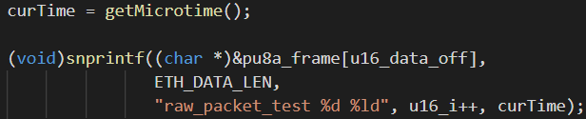
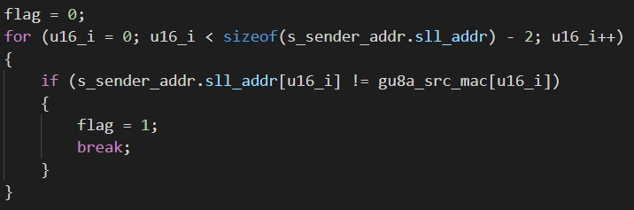
2
5th week
Sockets in wireless network
We sent the data with
the time that checked
just before.
We created a flag to check
if the sender’s MAC addr is
the designated one or not.
If they are different, it means
the sender is another one.

Slide 32
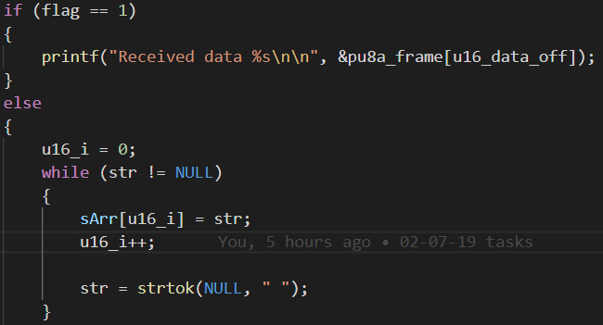
2
5th week
Sockets in wireless network
If flag is 1, we just print out.
Otherwise (flag is 0), we need to split
the data by looking at space.
Then,
sArr[0] = raw_packet_test
sArr[1] = the value of u16_i
sArr[2] = the value of curTime we sent

Slide 33
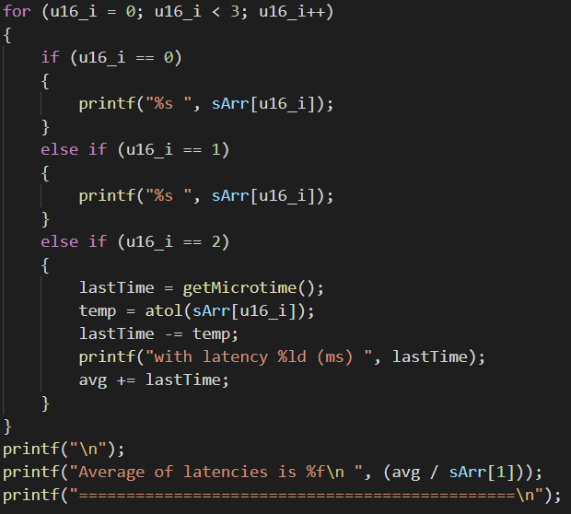
2
5th week
Sockets in wireless network
The last one (sArr[2]) would be a parameter
for our latency.
So, we get another time (lastTime) that
represents the time as soon as the data
decodes.
Then, we just subtract them to get latency
and average of it

Slide 34
2
5th week
Sockets in wireless network
Simple test results

Slide 35
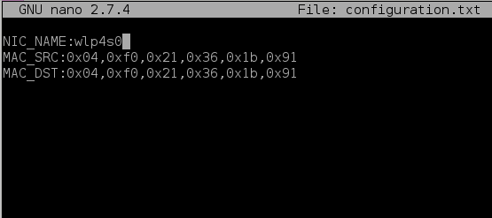
2
5th week
Sockets in wireless network

Slide 36
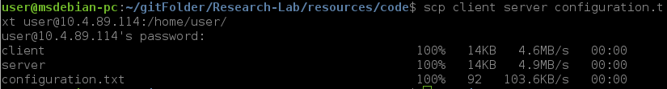
2
5th week
Sockets in wireless network
$make client
$make server
$sudo ./client
$sudo ./server

Slide 37
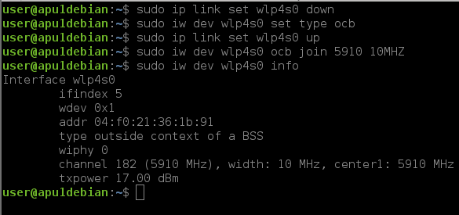
2
5th week
Sockets in wireless network

Slide 38
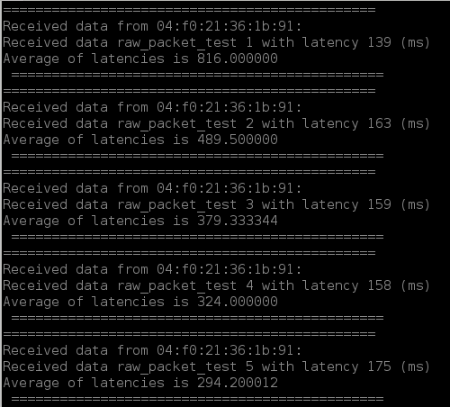
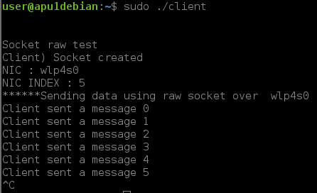
2
5th week
Sockets in wireless network

Slide 39
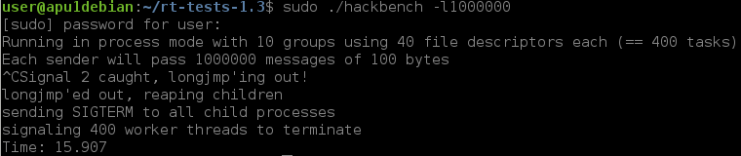
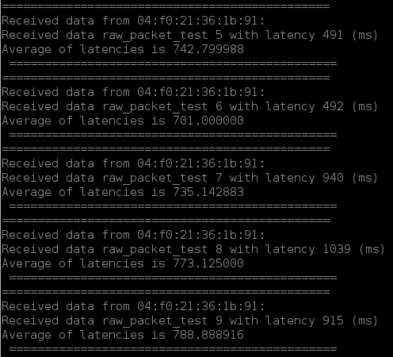
2
5th week
Sockets in wireless network
With a stressful condition

Slide 40
3
6th week
Testing and analyzing

Slide 41
6th week
3
2nd week
2
Testing and analyzing
Understanding basic Linux (Kernels, Network and so on)
Plan,
1. More tests and get some informative results with two boards.
2. Results-visualization (matlab, matplob.. Etc).
3. Dockerization (?)

Slide 42
Thank you

