Slide 1


Prototyping Delay-Aware
V2X Safe Communications
Hyunjae Lee
Jihun Lim

Slide 2
Contents
1
6th week
Revising and Refactoring codes
2
7th week
Testing on two boards and analyzing results
3
8th week (last week)
Organizing Github and documents
4
Feedback & Plans

Slide 3
1
6th week
Revising and Refactoring codes

Slide 4
1
6th week
Revising and Refactoring codes
1. Goals for week
Add setup command into makefile
Use gettime function
Add commands
Test mapping between two boards

Slide 5
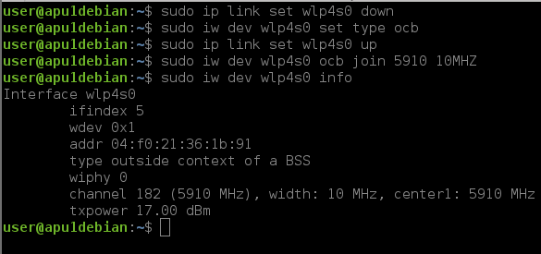
1
6th week
Revising and Refactoring codes
A) Add setup command into makefile
<Original process>
Configuration
Makefile
Client
Server
Separate steps

Slide 6
1
6th week
Revising and Refactoring codes
A) Add setup command into makefile
<Improved process>
Configuration
NIC_NAME, Bandwidth, Frequency
Makefile
Added
Client
Server

Slide 7

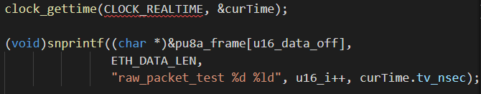
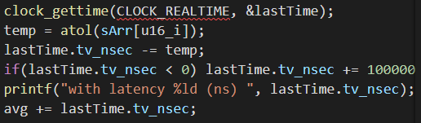
1
6th week
Revising and Refactoring codes
B) Use gettime function
Client.c
Server.c
Clock underflow

Slide 8
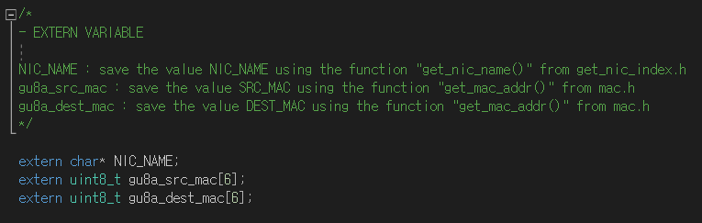
1
6th week
Revising and Refactoring codes
C) Add commands : client.c – EXTERN VARIABLE

Slide 9
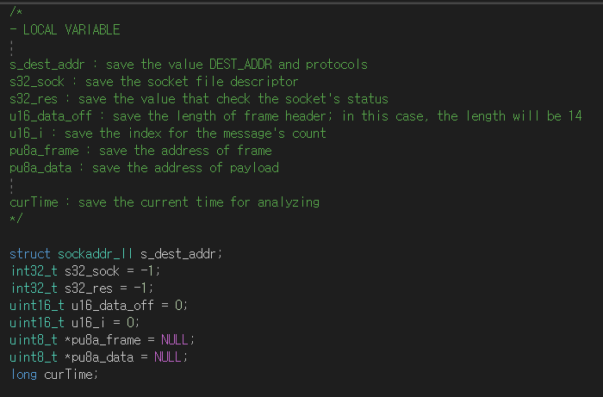
1
6th week
Revising and Refactoring codes
C) Add commands : client.c – LOCAL VARIABLE

Slide 10
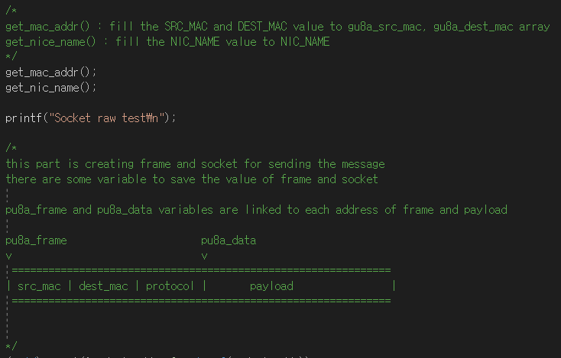
1
6th week
Revising and Refactoring codes
C) Add commands : client.c – Get variables and create frame and socket

Slide 11
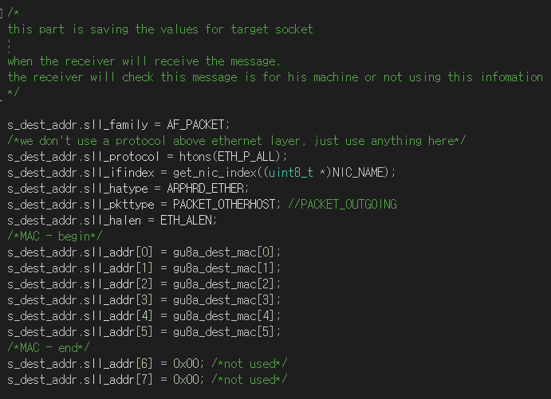
1
6th week
Revising and Refactoring codes
C) Add commands : client.c – Setting socket addr

Slide 12
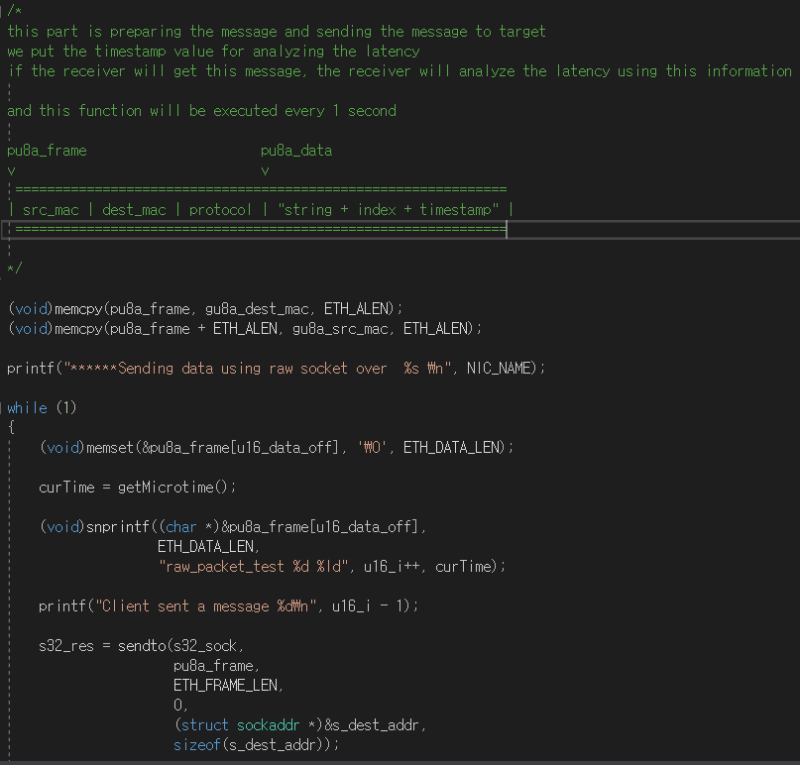
1
6th week
Revising and Refactoring codes
C) Add commands : client.c – Sending the message

Slide 13

1
6th week
Revising and Refactoring codes
C) Add commands : server.c – EXTERN VARIABLE

Slide 14
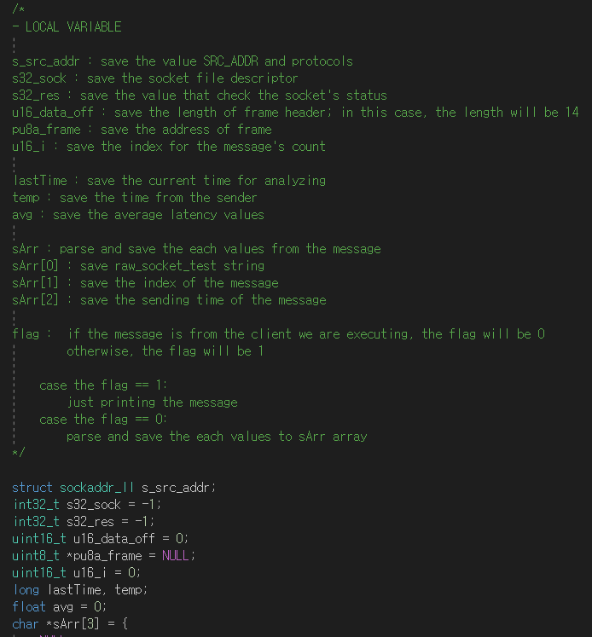
1
6th week
Revising and Refactoring codes
C) Add commands : server.c – LOCAL VARIABLE

Slide 15
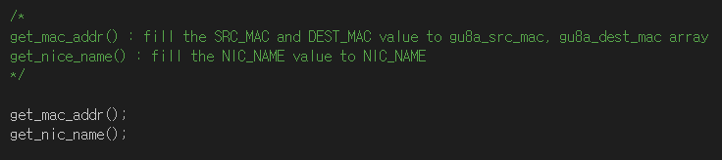
1
6th week
Revising and Refactoring codes
C) Add commands : server.c – Get variables

Slide 16
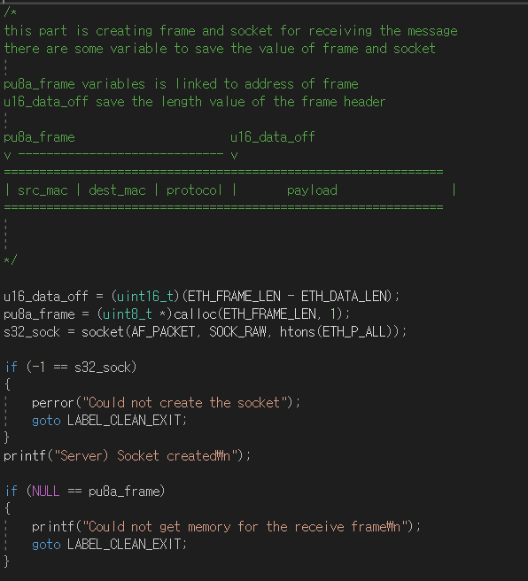
1
6th week
Revising and Refactoring codes
C) Add commands : server.c – Creating the frame and socket

Slide 17
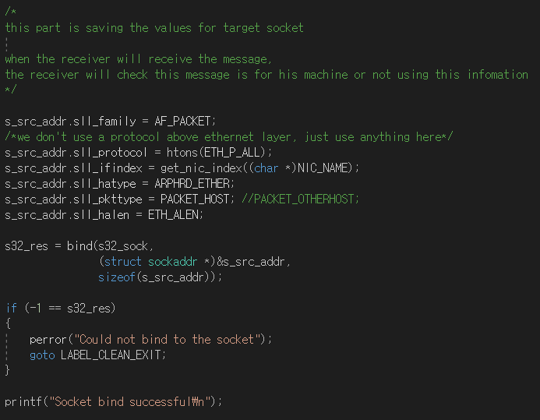
1
6th week
Revising and Refactoring codes
C) Add commands : server.c – Setting socket addr

Slide 18
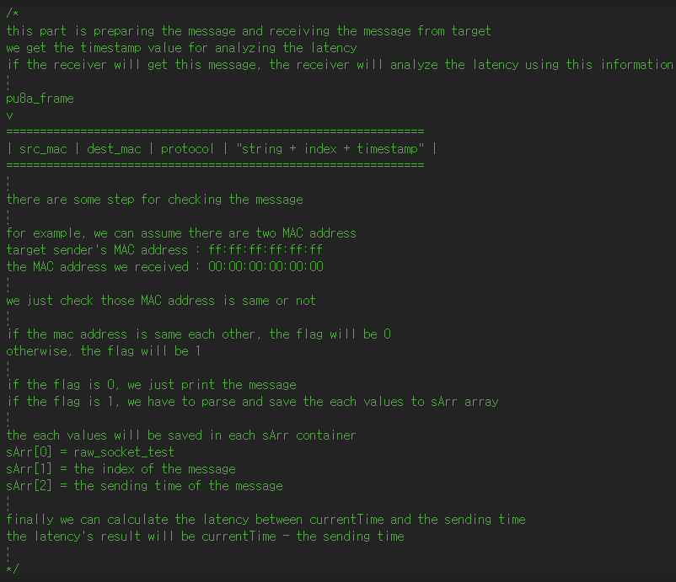
1
6th week
Revising and Refactoring codes
C) Add commands : server.c – Receiving the message

Slide 19
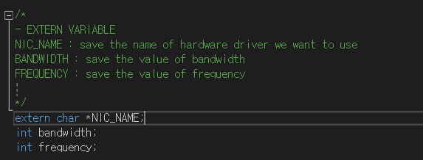
1
6th week
Revising and Refactoring codes
C) Add commands : setup.c – EXTERN VARIABLE

Slide 20
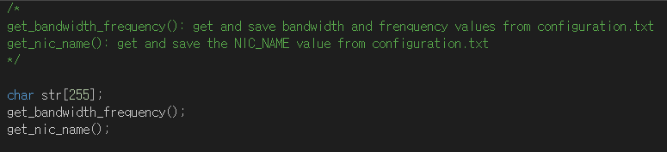
1
6th week
Revising and Refactoring codes
C) Add commands : setup.c – Get variables

Slide 21
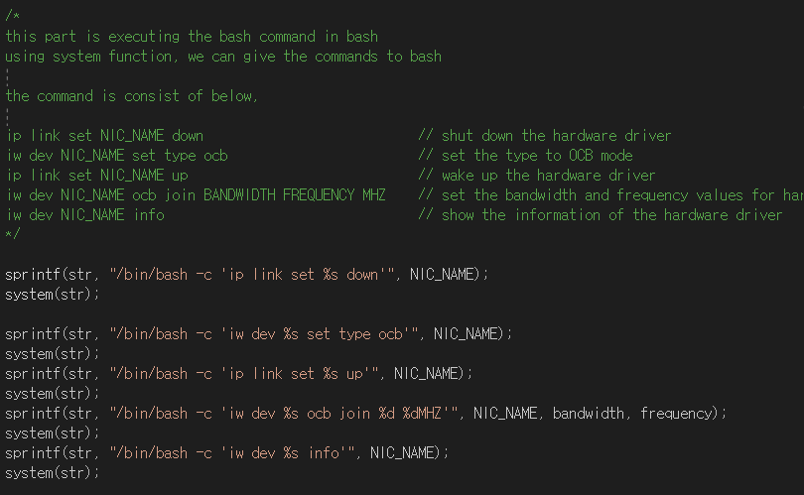
1
6th week
Revising and Refactoring codes
C) Add commands : setup.c – Executing the commands

Slide 22
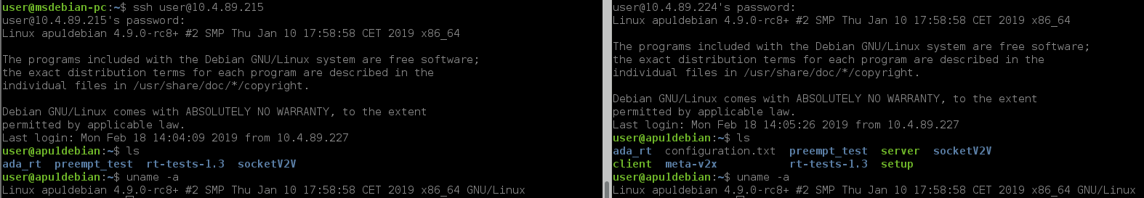
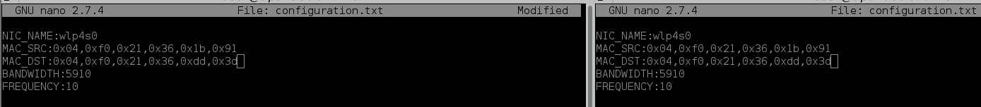
1
6th week
Revising and Refactoring codes
D) Test mapping between two boards

Slide 23
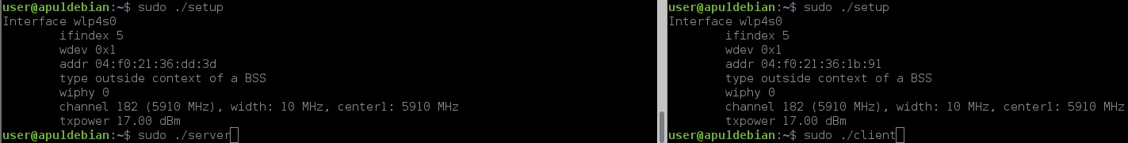
1
6th week
Revising and Refactoring codes
D) Test mapping between two boards

Slide 24
1
6th week
Revising and Refactoring codes
Problem.
Tx
Rx
./Client
Normal case
./Server
User:
1) ./setup
2) ./nano configuration.txt
NIC(1)
NIC(2)
MAC_sender
MAC_receiver
Add MAC_sender
Add MAC_receiver

Slide 25
1
6th week
Revising and Refactoring codes
Problem.
Tx
Rx
./Client
Bad case
./Server
User:
1) ./setup
2) ./nano configuration.txt
NIC(1)
NIC(2)
MAC_sender
MAC_receiver
Add MAC_sender as MAC_A
Add MAC_receiver as MAC_B
IT STILL WORKING.

Slide 26
1
6th week
Revising and Refactoring codes
Problem.
Tx
Rx
./Client
Bad case
./Server
Client
Server
NIC(1)
NIC(2)
Sending data to MAC_B
From MAC_A
MAC_sender
MAC_receiver

Slide 27
1
6th week
Revising and Refactoring codes
Problem.
Tx
Rx
./Client
Bad case
./Server
Client
Server
NIC(1)
NIC(2)
MAC_sender
Receiving data from MAC_A
After checking if the sender is
MAC_a
MAC_receiver

Slide 28
2
7th week
Testing on two boards and analyzing results

Slide 29
2
7th week
Testing on two boards and analyzing results
Hackbench
2. Clock_monotonic_raw

Slide 30
2
7th week
Testing on two boards and analyzing results
Test
 | FIFO low pri | FIFO High pri | Others Low pri | Others High pri
Voluntary + 802.11p patch
Real-time
Parameters,
Min, Avg, Max

Slide 31
2
7th week
Testing on two boards and analyzing results

Slide 32
3
8th week
Organizing Github and documents

Slide 33
6th week
3
2nd week
2
Testing and analyzing
Understanding basic Linux (Kernels, Network and so on)
Plan,
1. More tests and get some informative results with two boards.
2. Results-visualization (matlab, matplob.. Etc).
3. Dockerization (?)

Slide 34
Thank you

