Slide 1


Linear regression through the origin
Nuraly Dyussenov
Supervisor: Dr. József Mala

Slide 2
Goal
Familiarize reader with the concept of simple linear regression and simple linear regression through the origin (RTO)
Discover properties of both models
Compare two models

Slide 3
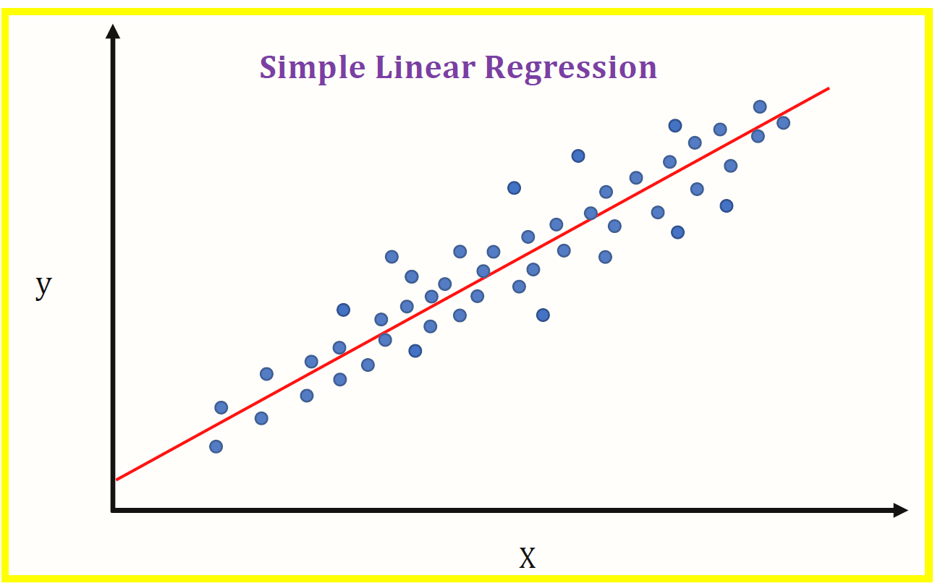
Introduction

Slide 4

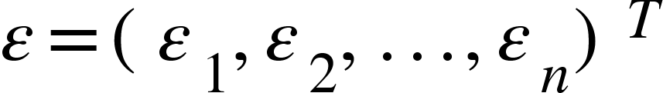
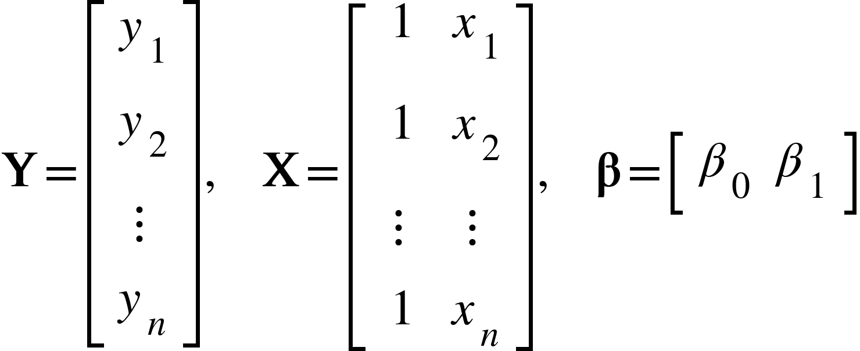

Simple Linear Regression
We are given a random sample of data points$,…,\left(x_{n},y_{n}\right)$
$\left(x_{1},y_{1}\right)$
Goal: to find parameters $β_{1}$, $β_{0}$such that
$$y_{i}= β_{1}x_{i}+ β_{0}+ε_{i}, \left(i= 1,2,…,n\right)$$
Or in matrix notation:
Where
Notes:
We are given a random sample of data points $\left(x_{1},y_{1}\right),…,\left(x_{n},y_{n}\right)$ from a population, and our goal is to find a linear function that describes the relationship between x and y as good as possible:

Slide 5
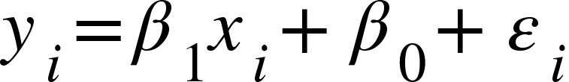
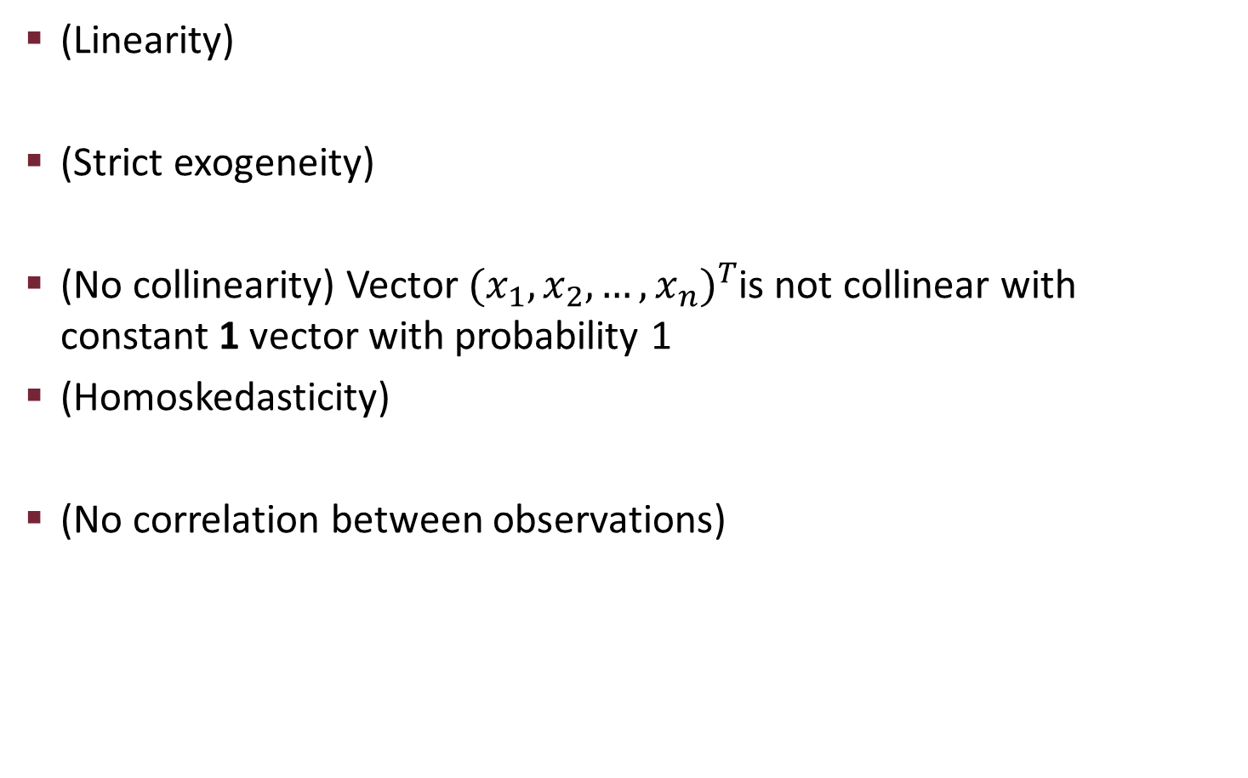
Assumptions
(Linearity)
(Strict exogeneity)
(No collinearity) Vector ${(x_{1},x_{2}, …,x_{n})}^{T}$is not collinear with constant 1 vector with probability 1
(Homoskedasticity)
(No correlation between observations)
Notes:
For the purpose of this paper, we will assume that errors are normally distributed with mean 0 and variance sigma^2

Slide 6
Properties
Likelihood, log-likelihood
Notes:
Don’t forget to mention what are S_xx and S_xy

Slide 7
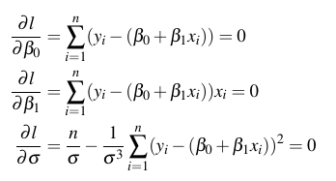

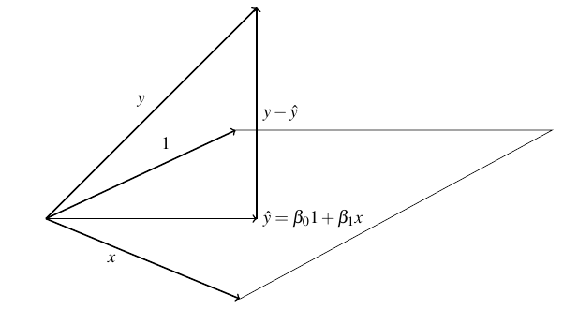
Properties: Maximum Likelihood
Or in matrix form:

Slide 8
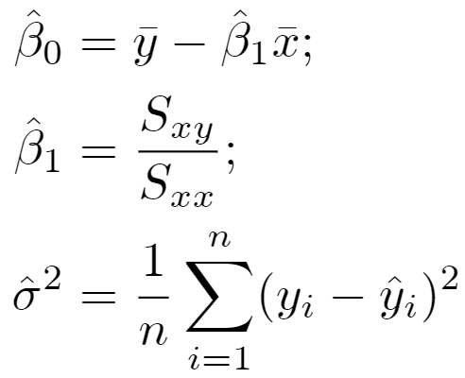
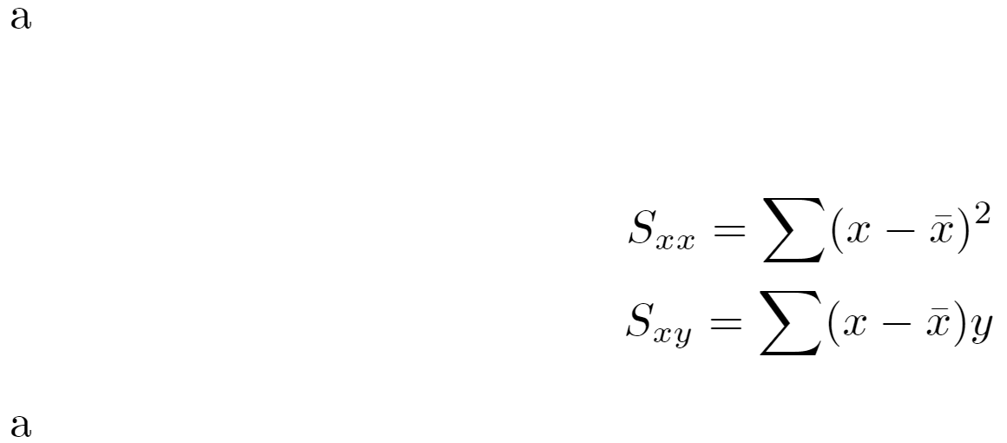
Maximum Likelihood Estimators
Note:

Slide 9

Corollary
Finding values of $\hat{β_{0}},\hat{β_{1} }$that minimizes MSE is same as finding MLE of $β_{0}$, $β_{1}$ :
Notes:
Residual perpendicular to plane spanned by 1 and x -> MSE estimators

Slide 10



Slide 11
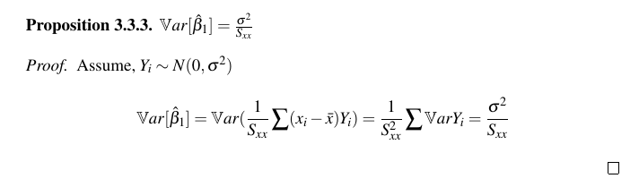
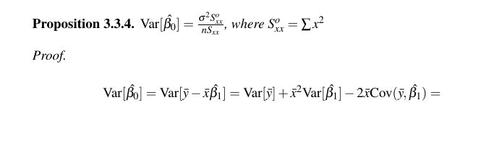
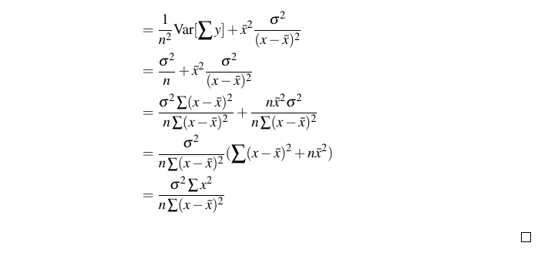
Variance of MLE estimators

Slide 12
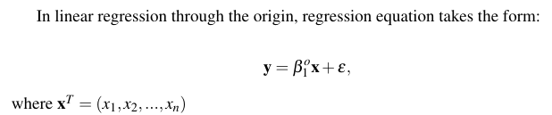
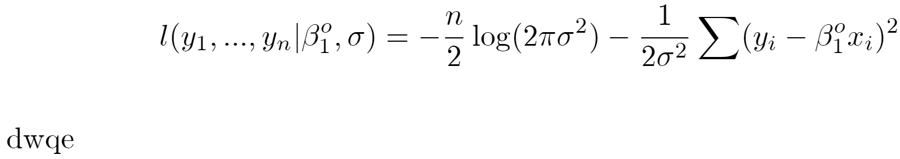
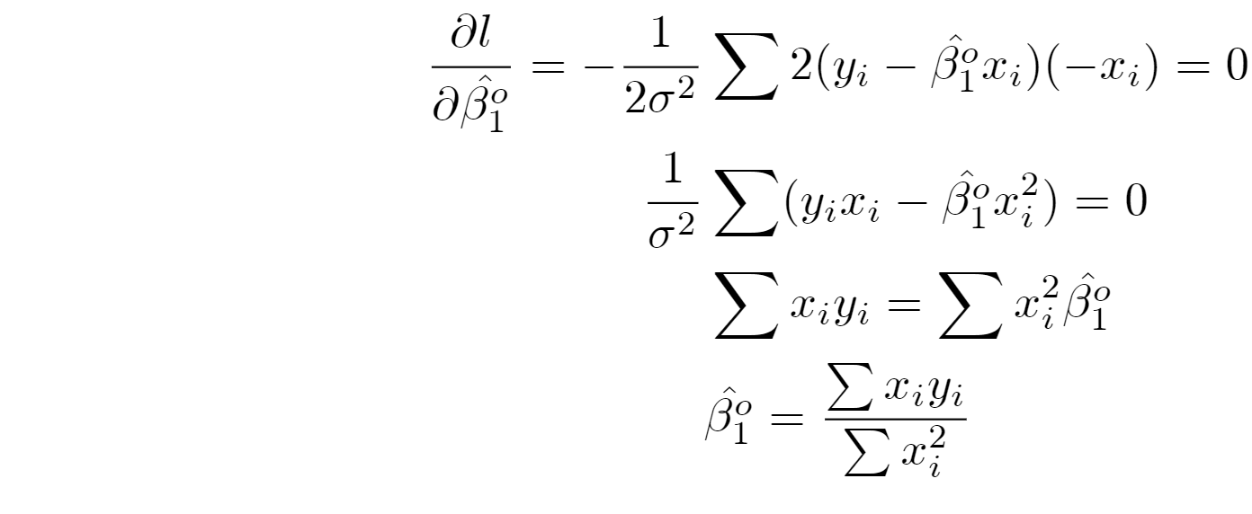
Linear Regression Through the Origin (RTO)
Likelihood, log-likelihood

Slide 13
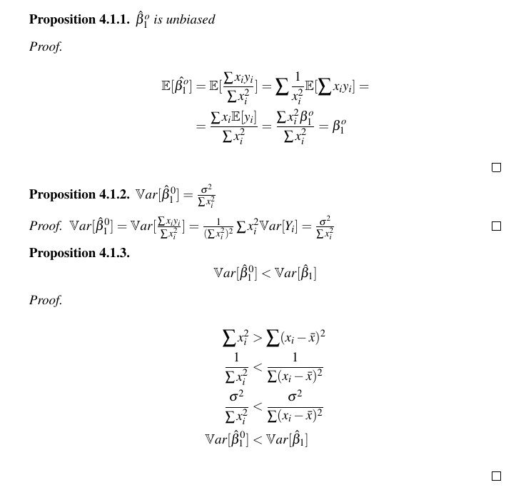
Properties of slope term estimator in RTO

Slide 14
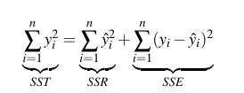
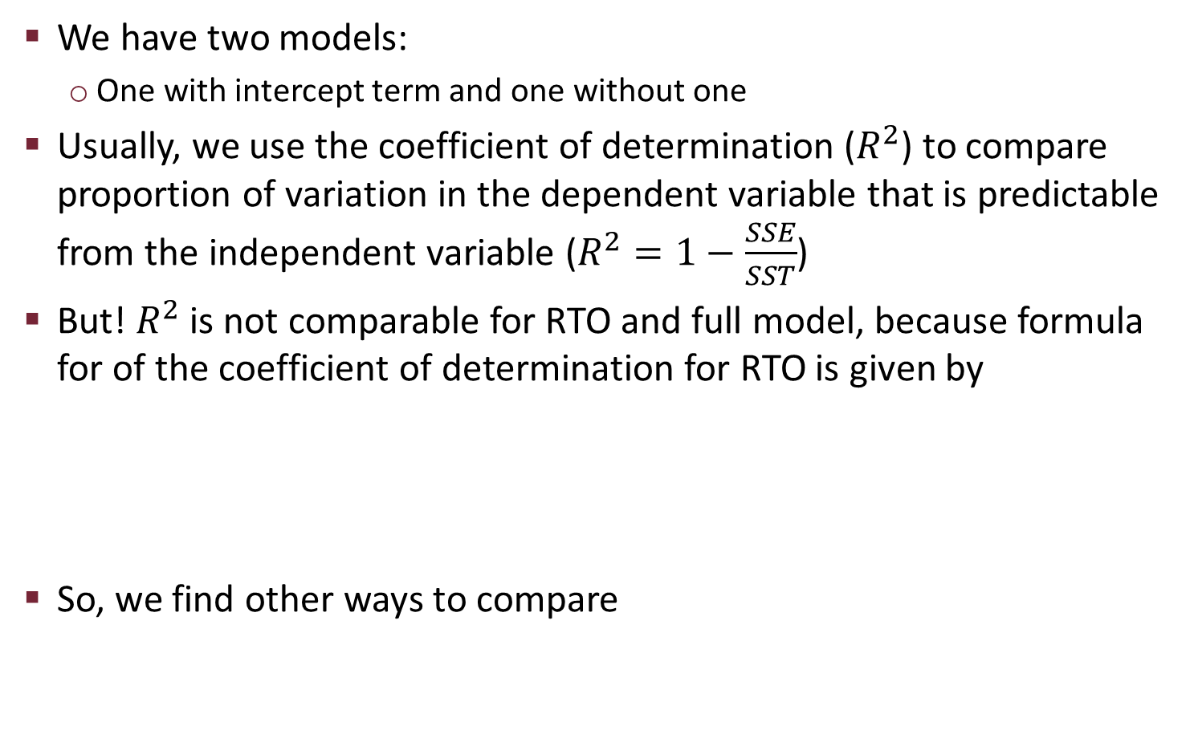
Model Comparison
We have two models:
One with intercept term and one without one
Usually, we use the coefficient of determination ($R^{2}$) to compare proportion of variation in the dependent variable that is predictable from the independent variable ($R^{2}=1−\frac{SSE}{SST}$)
But! $R^{2}$ is not comparable for RTO and full model, because formula for of the coefficient of determination for RTO is given by
So, we find other ways to compare

Slide 15




Akaike Information Criterion
AIC = -2 log(maximum likelihood) + 2k
Where k is the number of independently adjusted parameters within the model
AIC is related to Kullback-Leibler divergence, which is given by
Where S is given by:
So KL divergence can be interpreted as “distance” between two distributions, since
Akaike found that maximized log-likelihood is a biased estimate of

Slide 16
Bayesian Information Criterion
BIC = -2 log(maximized likelihood) + k logn
The way how AIC and BIC penalize increasing number of parameters is different, but from the formulae we can see how closely they are related, and for the sake of practice we shall use both of them

Slide 17

Model Comparison: $β_{0}=0$
When the true intercept term is equal to zero, for both models MLE estimators are unbiased, but from our previous result we know that
Hence no-intercept model is preferred trivially

Slide 18
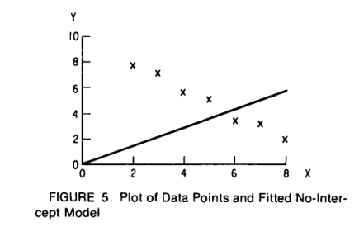
Model Comparison: $β_{0}≠0$
Intuitively, in general one might prefer the model which is unbiased and some anecdotal evidence might support that

Slide 19

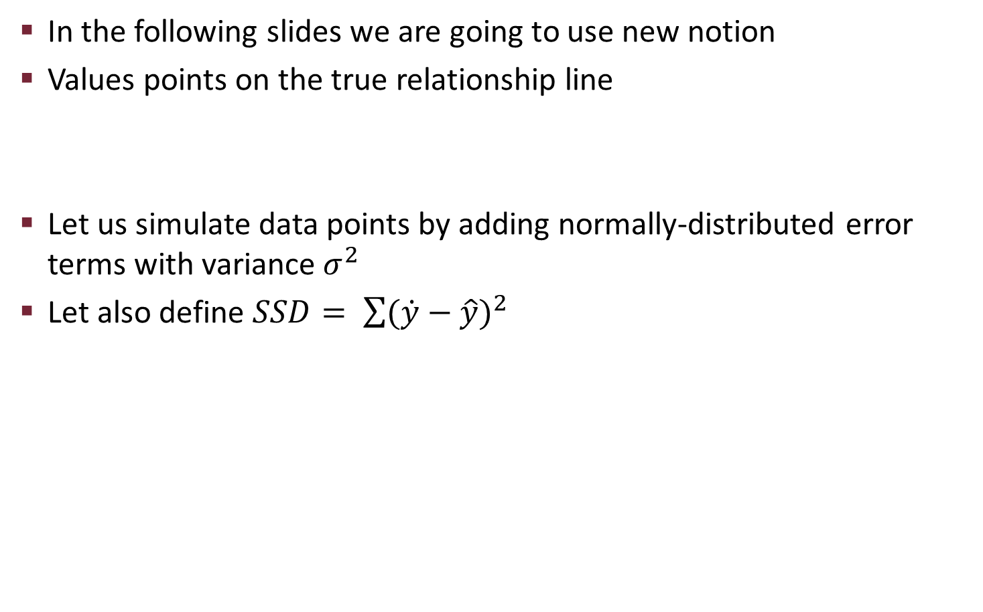
Model Comparison: $β_{0}≠0$
In the following slides we are going to use new notion
Values points on the true relationship line
Let us simulate data points by adding normally-distributed error terms with variance${ σ}^{2}$
Let also define $SSD= \sum{{(\dot{y}−\hat{y})}^{2}}$

Slide 20
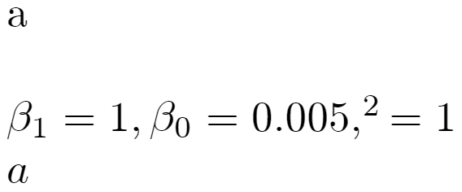
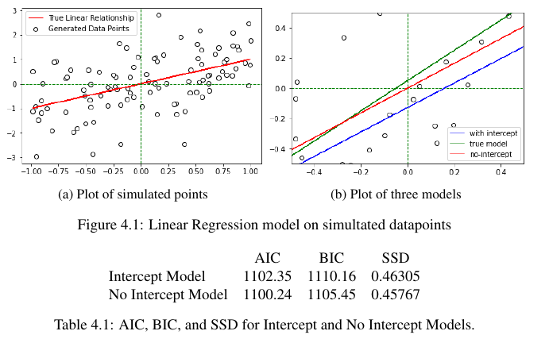
Simulation 1

Slide 21
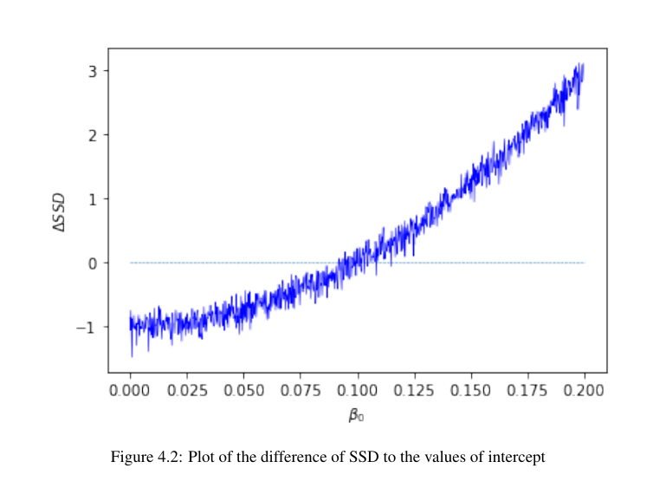
Simulation 2

Slide 22
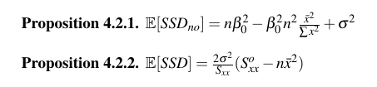
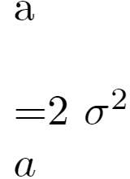

Slide 23


Expected value for the slope term (biased)

Slide 24
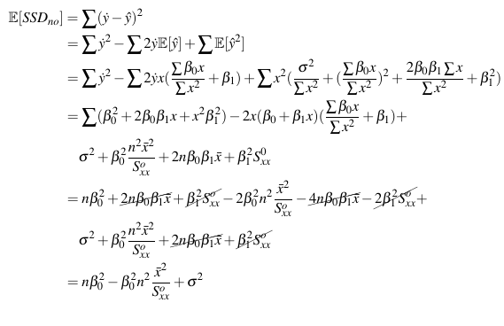
Proof of proposition 4.2.1

Slide 25







Slide 26
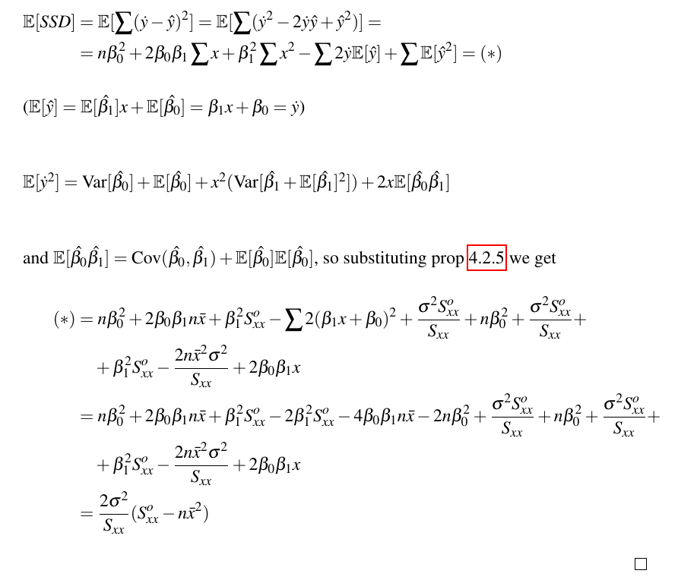
Proof of proposition 4.2.2

Slide 27
Conclusion
When true intercept is equal to zero RTO clearly is the best choice for the model
However, even if true intercept is non-zero RTO can be better model in average if the true intercept is very small

Slide 28
Question from reviewer
Q: Imagine that you fitted both linear regression versions to a sample of length n and would like to use the models to predict the dependent variable on a new sample. Can the non-intercept linear regression be better?
A: If the intercept is insignificant, RTO can be better. Also, general model can be too overfitted for the training sample and give results with higher SSE for a different sample. Even if the intercept is insignificant, using AIC/BIC can provide more information

Slide 29
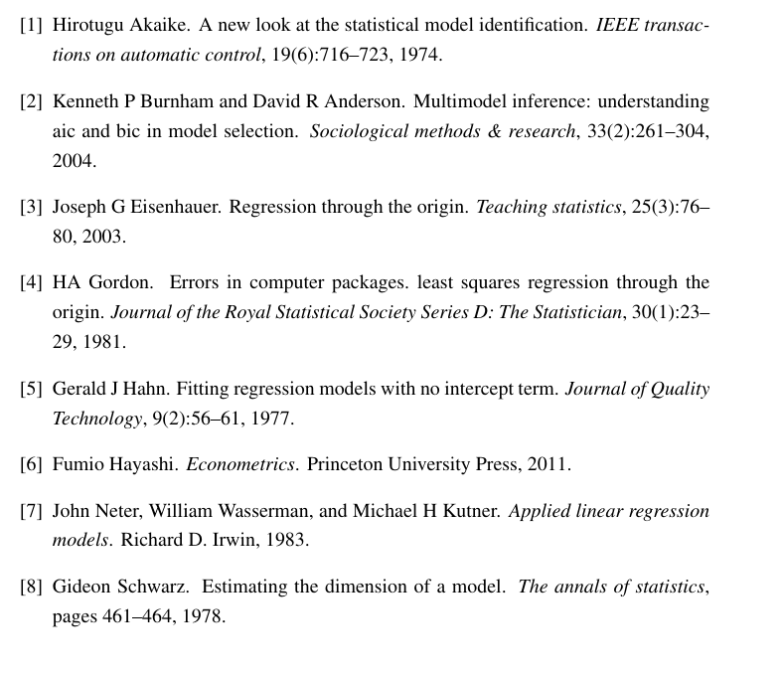
Bilbiography

Slide 30
Appendix

