Slide 1

SIREN (Siemens Rechargeable Emergency Notifier) Wristband
Team 5:
Chris Cortes Alex Nobles Steve Spinn | Baur Krykpayev Hieu Nguyen Steph Shinohara

Slide 2
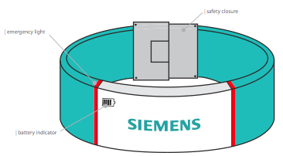
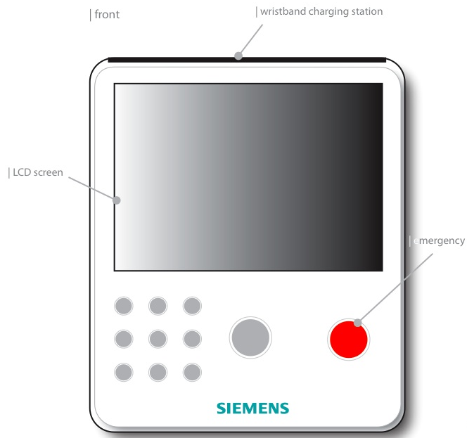
Agenda
Key Functions
  Monitor LCD & Keypad Interface
  Wristband LCD Interface
  Water Sensor & Alarm
  Synchronization
  Locate Wristband
  Wristband Battery Level Detector
Marketing/Art Influence
Schematics
Cost Analysis
Future Features

Slide 3
Marketing/Art Influence
Based parts choices on Marketing plan
  Chose cheaper, more reliable design
Art students had idea to include graphic LCD to entertain child
  Added more functionality to this idea and displayed status on screen

Slide 4
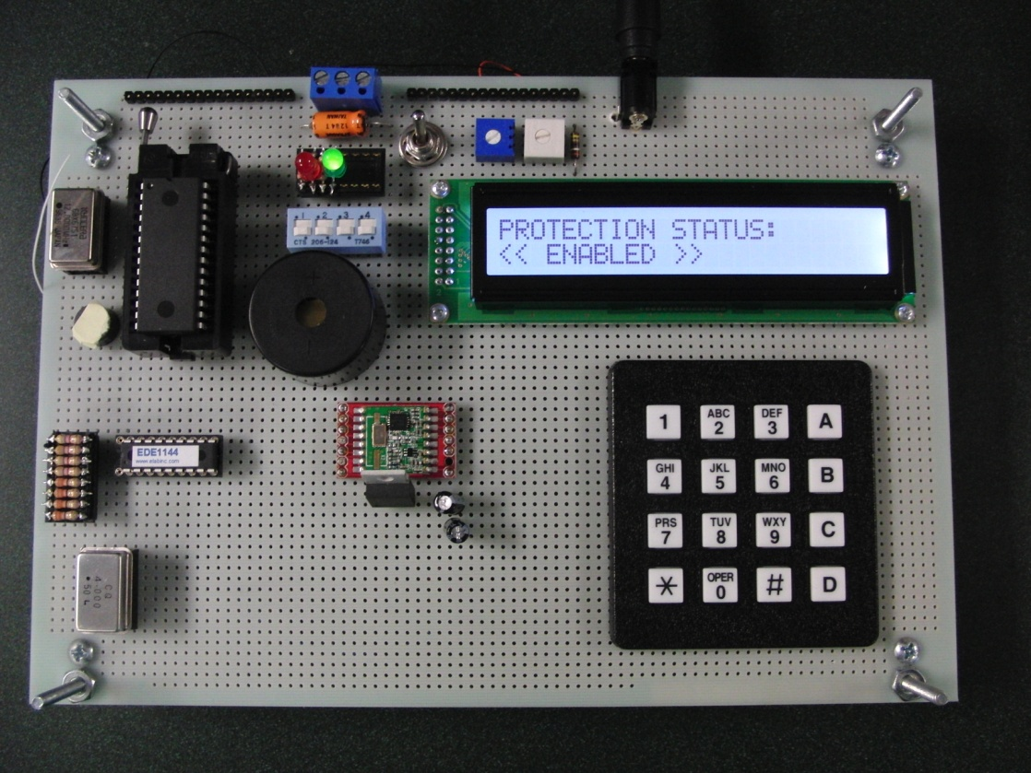
Monitor LCD & Keypad Interface
LCD: 24 x 2 character screen
User input: 4 x 4 keypad
Security: 4-digit password
Power Source: 5V Wall Adapter
  Configurable for rechargeable battery
Audio: alert buzzer, keypad feedback

Slide 5
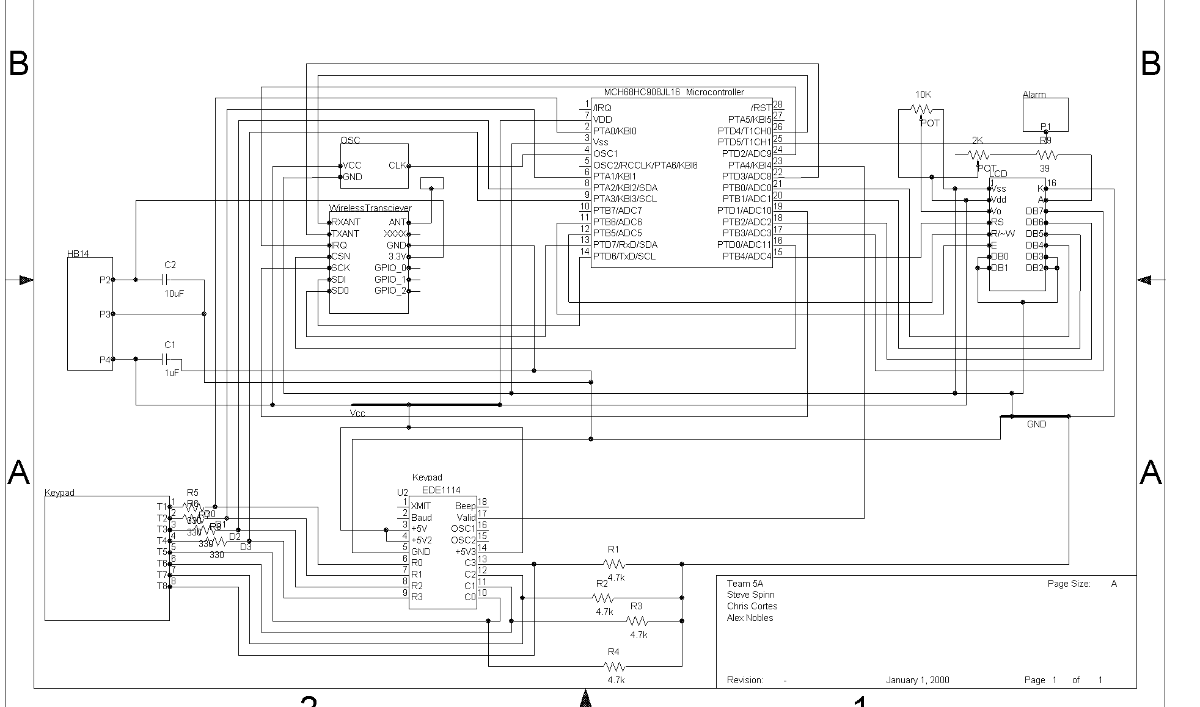
Monitor Schematic

Slide 6
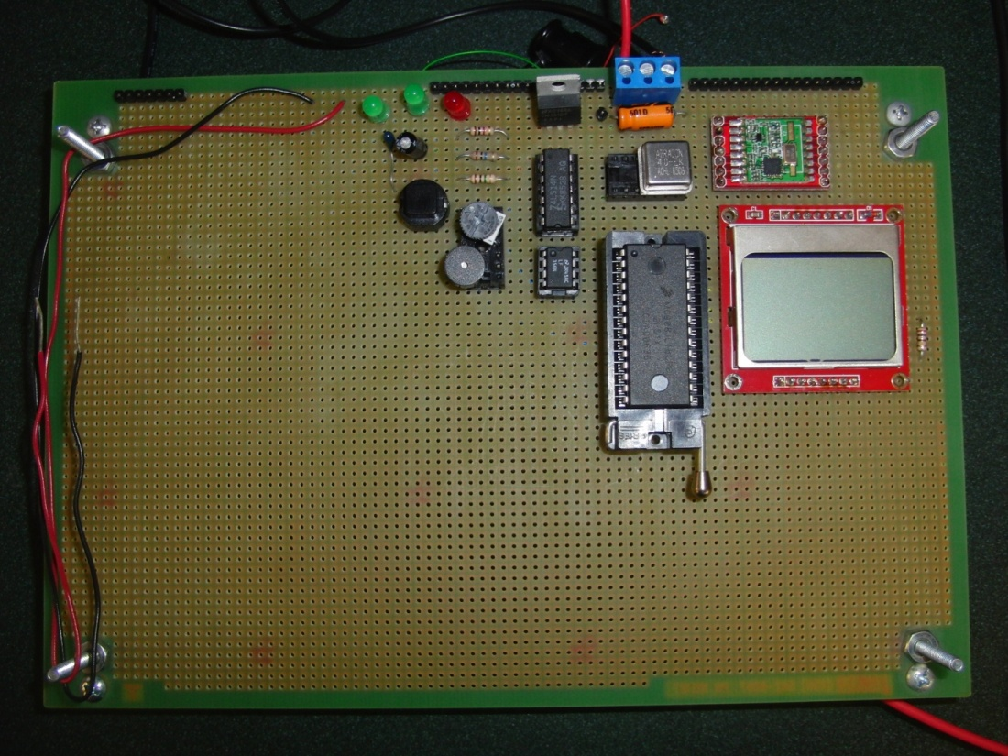
Wristband Components
JL16 Microcontroller
Nokia Graphic LCD
434MHz RF Transceiver
5V to 3.3V Regulation
Low Voltage 4MHz CLK
Push-Button & Debug LEDs
Buzzer
Li-ion Batteries
H2O Detection Circuit
Notes:
The hardware configuration for the SIREN wristband is fairly simple, only having a few major components: the JL16 Microcontroller, the Nokia Graphic LCD, and the 434MHz RF Transceiver. To make our design more energy-efficient, the entire prototype runs on 3.3 volts, with the exception of an op-amp in the water detection circuit that runs on 5 volts. Other components on the wristband prototype include a low-voltage 4MHz clock, a push-button and debug LEDs, a buzzer, and lithium-ion batteries (not pictured). There is also a simple water-detection circuit that uses the conductivity of water to bridge the connection between two wires, as shown here.

Slide 7
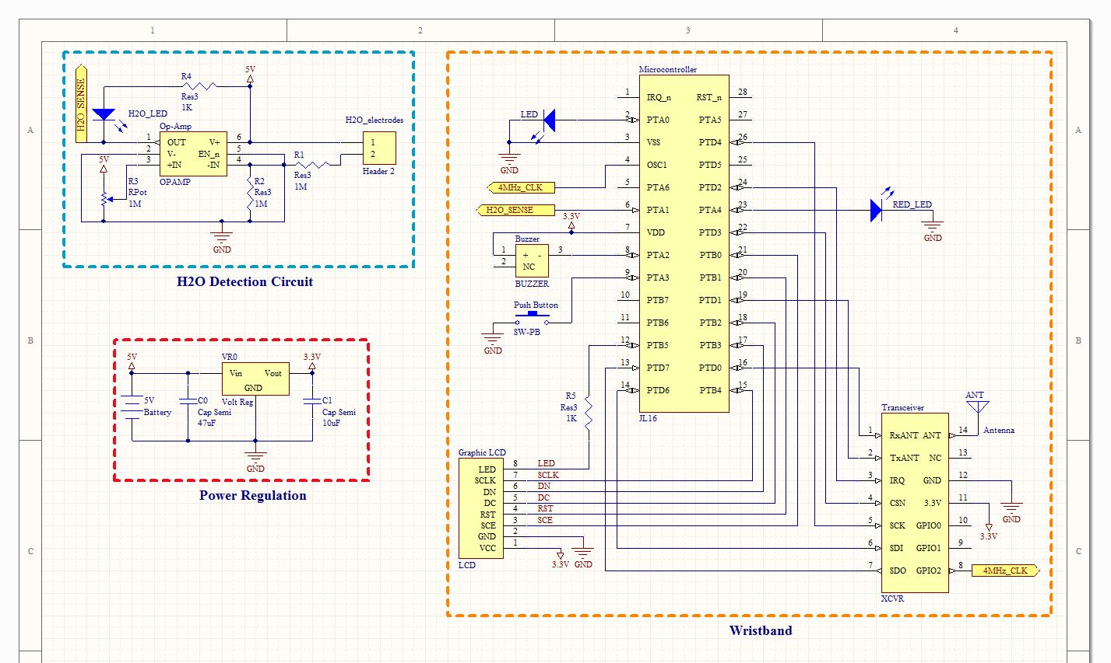
Wristband Schematic
Notes:
This is the schematic diagram for the wristband. Here is the water-detection circuit, the power regulation circuit, and the microcontroller circuit. When building this schematic, we included specifications for the package types and mechanical dimensions of each component. So, we were able to layout a PCB to visualize the approximate size of the actual product.

Slide 8
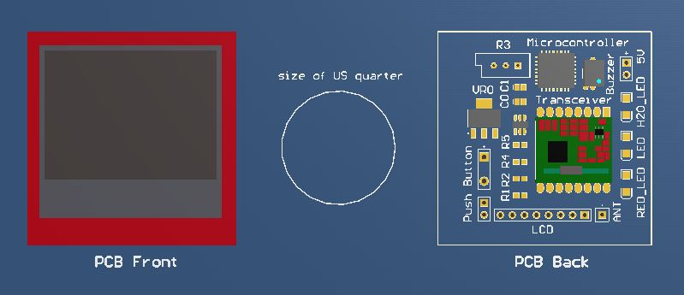

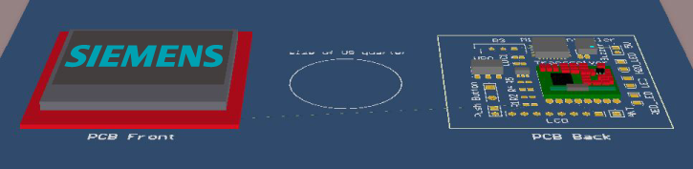
Printed Circuit Board
Notes:
Not including the batteries, we can fit all of the electrical components on a PCB the same size as the LCD, which is 45mm x 45mm. This side represents the front of the PCB, which will hold the LCD. And this side represents the back, which will hold the rest of the components. In this picture here, you can visualize the thickness of the design, which together is about 4mm. This design can probably be half of this size, if we use a smaller LCD and take out the unnecessary electrical components from the prototyped design.

Slide 9
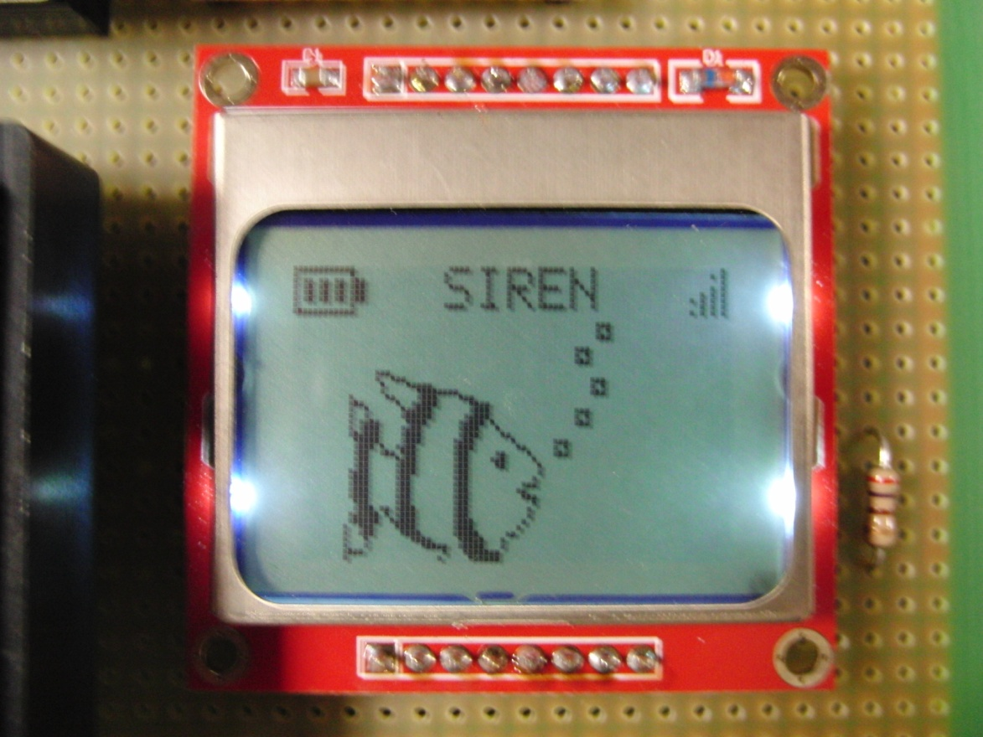
Wristband LCD Interface
On startup/recharge: Siemens logo displayed
Fish Animation for certain period of time
If inactive, goes into idle state (LCD off)

Slide 10
Synchronization - Monitor
push button on monitor
Waits for
wristband
IDLE
Gets packet
from wristband
Gets ACK
from wristband
- Saves wristband ID
Sends own ID to wristband
Notes:
Monitor waits to receive sync ID from wristband
When wristband button is held down*, it goes into sync mode and sends its wristband ID
Waits for monitor to send back acknowledge with its monitor ID
Wristband sends acknowledge of receipt to monitor and exits sync mode
If monitor wristband does not receive response from monitor after a few seconds, shows sync fail screen and exits sync mode
If not synced, communication between monitor and wristband will not work
* Wristband must be in active state (from idle state, push button to get to active state)

Slide 11
Synchronization - Wristband
FISH
SWIMS
Hold down
button
- Sends own ID to monitor
Waits for monitor’s ID
Does not receive ID
Receives monitor ID
Sync
Fail Screen
- Saves monitor ID
Sync Success Screen

Slide 12
Locate Wristband
Monitor transmits locate signal
Wristband checks for synced monitor ID
Wristband sounds buzzer until button is pushed or monitor sends stop signal

Slide 13
Locate Wristband
Poll for a locate signal
- Sends own ID to monitor
Waits for monitor’s ID
Does not receives ID
Receives monitor ID
Buzzer
Off
- Saves monitor ID
Sync Success Screen

Slide 14
Water Sensor & Alarm
Wristband:
  Presence of water completes circuit
  Triggers interrupt to transmit alert to monitor
If monitor is armed:
  Waits to receive alert from wristband
  Checks to see that synced wristband ID is sending alert
  Buzzer sounds until correct password is entered

Slide 15
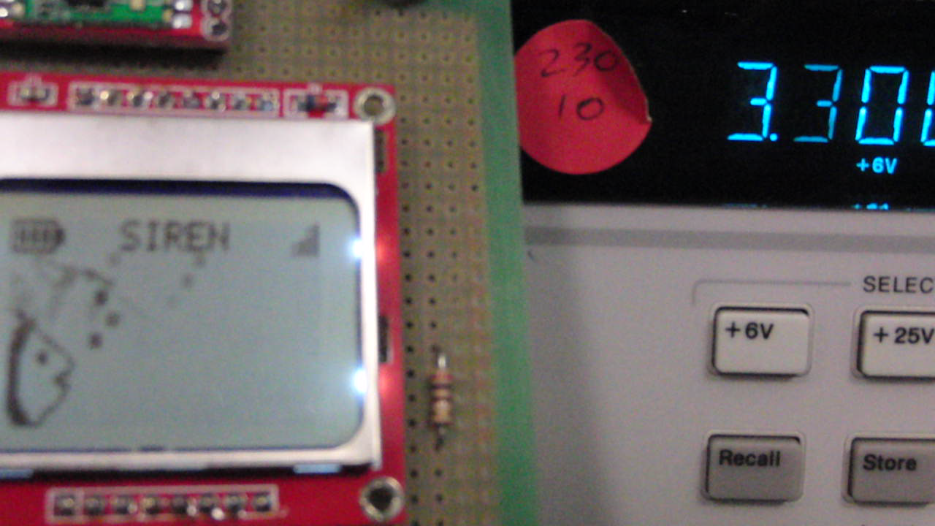
Wristband Battery Level Detector
Uses transceiver to monitor the current battery voltage
Updates LCD to indicate battery level

Slide 16
Monitor Cost Analysis
Part | Quantity | Bulk Unit Cost
Microcontroller | 1 | $ 1.74
Transceiver | 1 | $ 9.56
Buzzer | 1 | $ 3.49
24x2 LCD | 1 | $ 6.96
4x4 Keypad | 1 | $ 14.34
Miscellaneous (resistors, LEDs, voltage regulator, etc.) |  | $ 1.00
TOTAL: |  | $ 37.09

Slide 17
Wristband Cost Analysis
Part | Quantity | Bulk Unit Cost
Microcontroller | 1 | $ 1.74
Transceiver | 1 | $ 9.56
Buzzer | 1 | $ 0.25
Nokia Graphic LCD (84x48) | 1 | $ 7.96
Battery | 2 | $ 0.28
Miscellaneous (resistors, LEDs, voltage regulator, etc.) |  | $ 1.00
TOTAL: |  | $ 21.03

Slide 18
Future Features
Rechargeable batteries
Interactive wristband functions
Display wireless signal strength
Verify functionality of transceiver underwater

Slide 19
THANKS FOR YOUR ATTENTION!!
DEMONSTRATION!

