Slide 1
Porting the ISAAC QM-FIR Digital Filter Core to the iBoard
Hieu Nguyen
Section 345
Mentor: Dr. Yutao He
March 4, 2011
Notes:
Hello, my name is Hieu and today I will be speaking about the work I've done this spring, which I've called “Porting the QM-FIR Digital Filter Core to the iBoard”

Slide 2
Outline
Objectives & Motivation
Background Information
Technical Approach
  Hardware Configuration
  Testbed Setup
  Demonstration
Problems Encountered
Future Work
Notes:
I will start by stating the project objectives and motivation. Then I'll discuss some relevant background information. I'll move on to talk about my technical approach dealing with the hardware configuration, the testbed setup, and my results through a live demonstration. I will mention the problems I've encountered along the way. And I'll finish up with a discussion of planned future works.

Slide 3
Objectives & Motivation
Port the QM-FIR digital filter core to the iBoard, with iPanel as control and display
Consolidate different versions of the digital filter core (SMAP with processor, SMAP w/o processor, DESDynI, …)
Reverse engineer to provide complete documentation
Motivation:
  QM-FIR is part of ISAAC's iCore-dsp library
  Application to NASA space missions, such as the Soil Moisture Active-Passive (SMAP) L-band radar in the ISAAC Newton project
Notes:
The main objective of this project is to port the QM-FIR digital filter core to the iBoard, and use iPanel as control and display. Older configurations of the filter were implemented on older systems using Virtex-II and Virtex-4 FPGAs, but the current iBoard uses Virtex-5. So, porting involved integrating old with the new—utilizing different HW components and timing requirements. I aimed to verify the filter's design and functionality with simulated radar data.
Another objective is to consolidate different versions of the digital filter core (such as SMAP with processor, SMAP w/o processor, and DESDynl). There are multiple implementations of the QM-FIR with different specs, so consolidating will lead to a more modular design.
And of course, I had to reverse engineer the existing core design to provide complete documentation.
The QM-FIR core is part of the iCore library, which is a collection of “standard and parameterized IP cores that implement common computationally-intensive instrument control and computing functions.” It should have applications to various NASA space missions, as it has had in the past with SMAP's radar in the ISAAC Newton project.

Slide 4
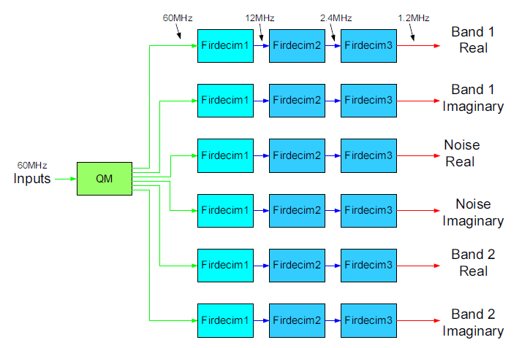
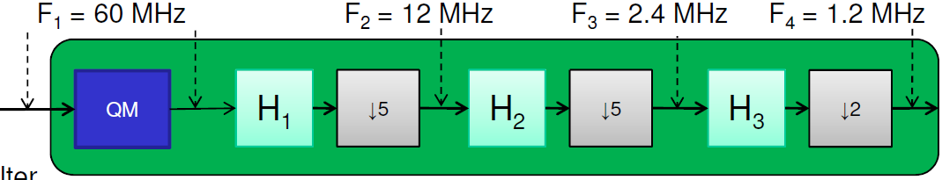
Background Information
The QM-FIR digital filter core merges two modules:
  QM and FIRDEC
Quadrature Demodulation
z(t) = I(t)*cos(ω_{c}t) + Q(t)*sin(ω_{c}t)
  I(t) - “in-phase” component
  Q(t) - “quadrature” component
Polyphase FIR Decimation
  Turn high-rate samples into data that is ready to be down-linked for further ground processing
  Three decimation stages for a ratio of 5x5x2 = 50x downsampling
Notes:
The QM-FIR filter itself is a combination of two modules: Quadrature Demodulation, and a Polyphase Decimation. From a mathematical standpoint, this is what a QM 2-dimensional complex signal looks like. The I/Q or real/imaginary parts of a signal are modulated with a cosine and sine at a particular carrier frequency to convey data in telecommunication systems. The QM takes in this signal and demodulates it, moving the subbands to baseband to recover the original data.
The FIRDEC uses a multi-stage decimation to turn the high-rate samples into data ready to be down-linked for further ground processing. It does a 50x decimation from a 60MHz input to a 1.2MHz output data rate.
- Equivalent to a demodulation decimating bandpass channelizer, which moves each of the subbands to baseband, filters it out to remove out-of band interference, and decimates it to yield a complex (I/Q) output data rate of 1.2MHz
--> equivalent to both ASK and PSK a single carrier
The signal is modulated, meaning the input signal varies the characteristics of a radio frequency carrier (sine wave)

Slide 5
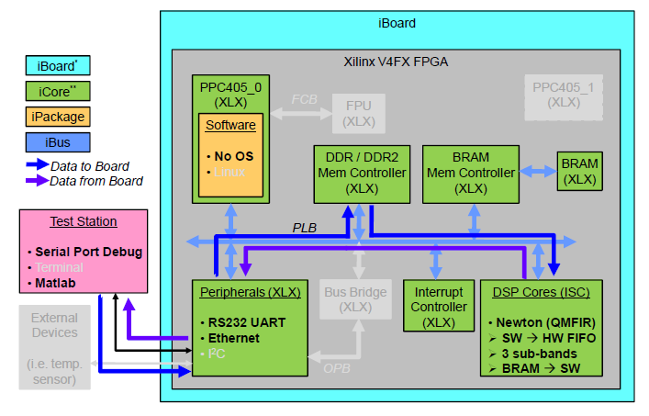
Background Information
QM-FIR core architecture
  iReg
  BRAM
  MAC
  QMFIR
    QM
      LkupTbl
    Firdecm
      firdecim_m5_n15
      firdecim_m5_n20
      firdecim_m2_n50
Notes:
The QM-FIR core architecture is somewhat complex
iReg keeps track of internal counters and pointers for interrupt control
The block RAM is where data is stored
The Ethernet MAC functions as packet transactions
The QMFIR has two parts:
The QM core is implemented using a sine/cosine lookup table and requires 6 multipliers running at 60MHz
FIRDEC core is implemented as a three-stage polyphase decimation filter
This picture illustrates how the different components are layout and connected with each other, but more on that later

Slide 6
Technical Approach
Integrate old EDK project with new iBoard HW/SW configuration
Revise and complete .m, .c, and .v source code
Verify QM-FIR digital filter core functionality using Matlab GUI and UDP transmission
Notes:
My technical approach to this project was primarily to start and develop a new project design from scratch, using the existing digital filter core as a model. First, I integrated the old EDK project with the new iBoard configuration. This involved removing or replacing certain components like the Compact Flash and other digital logic cores. The next step was to revise and complete the existing Matlab, C, and Verilog source code because the software controls the overall data flow of the design. The last task was to verify the digital filter's functionality, and I did so using a Matlab GUI and UDP Ethernet communication between an iBoard and a host machine.

Slide 7
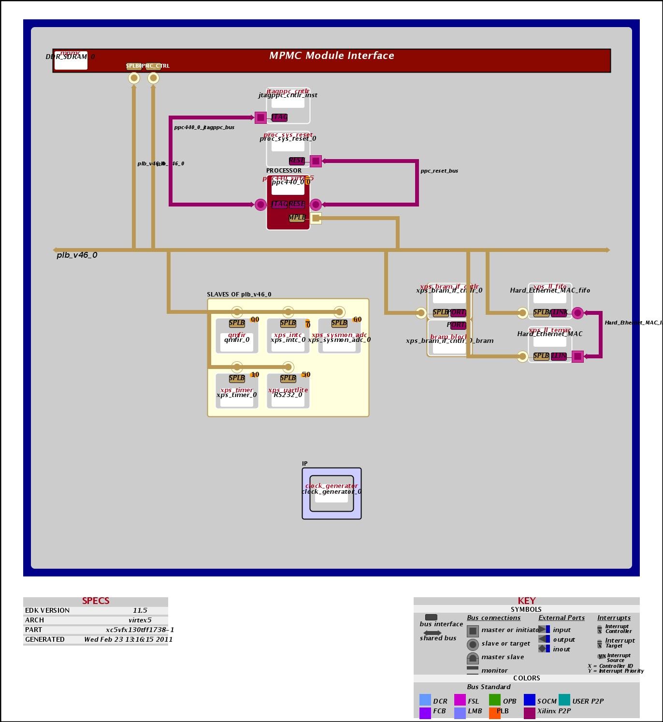
Hardware Configuration
Notes:
Here is a block diagram generated in EDK, which shows the connections between the different cores of my FPGA system. You can see here that it uses a PowerPC interfaced to several slave devices over the PLB – processor local bus. The hardware configuration consists of memory (DDR, BRAM), Ethernet MAC, UART, and interrupt controller, and a custom IP core called “qmfir,” which does the filtering.

Slide 8
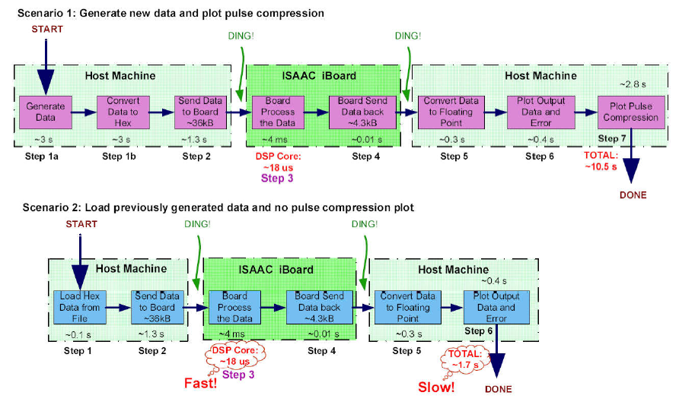
Testbed Setup
Overall System Data Flow
Notes:
Image from Kaylas
This is the overall system data flow for the testbed. It starts when Matlab generates synthetic input hex data or loads it from a file. The hex data is transferred to the iBoard where it is processed through the filter. The iBoard transfers the data back to the host machine where it is converted into floating point and can be viewed through a Matlab GUI.

Slide 9
Testbed Setup
Matlab, C, and Verilog source code control the FPGA Data Flow
pnet(udp,'writepacket',remoteport);
recv_callback();
QMFIR_mWriteToFIFO();
assign WFIFO2IP_Data_int[31:0] = ...
assign RAM2IP_Data_int[31:0] = ...
ICNT[31:0] <= ICNT[31:0] + WFIFO_WE;
iReg_intr <= WMI | OVFL;
qmfir_intr();
transfer_data();
pnet(udp,'readpacket');
Notes:
In terms of environment setup, on the host machine, you'll have a serial terminal for debugging and Matlab running the testing algorithms to visualize the data. The host machine and iBoard are connected via Ethernet and data is transferred using UDP. Wireshark can monitor packet data over the USB/Ethernet adapter.
The software architecture takes care of the FPGA data flow from host machine to iBoard to qmfir core, and back.
The software architecture is comprised of Matlab, C, and Verilog source code that control the data flow in the FPGA. The Matlab code controls the UDP rx/tx on the host machine side, whereas the C code manages UDP on the iBoard side. Once the iBoard receives a UDP packet through a Temac FIFO, it writes it into a QMFIR writeFIFO where the Verilog code steps in. The Verilog controls the hardware and assigns the input data to be processed through various filter modules and eventually, the output is written into 3 local block RAMs. A register, called ICNT, keeps track of the number of inputs, and when that number reaches a certain watermark threshold, an interrupt is generated that triggers the iBoard to send data back to the host machine.

Slide 10
Demonstration
Notes:
The GUI plots the output data and the expected data generated by mathematical algorithms in Matlab. It also plots the error between the output data and the expected data, as well as a pulse compression plot.
The top figure shows the data that is sent to the board to be processed. This data is sampled at 60MHz. The 2nd line shows the real data from Band 1, Band 2, and noise band from left to right. The 3rd line shows th imaginary data from Band 1, Band 2, and noise band from left to right. Line 4 shows the error between the real data of the FPGA processed data versus the data from simulation (Band 1 and Band 2 from left to right), and line 5 shows the error between the imaginary data. The last plot of lines 4 and 5 shows the pulse compression plots of the FPGA processed data.
The blue is the floating point Matlab simulated output, while the red is the fixed point hardware output from the iBoard. As you can see, they are very similar and the error is low (on the order of 10^-4), so the filter meets expectation and its functionality is verified.

Slide 11
Problems Encountered
Unfamiliarity with complex FPGA system design
  Acquired new skills using EDK, ChipScope Inserter/Analyzer, XMD, iMPACT, Wireshark, ethtool, Kermit
  Data flow diagrams for visual aid
After receiving data, iBoard does not transmit data back
  Fixed interrupt setup in source code
  Introduced a pause() to slow down UDP transmission rate, avoiding Temac Rx FIFO overrun errors and data packet loss
Notes:
So, as you just witnessed, I was able to implement the QM-FIR digital filter core on the iBoard, but it was not a smooth task. I ran into several problems along the way, mostly because of my unfamiliarity with such a complex FPGA system design. I spent a couple weeks learning how to use various design and debug tools. I was working with an old revision of the code because the old svn repository was lost. Learning how to fix design errors,
The biggest problem I had was that after receiving data from Matlab, the iBoard was not transmitting any data back. I was able to attribute this problem to the qmfir interrupts not being generated. I met with Jason a couple times to figure out how to properly setup the interrupts in the source code and get a better understanding about how they work. After I got the interrupts working, I noticed that the iBoard Temac Ethernet Tx FIFO had substantial packet loss, which caused the interrupt trouble. The FIFO was overrun and was not receiving the expected amount of data to generate an interrupt. To reduce packet loss, I slowed down the UDP transmission rate, adding a delay after each individual packet was sent from the host machine to the iBoard.

Slide 12
Future Work
Resolve bottleneck issue to preserve high-speed data processing
Implement digital filter entirely in hardware (no processor), sending/receiving data over UART, LVDS, SerDes, etc. interfaces
Utilize ADC/DAC board to simulate data acquisition in real-time
iPanel, a Python-based GUI that allows easy data visualization, control, and monitoring of FPGA-based digital systems
Notes:
Although slowing down the transmission rate works, it does not operate how it is intended. In my future work, I plan to resolve this issue by locating the bottleneck to preserve high-speed data processing.
Some other things I will continue to work on is implementing the digital filter entirely in hardware, using an ADC/DAC board for real-time simulation, and working with Kevin to develop an iPanel interface that will allow easy data visualization
User Data Protocol (UDP) – uses less overhead, but provides no assurance of delivery of any packet of data (increased data efficiency)

Slide 13
Acknowledgment
Mentor: Dr. Yutao He
Group Supervisor: Bill Whitaker
Technical Advisors: Kayla Kobayashi and Jason Zheng
Debby Cuda, Dean Holt, Petra Kneissl-Milanian
Interns
  Chester Lim
  Simon Margolis
  Kevin Ortega
  Eugene Sahagun
  Carson Umsted
Notes:
I would like to acknowledge a few people who have helped me along the way. They include my mentor, Yutao, my group supervisor, Bill Whitaker, ...

Slide 14
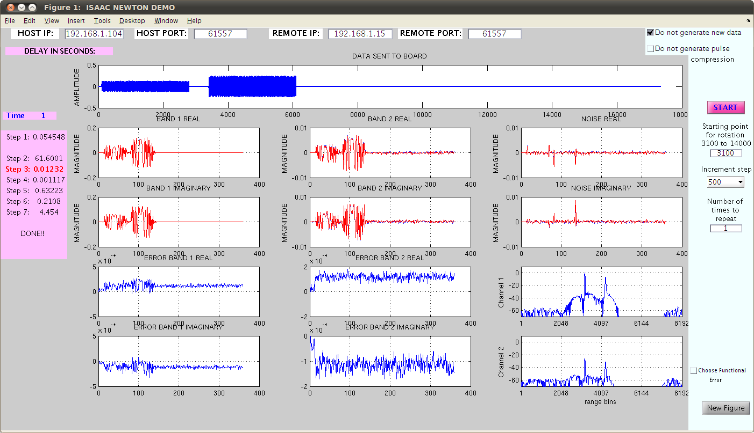
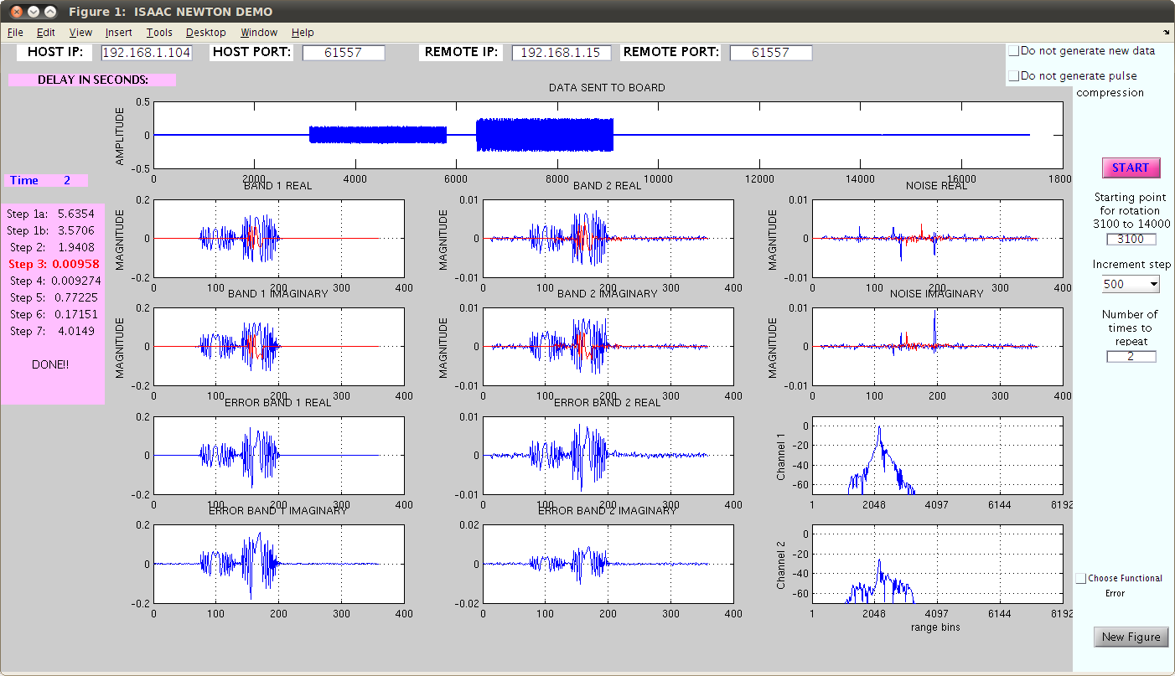
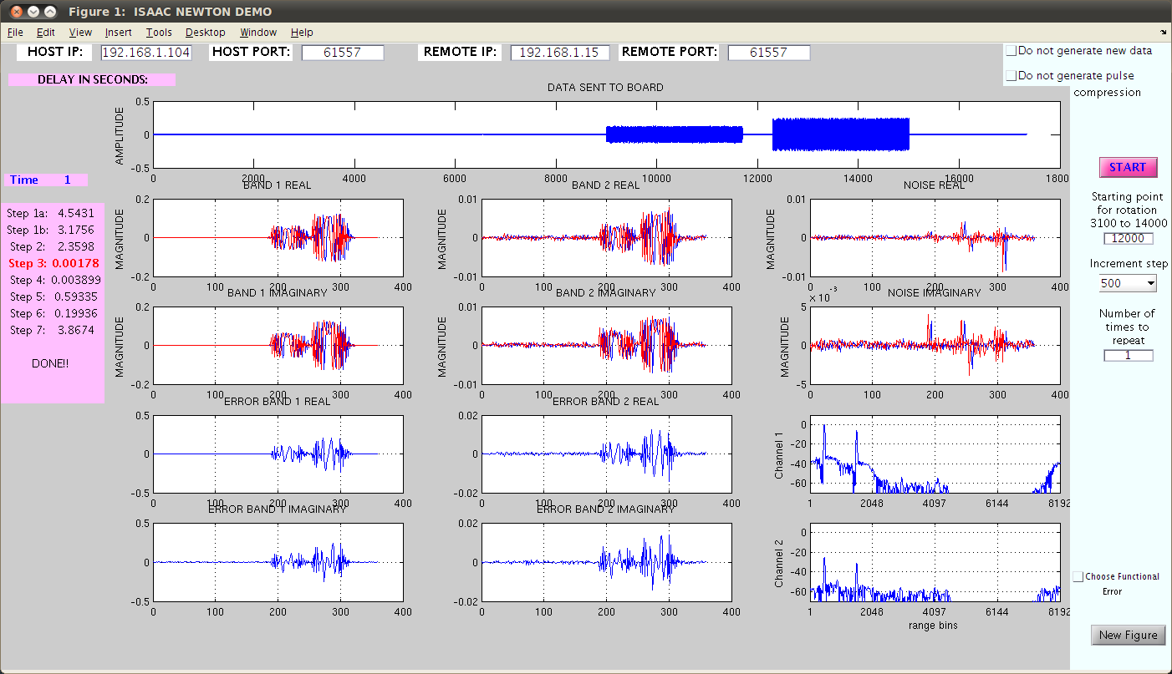
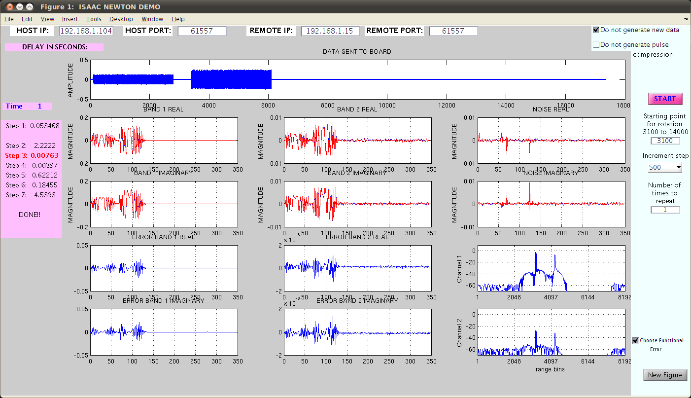
Backup Demo

