Slide 1

ISAAC Demo Plan
ISAAC Newton
Charles Le, Jason Zheng, Kayla Nguyen
July 24, 2008

Slide 2
Agenda
SMAP Requirements
  System Requirements
  Filter Requirements
Demo System
Algorithm Development
Hardware Design and Development
FPGA Design and Development
Software Design and Development
Hardware/Software Interface
iBench
Demo Plan

Slide 3
Demo Overview
Isaac Newton
Isaac Asimov
Isaac Stern
Targeted Missions
SMAP
ACE
SWOT/HAMSR
Instruments
L-band Radar
Imager (MSPI)‏
Radiometer
Key Capabilities
Digital Filtering
On-Board Processing
Control and Timing
Demo Lead
Charles Le
Paula Pingree
Will Zheng
Demo Team
Jason Zheng Kayla Nguyen

Slide 4
Agenda
SMAP Requirements
  System Requirements
  Filter Requirements
Demo System
Algorithm Development
Hardware Design and Development
FPGA Design and Development
Software Design and Development
Hardware/Software Interface
iBench
Demo Plan

Slide 5
SMAP Digital System Requirement
PARAMETER:
REQUIREMENT:
Computation Speed (MIPS/BOPS)‏
2 GOPS (minimum, w/o fault-tolerance design)‏
On-Board Instrument FSW Storage
10 (TBR) Mbits
On-Board Instrument Data Storage
40 (TBR) Mbits
On-Board Science Data Processing Capabilities
I/Q Demodulation with decimation
Power Detection and Multi-looking
Noise extimation
On-Board-Radar Control/Timing Capabilities
Mode/system control
S/C I/F
Commanding and telemetry
Instrument control
Onboard instrument/data calibration/diagnostics
Simple (non-autonomous) fault protection
FSW Needed
No
Processor Reconfiguration
Yes
Processor Reconfiguration Time
<100ms requirement-driven (periodic reconfig each scan)‏
In-flight bit-file Update
Yes (highly desirable)‏
Mass
<16 kg for one

Slide 6
SMAP Digital System Requirement
Cont’
PARAMETER:
REQUIREMENT:
Power
<50 W
Interface: Inputs
Signal / Type / Data Rate (Freq. Or BW)‏
Ref (STALO) clock ADC Clock / Digital ITBR) / ~200-250MHz
H-Beam Radar Video / Analog / ~80MHz BW?
V-Beam Radar Video / Analog / ~80MHz BW?
Reflector Position / clk, data, sync / min: 1 per rotation at 4.1s – 14.6 RPM rotation rate
HK Telemetry / Analog / sample at ~1Hz, ~64 (TBR) channels
Interface: Outputs
Signal / Type / Data Rate (Freq. Or BW)‏
L-Burst Timing Signals / Digital / ~10kHz
L-Pulse Timing Signals / Digital / ~1kHz
LH-Beam T/R Timing / / ~3.5kHz
LV-Beam T/R Timing / / ~3.5kHz
Radiometer Blanking / Digital / ~3.5kHz
Processor Radar Data / ~33Mbps
ADC or DAC on board
ADC is done on-board
Dimension
<5 6U cards (single-string, including ADCs, CTU, Data Processor, housekeeping, PCUs)‏
Radiation Requirement
50 Krad (orbit 650 – 800km, near polar)‏

Slide 7
SMAP Digital Filtering Requirement
PARAMETER:
REQUIREMENT:
Bandwidth
1MHz chirped signal
H-Channel / V-Channel / Noise Channel
Input Sampling Rate
60MHz
Output Sampling Rate
1.2MHz complex
Passband Ripple
-40dB
Stopband Ripple
0.1dB
ISLR
-20dB (TBR)‏
PSLR
-30dB (TBR)‏
Pulse Broadening
1.2

Slide 8
Agenda
SMAP Requirements
  System Requirements
  Filter Requirements
Demo System
Algorithm Development
Hardware Design and Development
FPGA Design and Development
Software Design and Development
Hardware/Software Interface
iBench
Demo Plan

Slide 9
Demo System Requirements
Show Matlab floating point
Run HDL design
Plot and compare HDL and Matlab
Basic capabilities:
  On board processing
  Speed
  Operation Scenario
  Test data generation

Slide 10
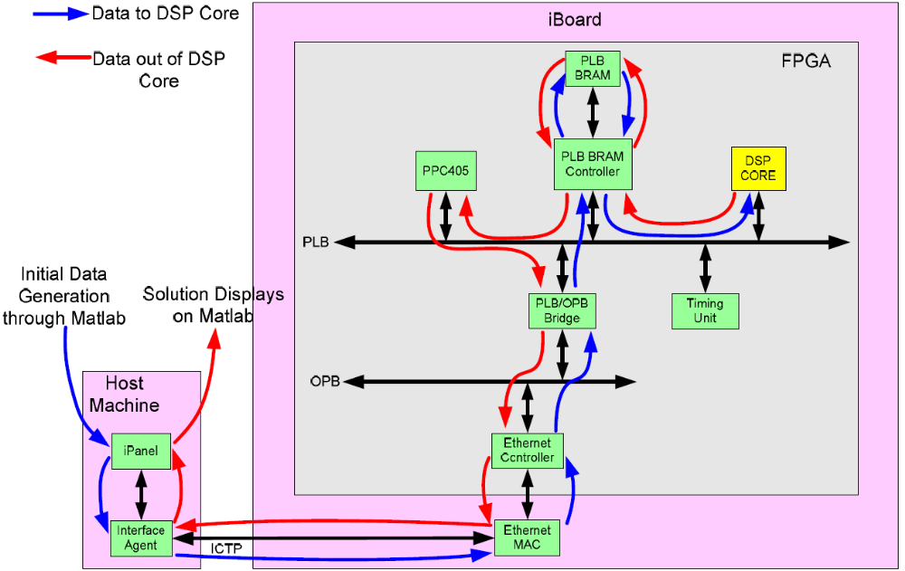
Demo System Top-Level Block Diagram and Data Flow

Slide 11
Agenda
SMAP Requirements
  System Requirements
  Filter Requirements
Demo System
Algorithm Development
Hardware Design and Development
FPGA Design and Development
Software Design and Development
Hardware/Software Interface
iBench
Demo Plan

Slide 12
Algorithm Development
Charles’ Algorithm

Slide 13
Agenda
SMAP Requirements
  System Requirements
  Filter Requirements
Demo System
Algorithm Development
Hardware Design and Development
FPGA Design and Development
Software Design and Development
Hardware/Software Interface
iBench
Demo Plan

Slide 14
Hardware Design and Development
ML410 board provides most of the hardware functions:
  Ethernet
  FPGA with embedded processor
  Clock source
  SRAM and DRAM
FPGA needs:
  Newton DSP core (done)‏
  OPB wrapper for DSP, FIFO interface
  Clock divider for Newton to generate 60MHz clock
  Register/control block
DRB
OPB
Register/
Control
FIFO
Newton
DSP
CLK
GEN

Slide 15
Agenda
SMAP Requirements
  System Requirements
  Filter Requirements
Demo System
Algorithm Development
Hardware Design and Development
FPGA Design and Development
Software Design and Development
Hardware/Software Interface
iBench
Demo Plan

Slide 16
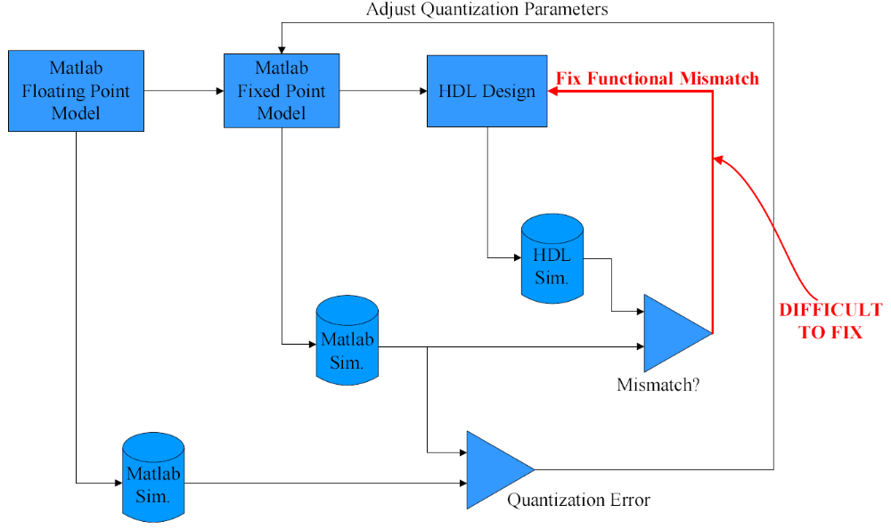
Traditional Hardware Design Methodology

Slide 17
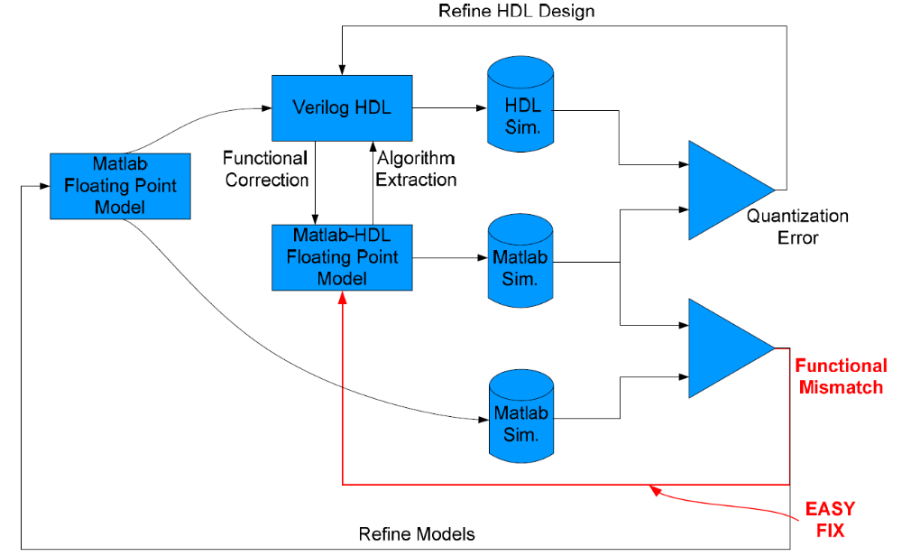
ISAAC Newton’s Hardware Design Methodology

Slide 18
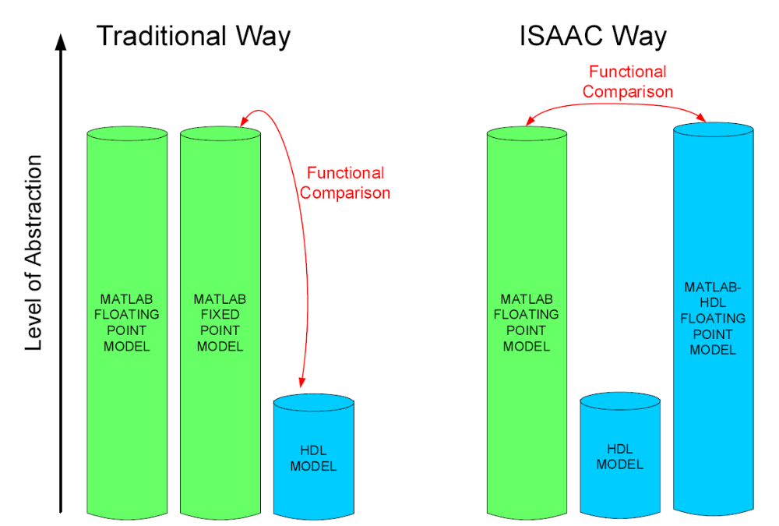
Method Comparison

Slide 19
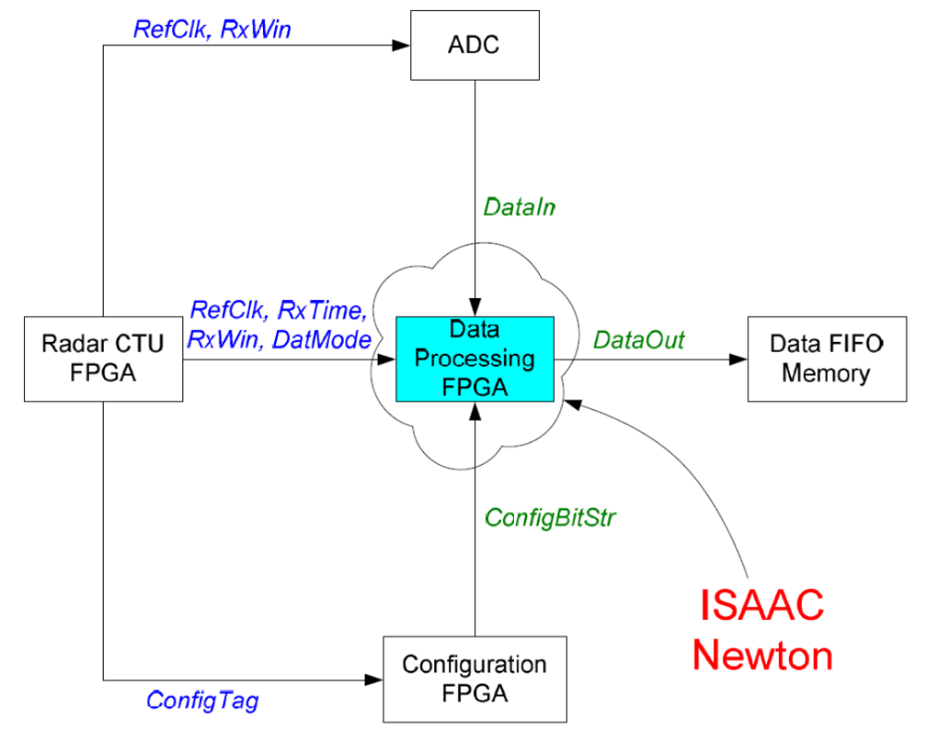
SMAP’s DPU Interface

Slide 20
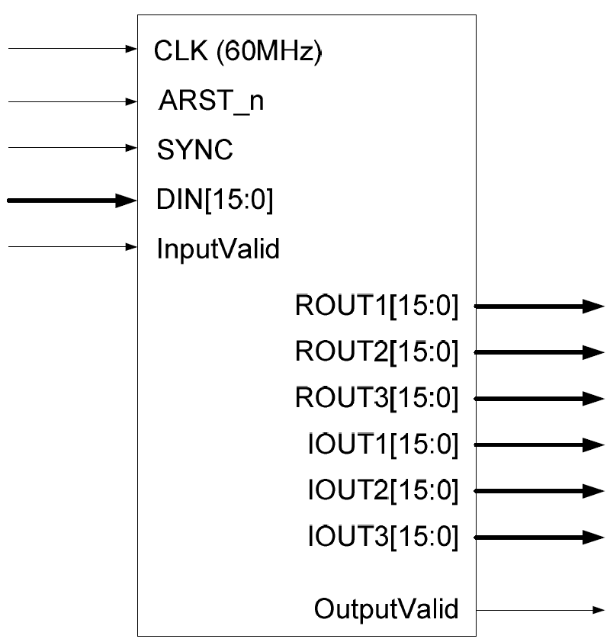
SMAP Data Processor Interface

Slide 21
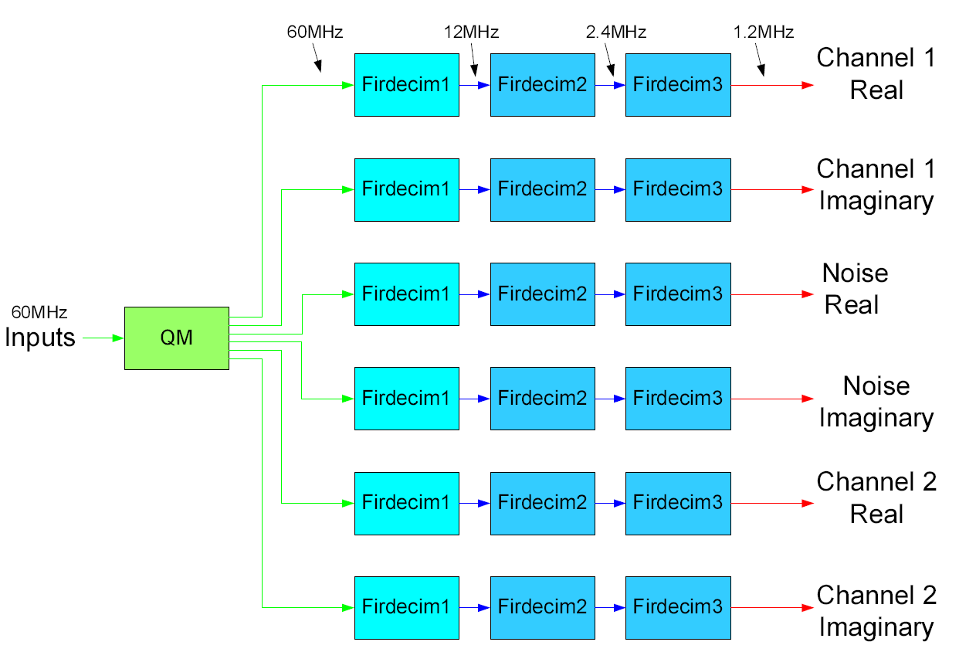
Quadrature Modulation and Polyphase Decimation Filters
36 total multipliers

Slide 22
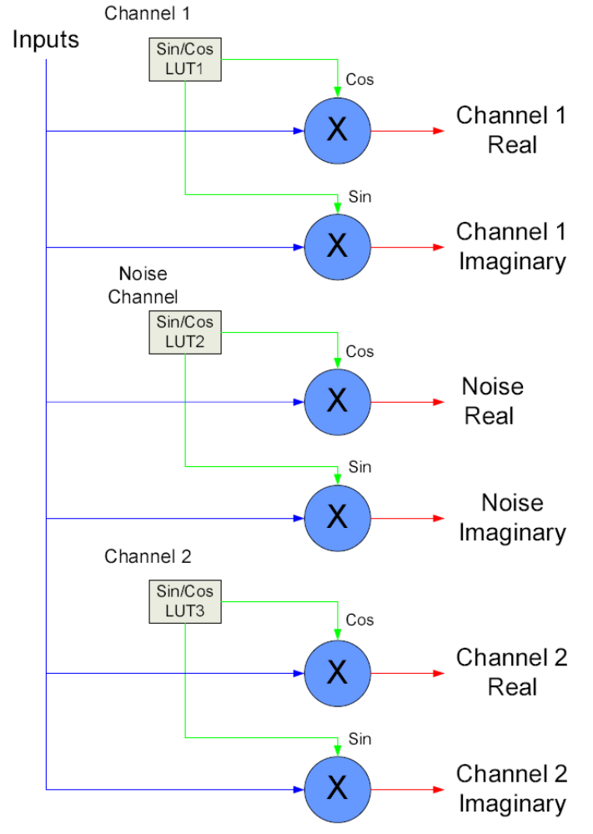
Quadrature Modulation
6 multipliers (3 channels, real and imaginary)‏
60MHz input
Multipliers running at 60MHz
Sin/Cos Look up Tables are generated through a Python script. Each table is optimized to the channel’s specific center frequency and the sampling frequency of 60MHz.
  Channel 1: 12.5MHz
  Noise Channel: 15MHz
  Channel 2: 17.5MHz

Slide 23
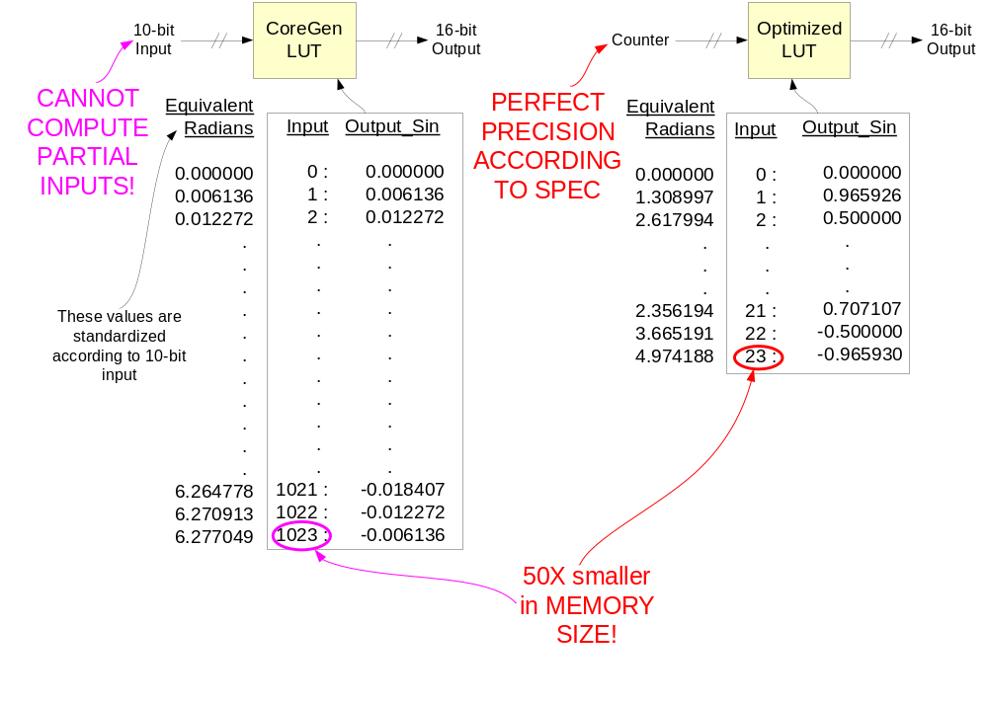
Quadrature Modulation: Sin/Cos Lookup Table Optimization

Slide 24
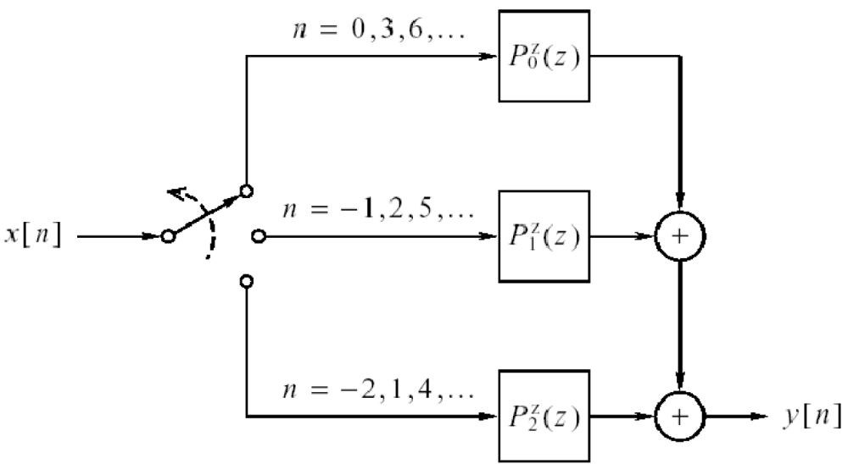
Polyphase Decimation: Traditional View
Source: Porat’s Book, Fig. 12.17

Slide 25
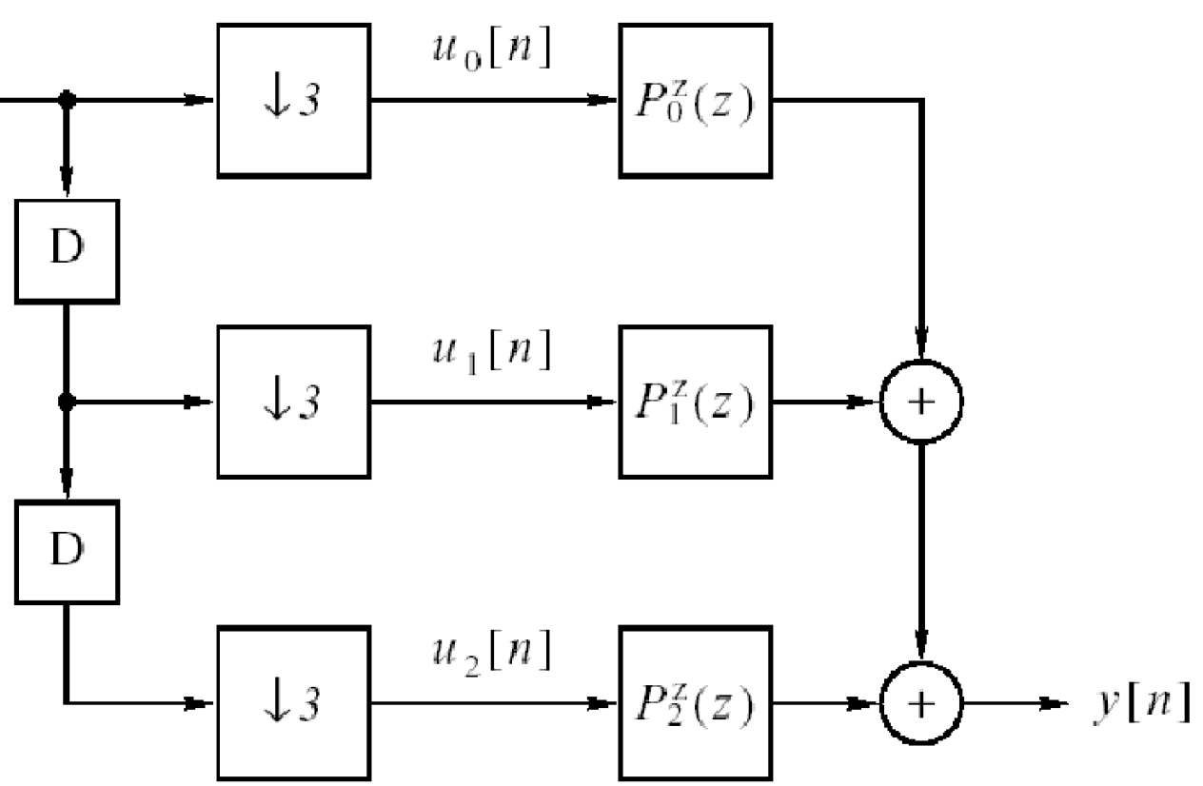
Polyphase Decimation: Traditional View
Source: Porat’s Book, Fig. 12.16

Slide 26
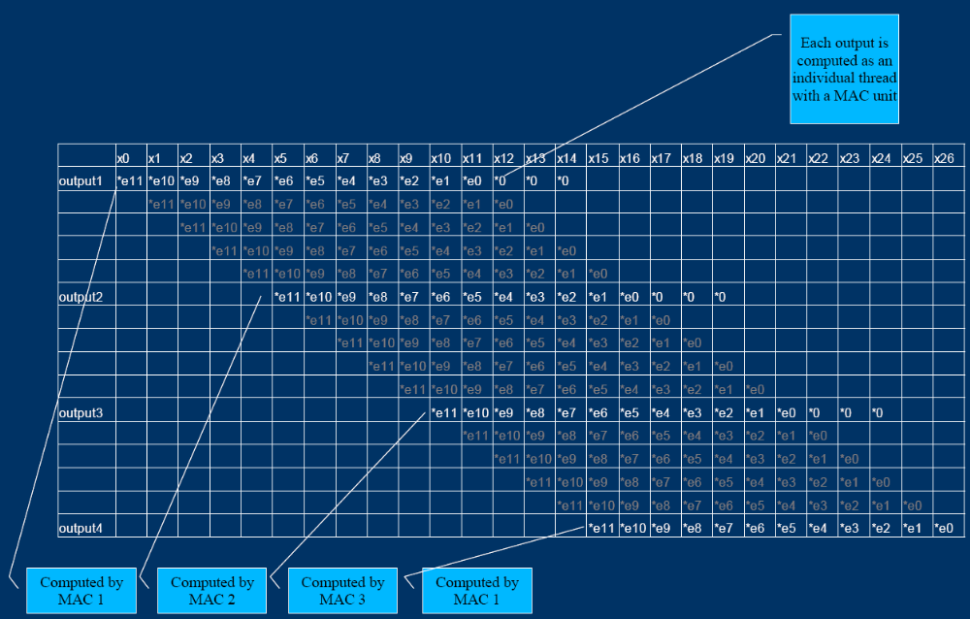
ISAAC’s Polyphase Decimation: Thread View

Slide 27
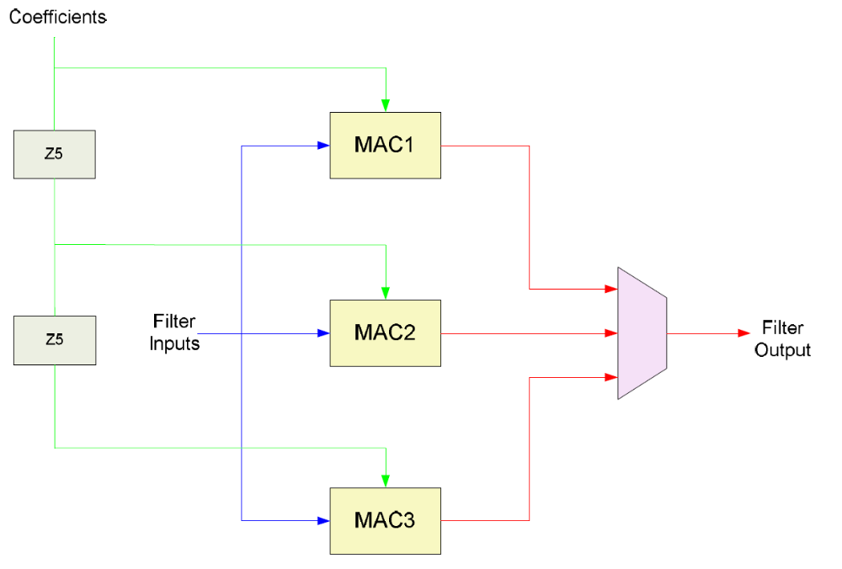
Polyphase Decimation: First Stage Design
L = 15
Decimation M = 5
60MHz Filter Inputs
3 multipliers
Multipliers running at 60MHz
Each MAC is reset after every 15 inputs

Slide 28
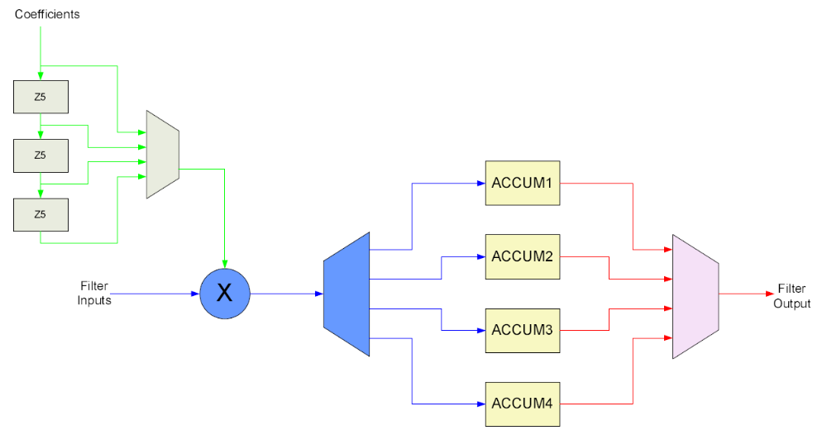
Polyphase Decimation: Second Stage Design
L = 20
Decimation M = 5
12MHz input (decimated by 5 from first stage)‏
1 multiplier
Multiplier running at 60MHz (5 times the speed of the input)‏
Each Accumulator is reset after every 20 inputs

Slide 29
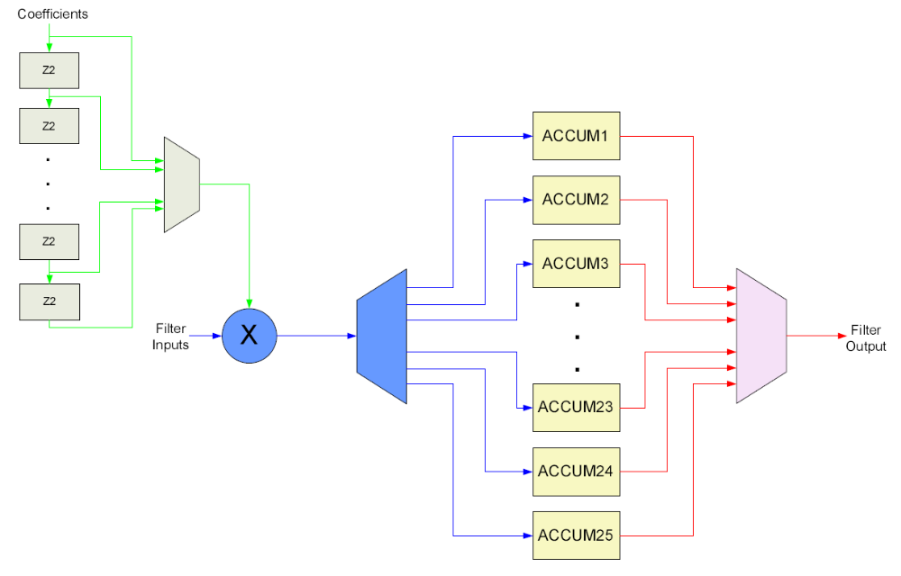
Polyphase Decimation: Third Stage Design
L = 50
Decimation M = 2
Each Accumulator is reset after every 50 inputs
2.4MHz input (decimated by 25 from first and second stage)‏
1 multiplier
Multiplier running at 60MHz (25 times the speed of the input)‏
1.2MHz Output

Slide 30
Agenda
SMAP Requirements
  System Requirements
  Filter Requirements
Demo System
Algorithm Development
Hardware Design and Development
FPGA Design and Development
Software Design and Development
Hardware/Software Interface
iBench
Demo Plan

Slide 31
Software Design and Development
Embedded Processor
  ICTP userland driver
  User program to facilitate data transfer
  DSP Core device driver (based on motor controller driver)‏
Host PC
  ICTP userland driver to send and receive data
  Matlab program to generate and display data
DSP
PPC 405
BRAM
ICTP
Host PC

Slide 32
Agenda
SMAP Requirements
  System Requirements
  Filter Requirements
Demo System
Algorithm Development
Hardware Design and Development
FPGA Design and Development
Software Design and Development
Hardware/Software Interface
iBench
Demo Plan

Slide 33
Hardware/Software Interface
Embedded Processor
  Raw Data is received through ICTP layer.
  Data is written into BRAM through OPB bus
  Processor configures DSP core, and activates the core through DRB bus
  DSP core reads data out of BRAM through OPB bus and processes them.
  Result is written back to BRAM over OPB
  Processor gets interrupted, reads data out of BRAM and sends back via ICTP
Host PC
  Matlab-generated data is sent through ICTP layer over ethernet
  User program receives data and save as text file
  Matlab script plots the file

Slide 34
Agenda
SMAP Requirements
  System Requirements
  Filter Requirements
Demo System
Algorithm Development
Hardware Design and Development
FPGA Design and Development
Software Design and Development
Hardware/Software Interface
iBench
Demo Plan

Slide 35
iBench
Key Parameters specific to the instrument demonstrated
Test Instrument Data stream
  Data format
  Data source
    Real
    Generated
  Approach to obtaining test data stream
  Display (Input/Output)‏
Charles & Jason & Kayla

Slide 36
Agenda
SMAP Requirements
  System Requirements
  Filter Requirements
Demo System
Algorithm Development
Hardware Design and Development
FPGA Design and Development
Software Design and Development
Hardware/Software Interface
iBench
Demo Plan

Slide 37
Demo Plan
From July 28 to Sept. 26
  July 28: preliminary design done
  Aug 28: demo system 80% done
  Sep 28: demo system ready
  Sep 28: documentation done
  Oct 10: DEMO to Customers
Current Status
  Preliminary design.
  What needs to be done: everything.
Resources
  Personnel: Charles (0.25 FTE), Kayla (1 FTE), Jason (0.4 FTE)‏
  Components: iBench, iBoard, iCore, iTool, iBus, …

