Slide 1
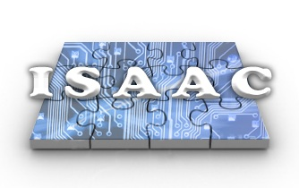
ISAAC Demo Plan
ISAAC Newton
Charles Le, Yutao He, Jason Zheng, Kayla Nguyen, Will Zheng
July 24, 2008

Slide 2
Demo Overview
Instrument Digital Electronics Requirement
Target Mission and Its Main Characteristics
5
25
SMAP, L-band scatterometer.
Onboard real-time digital filtering for data rate reduction.
Co
noise
X
V – pol
(& similar for H-pol)‏
12-13
14.5-15.5
17-18
F_{in} = 60 MHz
F_{out} = 1.2 MHz
Quadrature
Modulation
Baseband
Decimation
System Context Diagram
showing iBoard and the rest of Instrument
Demo System Capabilities
Matlab floating point golden model.
Realistic mission-specific test data
FPGA implementation on the ML410 performed at required speed with enough margin
Integrated tools for functional (speed & utilization) and performance (radar parameters) verification
Verification and validation tool to demonstrate design readiness to onboard processing requirement of specific mission
See next page, SMAP’s instrument electronics

Slide 3
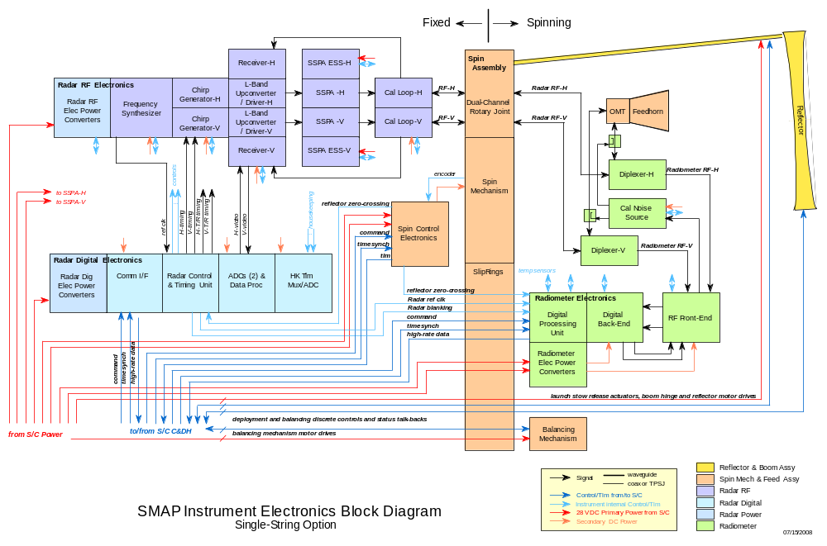
SMAP Instrument Electronics
L. Veilleux, 07/2008

Slide 4
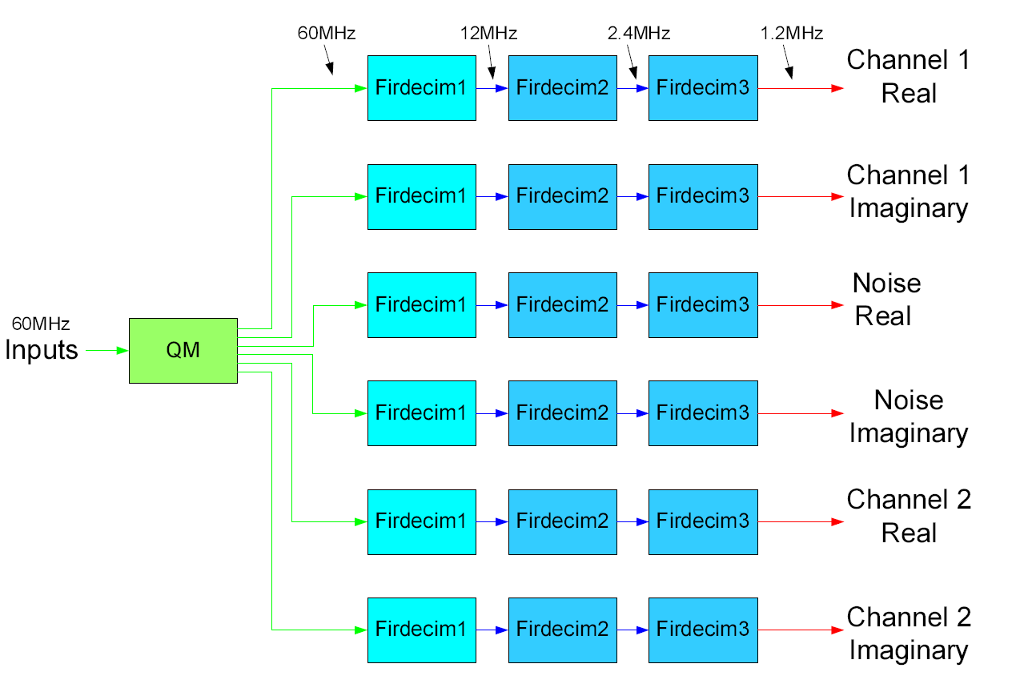
Quadrature Modulation and Polyphase Decimation Filters
36 total multipliers

Slide 5
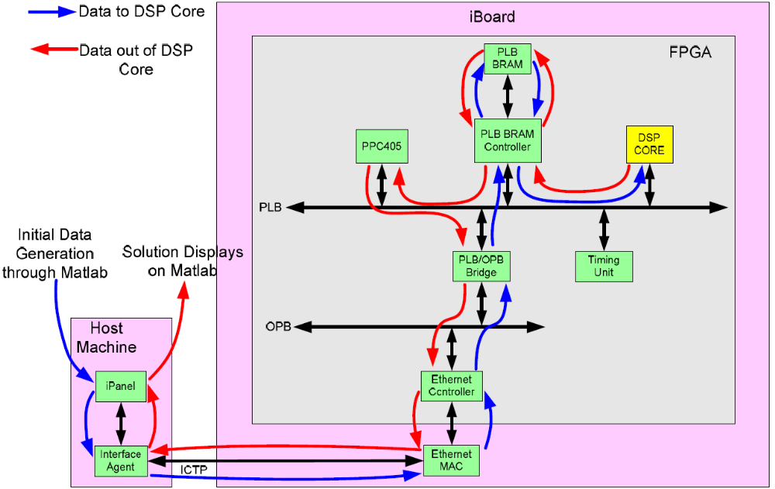
Demo System Top-Level Block Diagram

Slide 6
Operational Scenarios to be Demo-ed
Data stream
  16-bit binary offset video sampling @ 60MHz
  Simulated data stored and read from high-speed memory
Demo operations
  Show Matlab floating point golden model.
  Run FPGA implementation on the ML410.
  Plot and compare Matlab & FPGA results.
Validation approach
  Measure device speed and utilization
  Compare FPGA outputs with golden Matlab floating-point model
  Measure radar performance parameters
Key Parameters specific to the instrument demonstrated
  Onboard processing capability
  Design run at required speed
  Radar performance parameters satisfied
  Relevant interface
  Realistic test data

Slide 7
Future Work and Plan
Year-end final reports (description documents)‏
  Algorithm Development & Data Simulation.
  FPGA Design & Implementation.
  Demo System Design & Implementation.
Conference papers
  ISAAC-Newton overview (Yutao et. al., RadCon09).
  SMAP’s algorithm development (Charles et. al., RadCon09).
  FPGA design and implementation (Jason et. Al., ISCAS or ICASSP).
Talk to S314 to explore other radar applications
  Radar testbed (customer: Kevin Wheeler): integrated data simulation and signal processing.
  DesdynI (customer: Jim Hoffman): wideband digital filtering.
  Glistin (customer: Delwyn Moller): wideband digital beamforming
  ADOP (customer: Yunling Lou): real-time interferometric SAR processing

