Slide 1
Porting the QM-FIR Digital Filter Core to the ISAAC iBoard
Hieu Nguyen
Section 345
Mentor: Dr. Yutao He
May 5, 2011
Notes:
Hello everyone, my name is Hieu and today I’ll be speaking about the research work I've been doing for USRP. My mentor is Dr. Yutao He (how to pronounce last name?) and we are part of section 345, Flight System Avionics in the Advanced Computer Systems & Technologies group.

Slide 2
Outline
Background Information
Objectives & Motivation
Technical Approach
Results & Contributions
Problems Encountered
Future Study
Notes:
For this presentation, I will start by discussing some relevant background information. Then I’ll state the project objectives and motivation. I'll move on to talk about my technical approach, which involves design review, implementation, and testing. I’ll include an overview of my results and contributions, also mentioning the problems I've encountered along the way. And finally, I'll finish up with a discussion of future study.

Slide 3
My Background
Hieu Nguyen
  Born in Panama, grew up in Hawaii
  4th year electrical engineering student at USC
    Emphases in computer architecture/organization
    Experience with controls and robotics
  Undergraduate Student Research Program (USRP) at JPL
    Section 345, Flight System Avionics
    ISAAC/NEXUS team of six interns
Notes:
A little bit about myself: my name is Hieu. I was born in Panama and grew up in Hawaii on the island of Oahu. I’m a 4th year electrical engineering student at USC… so this semester, I enrolled half-time in order to complete the USRP internship. As an EE major, I am specializing in computer architecture/organization and controls & robotics. These interests helped me to find JPL, and through USRP, I was able to take on a very relevant research project in Flight System Avionics.

Slide 4
Background Information
“Porting the QM-FIR Digital Filter Core to the ISAAC iBoard”
Notes:
So, the title of my research is “Porting the QM-FIR Digital Filter Core to the ISAAC iBoard.” Many of you are probably wondering what that means. What do the acronyms stand for and what is an “iBoard”? Those are questions I was asking myself when I first started this internship.
I’ll start by explaining the logo on the upper right, which represents the ISAAC project.

Slide 5
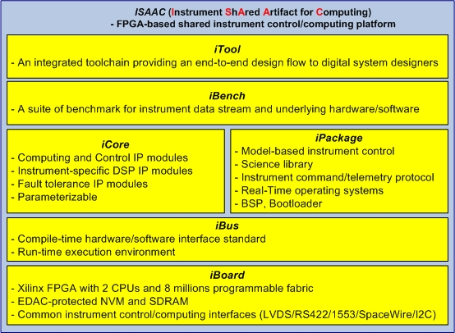
ISAAC Technology
ISAAC (Instrument ShAred Artifact for Computing)
A technology developed under the JPL R&TD program
Dr. Yutao He is the PI of the task
Provide a set of six modular and reusable components under a common framework that can be configured to a complete instrument control and computing system on a per-application-basis to meet various instrument requirements as defined in the NRC Decadal Survey Report.
Notes:
ISAAC, which stands for Instrument Shared Artifact for Computing, is a new technology developed under the JPL R&TD program. My mentor is the PI. Many digital electronics instruments used in NASA space missions, like radar and interferometers, have very demanding on-board processing requirements. And many of those on-board processors were designed to be application-specific, meaning they are only used once for a single purpose in space-borne instruments.
ISAAC technology consists of a set of six modular and reusable components that are used on a per-application basis to configure a complete instrument control and computing system. The six componets, shown in this diagram, are the iTool, iBench, iCore, iPackage, iBus, and iBoard. ISAAC technology provides an integrated framework for high-performance computing designs, while reducing non-recurring cost and risk to Earth-science instruments.

Slide 6
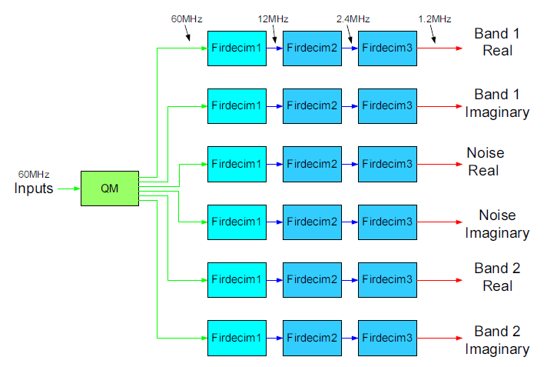
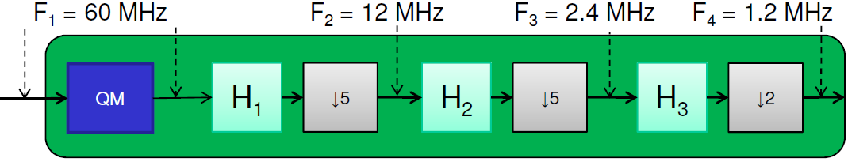
ISAAC QM-FIR Digital Filter Core
A common DSP function used in telecommunication applications
Reduce high-rate samples into data that is ready to be down-linked for further ground processing
The QM-FIR digital filter core merges two modules:
  QM and FIRDEC
Quadrature Demodulation
z(t) = I(t)*cos(ω_{c}t) + Q(t)*sin(ω_{c}t)
  I(t) - “in-phase” component
  Q(t) - “quadrature” component
Notes:
The QM-FIR digital filter core is a reusable logic design that performs a common DSP function used in telecommunication applications. The digital filter reduces high-rate samples into data ready to be down-linked for further ground processing. QM-FIR is a combination of two modules—quadrature modulation (QM) and the finite impulse response polyphase decimation (FIRDEC).
From a mathematical standpoint, this is what a QM 2-dimensional complex signal looks like. The I/Q or real/imaginary parts of a signal are modulated with a cosine and sine at a particular carrier frequency to convey data. In this block diagram, the QM module takes in an input signal and demodulates it, moving the subbands to baseband to recover the original data.
Together with the FIRDEC modules, they act as a demodulation decimating band-pass channelizer that removes out-of-band interference, and decimates high-rate samples to yield a complex (I/Q) output data rate at a lower frequency. This particular diagram illustrates a three-stage decimation, turning a 60MHz input into a 1.2MHz output.

Slide 7
Objectives & Motivation
Port the ISAAC QM-FIR digital filter core to the iBoard, with iPanel as control and display
Consolidate multiple implementations of the digital filter core
Reverse engineer designs to provide complete documentation
Motivation:
  QM-FIR is part of the ISAAC iCore-dsp library
  Has application to the Soil Moisture Active Passive (SMAP) and the Deformation, Ecosystem Structure and Dynamics of Ice (DESDynI) JPL/NASA space missions
Notes:
The main objective of my research project was to port the QM-FIR digital filter core to the ISAAC iBoard, and use the iPanel as control and display. Porting a core entails integrating an old design with a new hardware substrate—utilizing different HW components and timing requirements, and verifying that the filter is fully-functional in simulation.
The goal of ISAAC is to make IP cores which are parameterizable to different instruments needs. Therefore, the configurations in the QM-FIR digital filter core need to be adjustable to meet various instrument requirements. Thus, another objective was to consolidate different versions of the digital filter core to make a more modular design. I also aimed to reverse engineer the existing core designs to provide complete technical documentation.
For motivation, the QM-FIR core is part of the ISAAC iCore library, which is a collection of “standard IP cores that implement common computationally-intensive instrument control and computing functions.” The QM-FIR digital filter core has applications to various NASA space missions, including SMAP and DESDynI.

Slide 8
Technical Approach
Read relevant documentation
Become familiar with embedded development tools (Xilinx ISE/EDK, ChipScope, CoreGEN, iMPACT)
Examine existing QM-FIR core implementions
Translate configurations to port over to iBoard
Improve functionality and robustness
Debug errors
Notes:
My approach to these objectives was to first read relevant documentation and get famililar with the design entry and embedded development tools to obtain a basic understanding of my task. I then examined two versions of the QM-FIR digital filter core (project files and source code), which were implemented on older commercial development boards in 2009. This helped me to understand the QM-FIR algorithm and overall system data flow. Then, using ISE and EDK, I began translating that information to port the QM-FIR digital filter core to the iBoard. I added small parts to optimize and improve functionality and robustness. And I also debugged errors when they arose.
Xilinx ISE, Matlab, Python, ChipScope Analyzer, CoreGEN, iMPACT, Numeric, Xilinx EDK, Matlab, ChipScope Inserter/Analyzer, XMD, iMPACT, Wireshark, ethtool, Kermit

Slide 9
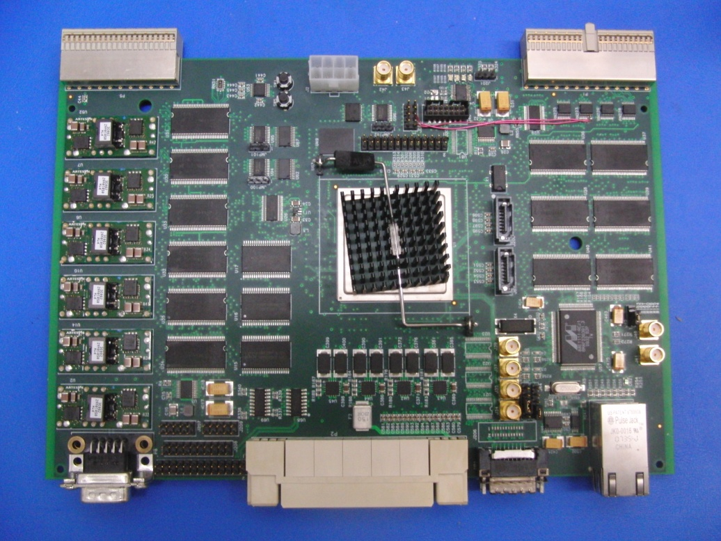
ISAAC iBoard
Path-to-flight Virtex 5 FX130T FPGA
2 PPC440 hardcore
Millions of programmable fabric
2-bank 512 MB EDAC-protected DDR SDRAM
4MB EDAC-protected SRAM
16 MB EDAC-protected Flash memory
32-bit (33 MHz) cPCI backplane interface
16-bit 240 Mbps ADC LVDS interfaces
4 GTX digital interfaces
1 XAUI interface
40 240 Mbps LVDS digital interfaces
1 10/100/1000 Tri-mode Ethernet port
1 SPI/1 I2C port
8 GPIOs
2 RS232 UART ports
8 channels engineering telemetry ADC interfaces
1 on-board 100 MHz master clock, 1 external clock via SMA, and 1 external clock via LVDS
Form factor: 6U
Power consumption: 7 to 25 W
Mass: 0.8 kg
Notes:
The current ISAAC iBoard prototype features a high-performance Virtex-5 FPGA with two PowerPC processors. It has 512MB of DDR SDRAM and a wide range of digital inferfaces. The iBoard is FPGA-based, allowing reprogrammable digital logic blocks to be configured for true parallel operation at hardware-timed speed. All of the components have flight-qualified space-grade equivalents, enabling the iBoard to perform in extreme cosmic radiation environments.
Porting the QM-FIR digital filter core to this iBoard required importing new cores for a more advanced hardware configuration and working with new timing requirements. I used the UART and Ethernet connection interfaces in simulation and testing.

Slide 10
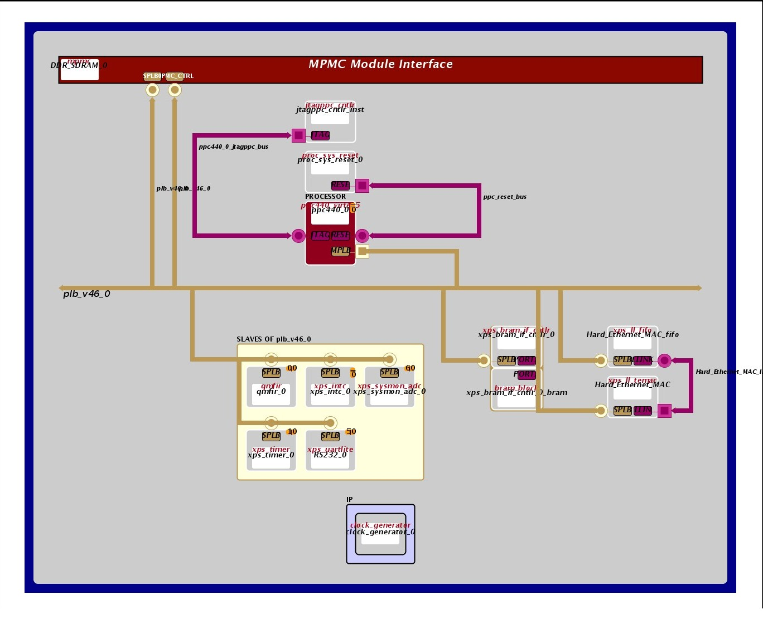
QM-FIR Ethernet
Core Design
Integrate old EDK project with new iBoard HW/SW configuration
Revise and complete .m, .c, and .v source code
Verify QM-FIR digital filter core functionality using Matlab GUI and UDP transmission
Notes:
Here is a block diagram, which shows the connections between the different cores of my FPGA system. You can see here that it uses a PowerPC interfaced to several slave devices over the PLB, or ISAAC iBus. The hardware configuration consists of memory (DDR, BRAM), Ethernet MAC, UART, an interrupt controller, and a custom IP core called “qmfir,” which does the filtering.
My technical approach to this project was primarily to start and develop a new project design from scratch, using the existing digital filter core as a model. First, I integrated the old EDK project with the new iBoard configuration. This involved removing or replacing certain components like the Compact Flash and other digital logic cores. The next step was to revise and complete the existing Matlab, C, and Verilog source code because the software controls the overall data flow of the design. The last task was to verify the digital filter's functionality, and I did so using a Matlab GUI and UDP Ethernet communication between an iBoard and a host machine.

Slide 11
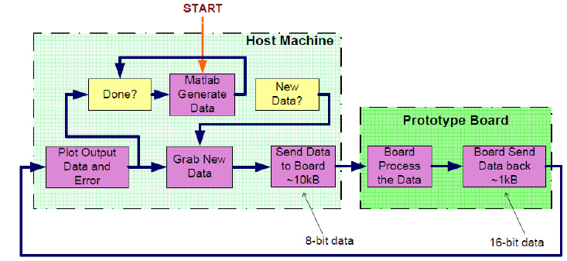
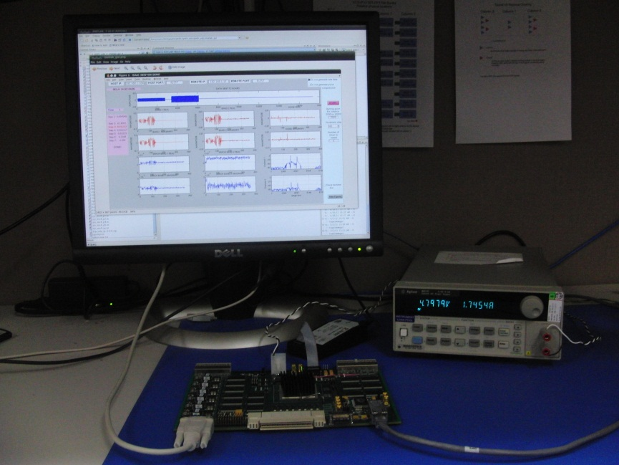
QM-FIR UART
Simulation & Testing
Overall System Data Flow
Testbed
Notes:
Unfortunately, due to time constraints, I can’t show you a live demonstration of the running simulation. But this is the overall system data flow for the testbed, between a host machine and the iBoard. It starts when Matlab generates simulated data for filter input. The data is transferred to the iBoard via the UART or Ethernet connection, and stored into block RAM, where it is processed through the QM-FIR digital filter. The iBoard then transfers the processed data back to the host machine where it is converted into floating point and can be viewed through the iPanel, a Python-based graphical user interface.
In this testbed, you can see the iBoard and the iPanel on the host machine.

Slide 12
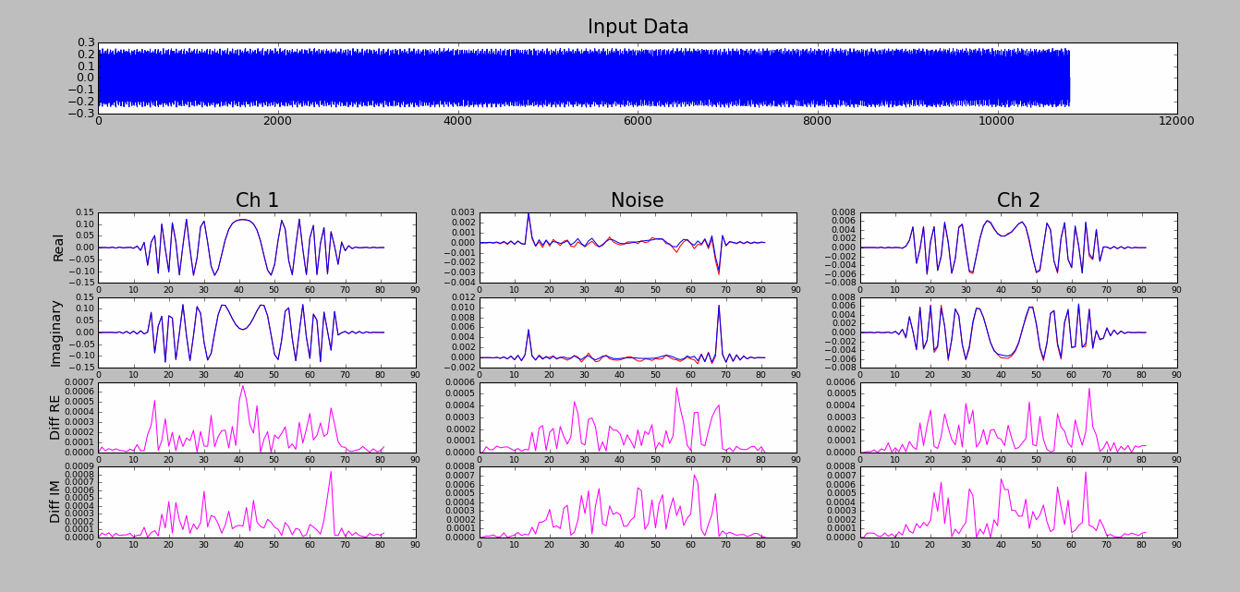
Results & Contributions
Successfully ported ISAAC QM-FIR digital filter core to the iBoard
Verified functionality through UART and Ethernet digital interfaces
Wrote and compiled a comprehensive technical documentation
Notes:
The iPanel plots the fixed-point output data from the iBoard and also the expected data generated by floating-point Matlab algorithms. Using these values, it superimposes the core output (in red) and the expected output (in blue) for the real and imaginary parts of Band 1, noise, and Band 2. The iPanel also also plots the error between the two to help you visualize the data and verify the functionality of the core. As you can see, the red and blue lines overlap almost perfectly with minimal error, meaning the digital filter core is performing as expected.

Slide 13
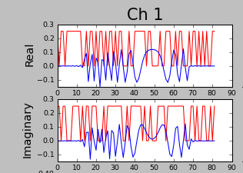
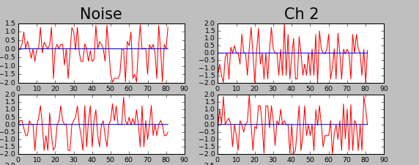
Problems Encountered
Meeting timing requirements across clock domains
  UDP transmission rate → FIFO overrun errors and packet loss
  UART baud frequency rate → corrupt data write
Interrupt sequence in source code did not allow iBoard to transfer data back to host machine
UART module not initialized in correct state
Notes:
Although I was able to implement the QM-FIR digital filter core on the iBoard, it was not a smooth task. I ran into several problems along the way, mostly because of my unfamiliarity with such a complex FPGA system design. Remember how I talked about the red output data matching the expected blue plot? I ran into this sight many times, and it was only through trial and error and hours of re-synthesizing designs until I got a working configuration. The biggest problem I had dealt with meeting timing requirements across different clock domains. The master clock on iBoard runs at 100MHz, but other modules like the UART run at lower frequencies. I had to slow down UDP transmission rate and the UART baud rate to avoid FIFO overflows and corrupt data.
Another major problem I dealt with was the QM-FIR interrupt sequence. The iBoard was not transmitting any data back to the host machine, and it was due to an Ethernet FIFO having substantial packet loss. To resolve this, I modified the interrupt control.
Another problem involved the UART being initialized into the wrong state, which caused successive UART transactions to have bit offsets and thus corrupt data. I fixed this by asserting a reset upon starting the core.
I spent some time learning how to use various debugging tools like ChipScope and WireShark. These tools were extremely helpful for identifying where problems were and how to fix them.

Slide 14
Future Study
Things Learned from USRP:
  Research has given me valuable hands-on experience with a complex FPGA-based system, in all parts of the development cycle
  Mentored internship helped prepare me for an engineering career
Future Work:
  Implement QM-FIR digital filter core using other interfaces/protocols (raw Ethernet, split spectrum UART, LVDS, SerDes, etc.)
  Utilize DAC board to simulate analog data acquisition in real-time
  Rigorous fixed-point error analysis and measurement
Notes:
I’ve learned a lot during the past 15 weeks of USRP. The research work has given me a valuable hands-on experience with a complex FPGA-based system, in all parts of the development cycle. I am glad I had the opportunity to work on a project that will be actively used in future NASA space missions. The mentorship aspect of USRP has helped me with career preparation. I gained advice and direction through my mentor’s insight on engineering in the space industry.
Although my internship is ending, here are some things I would like to do if I had more time. I would like to look into other implementations of the digital filter core using other interfaces and protocols. Like raw Ethernet data transmission with no software overhead, and split spectrum filtering with UART for the DESDynI project. I also want to utilize a DAC board to simulate analog data acquisition in real-time, and perform rigorous fixed-point error analysis to improve simulation and benchmarking of the QM-FIR digital filter core.

Slide 15
Acknowledgments
Mentor: Yutao He
Group Supervisor: Bill Whitaker
Technical Advisors: Kayla Kobayashi and Jason Zheng
ISAAC/NEXUS Team: Chester Lim, Simon Margolis, Kevin Ortega, Eugene Sahagun, Carson Umsted, Dean Holt
USRP: Petra Kneissl-Milanian, Richard Alvidrez
Notes:
I would like to acknowledge a few people who have helped me along the way. My mentor, Yutao. My group supervisor, Bill Whitaker. My technical advisors, Kayla and Jason. And my fellow ISAAC and NEXUS team members: Chester, Simon, Kevin, Eugene, Carson, and Dean. I would also like to thank Petra and Rich for their work with USRP and for making this a great internship experience.

Slide 16
Thank you for your attention!
Notes:
And I would also like to thank you all for your attention. Do you have any questions?

Slide 17
Questions?
Notes:
I would now like to open the floor for questions.

Slide 18
Backup Material

Slide 19
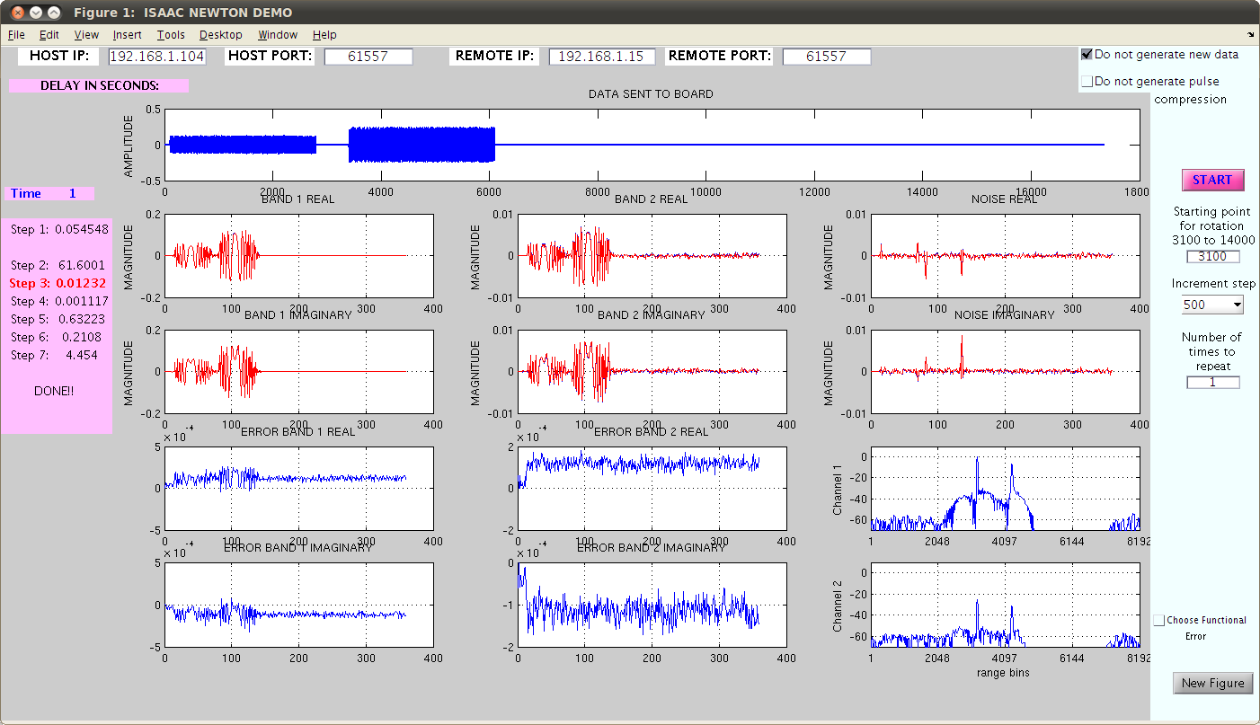
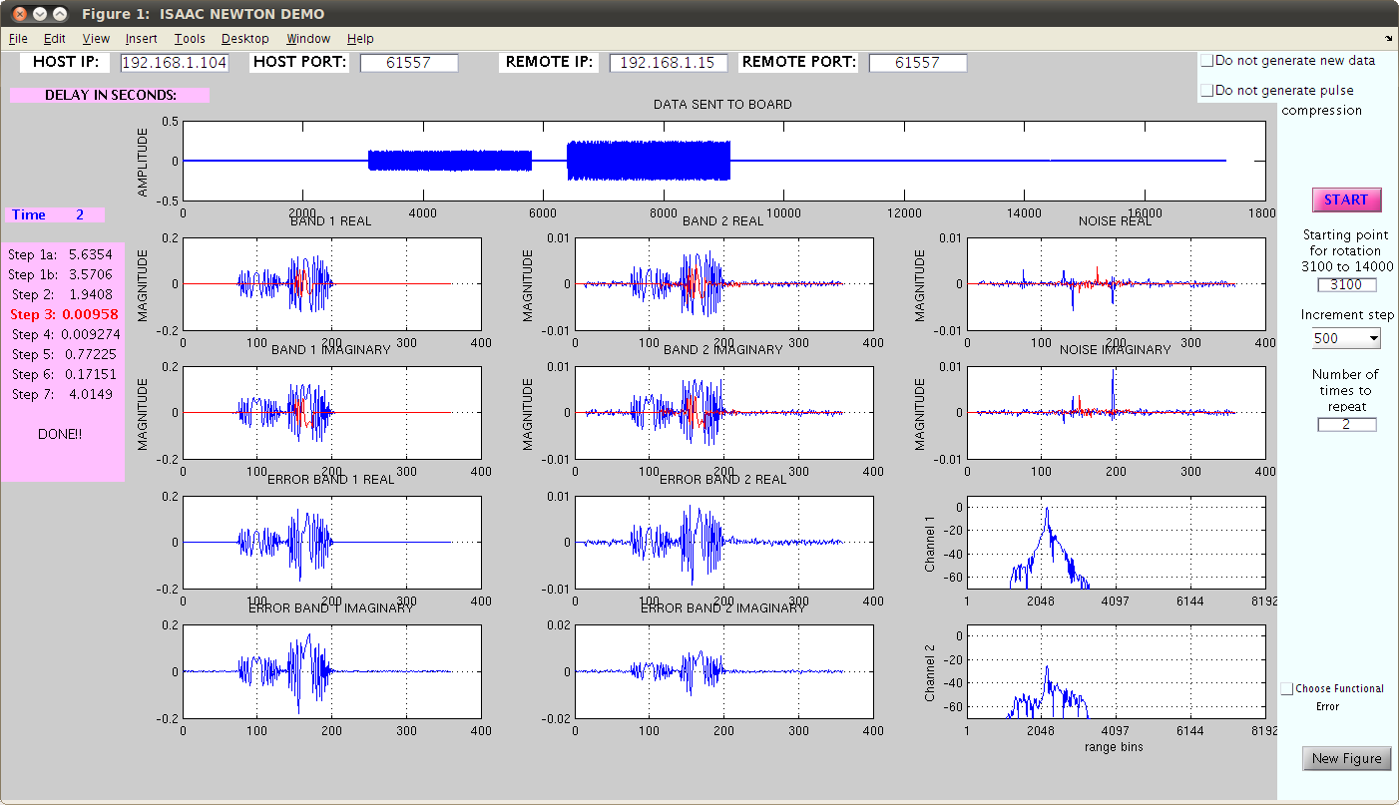
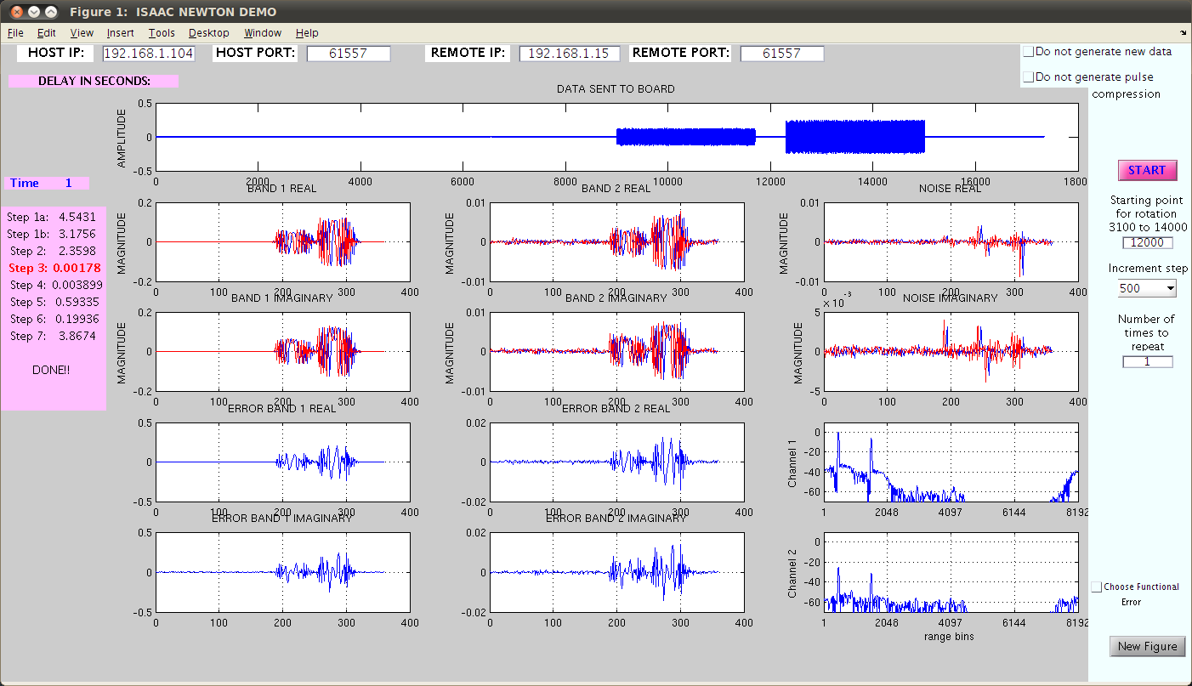
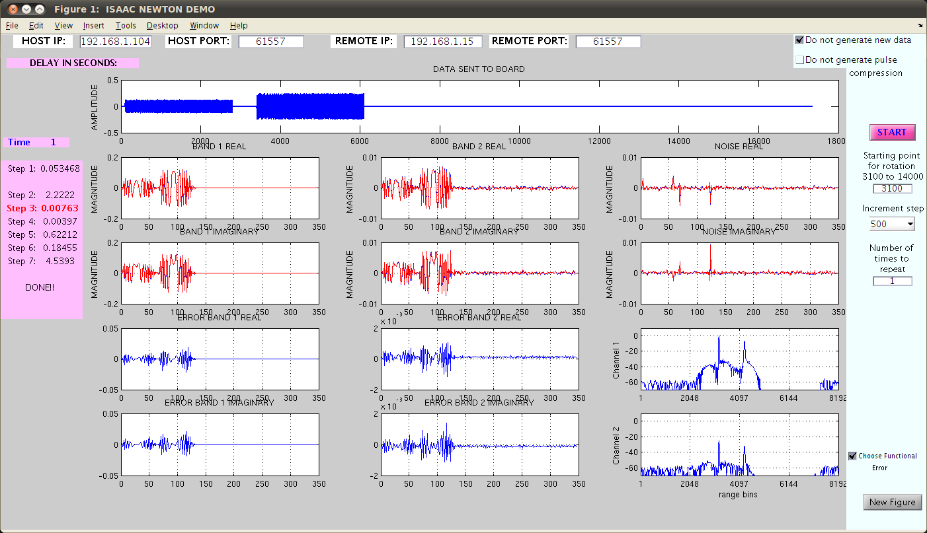
Backup Demo

Slide 20
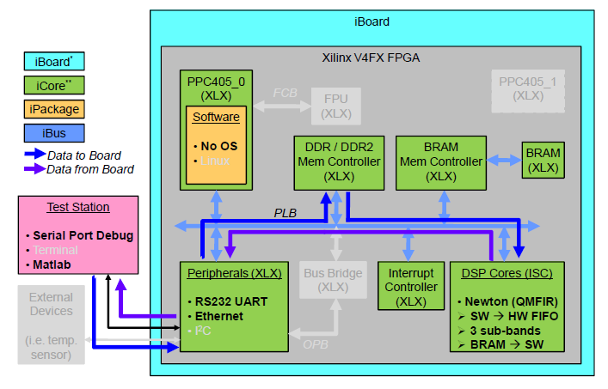
Background Information
QM-FIR core architecture
  iReg
  BRAM
  MAC
  QMFIR
    QM
      LkupTbl
    Firdecm
      firdecim_m5_n15
      firdecim_m5_n20
      firdecim_m2_n50
Notes:
The QM-FIR core architecture is somewhat complex
iReg keeps track of internal counters and pointers for interrupt control
The block RAM is where data is stored
The Ethernet MAC is used to manage packet transactions
The QMFIR has two parts:
The QM core is implemented using a sine/cosine lookup table and requires 6 multipliers running at 60MHz
FIRDEC core is implemented as a three-stage polyphase decimation filter
This picture illustrates how the different components are layout and connected with each other, but more on that later

Slide 21
QM-FIR Ethernet
Core Development
Matlab, C, and Verilog source code control the FPGA Data Flow
pnet(udp,'writepacket',remoteport);
recv_callback();
QMFIR_mWriteToFIFO();
assign WFIFO2IP_Data_int[31:0] = ...
assign RAM2IP_Data_int[31:0] = ...
ICNT[31:0] <= ICNT[31:0] + WFIFO_WE;
iReg_intr <= WMI | OVFL;
qmfir_intr();
transfer_data();
pnet(udp,'readpacket');
Notes:
In terms of environment setup, on the host machine, you'll have a serial terminal for debugging and Matlab running the testing algorithms to visualize the data. The host machine and iBoard are connected via Ethernet and data is transferred using UDP. Wireshark can monitor packet data over the USB/Ethernet adapter.
The software architecture takes care of the FPGA data flow from host machine to iBoard to qmfir core, and back.
The software architecture is comprised of Matlab, C, and Verilog source code that control the data flow in the FPGA. The Matlab code controls the UDP rx/tx on the host machine side, whereas the C code manages UDP on the iBoard side. Once the iBoard receives a UDP packet through a Temac FIFO, it writes it into a QMFIR writeFIFO where the Verilog code steps in. The Verilog controls the hardware and assigns the input data to be processed through various filter modules and eventually, the output is written into 3 local block RAMs. A register, called ICNT, keeps track of the number of inputs, and when that number reaches a certain watermark threshold, an interrupt is generated that triggers the iBoard to send data back to the host machine.

