Slide 1

ISAAC iBoard
Subsystem Requirement Review (SRR)
R&TD ISAAC Team
February 6, 2009
http://isaac

Slide 2
Agenda
9:00am - 9:05am: Introduction
9:05am - 9:15am: SRR Overview
9:15am - 10:30am: iBoard Requirement Review
10:30am - 11:00am: Discussion and Summary

Slide 3
ISAAC iBoard SRR Board
Chairman
Rafi Some - 340
Review Board Members
Jean-francois Blavier - 328 Duane Clark - 334 Ab Davis - 382 Curt Henry – 382 Jason Hyon - 800 Robert Jarnot – 382 Martin Le - 345 Yunling Lou - 334 Louise Veilleux - 334

Slide 4
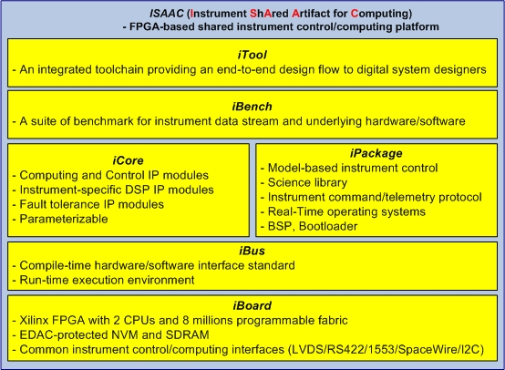
ISAAC Overview
Objectives
Provides a highly-capable, highly-reusable, modular, and integrated FPGA-based instrument control and computing platform to meet a wide range of instrument needs as defined in the NRC Decadal Survey Report
Offers an unprecedented combination of adaptability, computation power, I/O bandwidth, digital interface standards, and data processing capability in a single platform
Provides low power and low mass
Reduces non-recurring cost and risk significantly
Team
Funding and Milestones
Principal Investigator: Yutao He (345)
Initiative Leader(s): Curt Henry (382)
Steering Committee Chair: Jason Hyon (8x)
FY’09 ISAAC Team:
Co-I: Charles Le (334)
Co-I: Pekka Kangaslahti (382)
Dmitriy Bekker (388)
Jason Zheng, Will Zheng, Kayla Nguyen (345)
Jordan Tanabe (382)
Mohammad Ashtijou (345)
Ron Morgan (347)
USRP Student: Jason Chu (345)
FY’08 ($K) | FY’09 ($K) | FY’10 ($K)
380 | 350 | 250 (Proposed)
Milestones | Date
Develop and deliver ISAAC-1 | FY’08
Develop and deliver ISAAC-2 | FY’09
Develop and deliver ISAAC-3 | FY’10
Notes:
I want to draw your attention to the chart in the upper left.
The goal is to drive that curve down from the red to the green, and do so in a way that will enable us to more easily and reliably take the knowledge, tools, practices, and principles from one project to another.
In summary, PP has been recognized as a strategic investment for the lab. Indeed, JPL is the PP caretaker and the center of expertise for NASA. While we continue to be on the cutting edge, it is important to note that we are not without competition: Marshall is actively trying to branch out from microbial monitoring into PP. This R&TD will help us keep our competitive edge by looking at PP in a larger sense, and by creating a context to address systems issues by providing tools which enable SE.

Slide 5
ISAAC Technical Approach
Provide a set of six modular and reusable components under a common framework that can be adapted to configure a complete instrument control & computing system on a per-application-basis to meet digital electronics requirements of wide variety of instruments defined in the NRC Decadal Survey Report.

Slide 6
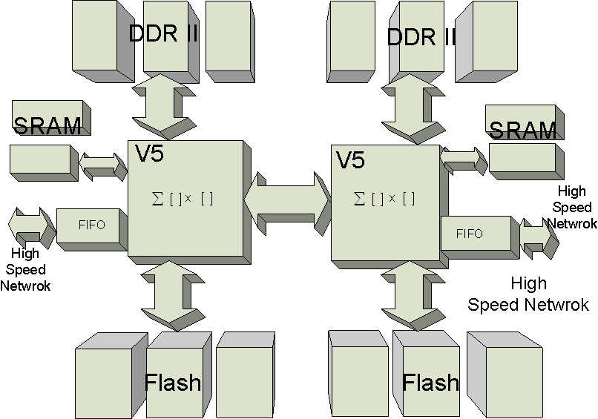
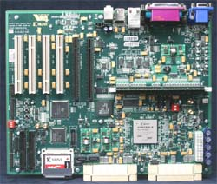
iBoard Evolution
iBoard 2 (FY’09)
First custom board
Path-to-flight
Virtex 5 FX130T FPGA
  2 PPC440 hardcore
  Millions of programmable fabric
1 GB DDR RAM/4MB SRAM
32 MB Flash
3 Gbps
Targeted to DESDnyl SweepSAR DPU and GEO-CAPE panFTS
iBoard 3 (FY’10)
Second custom board
Path-to-flight
2 Virtex 5 FX130T FPGAs
  2 PPC440 hardcore
  Millions of programmable fabric
12 GB DDR RAM/32MB SRAM
128 MB Flash
3 Gbps
Targeted to DESDnyl SweepSAR Specialty Processor and GEO-CAPE panFTS
iBoard 1 (FY’08)- Xilinx ML410 Board
Virtex 4 FX60 FPGA
  2 PPC405 hardcore
  Millions of programmable fabric
256 MB DDR-II RAM/64 MB DDR RAM
SystemACE compactFlash
Two 10/100/1000 Ethernet PHYs
Two RS-232 ports and other interfaces
16 multiple-gigabits transceivers

Slide 7
iBoard 2 Development Schedule
Technical Readiness Review (TRR): 12/12/08
Subsystem Requirement Review (SRR): 2/6/09
Inheritance Review: 2/12/09
iBoard Specification Review: 2/23/09
Design Technical Peer Review (DTPR): 4/3/09
  Board design
  Schematic design
Layout Peer Review: 5/3/09
PCB Fab: 5/29/09
Board Assembly: 6/20/09
Board Testing: 7/30/09
Integrated Testing: 8/30/09
DDR: 9/16/09
Demonstration: 9/27/09

Slide 8
Status of TRR Action Items

Slide 9
SRR Objective
The objective of the SRR is to review whether the captured and documented key requirements are sufficient so that iBoard development can proceed to the next stage of the iBoard design.
The SRR is the second milestone for the iBoard development

Slide 10
SRR Process
Identify a set of current and future flight instrument missions
Develop the requirement template of instrument digital systems
Interview and survey the instrument architects/designers
Collect key digital system requirements of selected instruments
Down-select the iBoard 2 customers
Compile a set of key requirements
Conduct the study for main microelectronic technology
Develop a set of iBoard key requirements
Hold SRR to confirm the iBoard key requirements

Slide 11
Instrument Digital System
Requirement Template

Slide 12
Lists of Surveyed Instruments
FY’08 iBoard 1 customers
FY’09 iBoard 2 customers

Slide 13
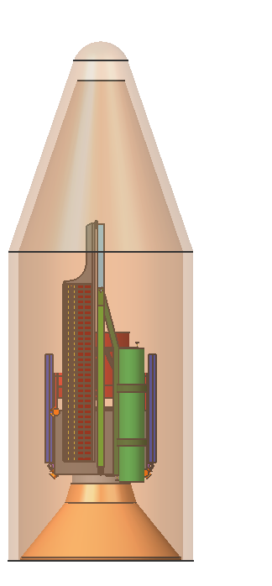
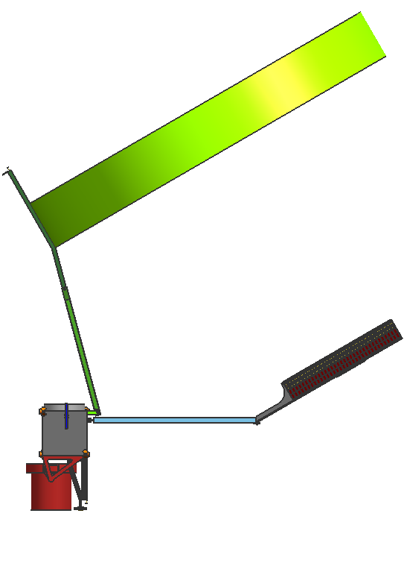
DESDynI Mission Overview
Recommended by the NRC Decadal Survey for near-term launch to address important scientific questions of high societal impact:
  How do we manage the changing landscape caused by the massive release of energy of earthquakes and volcanoes?
  How are Earth’s carbon cycle and ecosystems changing, and what are the consequences?
  What drives the changes in ice masses and how does it relate to the climate?
15m reflector
10m
S/C bus
Lidar
Radar Feed
X
One configuration concept with nadir-looking lidar and L-band radar with 15m reflector w/ arrayed feed
Mission Sciences
  Deformation of Solid Earth for improving forecasts of seismic and volcanic events
  Ecosystem Structure for carbon budget and species habitat
  Dynamics of Ice for improving understanding of changes in ice masses and climate
Instrumentation
  Multi-Beam Profiling Lidar
  Full Polarimetric Multi-mode L-band Radar operated as repeat-pass interferometer
  GPS Receiver for precision orbit determination and reconstructions
Launch date: Sep 2015 (assume Phase A starts Oct 2010)
Mission lifetime: 5 years

Slide 14
DESDynl SweepRadar Architecture
Radar Electronics are distributed between the S/C bus and the Radar Antenna Feed
  Avionics interface and central timing & datatake sequencing functions are mounted near the avionics bay
  Distributed feed functions are mounted near the feed elements

Slide 15
Proposed iBoard-based
DESDynl SweepRadar Architecture
Radar Electronics are distributed between the S/C bus and the Radar Antenna Feed
  Avionics interface and central timing & datatake sequencing functions are mounted near the avionics bay
  Distributed feed functions are mounted near the feed elements

Slide 16
DESDynl SweepRadar
Key Digital System Requirements
 | Tall-Pole Processing Units
 | DPU | Specialty Processor
On-Board Data Processing Algorithms | Digital Filter, BFPQ, Data beamformer, Data Averaging | SAR image processing, TBD
Integer Throughput (MIPS) | N/A | N/A
Floating-Point Throughput (GFLOPS) | N/A | N/A
DSP Throughput (GOPS) | 10 (basic mode) 5 (advanced mode) | TBD
Volatile Storage (bits) | 0 | DDR: 64 G SRAM: 48 M Total: 64.048 G
Non-Volatile Storage (Mbits) | 97.3 | 97.3
Data Rate (bps) | Input: 1.92 G Output: Basic:18 M Advanced: 200 M | Input: 6.8 G Output: 68-680 M
Need Software | No | No

Slide 17
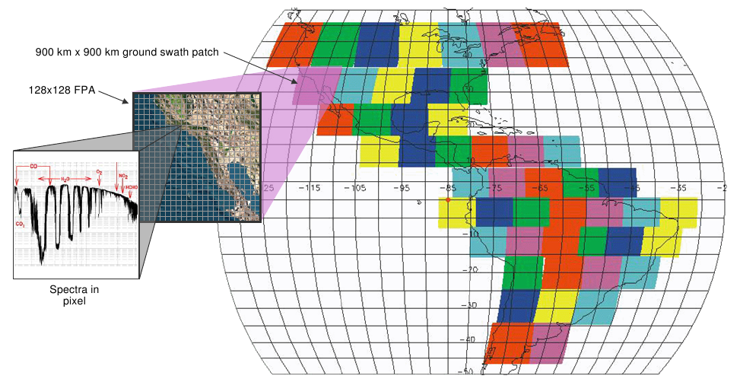
GEO-CAPE Mission Overview
GEO-CAPE is a mission concept recommend in the 2007 NRC Decadal Survey with the following objectives:
  Coastal ocean biophysics
  Atmospheric composition / chemistry
Continuous scanning of N. and S. America from geostationary orbit
High-resolution event imaging done by onboard image processing to target specific episodes (e.g., forest fires, pollution events, etc.)
Each spectrum is ~500,000 points; PanFTS produces 16,000 spectra per minute
PanFTS is an Instrument Incubator Program (IIP) funded 3 year development to build and demonstrate a single instrument capable of making all GEO-CAPE science measurements
PanFTS uses imaging Fourier Transform Spectroscopy (FTS) over the spectral range of 0.25 μm to 15 μm enabling vertical profiling of atmospheric composition for enhanced science beyond what is required for the GEO-CAPE mission
Measurement capabilities: IR, UV, Visible, ocean color (four detectors)
Launch timeframe: 2013 – 2016
Mission length:
  3 years minimum to detect interannual variability
  5 year lifetime goal and consumables

Slide 18
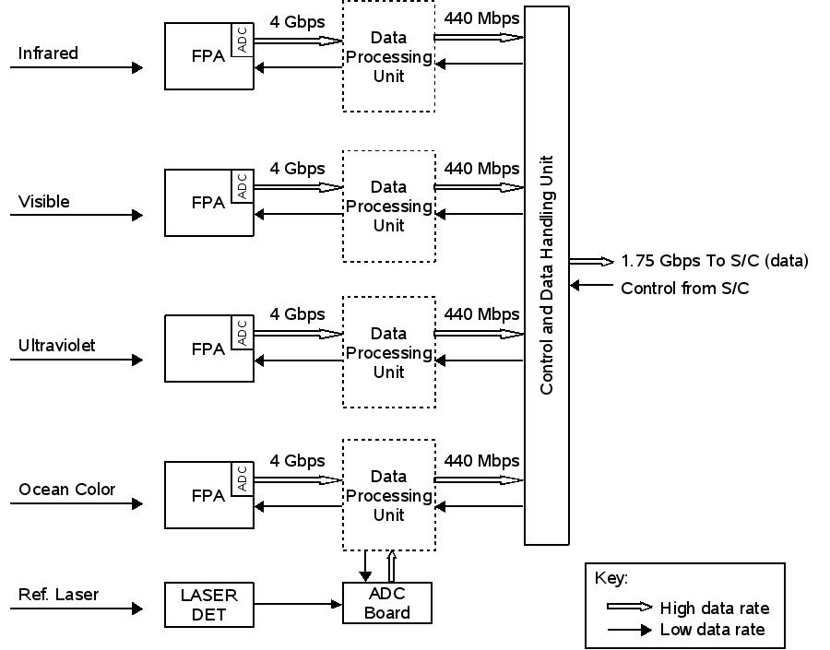
PanFTS Digital System Architecture

Slide 19
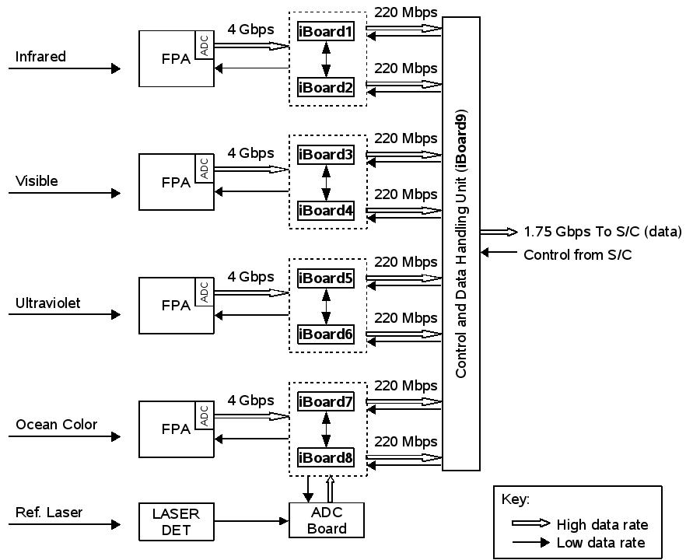
Proposed iBoard-based
PanFTS Digital System Architecture

Slide 20
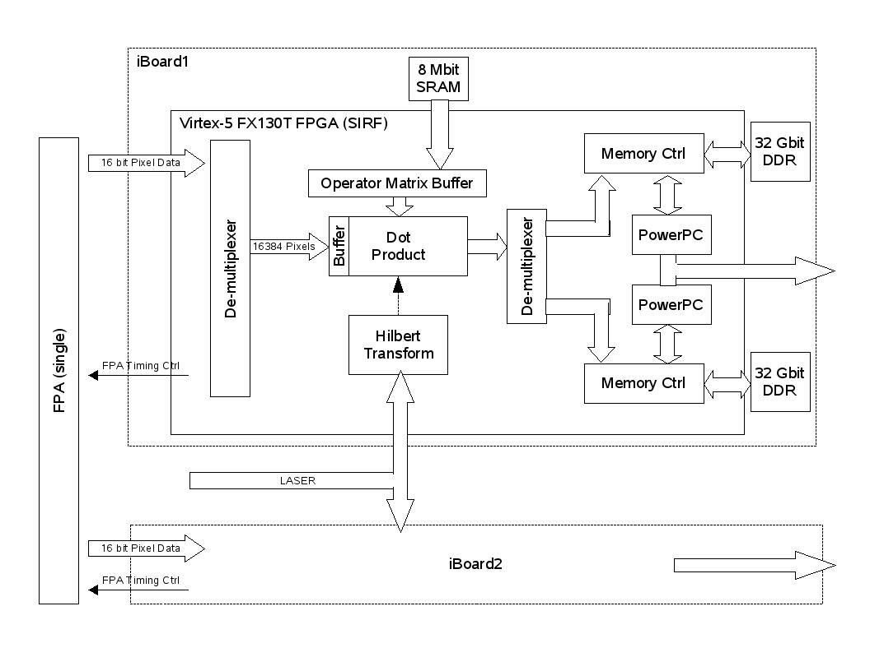
Conceptual iBoard Block Diagram for
GEO-CAPE PanFTS

Slide 21
GEO-CAPE PanFTS
Digital System Requirements
 | Data Processing Unit | C&DH Unit
On-Board Data Processing Algorithms |  | TBD
Integer Throughput (MIPS) | TBD | N/A
Floating-Point Throughput (GFLOPS) | 12.5 (single precision) | N/A
DSP Throughput (GOPS) | 80 | TBD
Volatile Storage (bits) | DDR: 64 G SRAM: 6.5 M BRAM: 9.2 M Total: 64.0157 G | TBD
Non-Volatile Storage (Mbits) | 49.3 | TBD
Data Rate (bps) | Input: 2 G Output: 220 M | Input: 220 M Output: 1.75 G
Need Software | Yes | No

Slide 22
The Key Customer
Requirements Summary
DS-001: The digital processing board shall provide an integer throughput of TBD MIPS.
DS-002: The digital processing board shall provide a float-point throughput of 12.5 GFLOPS.
DS-003: The digital processing board shall provide a DSP throughput of 80 GOPS.
DS-004: The digital processing board shall provide DDR RAM of 64 Gbits.
DS-005: The digital processing board shall provide SRAM of 48 Mbits.
DS-006: The digital processing board shall provide on-board non-volatile storage of 97.3 Mbits.
DS-007: The digital processing board shall provide up to 6.8 Gbps data rate.
DS-008: The digital processing board shall provide in-flight reprogrammability.
DS-009: The digital processing board shall be capable of running software.

Slide 23
Study of Path-to-Flight
Driving Microelectronics Technology
FPGA:
  Xilinx SIRF Virtex 5 FX130T
Volatile Memory:
  DDR: 3D-plus stack-up
  SRAM: 3D-plus stack-up
Non-Volatile Memory:
  Flash: 3D-plus NOR Flash
  EEPROM: Xilinx
High-speed (Gbits level) Interface:
  Xilinx RocketIO GTX on Virtex 5: 150 Mbps to 6.5 Gbps

Slide 24
The iBoard Driving Requirements Summary
Customers’ Requirements | The iBoard 2 Requirements (customers + self-imposed req) | The iBoard 3 Requirements (customers + self-imposed req)
DS-001: The digital processing board shall provide an integer throughput of TBD MIPS. | IB-001: The iBoard shall provide an integer throughput of 225 MIPS. | IB-001: The iBoard shall provide an integer throughput of 1000 MIPS
DS-002: The digital processing board shall provide a floating-point throughput of 12.5 GFLOPS. | IB-002: The iBoard shall provide a floating-point throughput of 25 GFLOPS (100% margin). | IB-002: The iBoard shall provide a floating-point throughput of 50 GFLOPS (100% margin).
DS-003: The digital processing board shall provide a DSP throughput of 80 GOPS. | IB-003: The iBoard shall provide a DSP throughput of 104 GOPS (30% margin). | IB-003: The iBoard shall provide a DSP throughput of 208 GOPS (30% margin).
DS-004: The digital processing board shall provide DDR RAM of 64 Gbits. | IB-004: The iBoard shall provide DDR RAM of 8 to 64 Gbits (≤ 0% margin). | IB-004: The iBoard shall provide DDR RAM of 96 Gbits (50% margin).
DS-005: The digital processing board shall provide SRAM of 48 Mbits. | IB-005: The iBoard shall provide SRAM of 32 to 256 Mbits. ( -33% to 200% margin) | IB-005: The iBoard shall provide SRAM of 256 Mbits (200% margin).
DS-006: The digital processing board shall provide on-board non-volatile storage of 97.3 Mbits. | IB-006: The iBoard shall provide on-board non-volatile storage of 126.5 Mbits. (30% margin) | IB-006: The iBoard shall provide on-board non-volatile storage of 126.5 Mbits (30% margin).
DS-007: The digital processing board shall provide up to a data rate of 6.8 Gbps. | IB-007: The iBoard shall provide up to a data rate of 3 Gbps (-127% margin). | IB-007: The iBoard shall provide up to 8 Gbps a data rate of 8 Gbps (11.2% margin).
DS-008: The digital processing board shall provide in-flight reprogrammability. | IB-008: The iBoard shall provide in-flight reprogrammability. | IB-008: The iBoard shall provide in-flight reprogrammability.
DS-009: The digital processing board shall be capable of running software. | IB-009: The iBoard shall be capable of running software. | IB-009: The iBoard shall be capable of running software.
 | IB-010: The iBoard shall have a path-to-flight. | IB-010: The iBoard shall have a path-to-flight.

Slide 25
Detailed iBoard Requirements Description
Requirement: IB-001: The iBoard shall provide an integer throughput of 225 MIPS.
Mission Objective Traceability: Instrument integer computation performance need
Rationale of Requirement: It is based on capability of PPC440 on the Xilinx Virtex 5 FX130T device with -50% uncertainty margin.
Verification: Analysis and Testing
Future Work: Find out the actual needs from the customer.
Risks: None.

Slide 26
Detailed iBoard Requirements Description
Requirement: IB-002: The iBoard shall provide a floating-point throughput of 25 GFLOPS.
Mission Objective Traceability: Instrument floating-point computation performance need.
Rationale of Requirement: It is based on the customer requirement with 100% margin.
Verification: Analysis and testing.
Future Work: Keep track of the customer’s requirement change.
Risks: None.

Slide 27
Detailed iBoard Requirements Description
Requirement: IB-003: The iBoard shall provide a DSP throughput of 104 GOPS.
Mission Objective Traceability: Instrument data processing performance need.
Rationale of Requirement: It is based on the customer requirement with 30% margin.
Verification: Analysis and testing.
Future Work: Keep track of the customer’s requirement change.
Risks: None.

Slide 28
Detailed iBoard Requirements Description
Requirement: IB-004: The iBoard shall provide DDR RAM of 8 to 64 Gbits.
Mission Objective Traceability: Instrument data processing algorithm buffer need.
Rationale of Requirement: It is based on the capability of flight-qualified DDR SDRAM technology (3D-plus Inc.) - unstacked: 8 Gbits; stacked: 64 Gbits.
Verification: Analysis and inspection.
Future Work: Keep track of the customer’s requirement change.
Risks: The Current budget only allows use of unstacked parts. Mitigation: Obtain the extra funding from the customer. Zero margin in the current requirement will not meet DDR RAM requirement growth in the future. Mitigation: Negotiate with the customer to get the new set of requirement.

Slide 29
Detailed iBoard Requirements Description
Requirement: IB-005: The iBoard shall provide SRAM of 32 to 256 Mbits.
Mission Objective Traceability: Instrument data processing algorithm buffer need.
Rationale of Requirement: It is based on the capability of flight-qualified SRAM technology (3D-Plus Inc.) - unstacked: 32 Gbits (-33% margin); stacked: 256 Gbits (200% margin).
Verification: Analysis and inspection.
Future Work: Keep track of the customer’s requirement change.
Risks: The Current budget only allows use of unstacked parts. Mitigation: Obtain the extra funding from the customer.

Slide 30
Detailed iBoard Requirements Description
Requirement: IB-006: The iBoard shall provide on-board non-volatile storage of 126.5 Mbits.
Mission Objective Traceability: Instrument data processing need.
Rationale of Requirement: It is based on the customer requirement with 30% margin.
Verification: Analysis and inspection.
Future Work: Keep track of the customer’s requirement change.
Risks: None.

Slide 31
Detailed iBoard Requirements Description
Requirement: IB-007: The iBoard shall provide up to a data rate of 3.25 Gbps.
Mission Objective Traceability: Instrument data processing need.
Rationale of Requirement: It is based on capability of Xilinx Virtex 5 FX130T FPGA RocketIO GTX with -50% uncertainty margin.
Verification: Testing.
Future Work: Keep track of the customer’s requirement change.
Risks: iBoard 2 is not capable of the current DESDnyl Specialty Processor requirement. Mitigation: develop iBoard 3 with off-chip fiber transceivers

Slide 32
Detailed iBoard Requirements Description
Requirement: IB-008: The iBoard shall provide in-flight reprogrammability.
Mission Objective Traceability: Instrument data processing need.
Rationale of Requirement: It is based on the customer’s requirement.
Verification: Analysis and testing.
Future Work: None.
Risks: None.

Slide 33
Detailed iBoard Requirements Description
Requirement: IB-009: The iBoard shall be capable of running software.
Mission Objective Traceability: Instrument data processing need.
Rationale of Requirement: It is based on the customer’s requirement.
Verification: Testing.
Future Work: None.
Risks: None.

Slide 34
Detailed iBoard Requirements Description
Requirement: IB-010: The iBoard shall have a path-to-flight.
Mission Objective Traceability: None. Self-imposed.
Rationale of Requirement: It ensures the iBoard hardware design will take into account the space electronics constraints so that it can reduce the risk of new technology for high-performance on-board processing.
Verification: Analysis and inspection.
Future Work: None.
Risks: None.

Slide 35
Summary
iBoard design is targeted to DESDnyl SweepRadar digital systems and GEO-CAPE panFTS digital systems to address their high-performance on-board data processing challenges
iBoard intends to reduce the technology risks by providing an incremental capabilities via iBoard 2 and iBoard 3

Slide 36
Backup Material
Notes:
Comments/Notes
Issues
Areas to work on

Slide 37
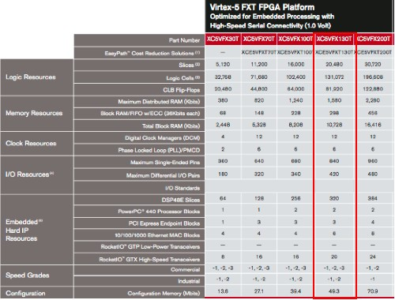
Virtex-5 FXT Feature

Slide 38
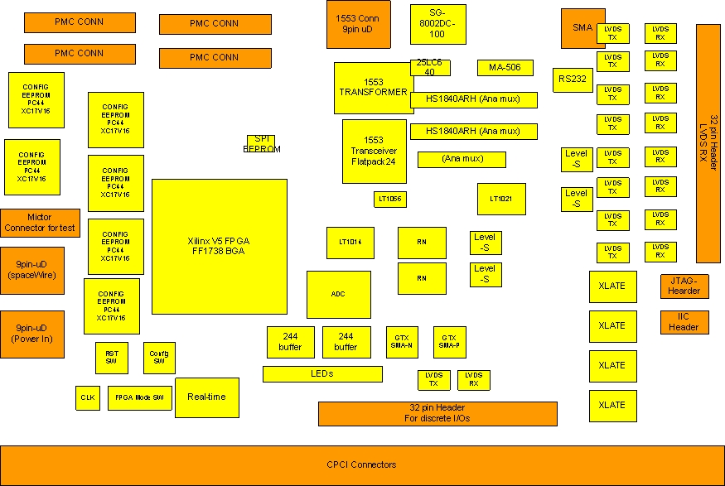
Preliminary iBoard 2 Layout - Front

Slide 39
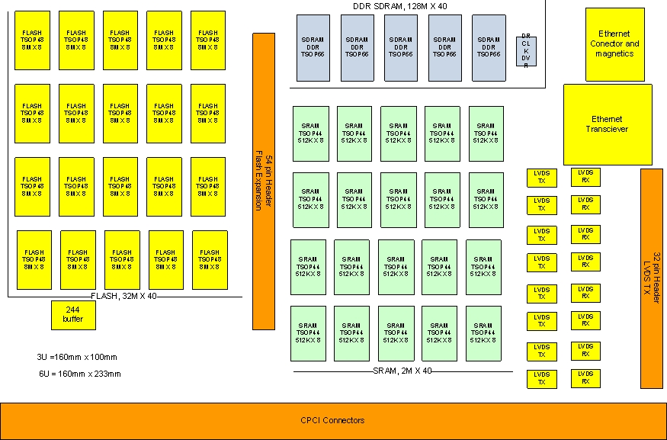
Preliminary iBoard 2 Layout - Back

Slide 40
iBoard 3 Conceptual Design

Slide 41
DESDynI SweepSAR Electronics Data Path
For 25 MHz Bandwidth Split-Spectrum, Single/Dual-Pol, Full Swath, “basic” mode (minimal on-board processing)
Quad-pol is also available at roughly twice the data rate, just not shown for this example.
from element N-1
L-Band Echo
from Element N
8 bits x 240 MHz
1920 Mbps
8 bits I&Q
480 Mbps
8 bits I&Q
480 Mbps
8 bits I&Q
33 Mbps (avg)
4 bits I&Q
18 Mbps (avg)
580 Mbps
(avg)
per Pol
ADC
Filter/
Decimate
Combine 3 Elements
Time Gate
BFPQ
Buffer/ Format
25 MHz BW
1.2 Oversampling
~50 us avg window width
1385 Hz PRF
1.2 Gbps Dual-Pol
1260 MHz CF
80 MHz BW
240 MHz
Sampling Freq
from element N+1
34 elements
per Pol
First-Stage Processor
(1 per element)
Data Combine/Format
(1 per polarization)
Data routed down mast to S/C SSR
The “combine 3 elements” step uses programmable coefficients for each element, so combining 3, 2, or 1 elements, or including weighting is easily incorporated.

Slide 42
DESDynI SweepSAR Electronics Data Path
For 80 MHz Bandwidth, Dual/Quad-Pol, Full Swath, “advanced” mode (experimental on-board processing)
from element N-1
L-Band Echo
from Element N
8 bits x 240 MHz
1.92 Gbps
8 bits I&Q
1.5 Gbps
8 bits I&Q
1.5 Gbps
8 bits I&Q
200 Mbps (avg)
8 bits I&Q
200 Mbps (avg)
6.8 Gbps
(avg)
per Pol
ADC
Filter/
Decimate
Combine 3 Elements
Time Gate
BFPQ
Buffer/ Format
80 MHz BW
1.2 Oversampling
~50 us avg window width
2666 Hz PRF
13.6 Gbps Dual-Pol
1260 MHz CF
80 MHz BW
240 MHz
Sampling Freq
from element N+1
34 elements
per Pol
First-Stage Processor
(1 per element)
Data Combine/Format
(1 per polarization)
Data routed to “specialty”
Hi-Res Processor
(DLR-provided)
Output of “specialty” Hi Res Processor is then routed down the mast to S/C SSR.

Slide 43
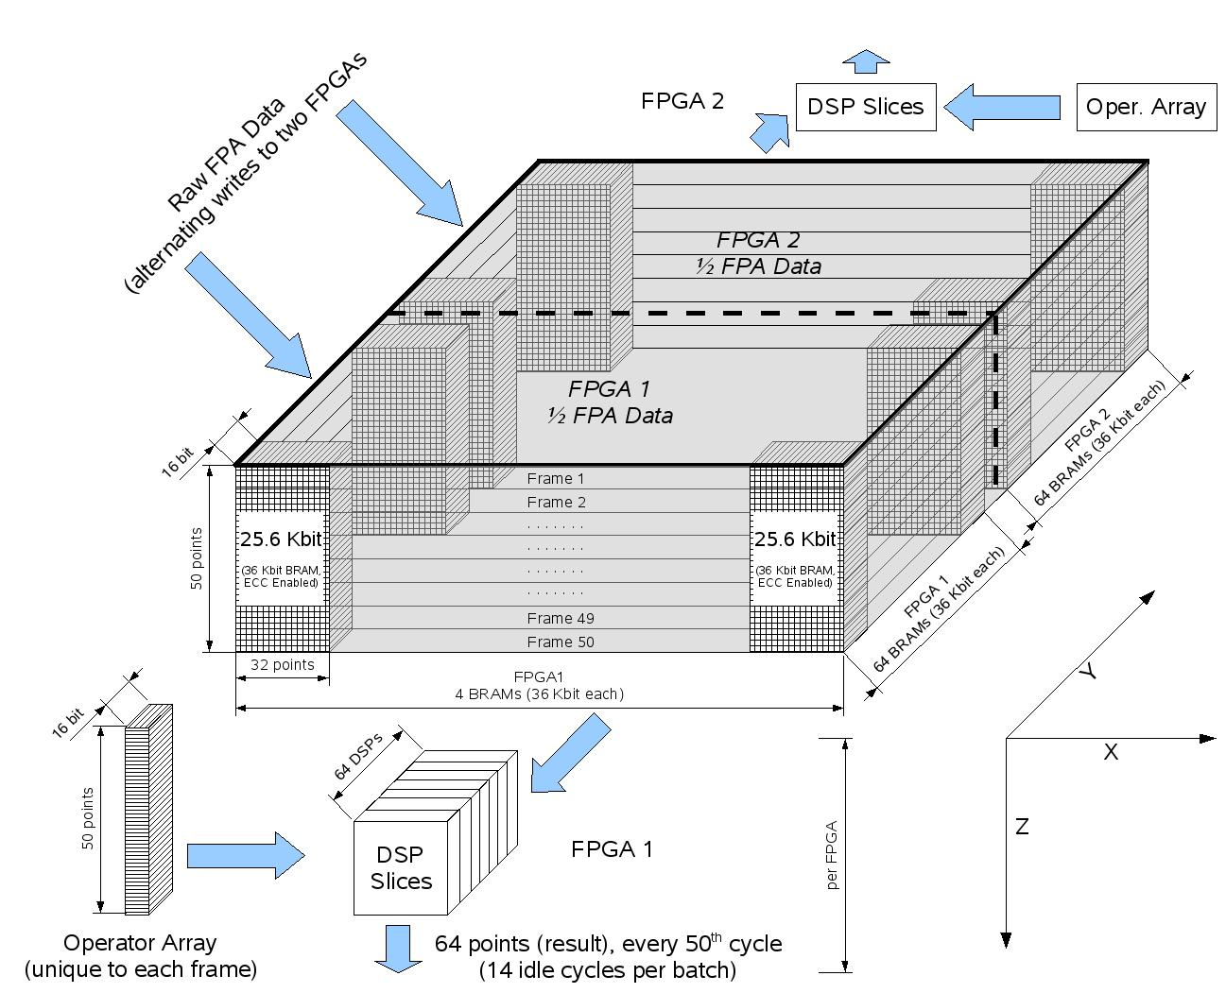
GeoCAPE PanFTS Data Path

