Slide 1
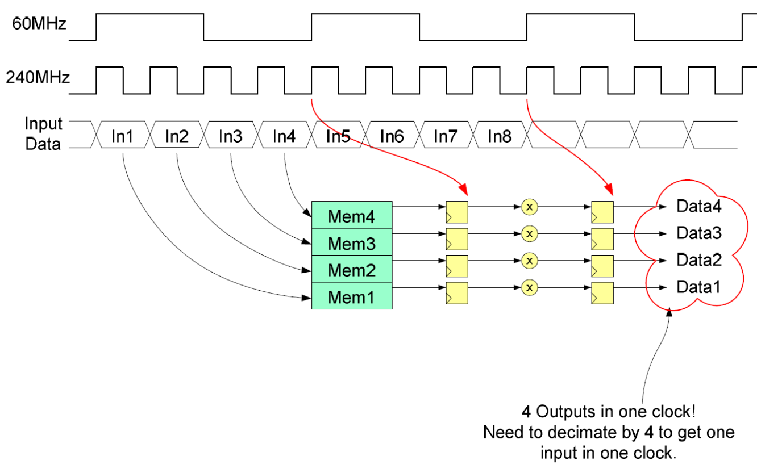

Slide 2
Generalized Firdecim
Generalized Firdecim with:
  MAC clock speed of fmac
  Input clock speed of fin (inputs per MAC clock = fin/fmac)‏
  Output clock speed of fout (num. of MAC clocks per output = fmac/fout)‏
  Decimation factor m = fin/fout
  Number of taps n
Some restrictions:
  m, fmac/fout are integers
  fin>fmac => fin/fmac is integer, o.w. fmac/fin is integer
  m>1 => m/(fin/fmac) is integer
Resource usage:
  Number of multipliers = n*(fin/fmac) / (fmac/fout) = n * fin * fout / (fmac)^2
  Number of accumulators = n / m
  Number of input shifters = fin/fmac

Slide 3
General Firdecim Architecture
Input
Stream
De-Serializer
Input Data (Fmac)‏
Accum.
Bank
X(0), X(P), X(2P), ...
Input Data (Fin)‏
X
X(1), X(P+1), X(2P+1), ...
X
X(2), X(P+2), X(2P+2), ...
X
...
X(P-1), X(2P-1), X(3P-1), ...
X
Coe
Registers
Coe
Bank
...

