Slide 1

ISAAC Demonstration Planning
Yutao He
July 17, 2008

Slide 2
Outline
Objectives
Approach
Schedule and Plan
Brainstorming and Discussion

Slide 3
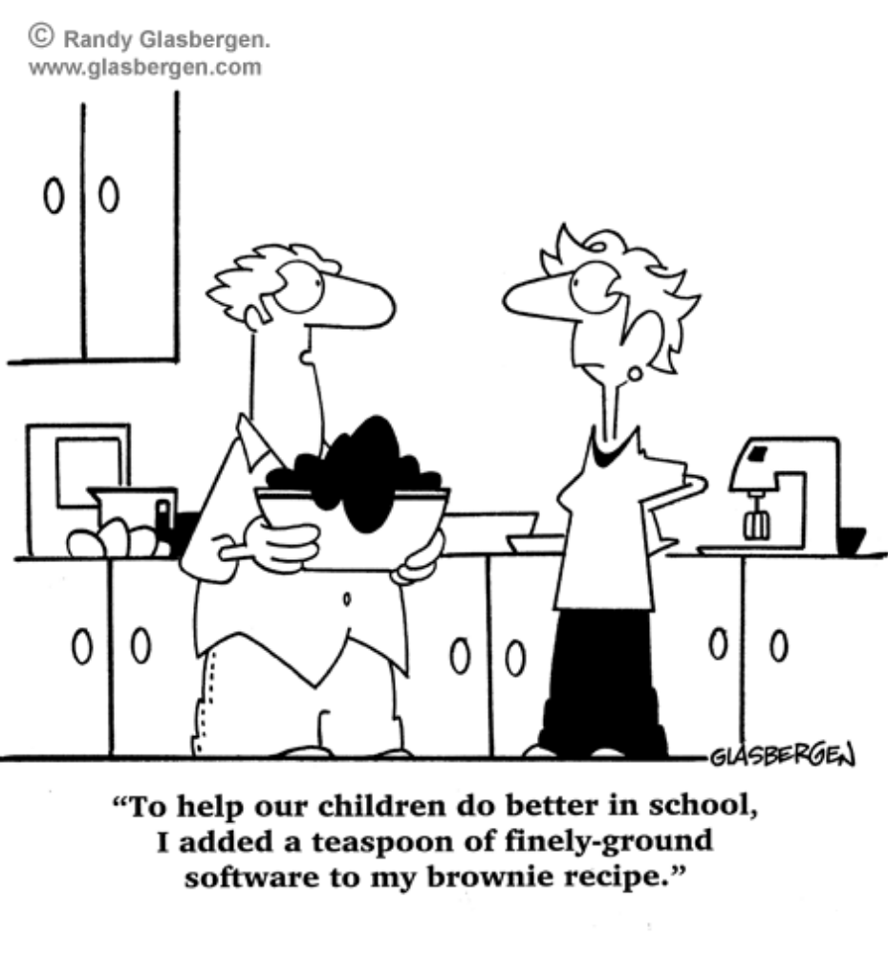
ISAAC Joke

Slide 4
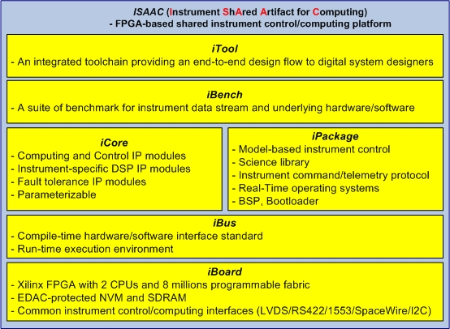
Objectives
Demonstrate key ISAAC capabilities by applying the same ISAAC framework to three types of real instruments
Complete the delivery as part of FY08 ISAAC Task plan

Slide 5
Three ISAAC Demos
Isaac Newton
Isaac Asimov
Isaac Stern
Targeted Missions
SMAP
ACE
SWOT/HAMSR
Instruments
L-band Radar
Imager (MSPI)‏
Radiometer
Demo Lead
Charles Le
Paula Pingree
Will Zheng
Key Capabilities
Digital Filtering
On-Board Processing
Control and Timing

Slide 6
Framework and Demo Mapping
Isaac Newton
(Radar)‏
Isaac Asimov
(Imager)‏
Isaac Stern
(Radiometer)‏
Impact
Data Reduction for Downlink Data rate
Data Reduction for Downlink Data rate
And on-board processing
MBE-based Controller
Instrument-S/C Interface
iBoard
ML410
ML410
ML410
iBus
CoreConnect
CoreConnect
CoreConnect
iCore
I/Q Demodulation Decimation
Bessel Function Fitting
(Data Compression)‏
I2C
Control/Timing
iPackage
BSP
Linux, ICTP
BSP
GSL, ICTP
BSP
Linux, MBE, ICTP
iBench
Input: Memory
Output: Matlab
Input: Hw generator
Output: datafile
Input: Memory
Output: iPanel/ICTP
iTool
ISE/EDK
GNU SDE
AccelDSP
TMRTool
ISE/EDK
GNU SDE
ImpulseC
ISE/EDK
GNU SDE

Slide 7
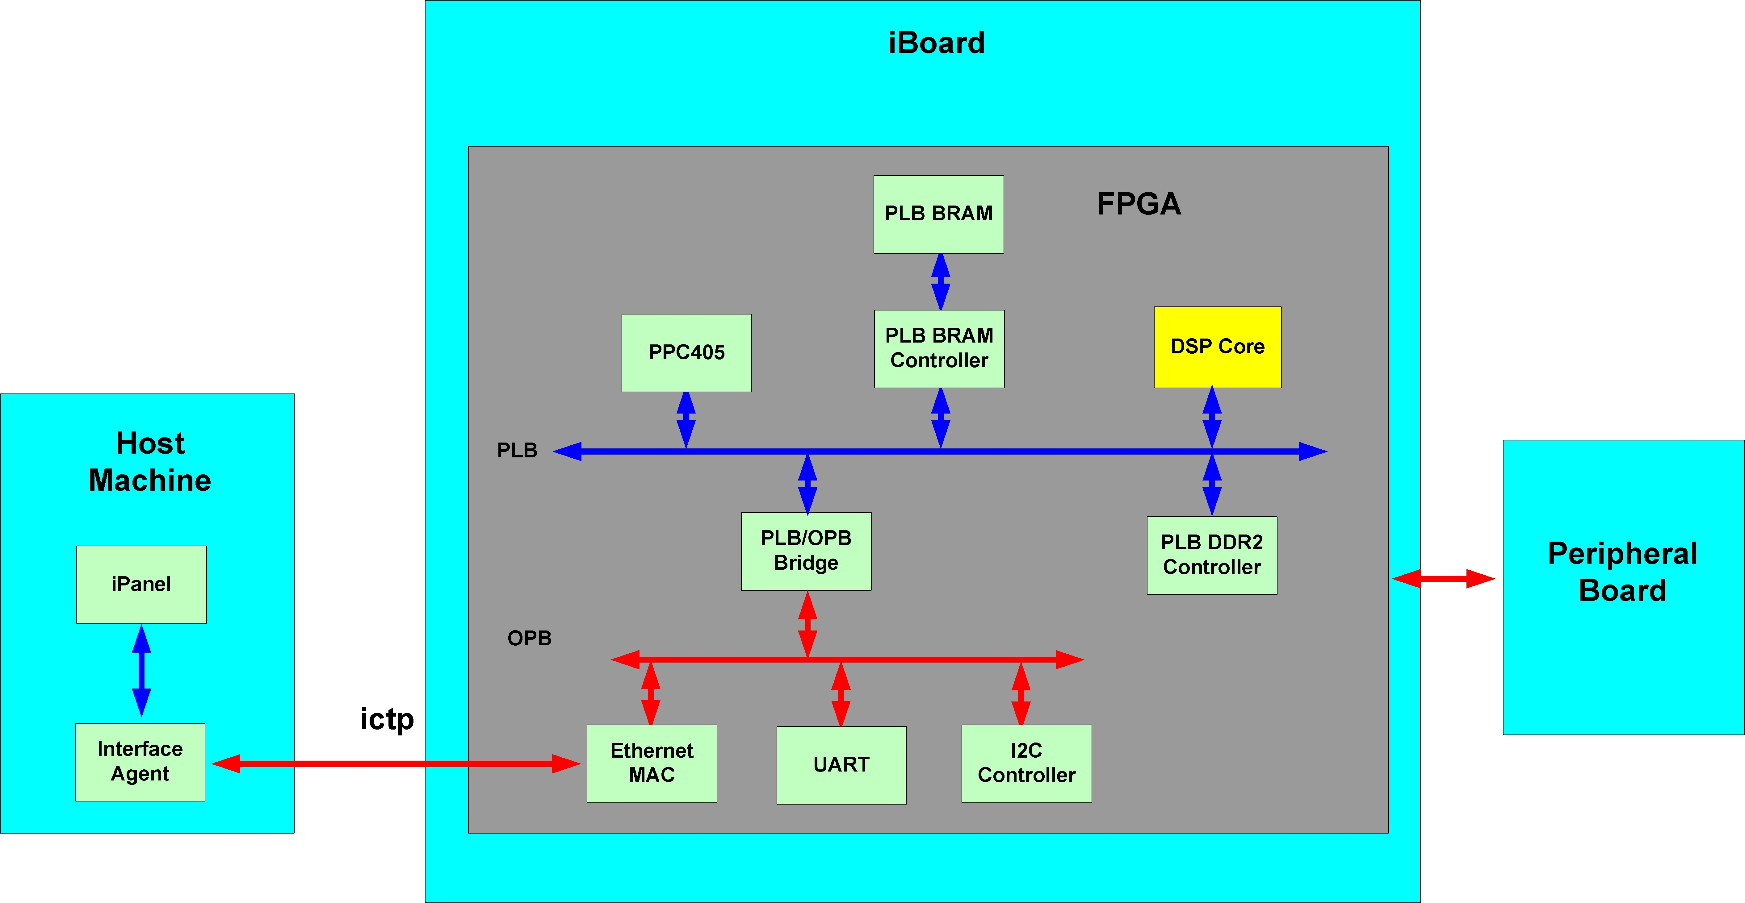
Approach
Demonstrate three types of real instruments under the same ISAAC framework

Slide 8
Key Technical Issues
Test Instrument Data stream - iBench
  Data format
  Data source
    Real
    Generated
  Display (Input/Output)‏
Spacecraft to Instrument Interface - iBoard/iPackage
IP core interface and HW/SW interface - iBus
On-Board processing - iCore/iPackage

Slide 9
Tentative Schedule
Status Recap
  Week of July 21
  Each demo team presents where it stands and the demo plan
First Internal Demo
  Week of July 28
Second Internal Demo
  Week of August 18
Third Internal Demo
  Week of Sept. 22
Customer Demo
  Early October

Slide 10
ISAAC Demo Task Plan Template
Targeted Mission(s)‏
Requirements
  Targeted missions
  Demo systems
Deliverables
  Baseline (end-of-FY08)‏
  Upscope
Schedule and milestones
  Architecture Design (Block Diagram)‏
  Algorithm Development
  Hardware design and development (iBoard/iBus/iCore/iTool)‏
  FPGA design and development (iBoard/iBus/iCore/iTool)
  Software design and development (iPackage/iTool)‏
  Integration and test (iBench)‏
Resources
  Workforce
  ISAAC components
  Additional procurements

