Slide 1

Virtex II-based 240 MHz Digital Filter Proposal
for the SMAP Project
Yutao He, Charles Le, Jason Zheng, and Kayla Nguyen
R&TD FY’09 ISAAC Task
December 9, 2008

Slide 2
Objectives and Scope
The objective of the task is to investigate whether it is feasible to implement the 240 MHz digital filter design based on the ISAAC’s 60 MHz digital filter core on the Xilinx Virtex II 3000 device.
The study is critical for SMAP to make the system-level design decision by its SRR in February, 2009.
The proposed task will
  Develop the 240 MHz digital filter algorithm based on the ISAAC 60 MHz digital filter design
  Implement the 240 MHz digital filter algorithm based on the ISAAC 69 MHz digital filter core on the Xilinx Virtex II 3000 device
  Evaluate, validate, and demonstrate the design on a testbed based on a Virtex II prototype
  Document the design and summarize the findings in a technical memo delivered to SMAP

Slide 3
Approach
Inherit and extend the ISAAC 60 MHz digital filter design
  Algorithm Design
  FPGA implementation
  Testbed set up

Slide 4
Algorithm Design
Charles, please fill in this slide

Slide 5
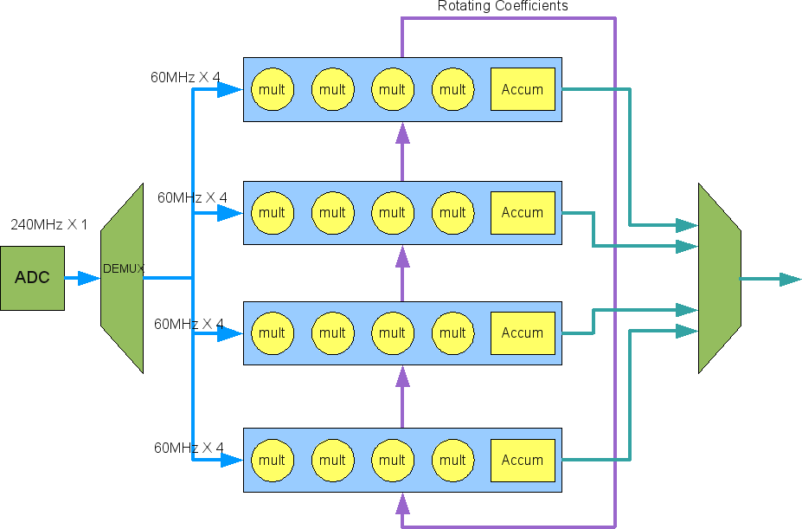
FPGA Design and Implementation
First stage FIR filter with 4x decimation and 16 taps
8-bit ADC @ 240MHz
Off-chip demux changes the input rate to 60MHzx4 samples
All samples are fed to 4 special MAC units with 4 multiplier and 1 accumulator
Multipliers can be either full or VKCM
Multiplexed 8-bit output at 60MHz

Slide 6
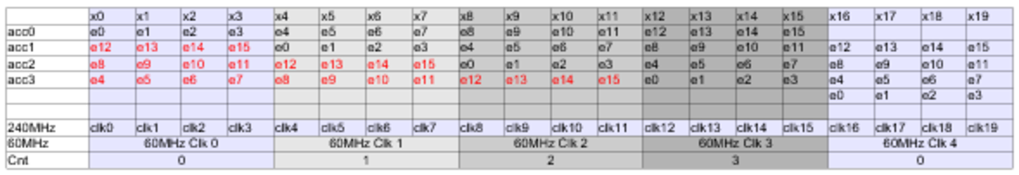
Special MAC Design
Multiplications and additions per 240MHz/60MHz clock is expanded in the table above
Each row represents the steps toward a single 60MHz output data and a concurrent thread
4 special MACs are needed, each performing 4 multiplications and 4 additions
Total of 16 multiplications and 16 additions per 60MHz clock

Slide 7
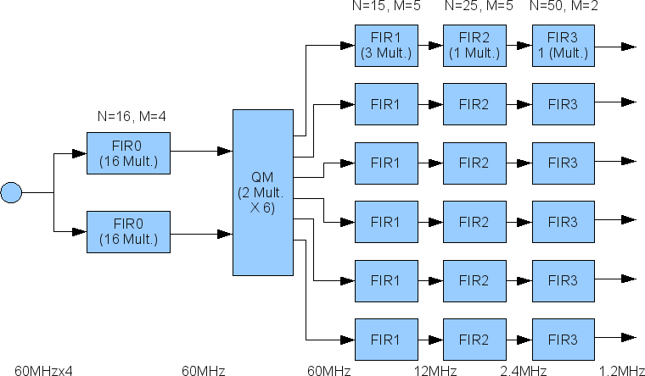
Big Picture
Total Number of 60MHz 8x8 Multipliers:
16x2 + 2x6 + (3+1+1)x6 = 74.
FIR0 can use VKCM to reduce the full
multiplier count to 42.
V2-3000 Has 96 Full Multipliers

Slide 8
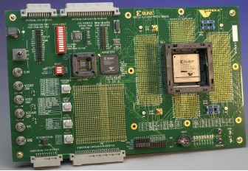
Testbed Setup
Set up the testbed based on ISAAC Newton iBench
Purchase a Virtex II evaluation board
  Xilinx AFX-FF1152-200 Evaluation Board
    Key Features:
      Xilinx Devices: XC2V3000, XC2V4000, XC2V6000, XC2V8000 in FF1152
      On-board programmable oscillator, LVTTL-type oscillator sockets, Global Clocks, Selectable on-board clock frequency (from 25 MHz to 90 MHz), Four global clock (GCLK) inputs
      JTAG port for reprogramming the reconfigurable PROMs and the user FPGA (DUT), Upstream and downstream System ACE™ and Configuration Interface
    Price:
      $2,300
    Lead Time:
      TBD week
Test Station
Serial Port Debug
Terminal
Matlab
240 MHz QMFIR

Slide 9

Schedule

Slide 10
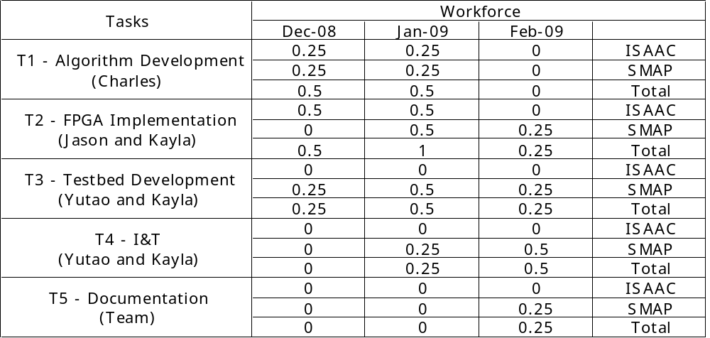
Budget
Labor
Procurement
  2 Xilinx AFX-FF1152-200 Evaluation Board
  Cost: $4,600 (2 x $2,300)

Slide 11
Deliverables
The technical memo includes
  The study findings
The 240 MHz digital filter algorithm design includes
  The golden model in Matlab
  The documentation
The 240 MHz digital filter FPGA implementation includes
  The Verilog source code optimized for Virtex II device
  The testbench
  The documentation
The testbed includes
  Two testbed hardware based on Xilinx AFX-FF1152-200 Evaluation Board
  The complete FPGA configuration for testing the digital filter core
  Synthetic radar test data
  Test plan, script, and software
  The documentation
Procurement
  2 Xilinx AFX-FF1152-200 Evaluation Board
  Cost: $4,600 (2 x $2,300)

