Slide 1
Reverse Engineering the QM-FIR Digital Filter Core
Hieu Nguyen
Section 345
Mentor: Dr. Yutao He
March 2, 2011
Notes:
The QM-FIR IP core is part of the iCore library, which consists of “standard and parameterized IP cores that implement common computationally-intensive instrument control and computing functions
ISAAC Newton focuses on the radar application, specifically for the on-board processing power which will eventually suppor the SMAP (Soil Moisture Active-Passive) L-band radar project
showcase the Quadrature Modulation and Polyphase Decimation Filter
More info from progress report and Yutao's paper

Slide 2
Outline
Background Information
Project Objectives & Motivation
Approach
  Hardware Configuration
  Software Applications
  Testing
Demonstration
Summary & Conclusion

Slide 3
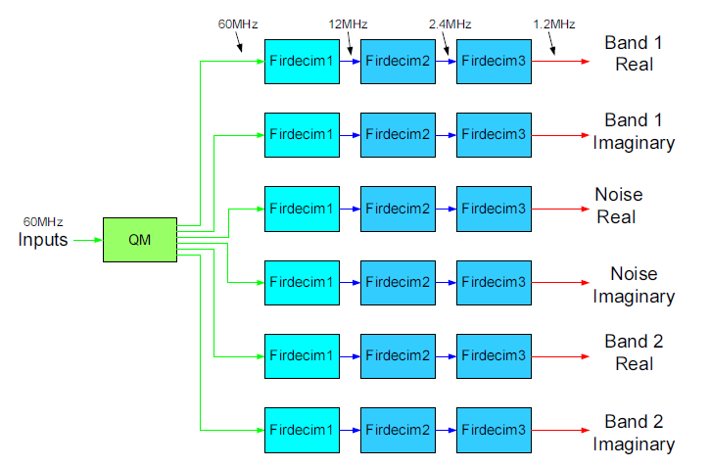
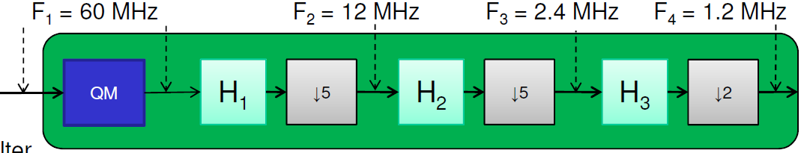
Background Information
The QM-FIR digital filter core merges two IP cores:
  QM and FIRDEC
Quadrature Demodulation
z(t) = I(t)*cos(ω_{c}t) + Q(t)*sin(ω_{c}t)
  I(t) - “in-phase” component
  Q(t) - “quadrature” component
PolyPhase FIR
  Three decimation stages for a decimation ratio of 5x5x2 = 50x downsampling
  Turn high-rate samples into data ready to be down-linked for further ground processing
Notes:
http://zone.ni.com/devzone/cda/tut/p/id/3896
What is QM-FIR, and what does the filter do?
- Equivalent to a demodulation decimating bandpass channelizer, which moves each of the subbands to baseband, filters it out to remove out-of band interference, and decimates it to yield a complex (I/Q) output data rate of 1.2MHz
QM is a way of modulating two carriers and encodes a 2-dimensional complex signal, using sine and cosine for amplitude modulation
Conveys data by modulating a cosine and sine carrier signal with the real and imaginary parts, respectively, to send with two carriers on the same frequency --> equivalent to both ASK and PSK a single carrier
Used for telecommunication systems
The signal is modulated, meaning the input signal varies the characteristics of a radio frequency carrier (sine wave)
The signal is demodulated, meaning the signal variations are measured to deduce the original signal
(90deg out of phase)
ωc is the carrier frequency
QM to move each of the subbands to baseband and a multi-stage decimation filter to reduce the sample rate from 60MHz to 1.2MHz
ADCs sample real signal at 60MHz
50X decimation, incoming data rate at 60MHz → 1.2MHz
Reducing the number of samples (downsampling)

Slide 4
Project Objectives & Motivation
Implement the QM-FIR digital filter core on iBoard3 (Virtex-5)
  Older configurations ran on Virtex-II FPGA and ML410 (Virtex-4)
  Different hardware components and timing requirements
Verify filter and FPGA system design with simulated radar data
  Send data to digital filter core → plot filter output and analyze the error
Motivation:
  QM-FIR is part of ISAAC's iCore-dsp library
  Application to NASA space missions, such as the Soil Moisture Active-Passive (SMAP) L-band radar in the ISAAC Newton project
Notes:
The QM-FIR IP core is part of the iCore library, which consists of “standard and parameterized IP cores that implement common computationally-intensive instrument control and computing functions
ISAAC Newton focuses on the radar application, specifically for the on-board processing power which will eventually suppor the SMAP (Soil Moisture Active-Passive) L-band radar project
showcase the Quadrature Modulation and Polyphase Decimation Filter
SMAP used on-board processor with multi-stage demodulation and decimation bandpass digital filter

Slide 5
Approach
Integrate old EDK project with new iBoard3 HW/SW configuration
Complete .c, .v, and .m source code
Verify QM-FIR digital filter core functionality using Matlab GUI and UDP transmission
Notes:
Issue with interrupts not being set up
Empty svn, couldn't locate latest version of project code

Slide 6
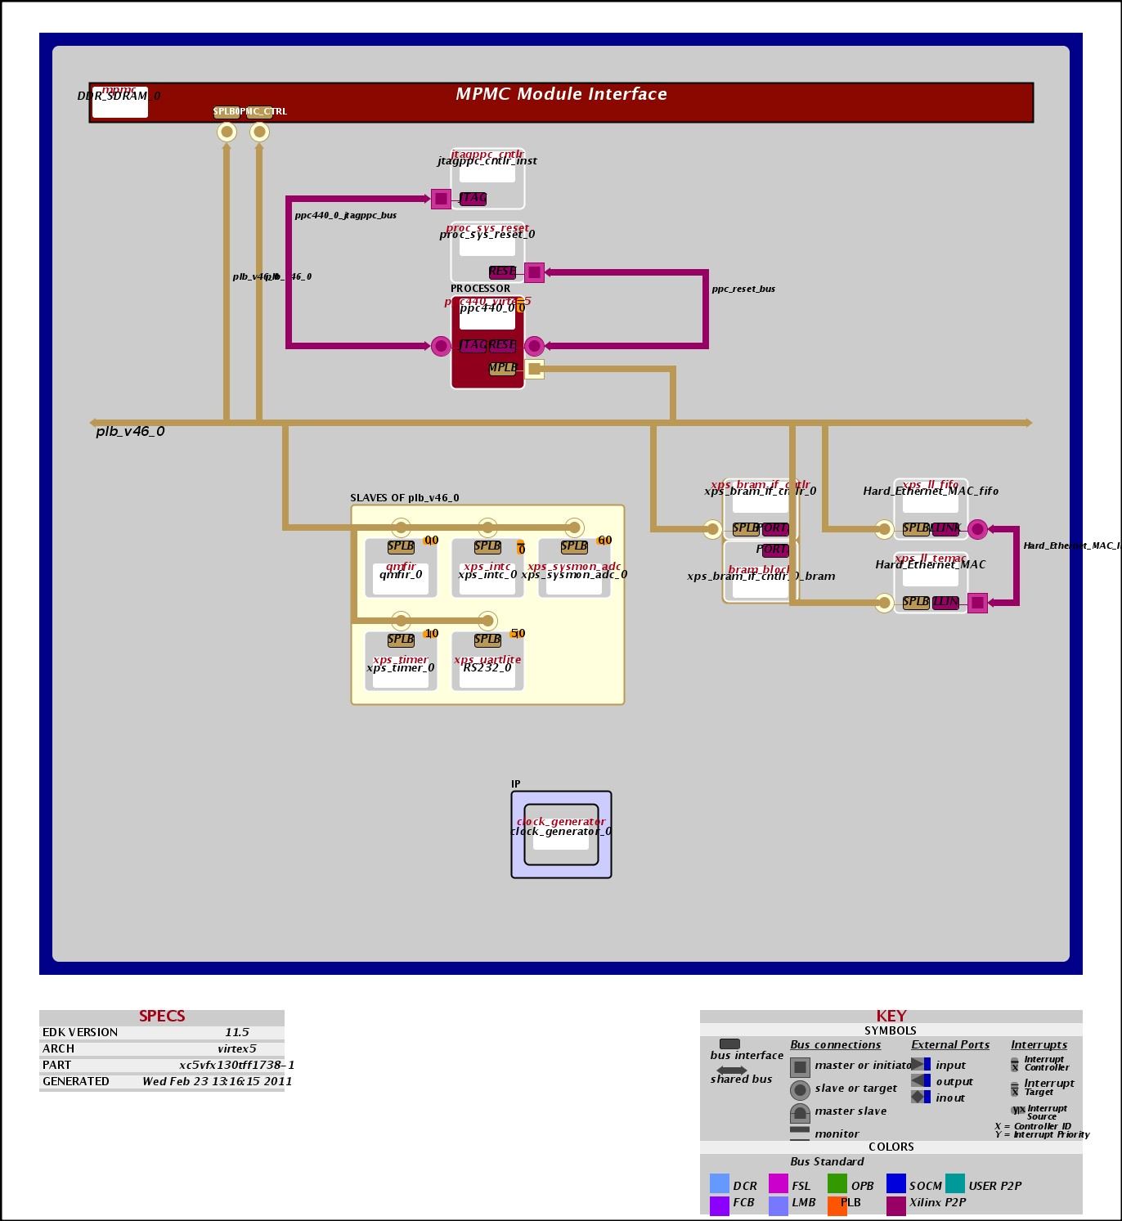
Hardware Configuration
Notes:
EDK block diagram shows hardware/software configuration

Slide 7
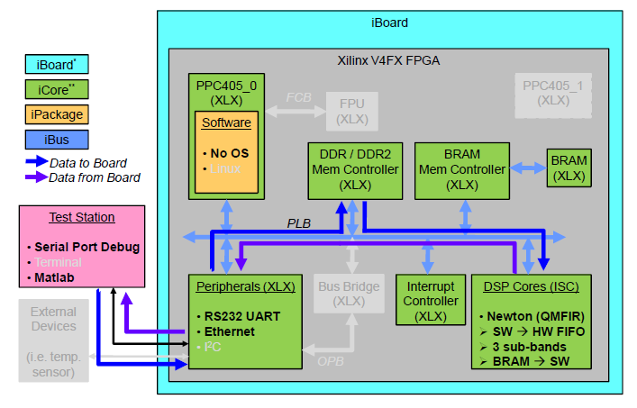
Software
FPGA Data Flow
Data is first transferred from the host machine through ethernet to the board. The data gets temporarily stored in the DDR memory. When all the data has been stored, the PPC will transfer the data to the FIFO into the QMFIR DSP core. The data gets processed and the result will be written into 3 local Block RAM inside the DSP core. When all the data has been written, there will be an interrupt to let the PPC know that it can then grab the data from the BRAM and transfer it back through ethernet to the host machine.
Software applications
Matlab → .elf → FIFO → BRAM → intr → udprecv → plot data

Slide 8
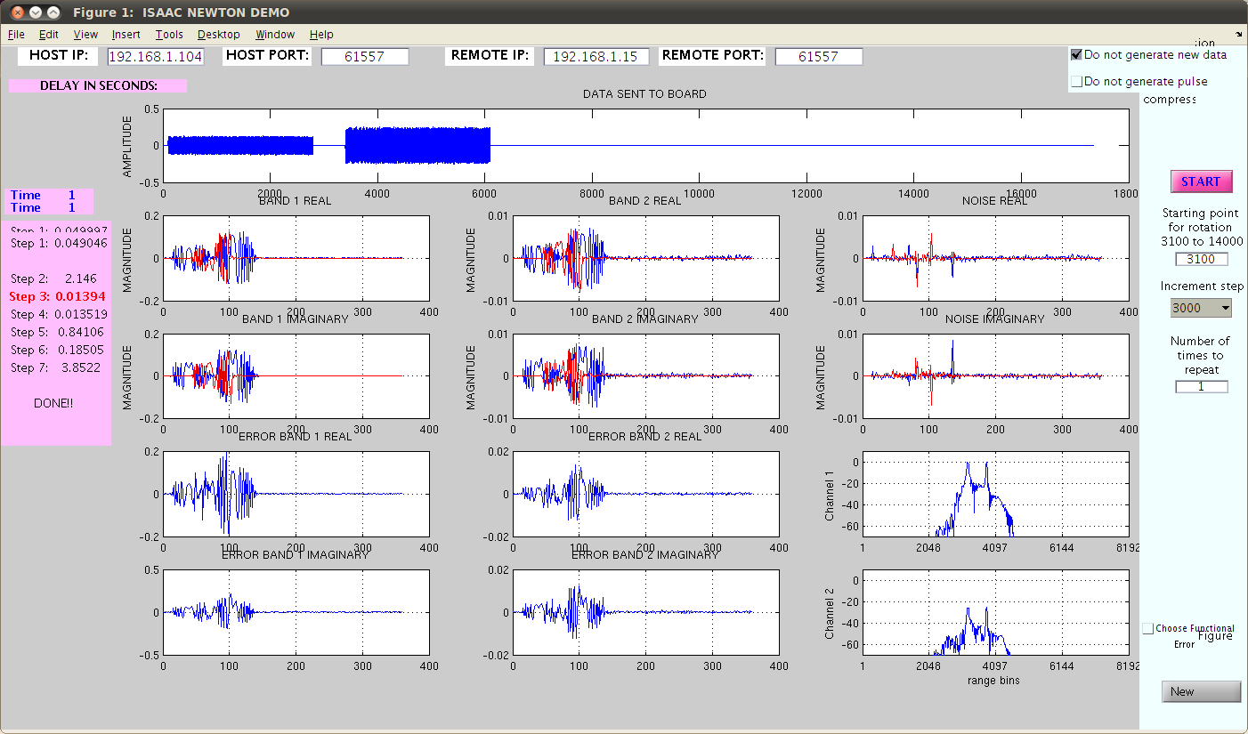
Testing
Matlab GUI
Notes:
Image from Kaylas
The QM core is implemented using a sine/cosine lookup table and requires 6 multipliers running at 60MHz
FIRDEC core is implemented as a three-stage polyphase decimation filter

Slide 9
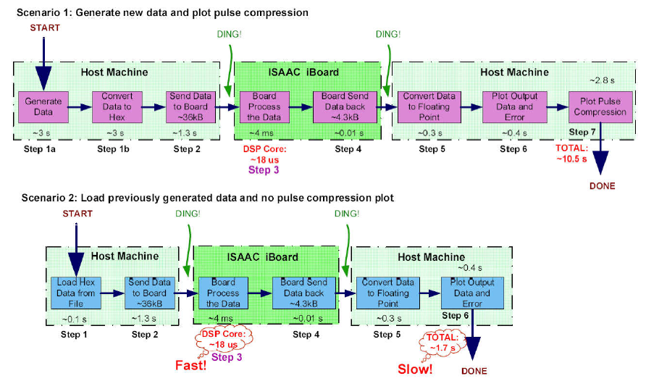
Testing
Overall System Data Flow
Notes:
Image from Kaylas
Host Machine calls Matlab to generate syntethic data, sends data to the board over ethernet UDP to be stored in Input BRAM insided FPGA, starts digital filter core
Digital filter core processes all of the data and stores the outpus in the Outpu BRAM
Host Machine grabs the data from the output BRAM through ethernet, plots the output data vs. the expected output data generataed by Matlab, plots the error between the output data and the expected data

Slide 10
Demonstration
The top figure shows the data that is sent to the board to be processed. This data is sampled at 60MHz. The 2nd line shows the real data from Band 1, Band 2, and noise band from left to right. The 3rd line shows th imaginary data from Band 1, Band 2, and noise band from left to right. Line 4 shows the error between the real data of the FPGA processed data versus the data from simulation (Band 1 and Band 2 from left to right), and line 5 shows the error between the imaginary data. The last plot of lines 4 and 5 shows the pulse compression plots of the FPGA processed data.

Slide 11
Summary and Conclusion
User Data Protocol (UDP) – uses less overhead, but provides no assurance of delivery of any packet of data (increased data efficiency)
Future applications (iPanel)python-based GUI for analyzing the filter’s outputs and simulate radar application
Extensive documentation for future users
Future administrators should be able to quickly pick up where the last left off, ensuring fluid maintenance of the server, its services, and its clients.

Slide 12
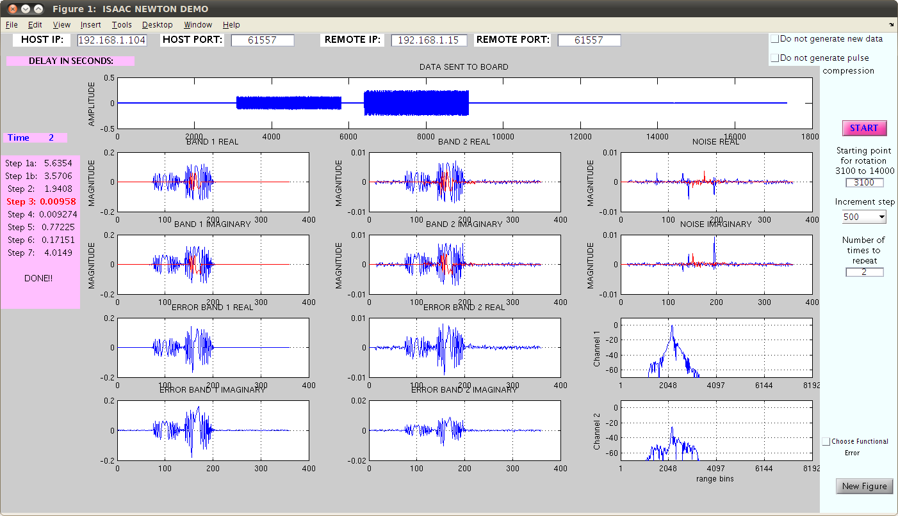
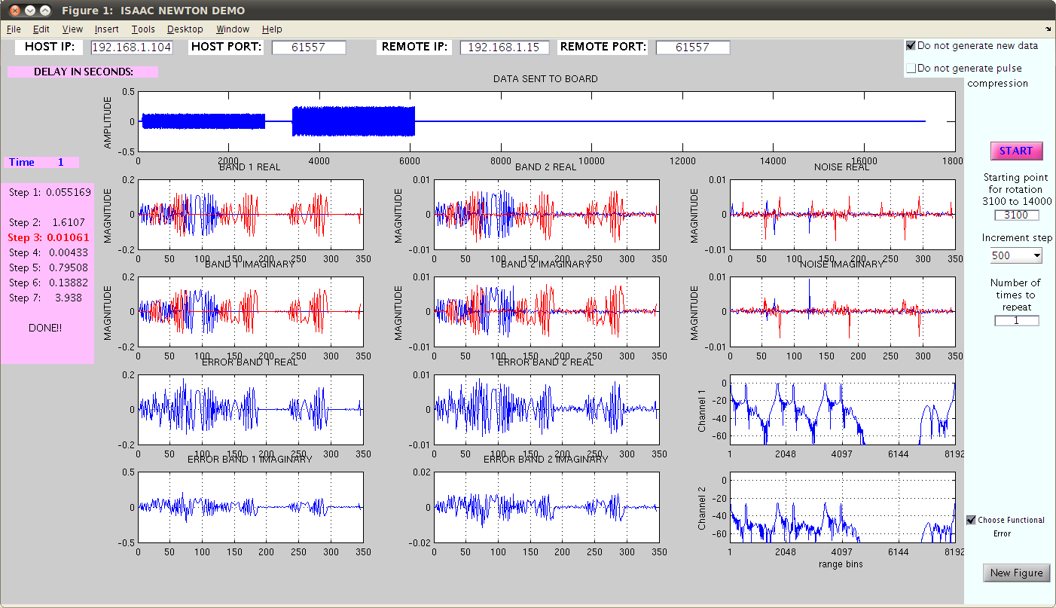
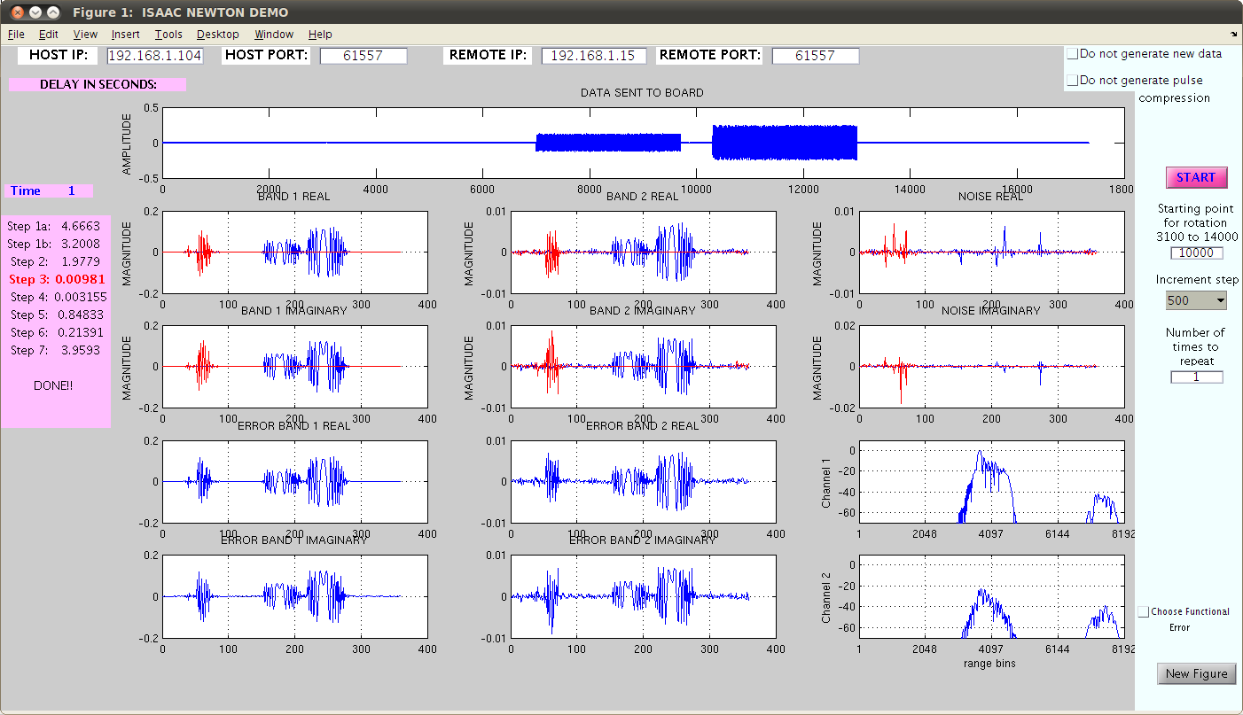
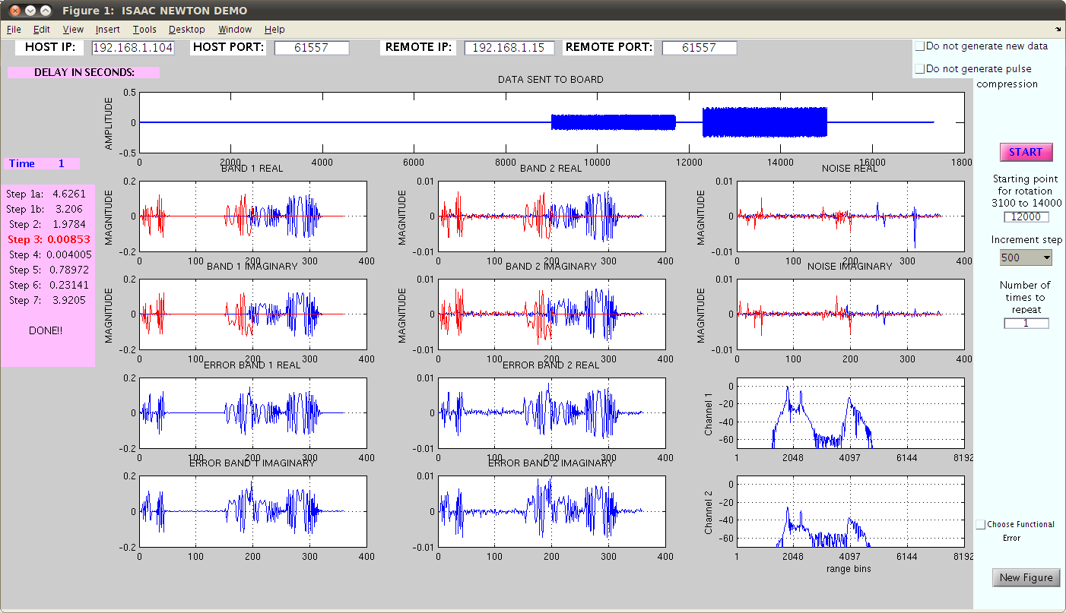
Backup Demo

