Slide 1
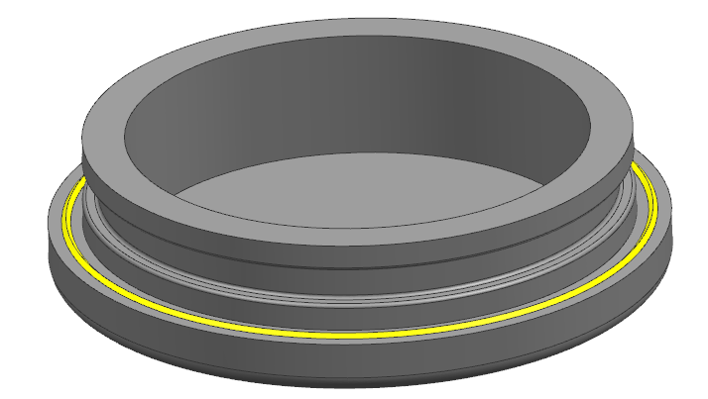
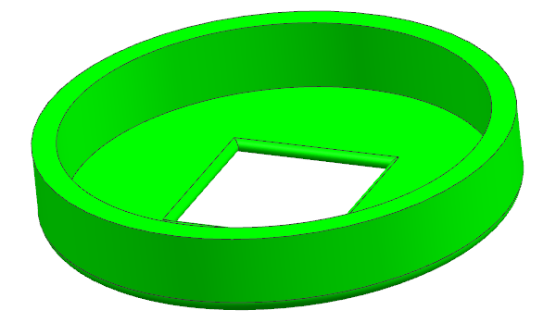
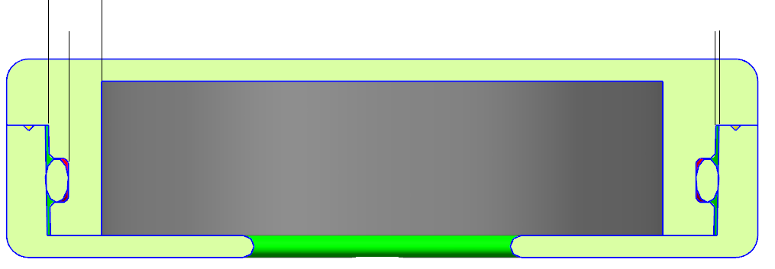
1.recall_top
2. recall_oring_bottom
Notes:
a. In order to simplify tooling, suggest doing groove on bottom part.
b. Suggest using POM material for these two parts, for its high mechanical strength , and better effect to press the o-ring.
Suggest using ultrasonic bonding
2.4mm
The gap is 0.15mm
1.5mm
2. recall_oring_bottom
3. o-ring( standard part)
1.recall_top

