Slide 1

Touch-Tone Recognition
EE301 Final Project
Group 1:
  Norman Chung
  Rocky Mark Juan
  Hieu Nguyen
  Alexander Nobles
  Bryce Toth

Slide 2

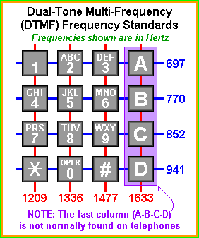
DTMF (Alex)
  4 x 4 grid, one frequency for each row and column
  Unique two-tone signal for each digit
  Switching station decodes signal with 8 bandpass filters

Slide 3
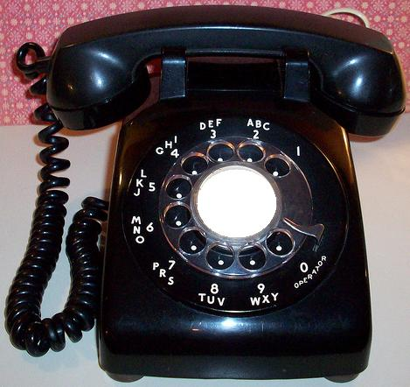
History (Alex)
  Pre-'60s: Manual switching, pulse dialing
    Pulse dialing payphone abuse
  DTMF frequencies chosen to avoid harmonics, modulation problems

Slide 4
Relation to EE 301(Norman)

Slide 6
Project Description
(Brief over view of Matlab, Hieu)
Notes:
Talk about Matlab

Slide 7
Individual Contribution
Use this one slide while we talk about what we did individually...
OR
Each slide per person about what they did

Slide 8
Demonstration

Slide 9
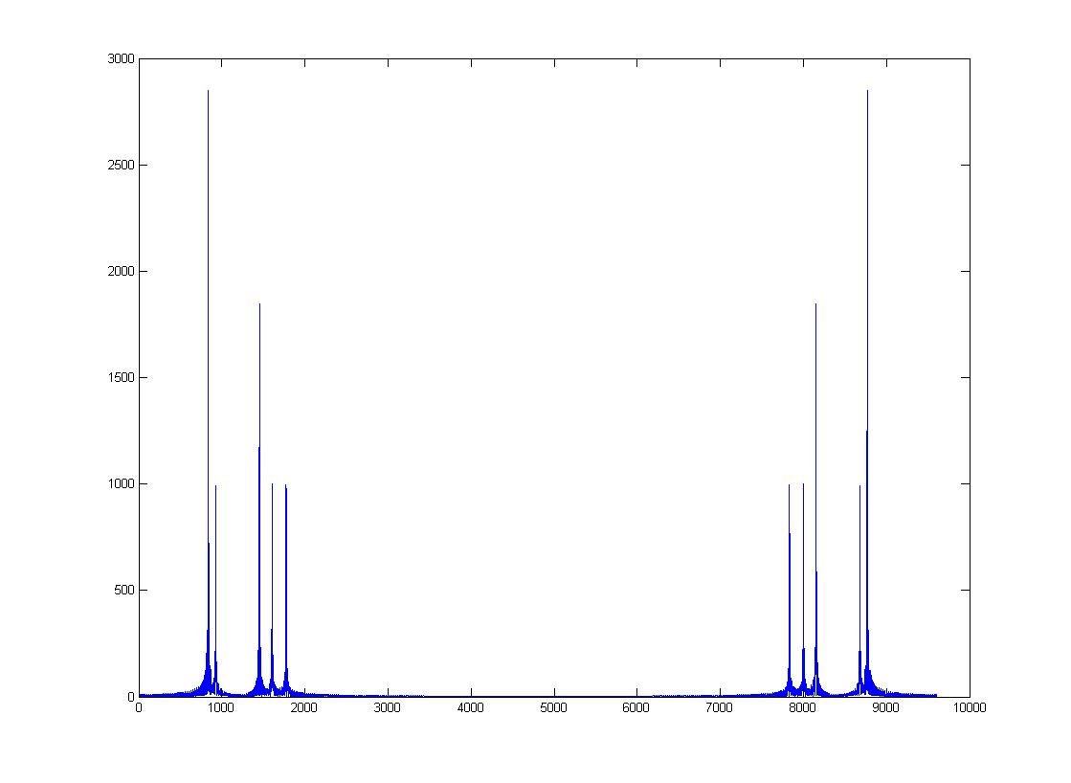
Results (Rocky)
  ???
  Signal to Noise Ratio (SNR)?
  Image of Signal, a FFT of the signal (with and without noise)
Notes:
*Our struggles with Matlab (maybe?)
*Images of our tone with, and without noise
*Talk about our problems with trying to record

Slide 10

Problems (Rocky)
  White Noise Filtering
  Analyze Raw Signal
Notes:
*Our struggles with Matlab (maybe?)
*Images of our tone with, and without noise
*Talk about our problems with trying to record

Slide 11
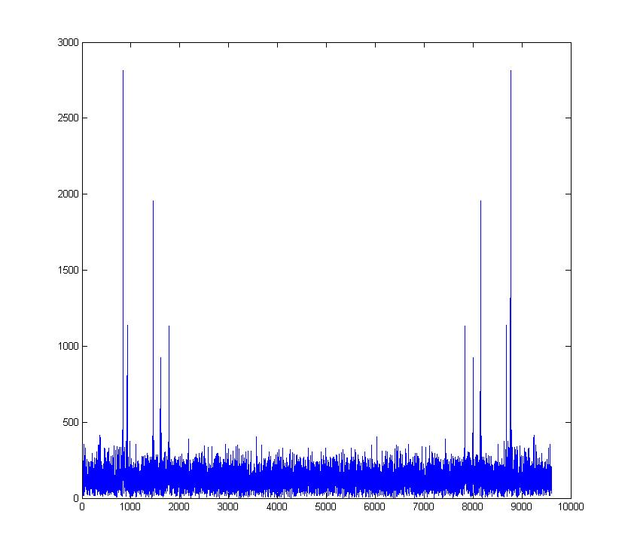
  Matlab Coding
    dtmfcut.m
  Adding Noise
    White Gaussian Noise
    FFT
  Noise Reduction
    FDATool
    wdencmp

