Slide 1


EPISODE I
Chee Keet Wong
Data Science Immersive
Singapore Batch 9th

Slide 2
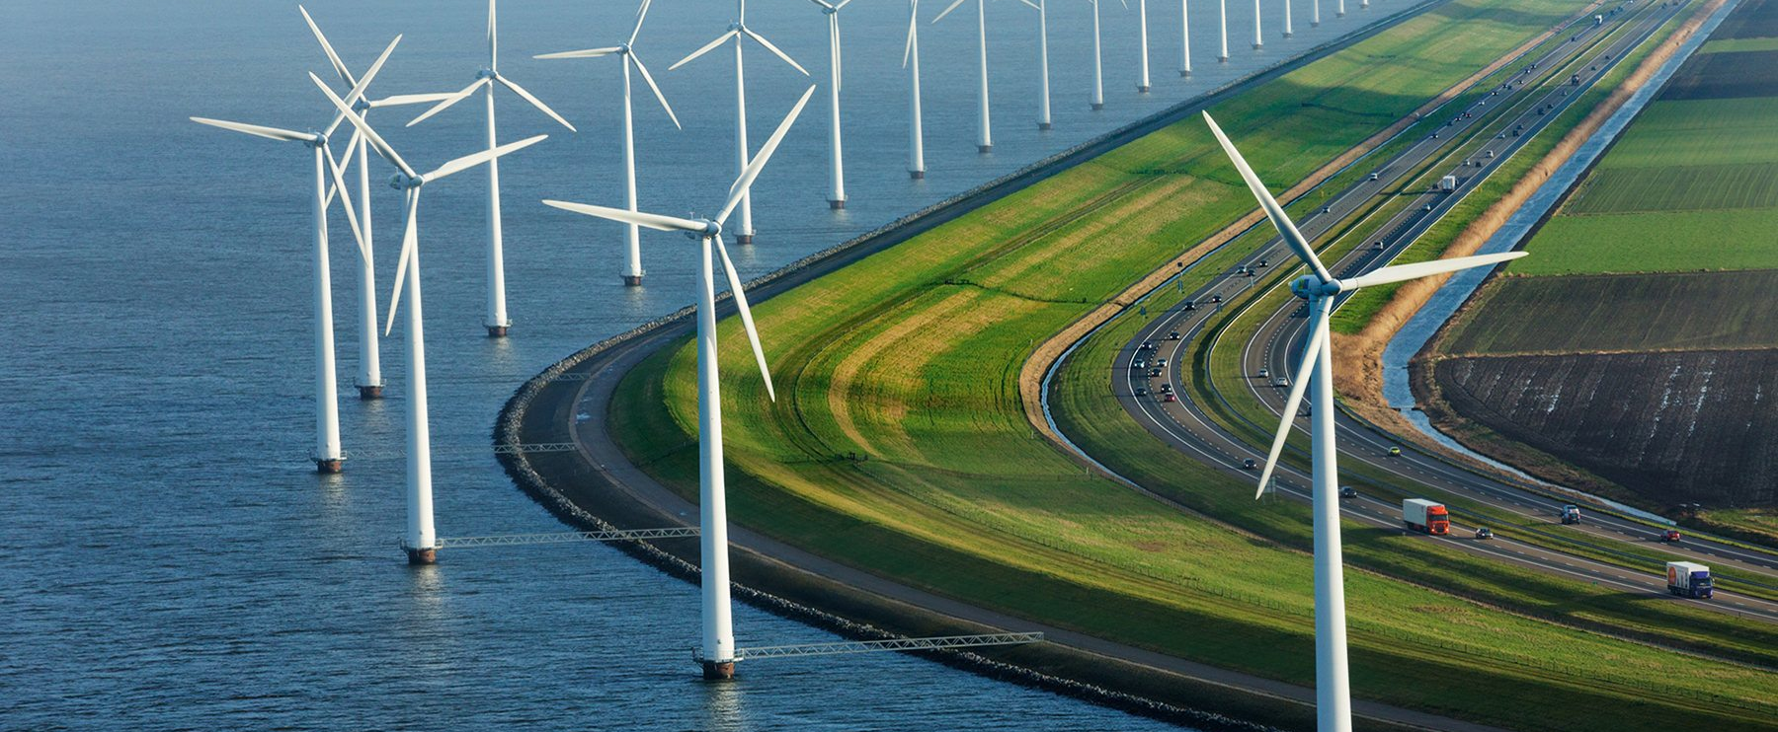
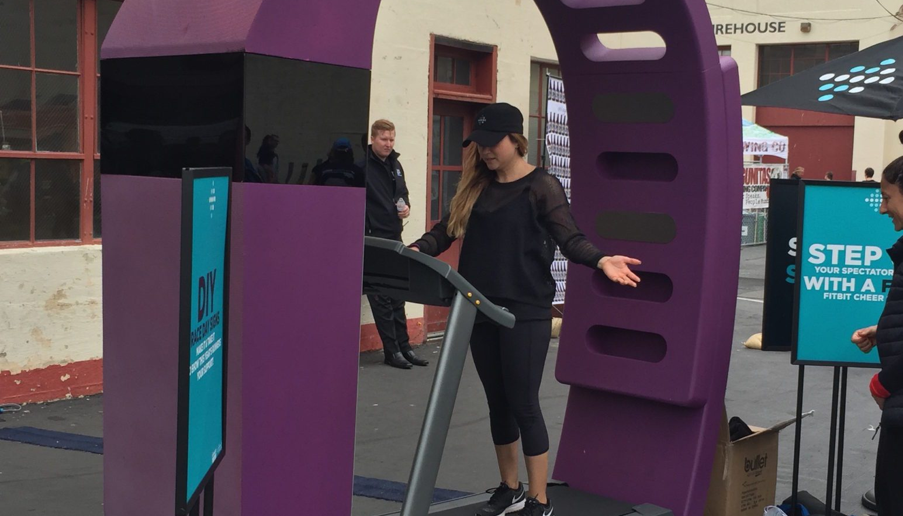
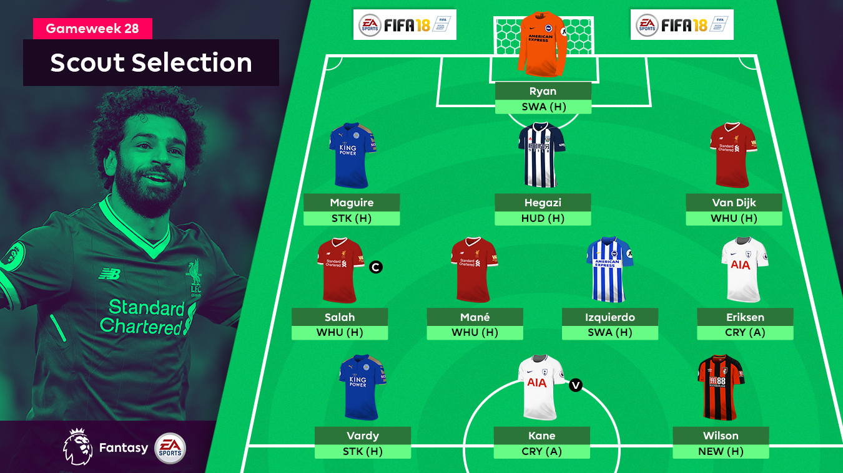


Slide 3

Problem
Model
To predict Netherlands energy consumption for 2020.
To analyse green energy trends in Netherlands e.g. home solar power, electric cars.
Linear Regression
Ridge Regression
Lasso Regression
Dataset
Product
https://www.kaggle.com/lucabasa/dutch-energy
Storyboard

Slide 4
Problem
Model
To predict the gameweek point for each FPL player.
Random Forest Classifier
Dataset
Product
https://fantasy.premierleague.com/api/bootstrap-static/
https://rapidapi.com/heisenbug/api/premier-league-live-scores
https://www.kaggle.com/delayedkarma/fantasy-premier-league-20182019
Storyboard

Slide 5
Problem
Model
To analyse data from Fitbit volunteers.
To predict volunteer id using past fitness data.
Classification Models
Dataset
Product
https://zenodo.org/record/53894#.XUWXGG8zbIU
Storyboard

Slide 6

Problem
Model
To predict the outcome of a Clash Royale game for ladder or tournament mode.
Logistic Regression
Naive Bayes
Dataset
Product
https://docs.royaleapi.com/#/
Technical Report

