Slide 1


EPISODE I
Chee Keet Wong
Data Science Immersive
Singapore Batch 9th

Slide 2
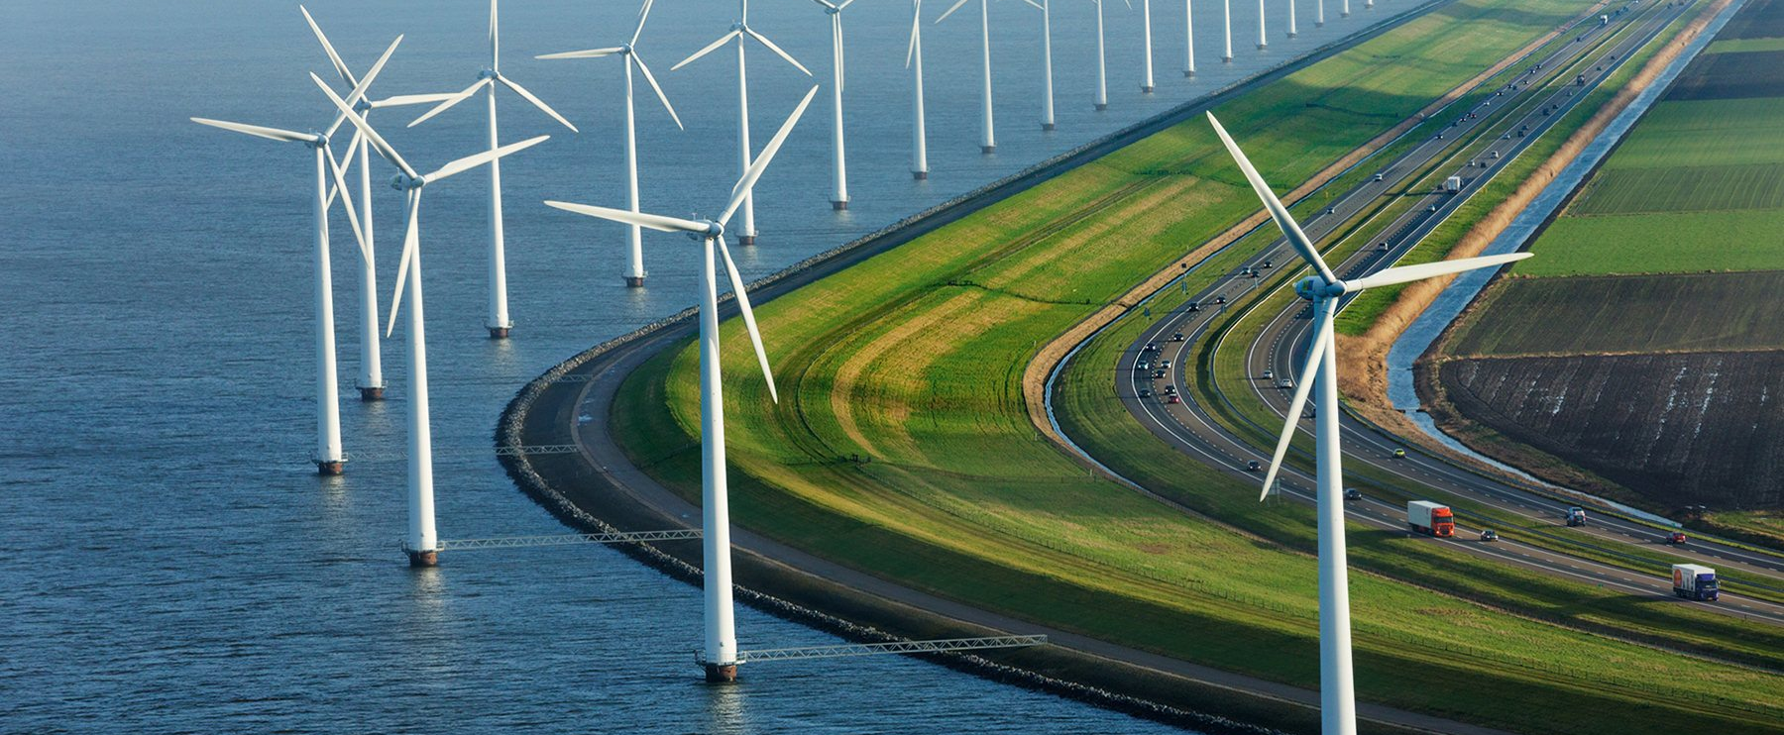
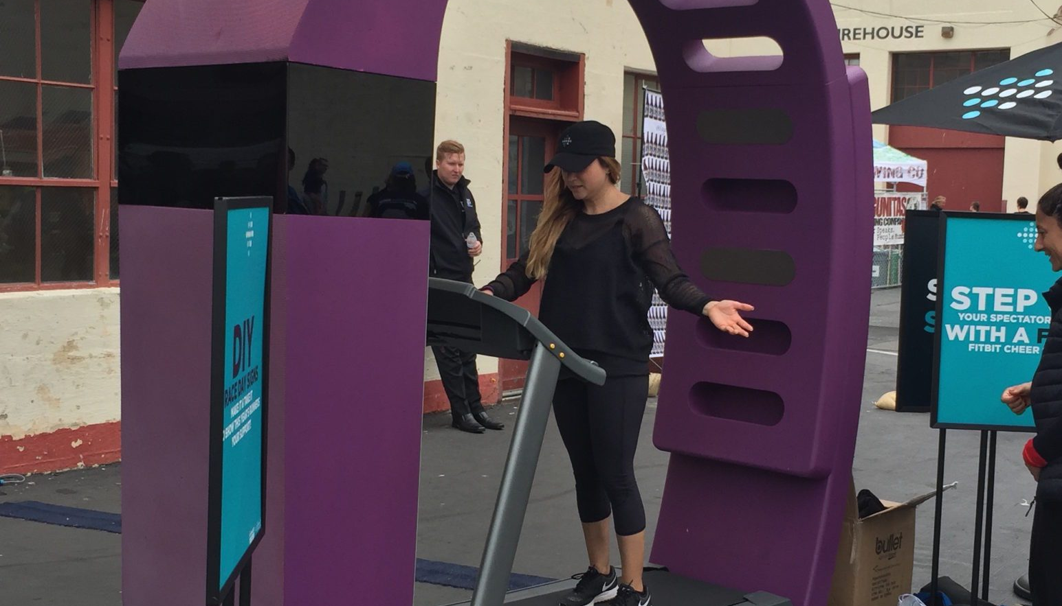
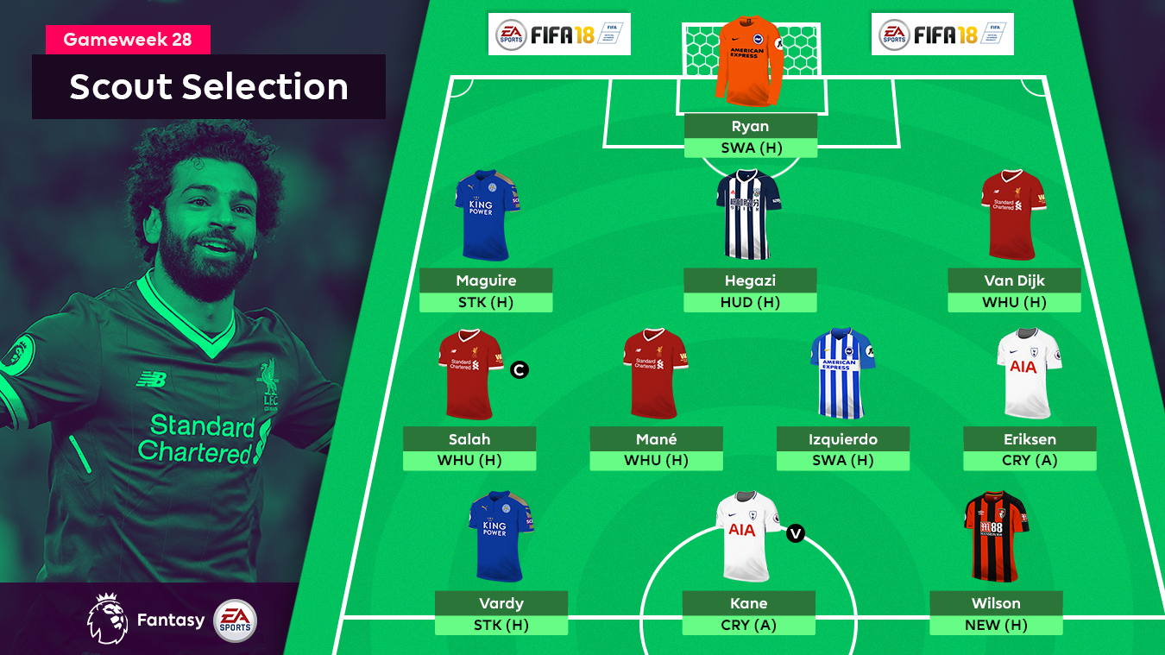


Slide 3

Problem
Model
To predict Netherlands energy consumption for 2020.
To analyse green energy trends in Netherlands e.g. home solar power, electric cars.
Linear, Ridge, Lasso Regressions
Dataset
Product
https://www.kaggle.com/lucabasa/dutch-energy
Storyboard

Slide 4
Problem
Model
To predict the gameweek point for each FPL player.
Random Forest Classifier
Dataset
Product
https://fantasy.premierleague.com/api/bootstrap-static/
https://rapidapi.com/heisenbug/api/premier-league-live-scores
https://www.kaggle.com/delayedkarma/fantasy-premier-league-20182019
Storyboard

Slide 5
Problem
Model
To analyse data from Fitbit volunteers.
To predict volunteer id using past fitness data.
Classification Models
Dataset
Product
https://zenodo.org/record/53894#.XUWXGG8zbIU
Storyboard

Slide 6

Problem
Model
To predict the outcome of a Clash Royale game for ladder or tournament mode.
Logistic Regression
Naive Bayes
Dataset
Product
https://docs.royaleapi.com/#/
Technical Report

