Slide 1

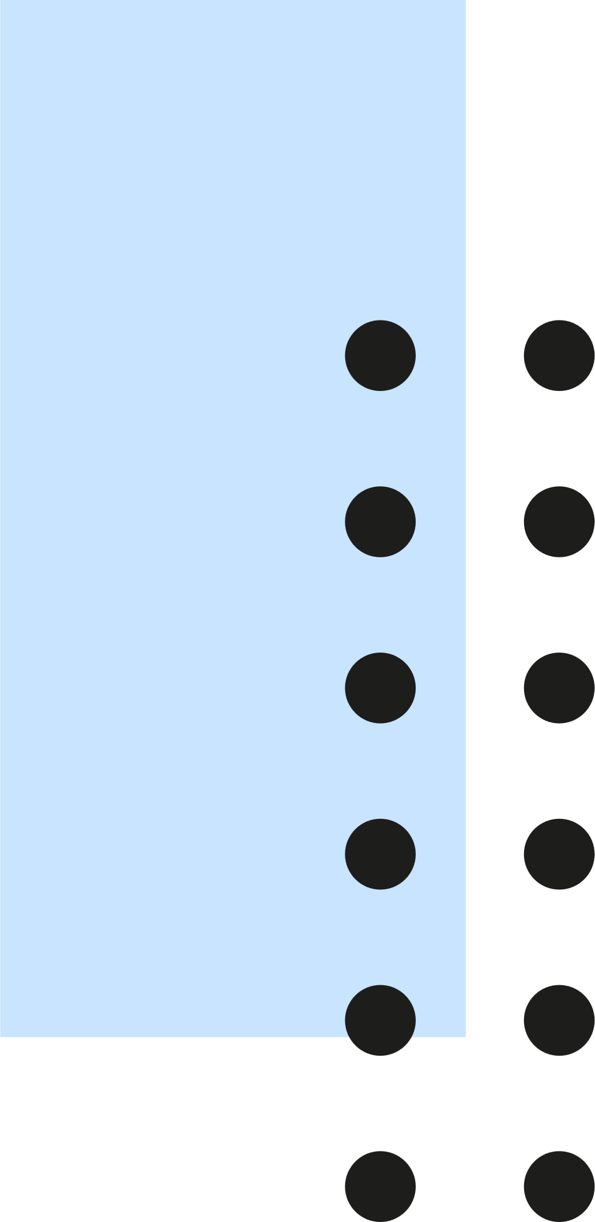

WELCOME TO
Dodle

Slide 2
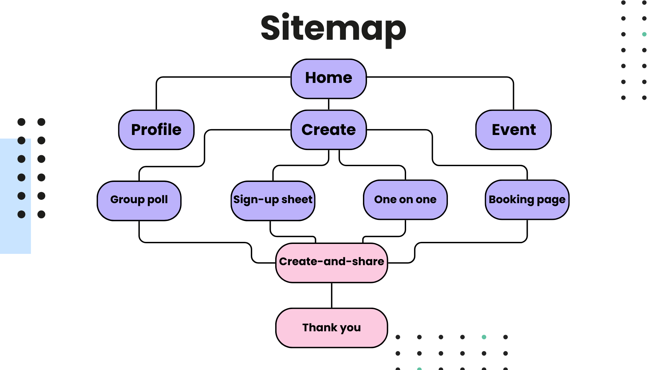

Sitemap
Home
Profile
Create
Event
Group poll
Sign-up sheet
One on one
Booking page
Create-and-share
Thank you

Slide 3
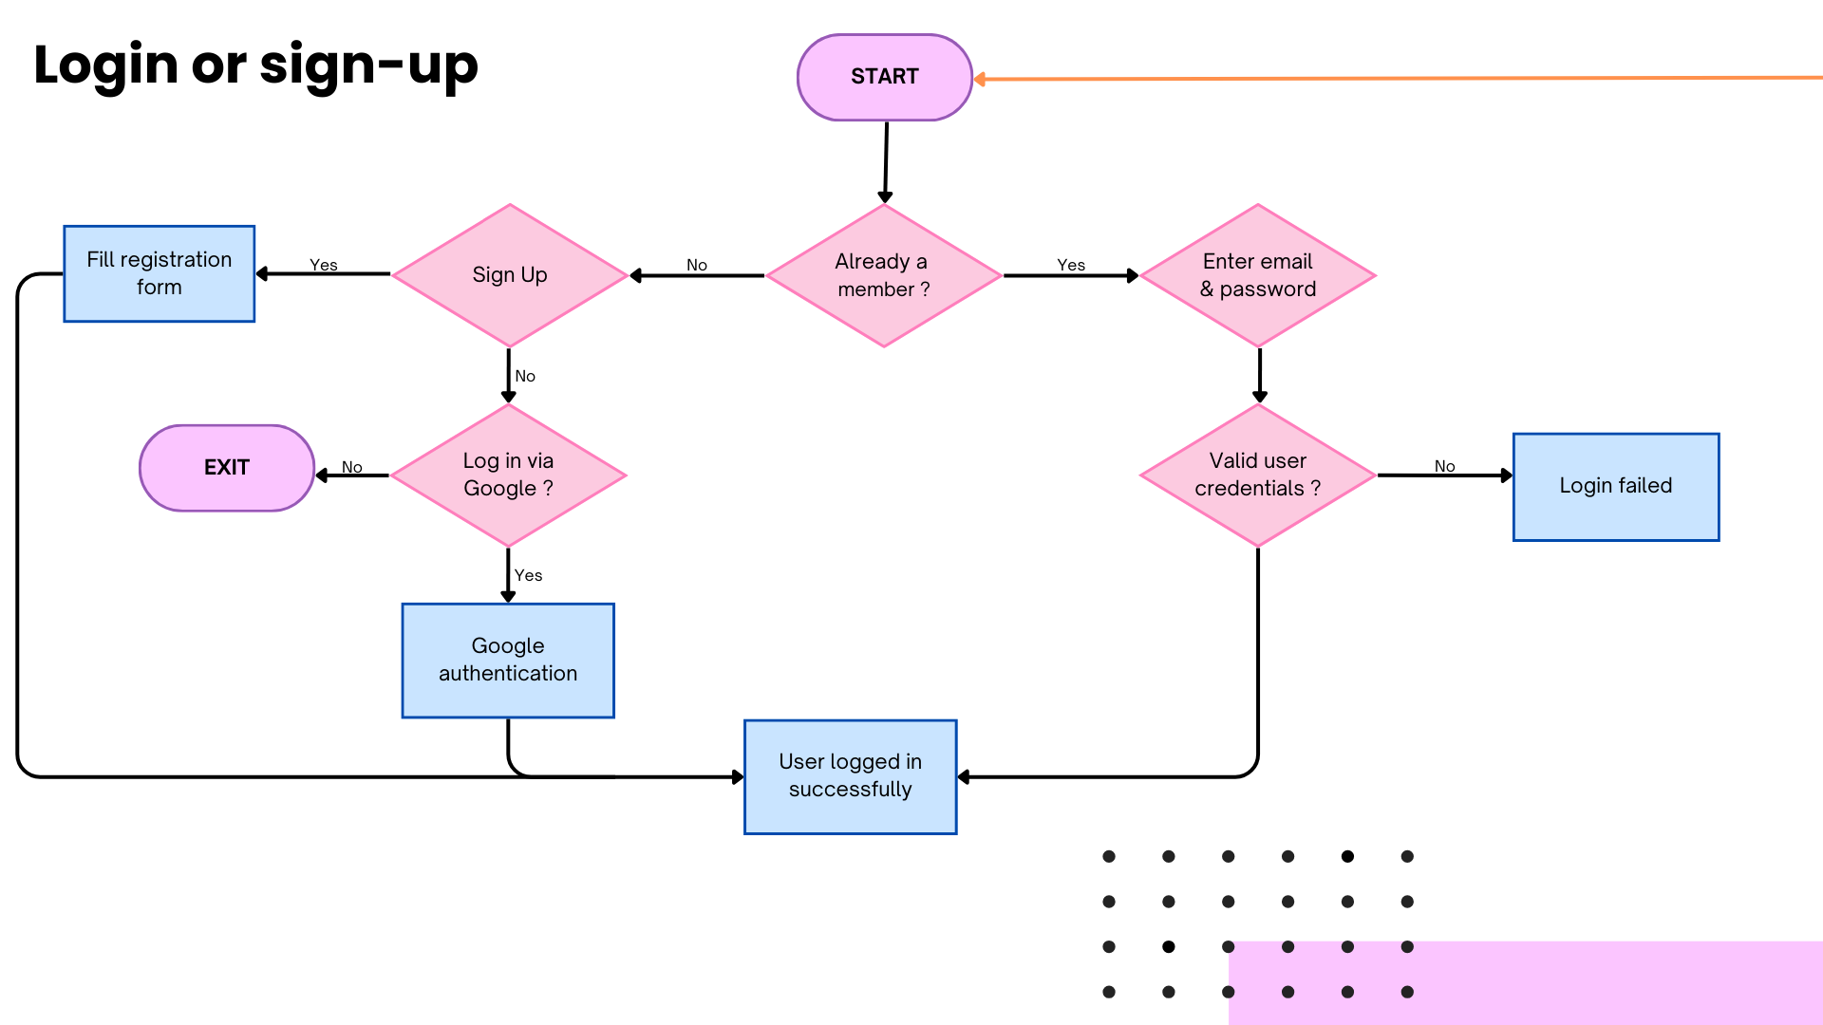

Login or sign-up
START
Fill registration
form
Sign Up
Already a
member ?
Enter email
& password
Yes
No
Yes
No
EXIT
Log in via
Google ?
Valid user
credentials ?
Login failed
No
No
Yes
Google
authentication
User logged in
successfully

Slide 4
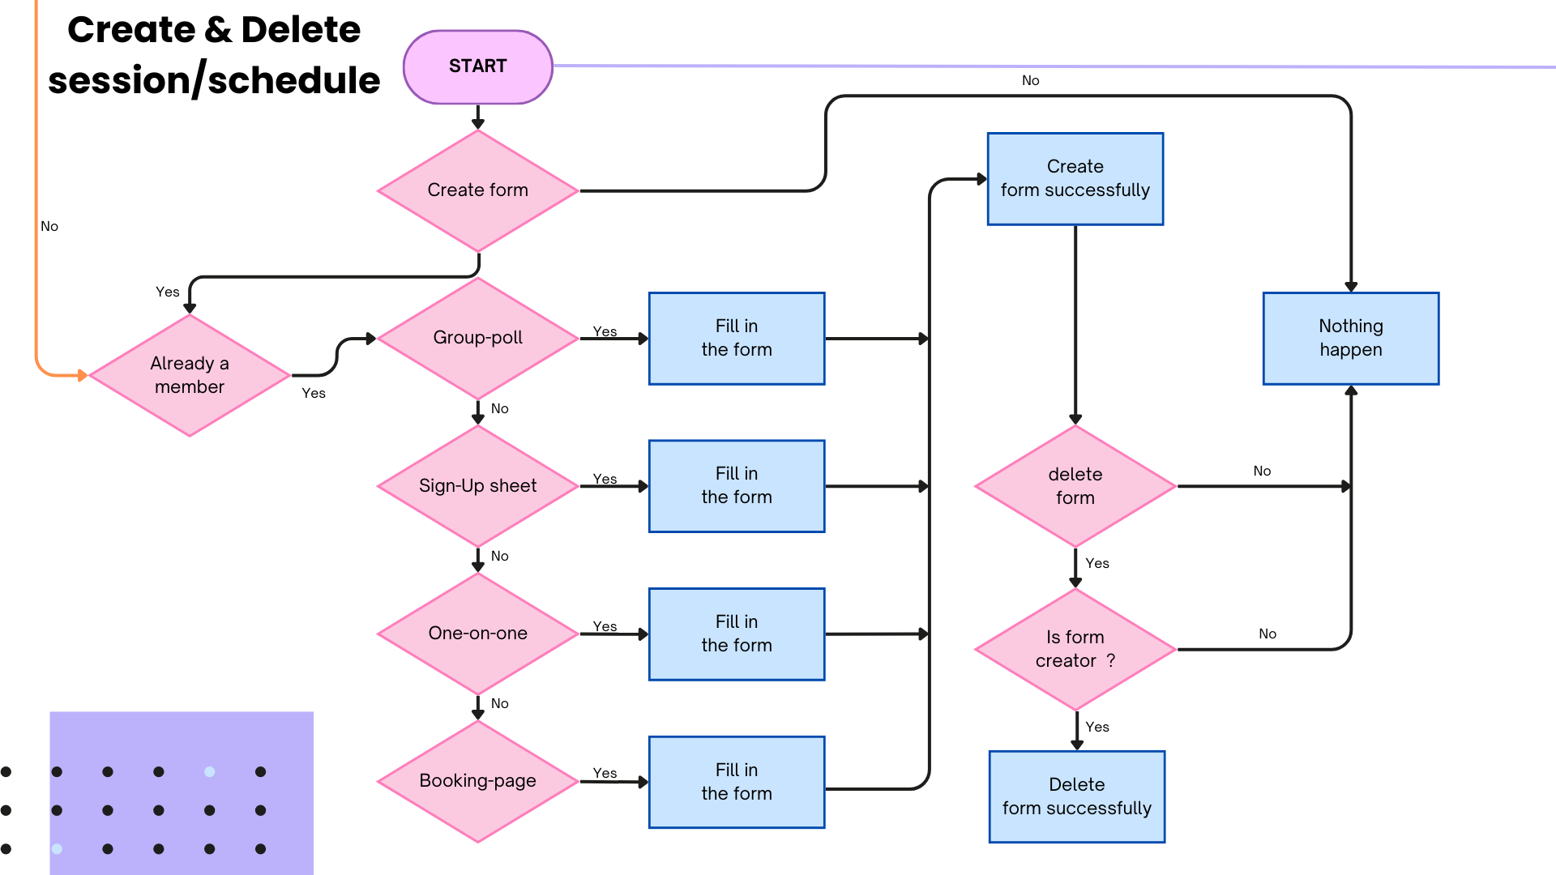

Create & Delete
session/schedule
START
No
Create
form successfully
Create form
No
Yes
Group-poll
Fill in
the form
Nothing
happen
Already a member
Yes
Yes
No
Sign-Up sheet
Fill in
the form
delete
form
Yes
No
No
Yes
One-on-one
Fill in
the form
Yes
Is form creator ?
No
No
Fill in
the form
Yes
Booking-page
Delete
form successfully
Yes

Slide 5
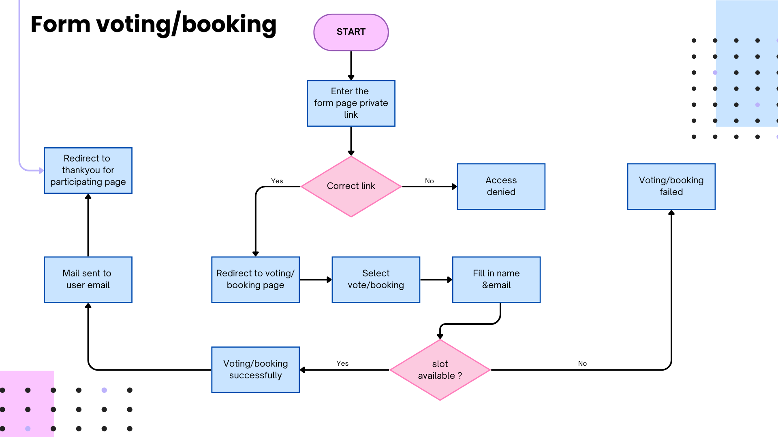

Form voting/booking
START
Enter the
form page private
link
Redirect to
thankyou for participating page
Correct link
Access
denied
Voting/booking
failed
Yes
No
Mail sent to
user email
Redirect to voting/
booking page
Select vote/booking
Fill in name
&email
Voting/booking
successfully
slot
available ?
Yes
No

Slide 6

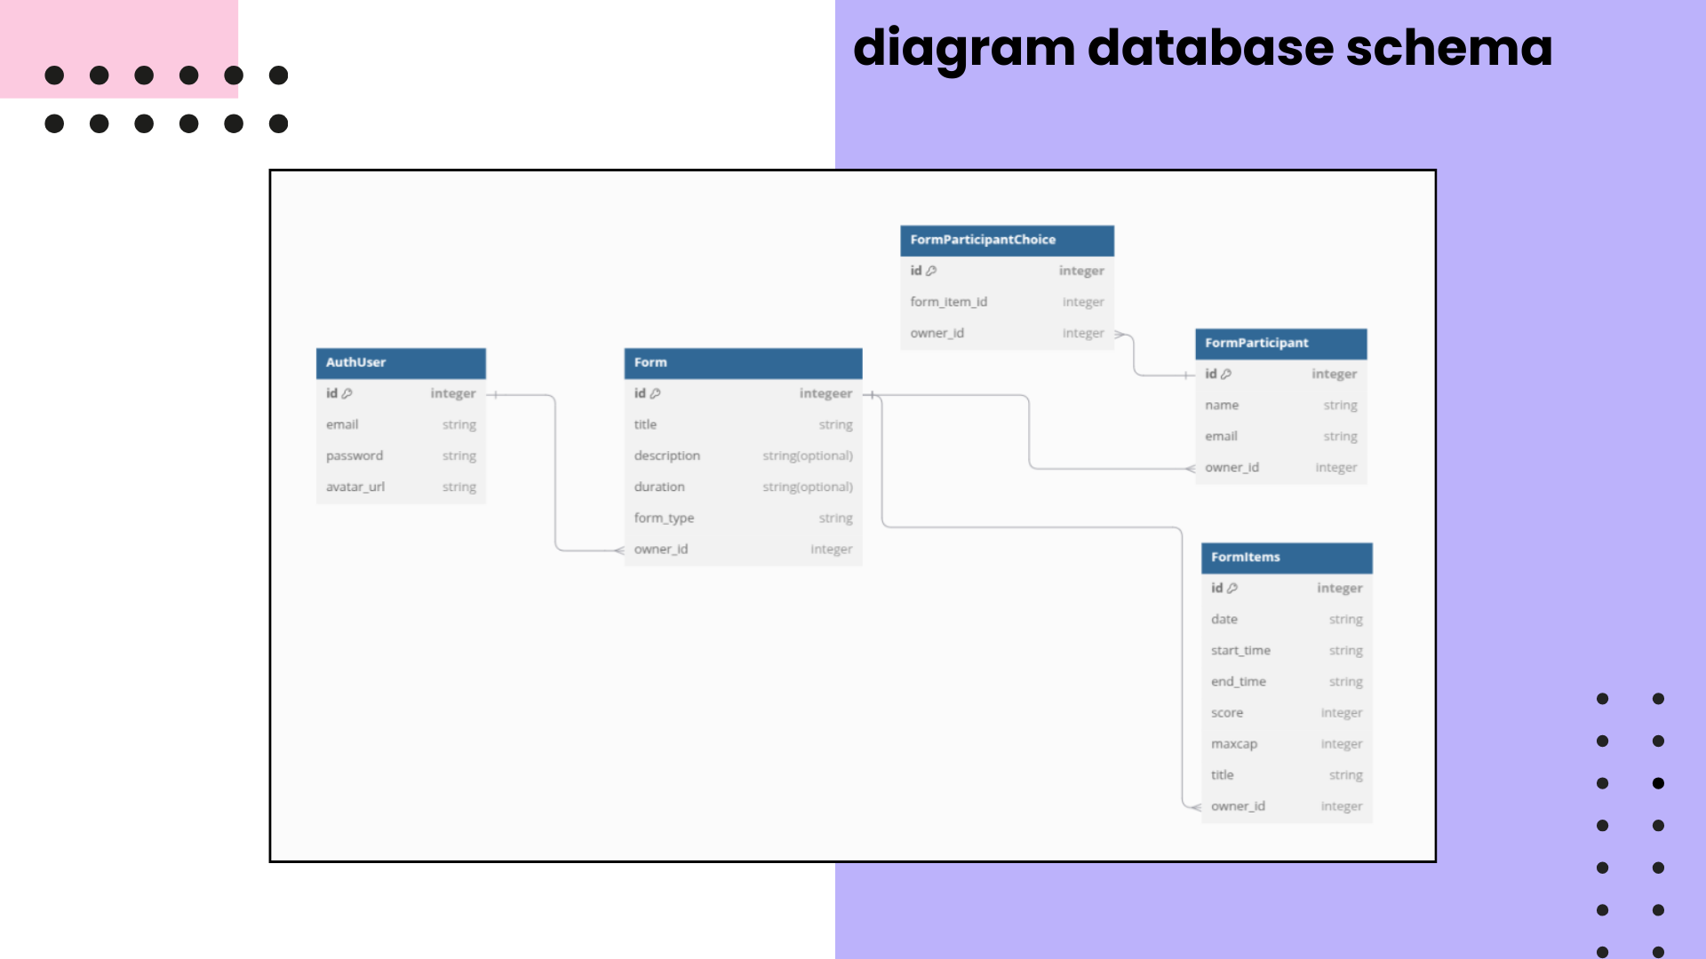
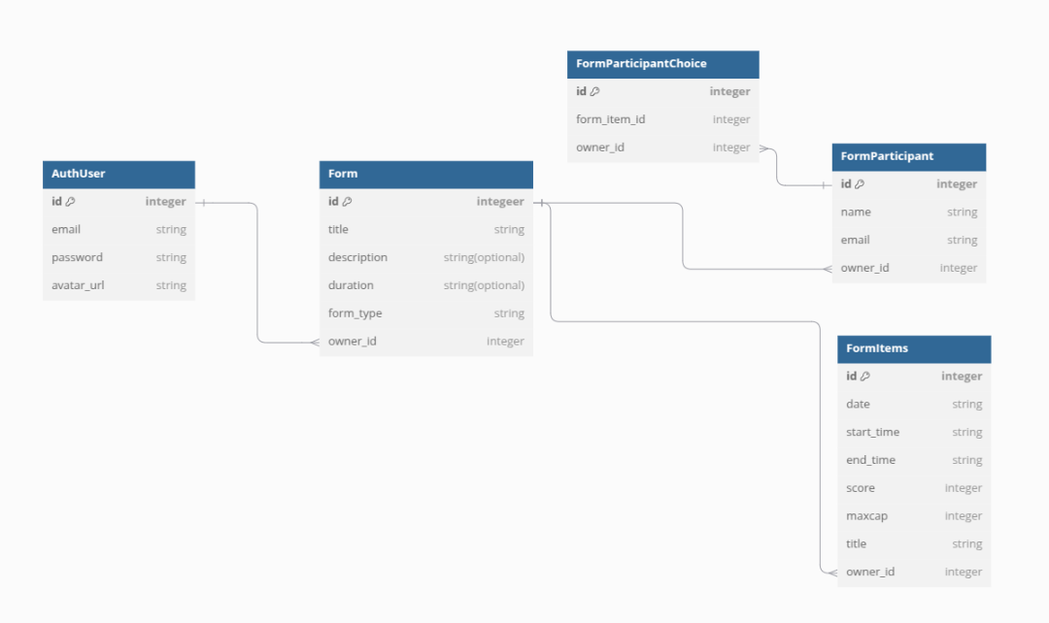
diagram database schema

