Slide 1

Energy Consumption Analysis
Presented By:
Cheeluru. Bindhu (81010626625)
Avula .Usha Sree (81010627825)

Slide 2
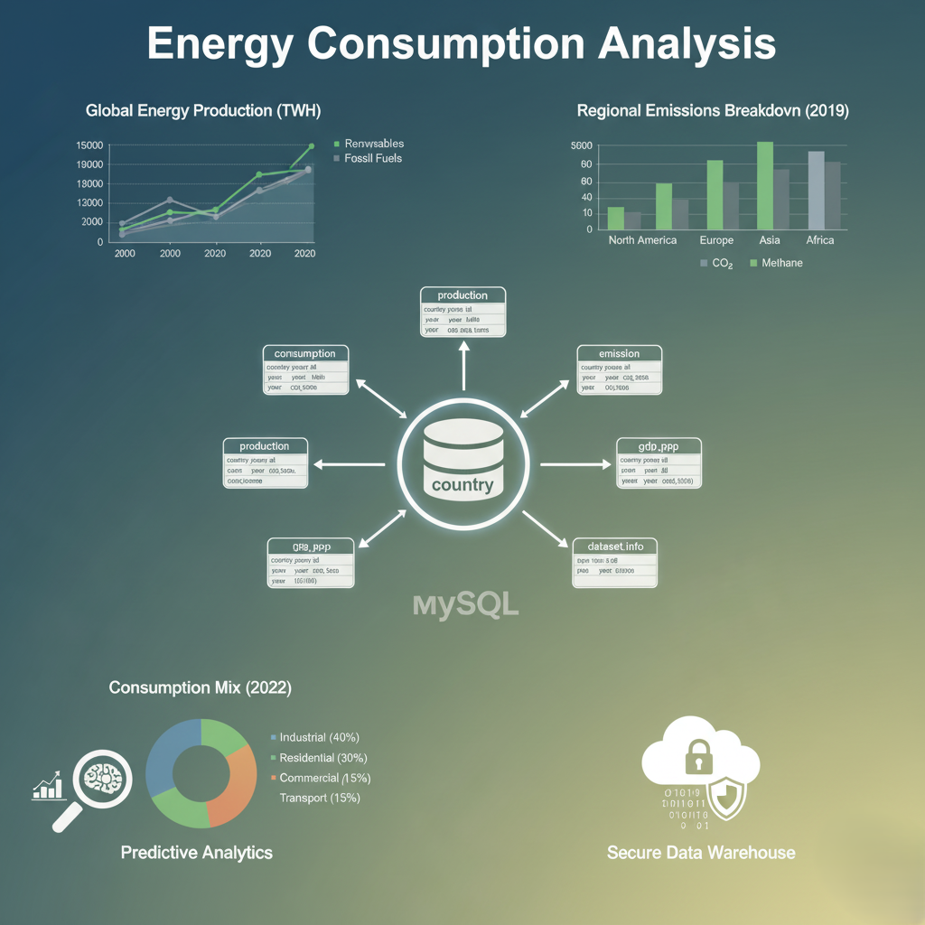

Slide 3

Agenda :
Objective of the Project
ER Diagram and schema explanation
Key analysis questions
SQL query results with screenshots
Final business insights and recommendations
Conclusion
Challenges working on SQL – Data Analysis Project.

Slide 4
Objectives :
Analyze the correlation between worldwide GDP, energy consumption, and CO2​ emissions.
Determine YoY trends in global emissions, GDP, and consumption for major economies.
Calculate efficiency ratios (Emission-to-GDP) and per capita metrics for all countries.
Identify top emission sources and the most energy-intensive economies.
Provide Data-Driven recommendations for sustainable energy plolicy
Evaluate the environmental impact and efficiency of countries through per capita and ratio-based metrics.

Slide 5
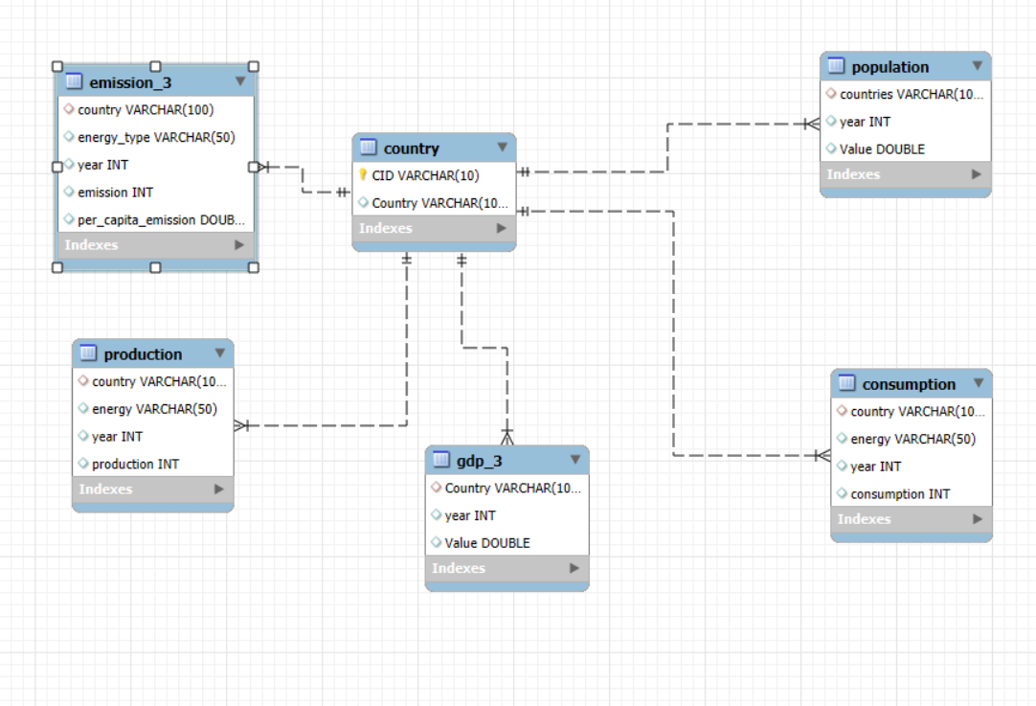
ER Diagram and schema explanation :
ER Diagram Explanation
The ER diagram for the SQL project on energy consumption analysis consists of star & six interconnected tables: country, emission, population, production, GDP, and consum. The central "country" table is linked to all other tables through the country attribute, enabling relational integrity and structured queries across datasets.
Schema Explanation
The country table serves as the reference, containing fields for country name and a unique country ID. All other tables connect to this to maintain data consistency.
The emission table stores emission details, energy type, year, total emission, and per capita emission values for each country.
The population table tracks population values by country and year.
The production table contains data on energy production amounts by country, energy type, and year.
The GDP_dd table records GDP values by country and year.
The consum table keeps track of energy consumption data segmented by country, energy type, and year.
Fig:ER Diagram Of Star Schema Model

Slide 6
Key analysis questions :
What is the total emission per country for the most recent year available?
What are the top 5 countries by GDP in the most recent year?
Which energy types contribute most to emissions across all countries?
How have global emissions, GDP, and population changed over time?
What is the emission-to-GDP and energy consumption per capita for each country?
Which countries have reduced their per capita emissions the most over the last decade?

Slide 7
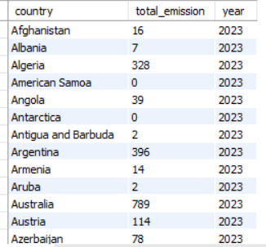
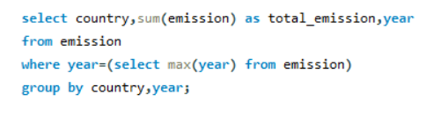
SQL query results with screenshots :
1. What is the total emission per country for the most recent year available?
OUTPUT
QUERY

Slide 8
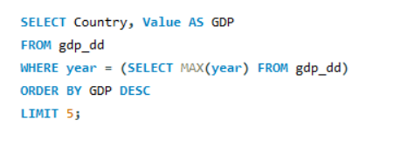
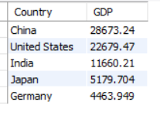
.
2.What are the top 5 countries by GDP in the most recent year?
QUERY
OUTPUT

Slide 9
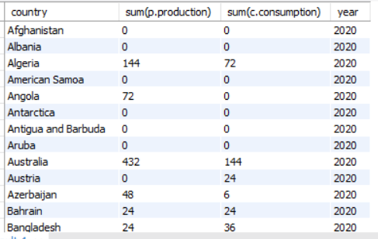
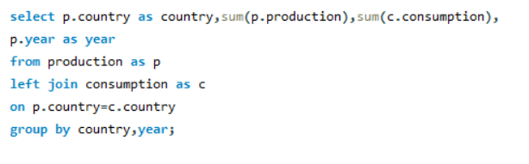
.
3.Compare energy production and consumption by country and year ?
QUERY
OUTPUT

Slide 10
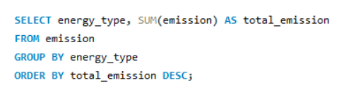
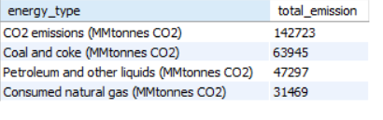
.
4. Which energy types contribute most to emissions across all countries?
QUERY
OUTPUT

Slide 11
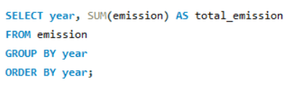
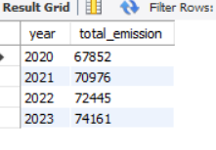
.
5. How have global emissions changed year over year?
QUERY
OUTPUT

Slide 12
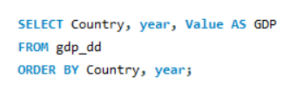
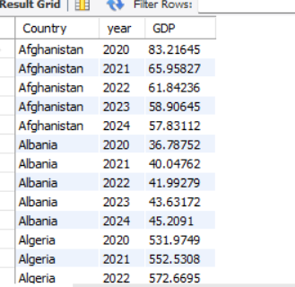
.
6. What is the trend in GDP for each country over the given years?
QUERY
OUTPUT

Slide 13
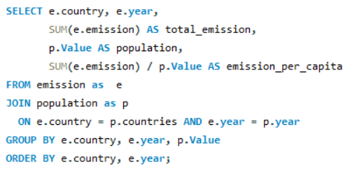
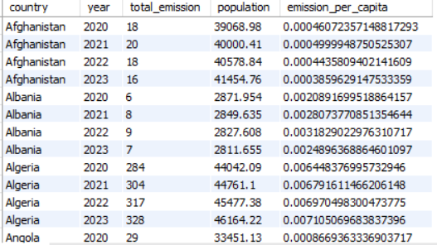
.
7. How has population growth affected total emissions in each country?
QUERY
OUTPUT

Slide 14
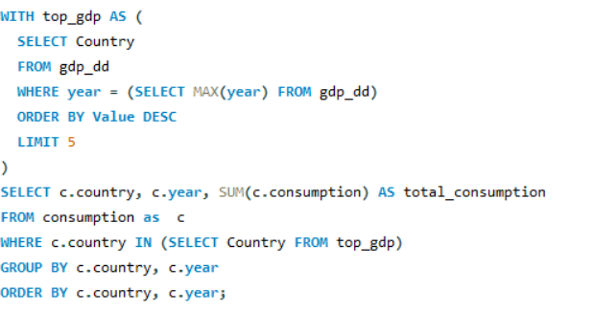
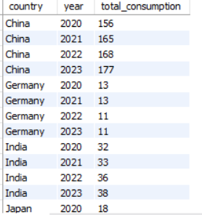
.
8. Has energy consumption increased or decreased over the years for major economies?
QUERY
OUTPUT

Slide 15
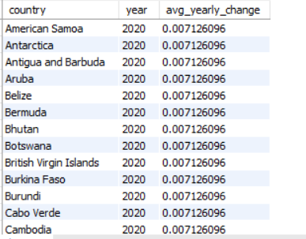
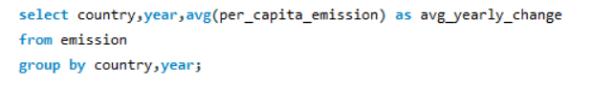
.
9.What is the average yearly change in emissions per capita for each country?
QUERY
OUTPUT

Slide 16
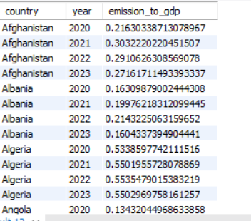
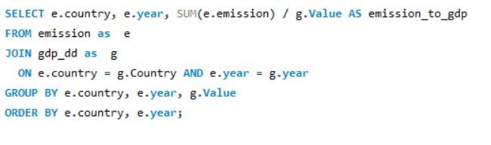
.
10. What is the emission-to-GDP ratio for each country by year?
QUERY
OUTPUT

Slide 17
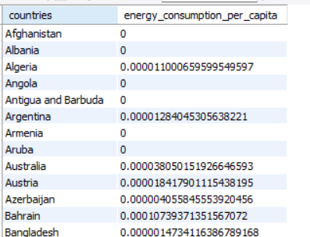
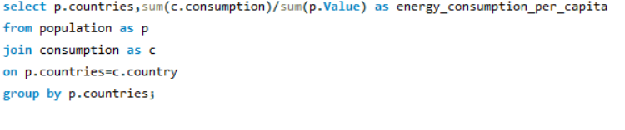
.
11. What is the energy consumption per capita for each country over the last decade?
QUERY
OUTPUT

Slide 18
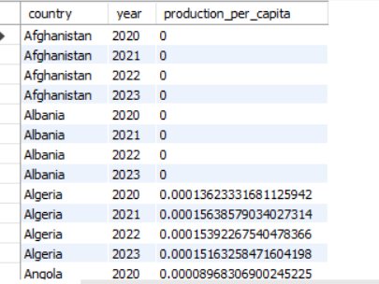
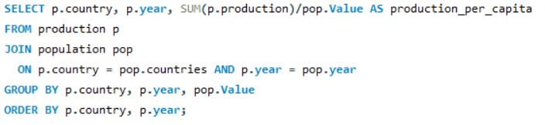
.
12. How does energy production per capita vary across countries?
QUERY
OUTPUT

Slide 19
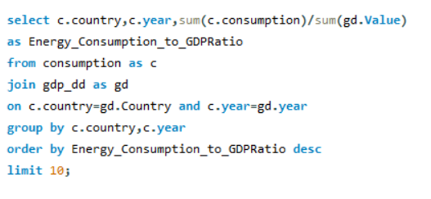
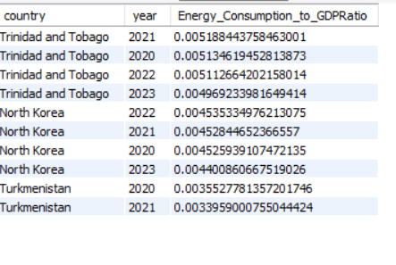
.
13. Which countries have the highest energy consumption relative to GDP?
QUERY
OUTPUT

Slide 20
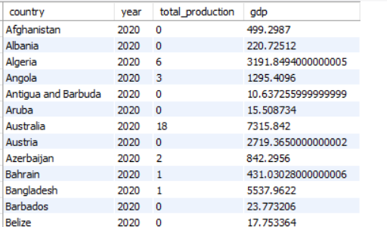
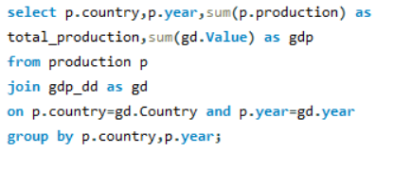
.
14. What is the correlation between GDP growth and energy production growth?
QUERY
OUTPUT

Slide 21
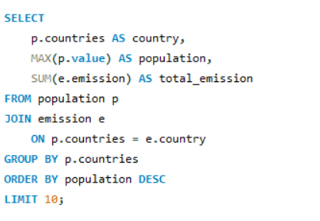
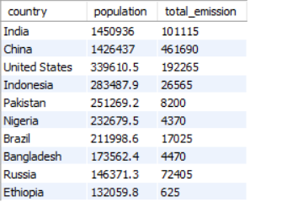
.
15. What are the top 10 countries by population and how do their emissions compare?
QUERY
OUTPUT

Slide 22
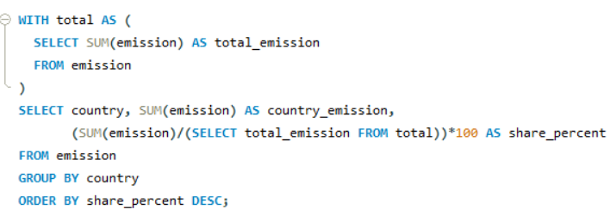
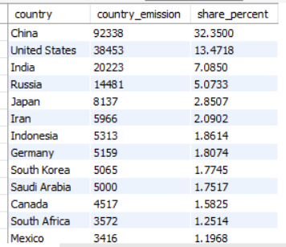
.
16. What is the global share (%) of emissions by country?
QUERY
OUTPUT

Slide 23
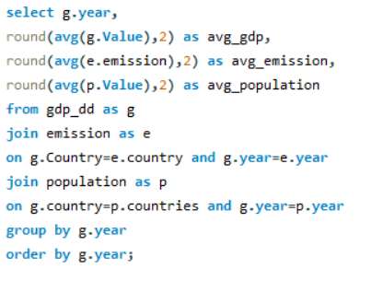
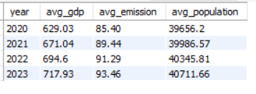
.
17. What is the global average GDP, emission, and population by year?
QUERY
OUTPUT

Slide 24
Final business insights :
Rich countries use more energy.
Nations with higher GDP (like the U.S., China, India) consume and emit more energy.
Some countries depend on others for energy.
A few produce extra energy and export it, while others import more than they produce.
Population growth increases energy use and pollution.
More people means more demand for power and higher emissions.
Global emissions are slowly stabilizing.
Some improvements is seen due to renewable energy and awarness.
Recommendations :
Use more renewable energy.
Focus on energy efficiency.
Set emission goals.
Increase awareness..
Work together globally.

Slide 25
Conclusion :
This project provided a clear understanding of how energy, economy, and environment are interconnected.
Using SQL, I analyzed how GDP, population, and energy usage together influence global emissions.
The results show that economic growth increases energy demand, but sustainable policies and renewable adoption can reduce environmental impact.
The study emphasizes the importance of data-driven decisions for building an energy-efficient and sustainable future.
Overall, this project strengthened my SQL, analytical, and problem-solving skills, and helped me link technical analysis with real-world impact.

Slide 26
Challenges working on SQL :
Experience
Learned to create and manage databases using SQL.
Gained hands-on practice in writing complex JOIN, GROUP BY, and aggregate queries.
Understood real-world relationships between energy consumption, GDP, population, and emissions.
Improved analytical thinking and data interpretation skills.
Challenges
Managing and integrating multiple tables with different attributes required careful schema design.
Ensuring data consistency and avoiding errors during SQL querying was sometimes difficult.
Interpreting results to draw clear business insights from raw data demanded critical thinking and domain understanding.

Slide 27

THANK YOU

