Slide 1

A
Project
On
Design issues of optical code division multiple access system
Under the supervision of
Dr. K.S. Bhatia
Department of Electronics and Communication Engineering
GBPIET
Submitted By- Bhawna Paliwal, Chandresh Pandey , Divya Pant

Slide 2
OVERVIEW
Introduction
Literature review
Research gaps
Objectives
Methodology
Software required
Results
Conclusion
References

Slide 3
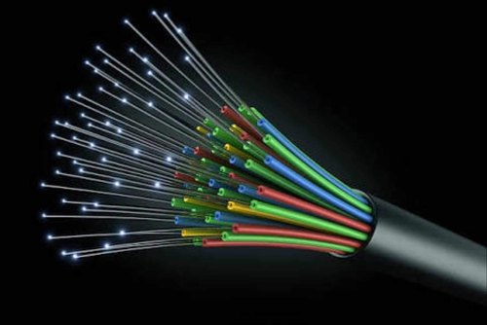
INTRODUCTION
OPTICAL FIBRE:
An optical fiber is a flexible, transparent fiber made by drawing glass (silica) or plastic to a diameter slightly thicker than that of a human hair.

Slide 4
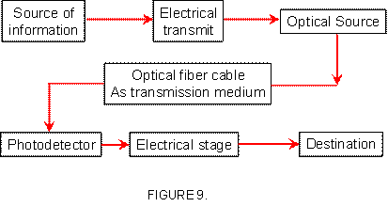
OPTICAL FIBRE COMMUNICATION SYSTEM
Optical Fiber Communication is the method of communication in which signal is transmitted in the form of light and optical fiber is used as a medium of transmitting those light signal from one place to another.

Slide 5
MULTIPLE ACCESS TECHNIQUES
Wavelength division multiple access
Time division multiple access
Code division multiple access

Slide 6
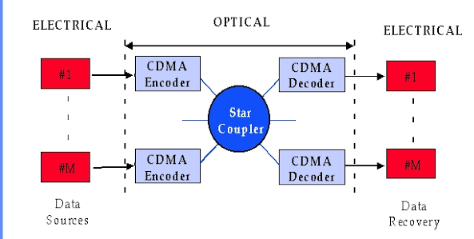
OCDMA(optical code division multiplexing access )
Optical code-division multiplexing (OCDM) is a process by which each communication channel is distinguished by a specific optical code rather than a wavelength, as in WDM or a time-slot as in TDM.
An encoding operation optically transforms each data bit before transmission. The encoding and decoding operations alone constitute optical coding.
OCDMA is the use of optical network technology to arbitrate channel access among multiple network nodes in a distributed fashion.

Slide 7
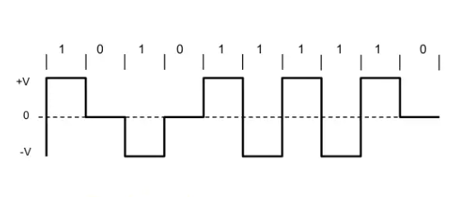
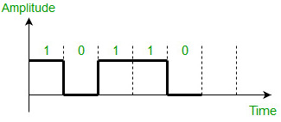
TYPES OF OCDMA
1. COHERENT OPTICAL CODE DIVISION MUTIPLE ACCESS
2. INCOHERENT OPTICAL CODE
DIVISION MULTIPLE ACCESS
In this system a given users code is generally applied VIA phase coding of the optical signal field. The signal are bipolar. | This system typically relies on amplitude modulated codes rather then directly manipulating the optical phase . The signal are unipolar.

Slide 8
APPLICATIONS
Wireless optical CDMA LAN
Radio over fiber network based on OCDMA.
Multimedia transmission employing OCDMA.

Slide 9
LITERATURE REVIEW
ISAACA.M.ASHOUR,SAHBUDINSHAARI,P.SUSTHITHA,MENONANHESHAM,A.BAKARMAN (2012). Empirically investigated on OCDMA-WDM overlay systems, including our hybrid approach of one dimensional coding of SAC OCDMA with WDM signals. The outcomes indicated that the feasibility of transmitting. Both OCDMA and WDM users on the same spectrum band can be achieved by using MQC family code .
ZHENYUJIA,FEIYUAN,KEYUCHEN introduced chirp signals as carrier which is widely used in UMA communication for improves the reliability and spectrum efficiency of underwater multiple access. It is used to combine CDMA and OFDMA and proposed a multi-carrier chirp signal based method. The result show that the proposed method has good bit rate performance.
MOHAMMAD HOSSEIN ZOUALFAGHARI, AND HOOSHANG GHAFOURI-SHIRAZ, proposed a novel multi-user interference (MUI) cancellation scheme for OCDMA systems employing prime code families. Also discussed the feasibility and implementation of this novel scheme. the proposed scheme is easy to implement and totally removes the MUI effect.

Slide 10
SALEHI JA (1989) explained fiber-optic code division multiple-access (FO-CDMA) communications techniques. A new class of codes(signature sequences), namely, optical orthogonal codes (OOC’s), that are suitable for FO-CDMA are introduced. An experiment that shows the desired auto- and cross correlation properties of these codes and their use in FO-CDMA is reported
D.ZACCARIN, AND M.KAVEHRAD(1993). explained an optical code-division multiple access (CDMA) system based on amplitude spectral encoding of low-cost broadband sources such as light-emitting diodes. The proposed system uses a standard non dispersive lens-grating apparatus, and simple direct-detection receivers.
MONGA H,RS kaler (2010).studied and analyzed the spectrally encoding/ decoding OCDMA system for different lengths of fiber in terms of quality factor (Q) and bit error rate (BER) performance. The performance characteristics like bit error rate, eye diagrams and eye closure penalty at the output are studied by simulating for different lengths of fiber.

Slide 11
JAWEDA.SALEHI(1989) introduced optical orthogonal codes for OCDMA. He reported the desirable auto-correlation and cross-correlation properties for the codes used. Further, introduced the optical disk patterns to represent the optical orthogonal codes (OOC’s) and to derive the probability density functions of any two interfering users.
SALEHIAND BRACKETT(1989) introduced the BER of OCDMA system with OOC’s as a function of data rate, code length, code weight, number of users, and receiver threshold. Further, the use of optical hard limiter to reduce the multiple access interference was introduced.
E.INATYETAL. Presented a bit rate flexible optical fast frequency hopping CDMA system architecture using a sequence of fiber Bragg gratings (FBGs).
PRUCNAL, SANTORO,AND FAN, (1986) It showed CDMA can be implemented on optical fibres using optical delay line and showed the wide bandwidth channel required by CDMA for a synchronous access to a LAN can be provided by fibre optic channel .
Aminata A. Garba and Jan Bajcsy(2011) suggested M-ary chip symbols to increase the spectral efficiency of optical code division multiple access (OCDMA) even though, when compared to its binary counterpart, M-ary OCDMA can have significantly increased multi-user interference (MUI).

Slide 12
Weiner, Heritage, and Salehi (1988) Demonstrated the frequency domain manipulation of coherent ultra short light pulses to implement CDMA in Optical domain. It was found that the developments of radio frequency communications can be applied to optical communication.
Kai-sheng Chen(2019)studied a multi-rate scheme capable of forwarding packets with different signal rates based on label switching. The multiple-code (MC) technique was employed to label a packet by conveying its payload bits to multiple optical code-division multiple-access (OCDMA) labels. Spectral-amplitude-coding (SAC), which represents the chips in an OCDMA code as a set of wavelengths, was introduced to remove the multiple-access interference (MAI) from the overlapping among labels
Shin-Pin Tseng, Eddy Wijanto, and Hsu-Chih Cheng(2020) developed a bipolar optical code division multiple access (Bi-OCDMA) technique based on spectral amplitude coding for the formation and transmission of optical-polarized and coded signals over wireless optical channels.
Qi Zhang,Liwei yang Zifang yu, wenzjie zhang(2021) studied an optical code division multiple access (OCDMA-WDM-PON) passive optical network technology based on chaotic spread spectrum, and proposed a system scheme of OCDMA-WDM-PON. Then we analyzed the initial value sensitivity, autocorrelation and cross-correlation of henon chaotic sequence as address code.

Slide 13
RESEARCH GAPS
With review of all papers we have come to know that there is still some work left in design issues of optical code division multiple access. There are many design issues problems in OCDMA. Multiple access interference is a main limiting factor which degrades the performance of the system.

Slide 14
OBJECTIVE
To design optical CDMA system using pseudo orthogonal coding which help to reduce the bandwidth expansion and enhance the performance of multi user OCDMA system.

Slide 15
METHODOLOGY
The very first step of any project work is to study about the area which is related to project topic. After the survey of literature review, it is found that how optical fiber communication and optical code division multiple access give benefits for high quality transmission. From study of basic domain we come to know that what work has been done in India and Abroad. For high transmission, it is necessary to encode and decode the data under different coding techniques. For conducting efficient results for successful transmission with optical code division multiple access, multiple access interference will be minimized to get spectral efficiency.

Slide 16

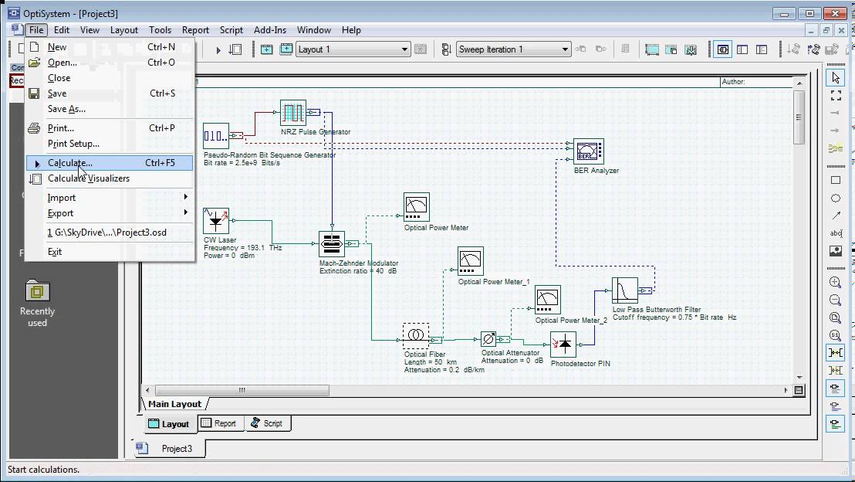
SOFTWARE REQUIRED
OptiSystem 17.0.0
Created to address the needs of research scientists, optical telecommunication engineers, system integrators, students and a wide variety of other users, OptiSystem satisfies the demand of the evolving photonics market for a powerful yet easy to use optical system design tool.
OptiSystem enables users to plan, test, and simulate (in both the time and frequency domain):
Cont.

Slide 17
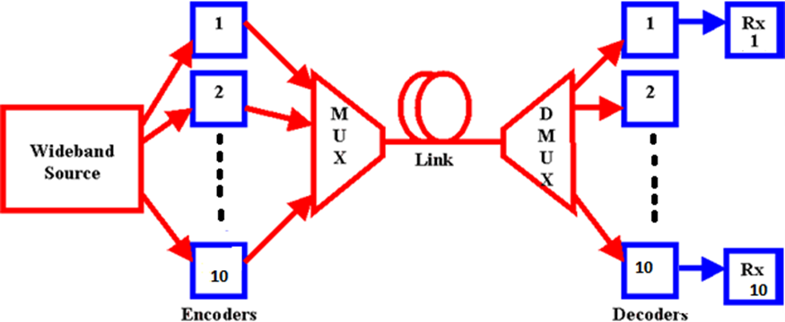
Performance Analysis of Optical Code Division Multiplex system
Block diagram of OCDMA for 10 users

Slide 18
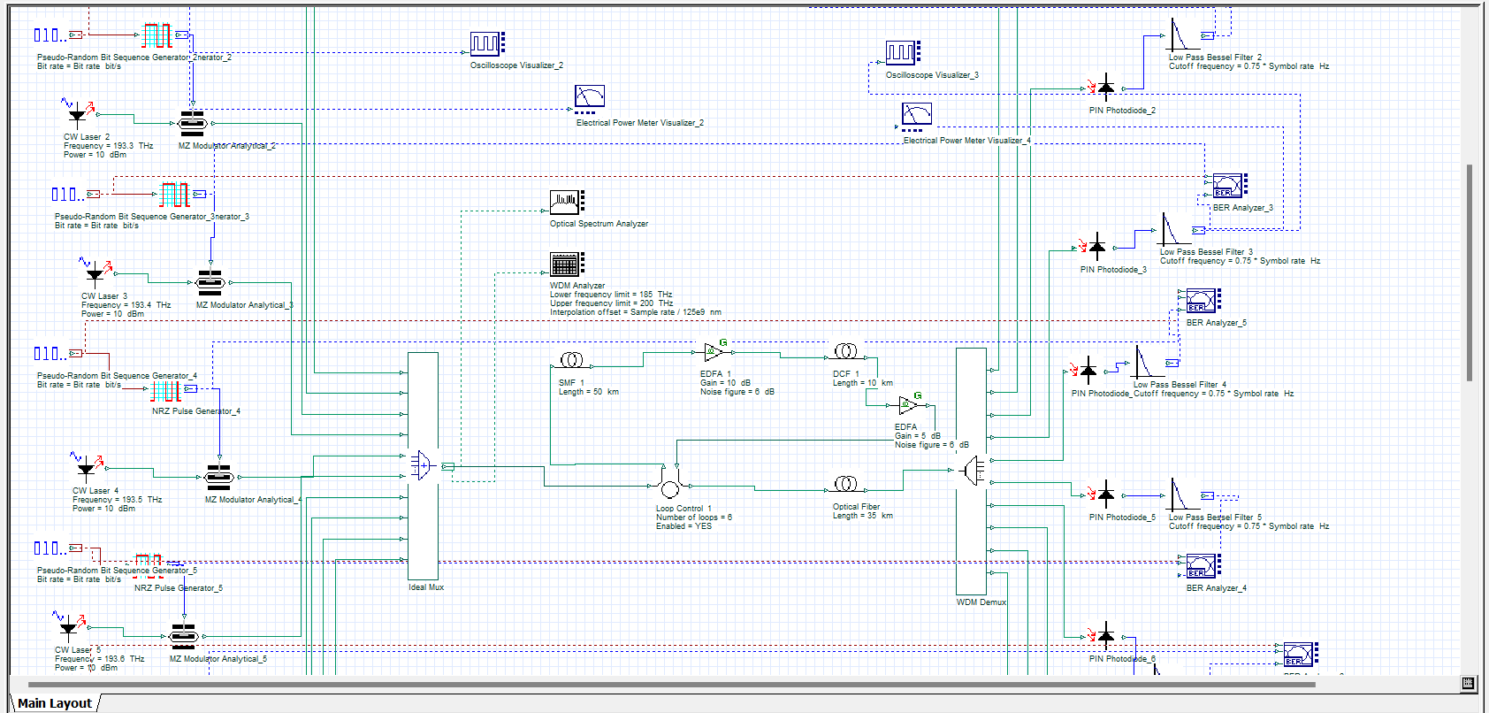
SIMULATION SETUP

Slide 19
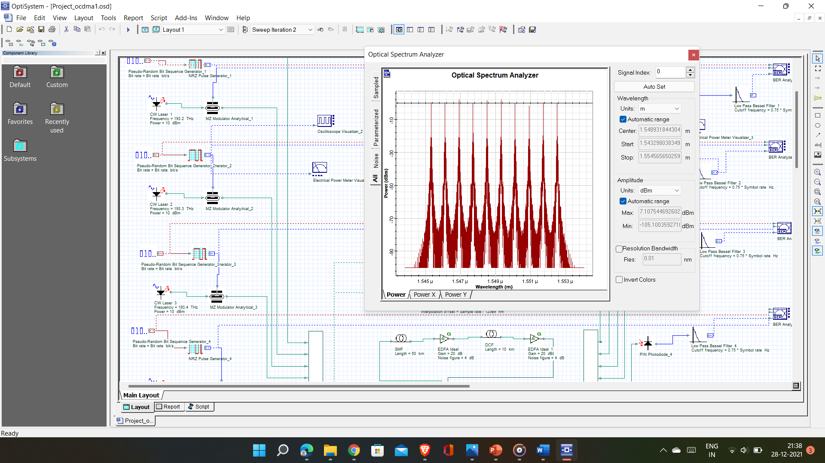
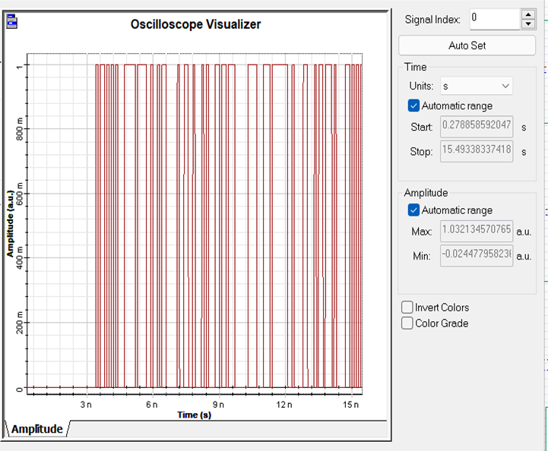
Spectrum before encoding at user Amplitude variation with time

Slide 20
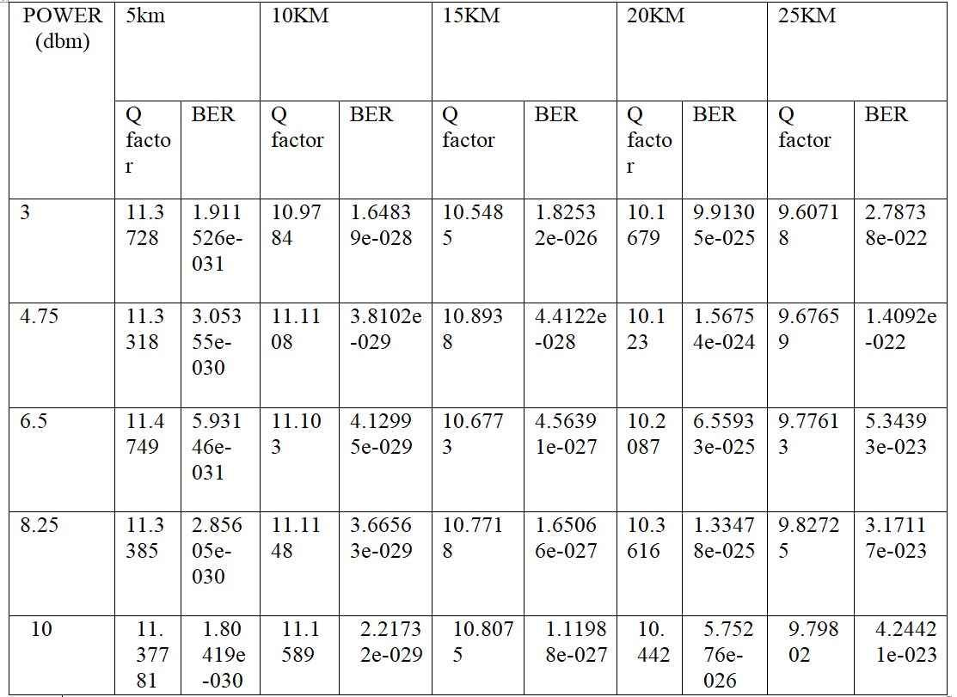
Variation of BER with Power for Different Lengths

Slide 21
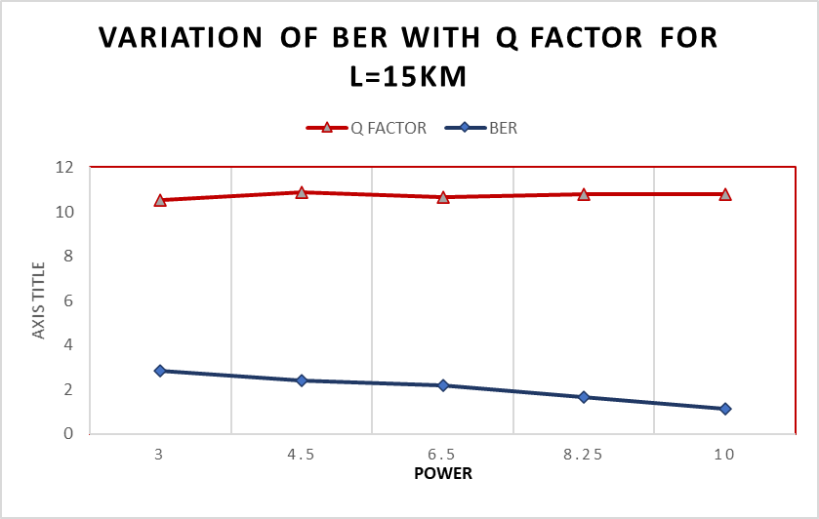
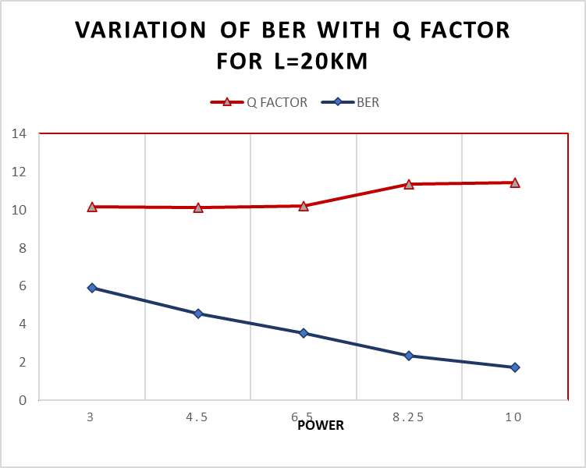

Slide 22
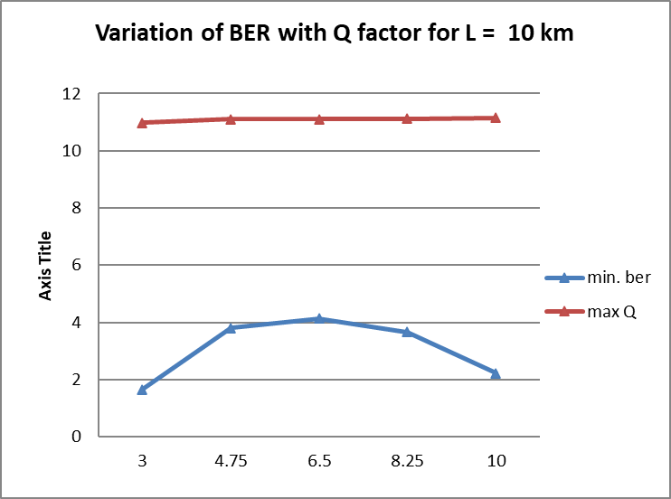
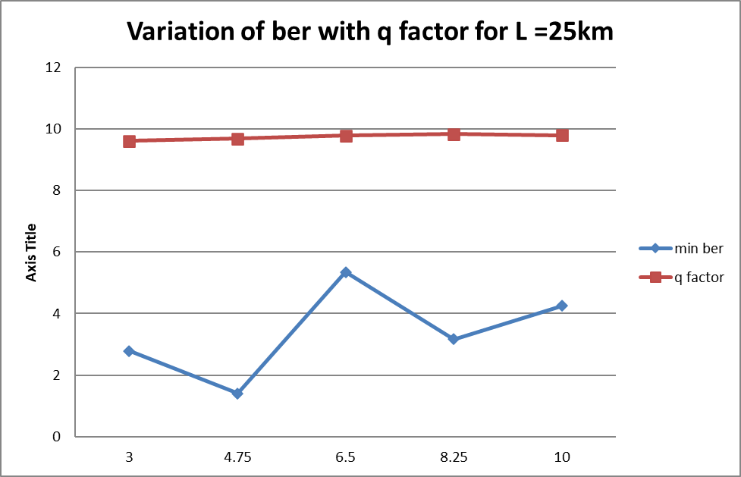
Power Power

Slide 23
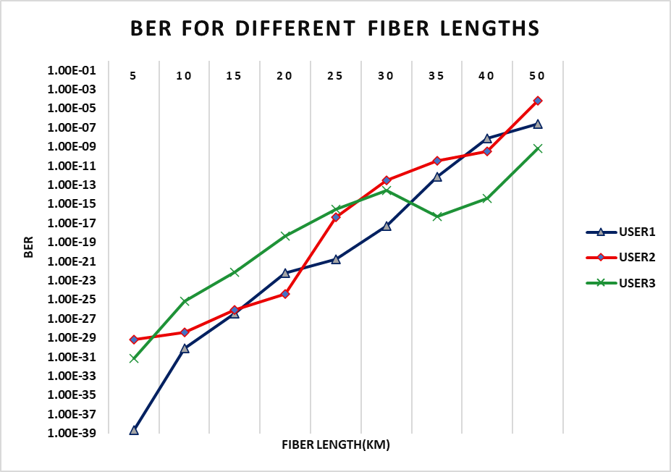

Slide 24
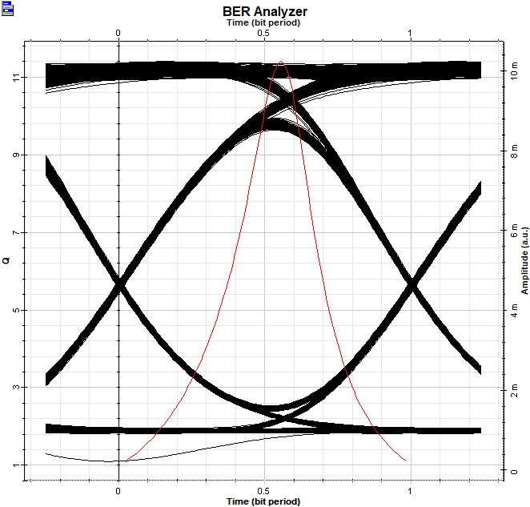
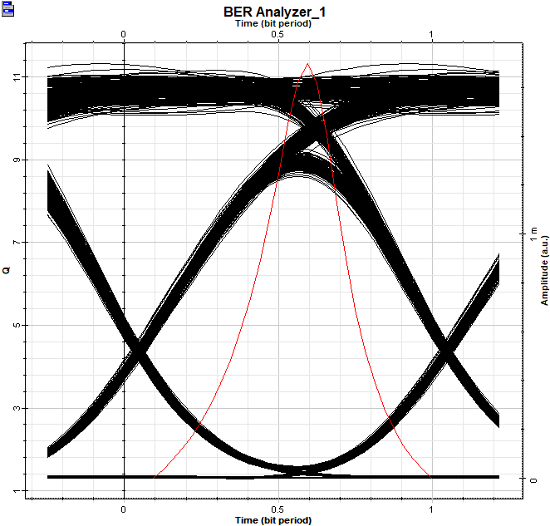
Receiver eye diagram at 3dBm
Receiver eye diagram at 10dBm

Slide 25
CONCLUSION
The performance of the OCDMA system with the Pseudo-Orthogonal Code technique using high data rate has been presented. The results of the experimental simulation have proved that the OCDMA provides a better performance even when we are using multi users. Also discussed the effect of MAI (multi access interference), as we are increasing number of users, the influence of MAI also raised.

Slide 26
REFERENCES
Jawed A Salehi, “Code Division Multiple-Access Techniques in Optical Fiber Networks-Part I: Fundamental Principles,” IEEE Transactions on Communications, Vol. 37, No. 8, pp. 824-833, Aug 1989.
E. Inaty, H. M. H. Shalaby, P. Fortier, and L. A. Rusch, “Multirate Optical Fast Frequency Hopping CDMA System Using Power Control,” IEEE Journal of Lightwave Technology, Vol. 20, No. 2, pp. 166–177, Feb 2002.
Kai-Sheng Chen,"Multiple-Code Technique for Multi-Rate Transmissions in Optical Packet Switching Networks Based on OCDMA Labels,"May 2019 Photonics 6(2):60DOI:10.3390/photonics6020060.
D. Zaccarin, S. Member, and M. Kavehrad, “An Optical CDMA System Based on Spectral Encoding of LED,” IEEE Photonic. Tech. L. 4, 479–482 (1993).

Slide 27
Mohammad Hossein Zoualfaghari, Student Member, and Hooshang Ghafouri-Shiraz, Senior Member,” A Novel Multi User Interference Cancellation Scheme for Synchronous OCDMA Networks” JOURNAL OF LIGHTWAVE TECHNOLOGY, VOL. 31, NO. 11, JUNE 1,2013,pp.1813-182.
Aminata A. Garba and Jan Bajcsy,” Optical Code Division Multiple Access Network Transmission With M-ary Chip Symbol”, J. OPT. COMMUN. NETW./VOL. 3, NO. 5/MAY 2011,pp.435-446.
Monga H, Kaler RS (2010). Performance analysis and improvement of spectral amplitude encoded/decoded OCDMA system. Optik. J. Light Elect., 122(22): 2006-2010.
Weiner, A. M., Heritage, J. P. and Salehi, J. A.: Encoding and decoding of femtosecond pulse. Optics Letters, Vol.13, No.4, May 1988, pp300 – 302.
Shin-Pin Tseng,Eddy Wijanto,Po-Han Lai,Hsu-Chih Cheng,"Multiple Access Techniques Using a Dual Electro-Optical Modulator Implemented in Free-Space Optics Communications,"Published: 24 June 2020.

Slide 28
Paul R. Prucnal, Mairo A. Santoro and Ting R. Fan, “Spread Spectrum Fiber-optic Local Area Network Using Optical Processing,” IEEE Journal of Lightwave Technology, Vol. 4, No. 5, pp. 547-554, May 1986.
Qi Zhang,LiWei Yang,Zifang Yu,"Optical Code Division Multiple Access Passive Optical Network based on Chaotic Spread Spectrum,"ICCBN 2021: 2021 9th International Conference on Communications and Broadband Networking February 2021.
Salehi JA (1989). Code division multiple access techniques in optical fiber network-Par I: Fundamental principles. IEEE. J. Trans. Commun., 37: 824-833.
Zhenyu Jia,Fei Yuan,Keyu Chen," Code Division Multiple Access Based on Chirp Multi-Carrier,"Publisher: IEEE.
Isaac A.M. Ashour, Sahbudin Shaari, P. Susthitha Menon and Hesham A. Bakarman"Optical Code-Division Multiple-Access and Wavelength Division Multiplexing: Hybrid Scheme Review,"Photonic Technology Laboratory(2012).

Slide 29
THANK YOU

