Slide 1
Capstone project Pneumonia Detection
SRI RAJESWARI YEKKISETTI
SEENUVASAN AYYANAR
NAVEEN GANESAN
SANJIVANI WANDARE
HARMANPREET SINGH
27-Aug-2022

Slide 2
Contents
What is Pneumonia?
What is Pneumonia Detection?
Project Description
Business Domain Value
Data Analysis
CNN Basic Modeling Technique
Transfer Learning
Summary of CNN Model
Conclusion
27-Aug-2022

Slide 3
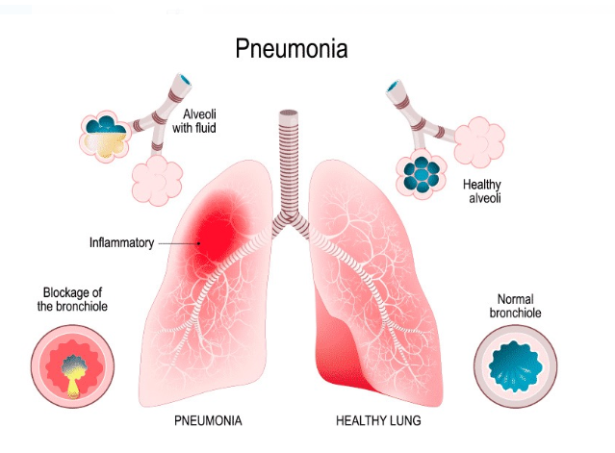
What is Pneumonia?
Inflammation of the lungs.
What is Pneumonia Detection?
Build an algorithm to detect a
visual signal for pneumonia in medical
images.
Algorithm needs to automatically
locate lung opacities on chest
radiographs.
27-Aug-2022

Slide 4
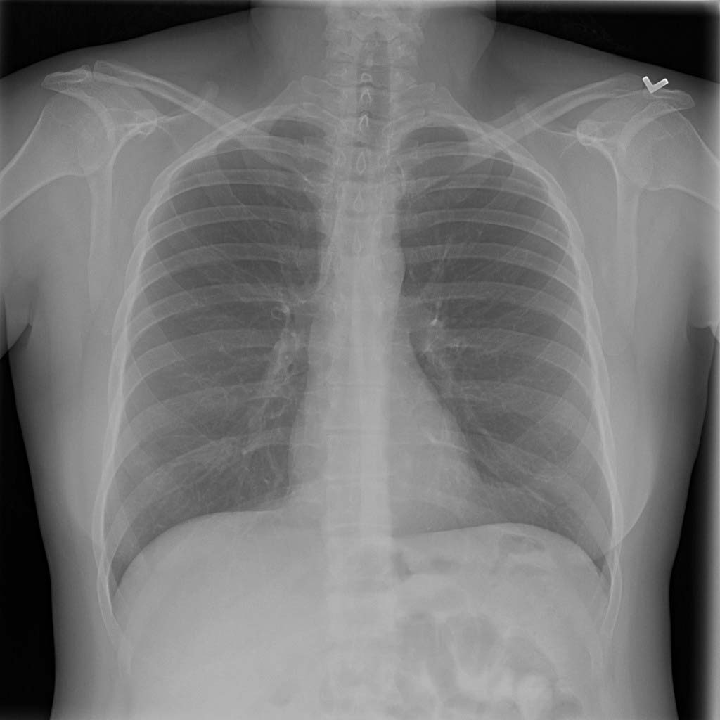
Project Description
Build a pneumonia detection system, to locate the position of inflammation in an image using various Modeling Techniques.
CNN is one of the effective approaches.
Medical images are stored in DICOM files (*.dcm).
27-Aug-2022

Slide 5
Business Domain Value
Automating Pneumonia screening
Assist physicians to make better clinical decisions.
To even replace human judgement in certain functional areas of healthcare (eg, radiology).
Guided by relevant clinical questions, powerful AI techniques can unlock clinically relevant information, which in turn can assist clinical decision making.
27-Aug-2022

Slide 6
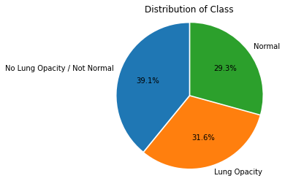
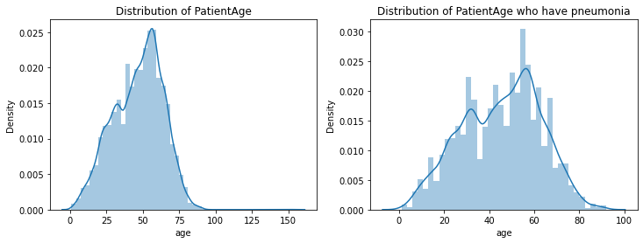
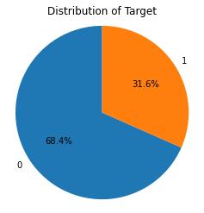
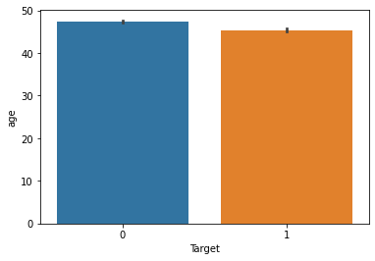
Data Analysis from the Pneumonia data set
31.6% of patients with pneumonia & the remaining are of no pneumonia.
29.3% Normal and the remaining is with Lung Opacity.
Distribution of Age among target as Patients of around 45 years age are of
with target class 1 (having pneumonia)
27-Aug-2022

Slide 7
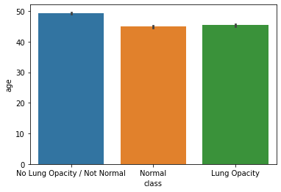
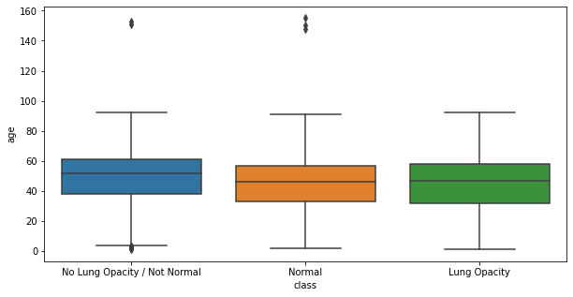
Data Analysis cont’d…
Distribution of Age among class as Patients of around 45 year’s age is having lung opacity (pneumonia).
Insight of box plot: The class which has no pneumonia has few outliers, there age is somewhere around 150 years.
27-Aug-2022

Slide 8
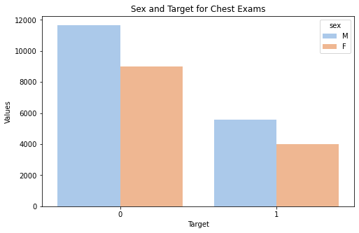
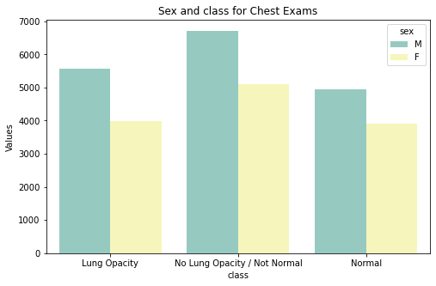
Data Analysis cont’d…
Distribution of Sex among the targets as, the number of males in both categories is higher than women.
Distributions of Sex among the classes as the number of males in all classes are higher than women.
27-Aug-2022

Slide 9
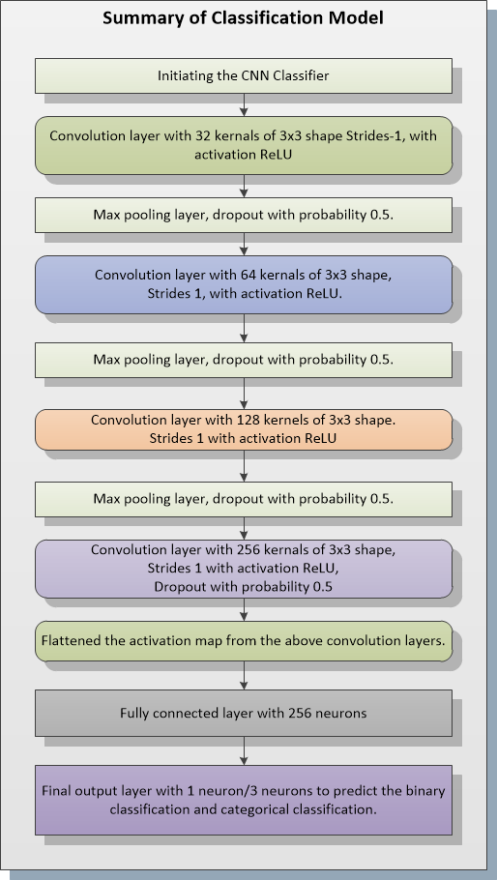
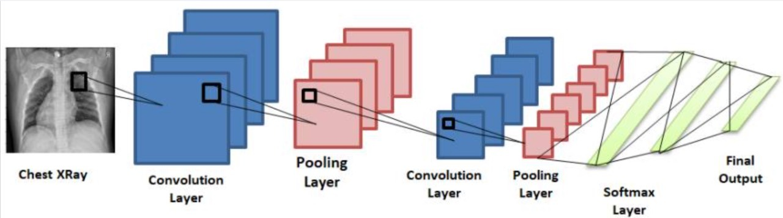
CNN Basic Modeling Technique
In the Target section, there are 20672 records with no pneumonia. 9555 with pneumonia.
In class section there are 8851 normal cases. 9555 - Person with lung opacity
11821 - Person with No Lung Opacity / Not Normal (May be not yet recovered during/after treatment)
CNN architecture is used to train the model.
27-Aug-2022

Slide 10
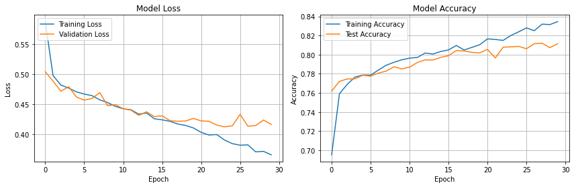
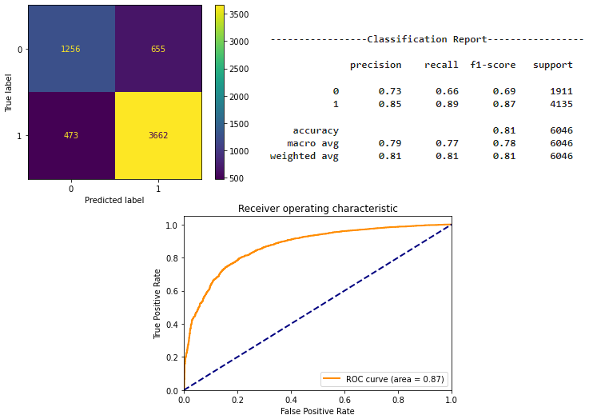
CNN Basic Modeling Technique
Model-1 with 2 classes
Method | Accuracy | Test Score | precision | Recall | f1-score | support
CNN with 2 classes | 83.45 | 81.34 | 84.43 | 88.56 | 86.65 | 4135
27-Aug-2022

Slide 11
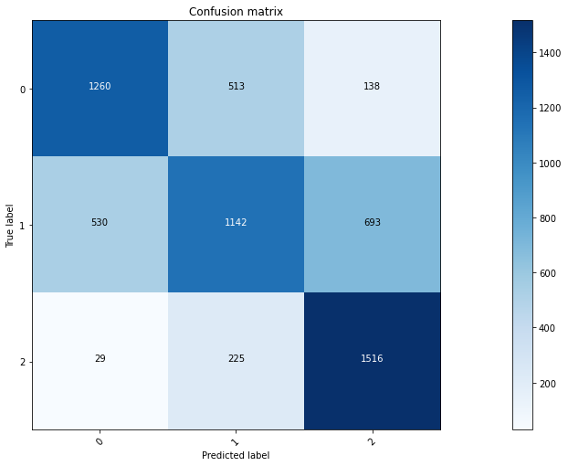
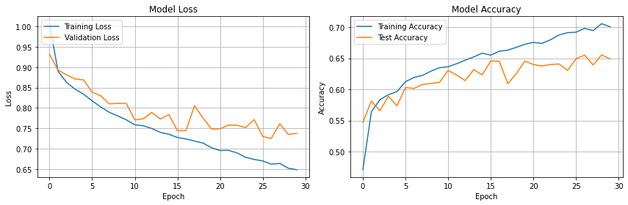
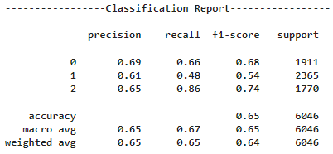
CNN Basic Modeling Technique
Model-2 with 3 classes
Method | Accuracy | Test Score | Precision | Recall | f1-score | support
CNN model with 3 classes | 70.06 | 64.80 | 60.74 | 48.29 | 53.8 | 2365
27-Aug-2022

Slide 12
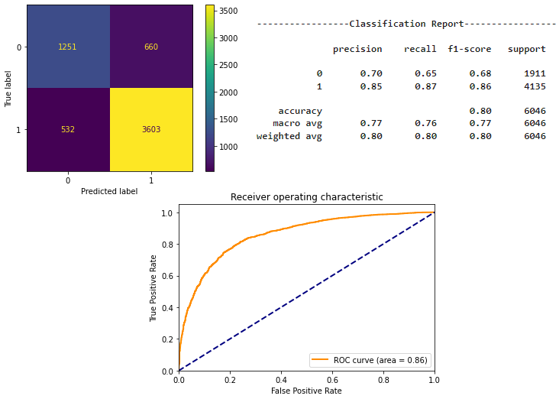
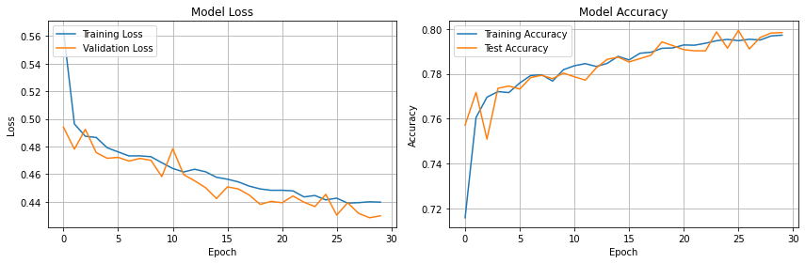
CNN Basic Modeling Technique
Model-1 with Data Augmentation(2 classes)
Method | Accuracy | Test Score | Precision | Recall | f1-score | support
CNN model-1 with Augmentation | 79.72 | 80.28 | 84.52 | 87.13 | 85.81 | 4135
27-Aug-2022

Slide 13

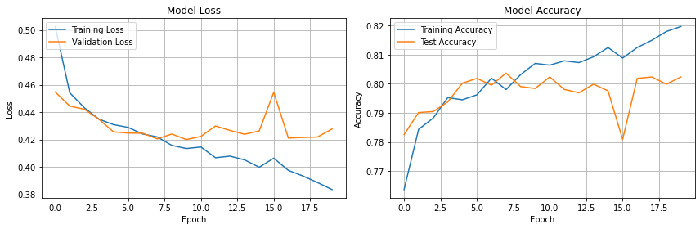
Transfer Learning
Modeling - Using VGG16 with trainable = False
Method | Accuracy | Test Score | Precision | Recall | f1-score | support
CNN_VGG16_model with trainable -False | 82.00 | 79.85 | 82.30 | 89.87 | 85.92 | 4135
27-Aug-2022

Slide 14
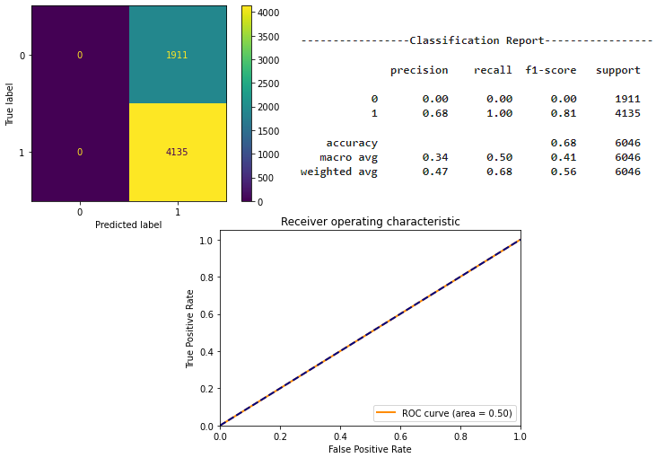
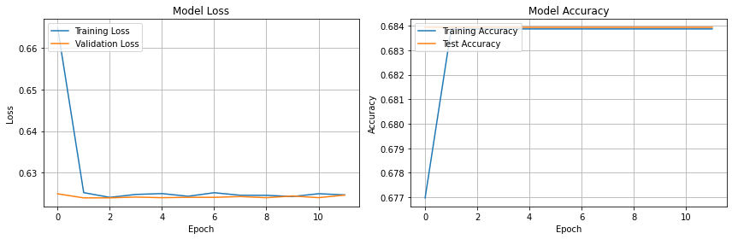
Transfer Learning cont’d…
Modeling - Using VGG16 with trainable = True
Method | Accuracy | Test Score | Precision | Recall | f1-score | Support
CNN_VGG16_model with trainable -True | 68.39 | 68.39 | 68.39 | 100.0 | 81.23 | 4135
27-Aug-2022

Slide 15
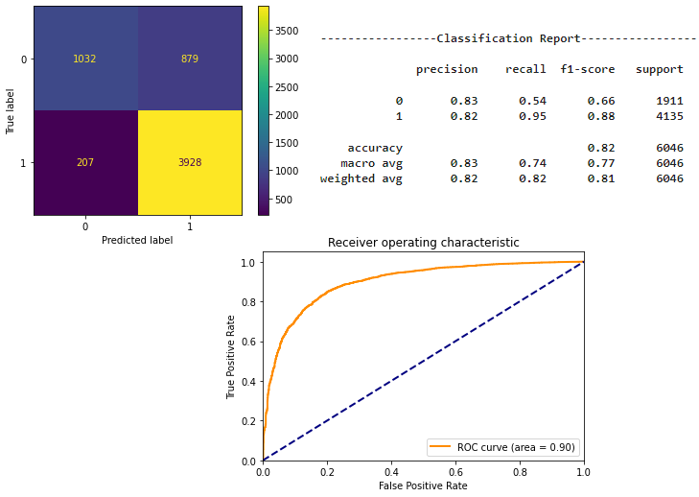
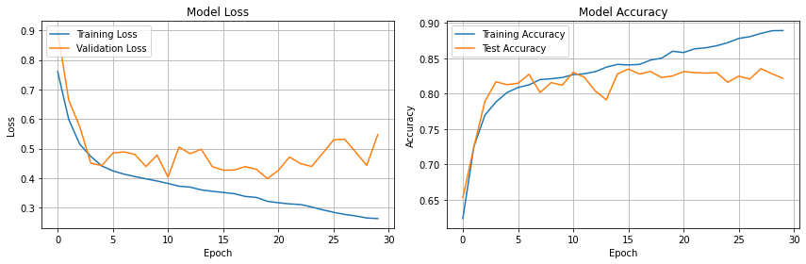
Inception Net
Also known as Google Net.
Fast training computing.
Complex patterns detection.
Optimal use of parameters.
27-Aug-2022

Slide 16
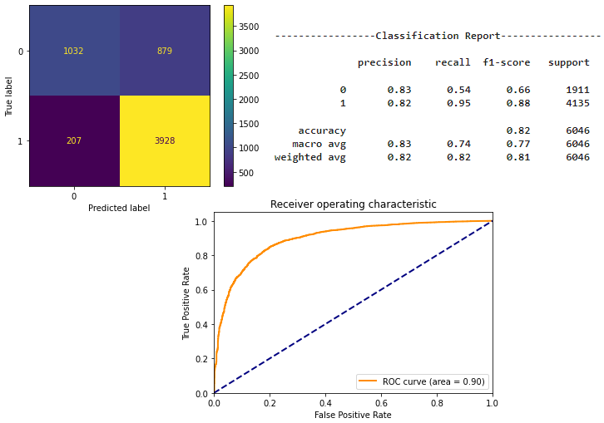
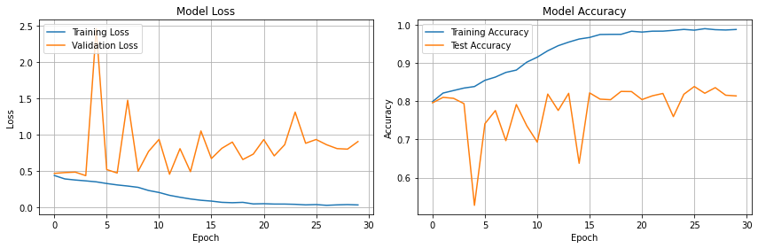
DenseNet
27-Aug-2022

Slide 17
CNN Models Summary
Method | Accuracy | Test Score | Precision | Recall | F1_score | Support
CNN model with 2 classes | 83.45 | 81.34 | 84.83 | 88.56 | 86.65 | 4135
CNN model with 3 classes | 70.06 | 64.80 | 60.74 | 48.29 | 53.80 | 2365
CNN model-1 with Augmentation | 79.72 | 80.28 | 84.52 | 87.13 | 85.81 | 4135
CNN_VGG16_model with trainable -False | 82.00 | 79.85 | 82.30 | 89.87 | 85.92 | 4135
CNN_VGG16_model with trainable -True | 68.39 | 68.39 | 68.39 | 100.00 | 81.23 | 4135
Inception base model | 88.92 | 82.04 | 81.71 | 94.99 | 87.86 | 4135
DenseNet Model | 98.81 | 81.79 | 81.38 | 95.14 | 87.72 | 4135
27-Aug-2022

Slide 18
Conclusion
CNN model with 2 classes and CNN model with 3 classes using stratify sampling , found that accuracy and recall of pneumonia class (class 1) are higher for model with 2 classes.
CNN model with augmenting the images , slightly increase in recall percentage with relatively no change in test accuracy and slight decrease in train accuracy.
VGG 16 trainable -False has shown relatively higher accuracy when compared to VGG trainable- True.
Dense net has given highest training accuracy among all the techniques but quite less recall percentage.
Inception net is the best among all transfer learning models and highest recall percentage which is the main moto of this project to focus on decreasing the false negative rate in health care domain.
27-Aug-2022

Slide 19

Questions?
27-Aug-2022

