Slide 1

Healthex
Cheer MONEDA
K00274654

Slide 2
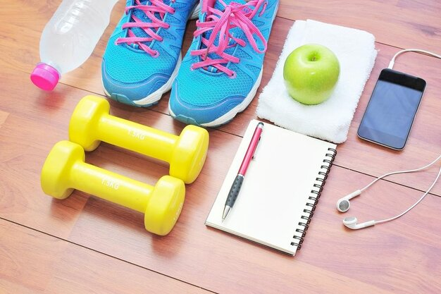

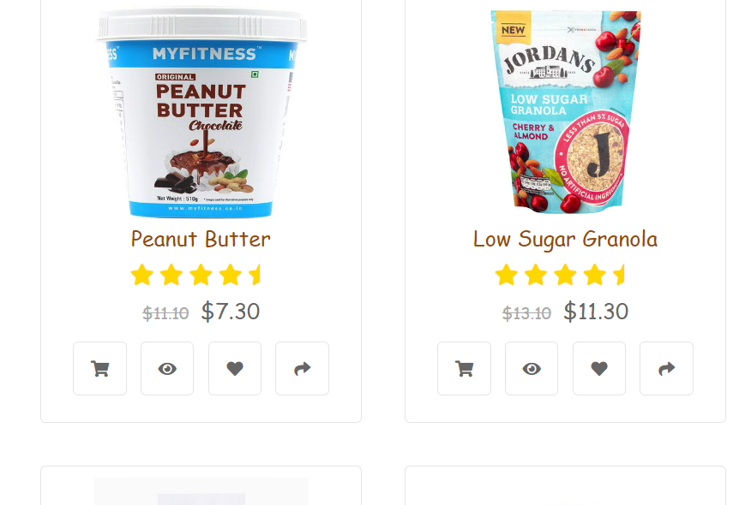
Introduction
Healthex is a website consisting of fitness, organic food products, and healthy tips that offer a healthy lifestyle to users.

Slide 3
JavaScript Features/Functions
SCRIPT(MAIN)
click() method simulates a mouse click on an element. . The click event of a supported element, such as an <input>, is triggered when click() is invoked on the element.
scrollTo(): The window Interface's scrollTo() method can be used to navigate to a specific spot on the page.
.modal("toggle") Toggles the modal
.modal("show") Opens the modal
.modal("hide") Hides the modal

Slide 4
JavaScript Features/Functions
Log-in
Document.querySelector() The document's first element that matches the given selector or set of selectors is returned by the querySelector() function.
Check if function
The instanceof operator is used to check the type of objects at run time. This operator returns a Boolean value(true or false).
onKey function
When a key is released, the onKeyUp event is started. When a user pushes and releases a key, the onKeyPress event is launched ( onKeyDown followed by onKeyUp ).

Slide 5
JavaScript Features/Functions
TIME
new Date(). toLocaleString
Creates a date object with the given date and time by calling new Date(year, month,...).Year, Month, Day, Hour, Minute, and Second are specified by 7 numerals (in that order)

Slide 6
JavaScript Features/Functions
Weather(API)
await fetch(url), response.json()
await keyword to ensure that JavaScript waits until that specific Promise is fulfilled and returns its results.
Response json allows method of the Response object that allows you to extract a JSON object from the response. This method returns a promise, so you should wait for the JSON: await response. json() .
addEventListener()
It is a way that you can wait for user interaction like a click or keypress and then run some code whenever that action happens.

Slide 7

Thank you

