Slide 1


POWER TRADING

Slide 2
Contents
Business Objective
Business Constraints
Project Architecture
Data Collection
Exploratory Data Analysis
Data Visualization

Slide 3
Business Problem
Intraday power trading is highly volatile due to multiple factors:
- Fluctuating supply-demand dynamics
- Unpredictable weather conditions
- Market speculation
- Regulatory changes
Impact: These challenges hinder traders and energy providers from optimizing pricing and risk management strategies.
Business Objectives
-Analyze and understand causes of price volatility in intraday power trading
- Develop data-driven strategies to optimize power trading decisions
Build predictive models for price trends using historical and real-time market data
Business Constraints
- Limited availability and accuracy of real-time market data
- Rapid changes in regulatory frameworks
- Integration challenges between renewable and traditional energy sources
Computational constraints in real-time analysis of large datasets
Success Criteria
Business Success: Improved intraday power trading decisions → higher profit margins
Economic Success: Reduced losses due to price volatility, enhanced forecasting accuracy
ML Success: Accurate models that predict and adapt to market fluctuations effectively

Slide 4
Project Overview & Scope
Project Overview
Title: Power Trading – Intraday Market Price Forecasting
Domain: Energy Markets, Real-Time Power Trading
Objective:
To analyze intraday electricity market data from the Indian Energy Exchange (IEX) to detect trading patterns, identify price volatility factors, and build predictive models for market clearing prices (MCP), enabling smarter energy trading decisions.
Description:
This project performs full-cycle data science implementation, including:
Web scraping IEX market data (15-min interval)
Preprocessing and outlier treatment
Statistical moment analysis (mean, skewness, kurtosis)
Visualizations (boxplots, KDE, pairplots, correlation heatmaps)
Model building (ARIMA, SARIMA, ETS, Holt-Winters, Gradient Boosting)
Performance comparison using RMSE
Dashboard-ready output for potential deployment (e.g., Streamlit)
Tools & Tech Stack:
Python (pandas, seaborn, statsmodels, scikit-learn)
MySQL (for data storage)
BeautifulSoup (web scraping)
Matplotlib & Seaborn (EDA & plotting)
ARIMA/SARIMA/ETS/Holt-Winters/LSTM/Gradient Boosting
Streamlit

Slide 5
Project Overview & Scope
Project Scope
Scraping and storing IEX real-time market data
Cleaning and normalizing market records
Statistical analysis: moments (mean, variance, skewness, kurtosis)
Visualizations for outlier detection, time series trends, correlation
Building and evaluating forecasting models:
  ARIMA, SARIMA, ETS, Holt-Winters, Gradient Boosting
RMSE-based model comparison and best model identification
Optional Streamlit dashboard design for visual decision support

Slide 6
Data Dictionary
- Web scraping from Indian Energy Exchange (IEX)
- Market segments: DAM, RTM
- 15-minute intervals with over 1 million records
- Data stored and queried via MySQL database
Date – The specific trading date for which market data is recorded.
Hour – The hourly time slot in the market during which transactions occur.
Session ID – A unique identifier for a particular trading session in the market.
Time block – The subdivision of an hour into smaller time slots(eg, 15-minute blocks) in which transactions are executed.
Purchase Bid (MV) – The total electricity demand (in Megawatts) placed by buyers during a specific time block.
Sell Bid (MV) – The total electricity demand (in Megawatts) offered by sellers during a specific time block.
MCV (MV) –The total volume of electricity (in Megawatts) successfully cleared in the market based on demand and supply.
Final Scheduled Volume (MV) – The actual volume of electricity (in Megawatts) scheduled for delivery after market settlement.
MCP (Rs/MWh) – The final price (in Rupees per Megawatt–hour) at which electricity is traded, determined by matching bids and offers.

Slide 7
Data Preprocessing
Column Renaming & Datatype Conversion
Renamed columns for clarity and consistency (e.g., Purchase_Bid_MW, MCP_Rs_MWh)
Converted Date column to proper datetime format
Cast numeric fields to floats using pd.to_numeric with error handling
Missing Value Imputation
Numeric columns with missing values were imputed using mean imputation to maintain data integrity and avoid bias in statistical measures or model training.
Outlier Treatment
Used the Interquartile Range (IQR) method to cap outliers in all numeric variables (e.g., bids, volumes, prices) to prevent model distortion.
Normalization (Min-Max Scaling)
Rescaled numeric variables to a [0, 1] range using Min-Max normalization.
Essential for models like Gradient Boosting and deep learning (e.g., LSTM).
Standardization (Z-Score Scaling)
Applied Z-score transformation to convert variables into a standard normal distribution (mean=0, std=1), improving model convergence for algorithms assuming Gaussian distributions.

Slide 8
EDA Highlights
- Boxplots: Outlier detection across bids, volumes, prices
- Time series: MCP trends over time
- KDE/Histogram: Price distribution
- Pairplots: Bid-volume-price relationships
- Heatmap: Correlation analysis

Slide 9
Business Insights
Business Insights:
Supply & Demand Trends:
  By analyzing Purchase_Bid_MW and Sell_Bid_MW, we can identify supply-demand gaps. If Purchase_Bid_MW > Sell_Bid_MW, there’s excess demand, which could drive MCP (Market Clearing Price) higher.
  If Sell_Bid_MW > Purchase_Bid_MW, it indicates oversupply, which could lower MCP.
Market Price Behavior (MCP_Rs_MWh):
  The time series chart of MCP_Rs_MWh over time helps track price fluctuations.
  Understanding MCP behavior facilitates the development of price prediction models and strategic bidding by power traders.
Volatility & Risk Assessment:
  Boxplots & IQR-based outlier detection indicate market volatility and unexpected price spikes.
  High volatility suggests risk for market participants and could indicate regulatory interventions or unexpected supply-demand shocks.
Correlation Between Market Variables:
  The heatmap shows interdependencies, e.g., how MCP correlates with MCV (Market Cleared Volume).
  A strong correlation between MCV_MW and MCP_Rs_MWh suggests that higher trading volumes impact clearing prices.
Trading Strategy Optimization:
  The skewness and kurtosis analysis helps in understanding price distributions.
  If MCP is highly skewed, it indicates asymmetric price movements, influencing hedging strategies.
  Kurtosis > 3 (Leptokurtic) means extreme price spikes occur frequently, requiring risk management strategies.

Slide 10
Statistical Insights
Central Tendency & Dispersion:
  Mean & Variance provide a measure of central market trends and price variability.
  High variance suggests a volatile market, requiring price stabilization policies.
Outlier Detection via Boxplot & IQR:
  Data points beyond 1.5x IQR bounds are treated as extreme market conditions.
  Outliers may indicate regulatory interventions, demand-supply shocks, or market manipulations.
Normalization & Standardization:
  Min-Max scaling ensures all features are within a [0,1] range for ML applications.
  Z-score standardization helps detect deviations from normal market conditions.
Time-Series Analysis:
  Seasonality in MCP trends could suggest peak trading hours with higher price volatility.
  Identifying recurring patterns can help traders optimize their bids.
Histograms & KDE Analysis:
  If MCP is normally distributed, pricing follows predictable trends.
If MCP has fat tails, extreme price events are frequent, requiring risk hedging.

Slide 11
Forecasting Models Used
- ARIMA: Short-term trend capture
- SARIMA: Seasonality handling
- ETS: Component decomposition
- Holt-Winters: Trend + seasonality smoothing
- LSTM: Long-term dependency via deep learning

Slide 12
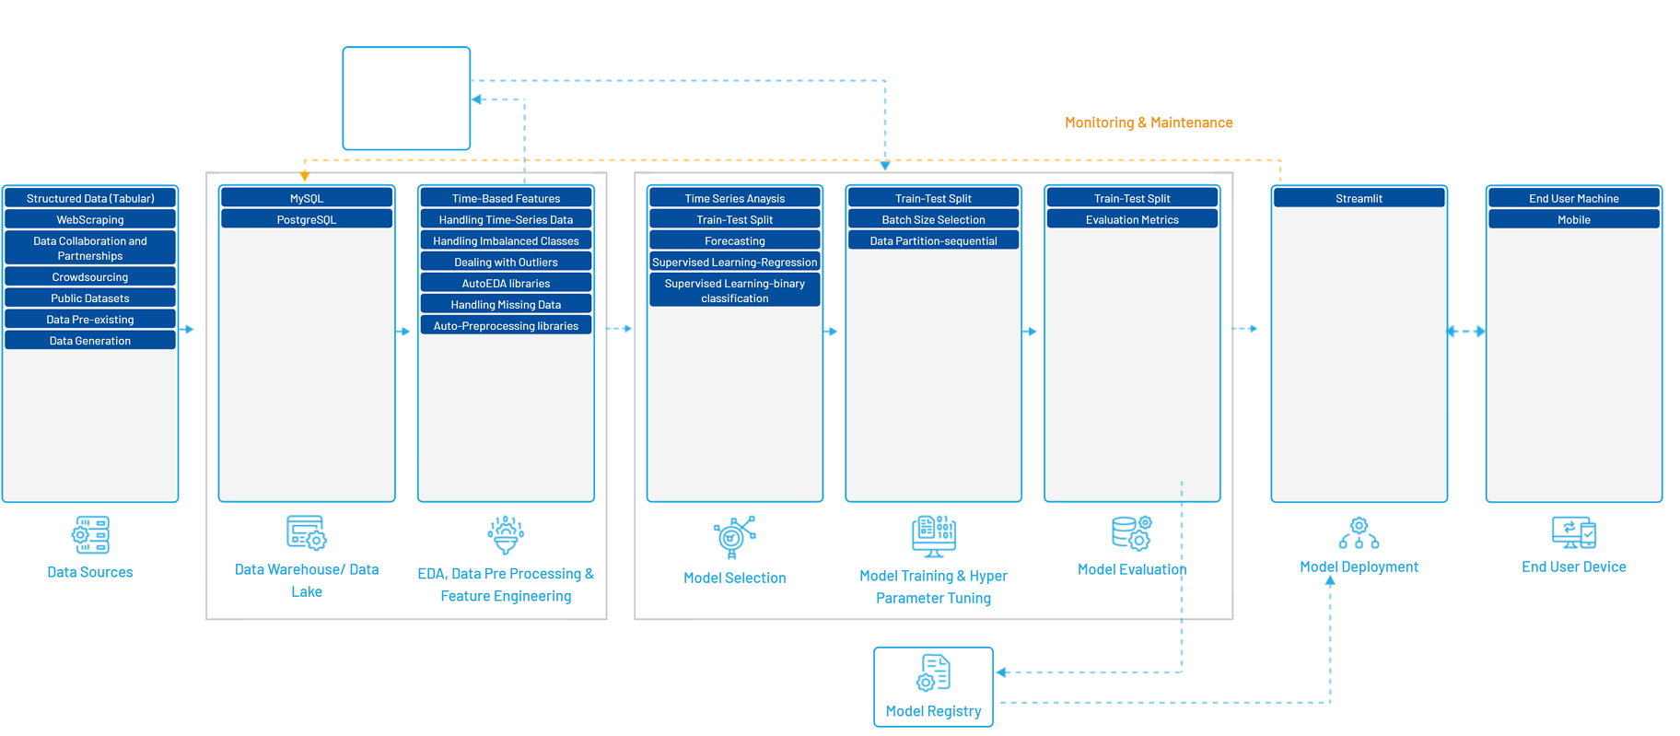
Project Architecture
High-Level Architecture

Slide 13
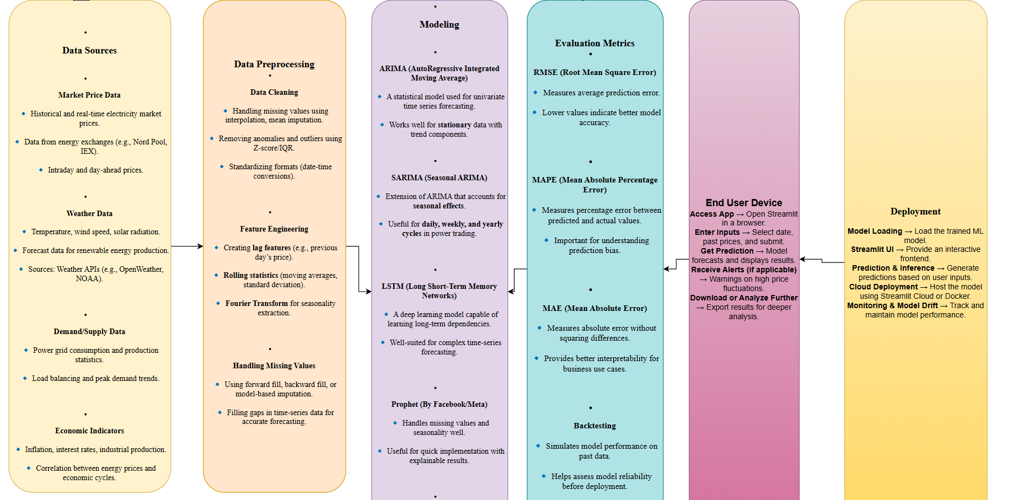
Project Architecture
Low-Level Architecture

Slide 14
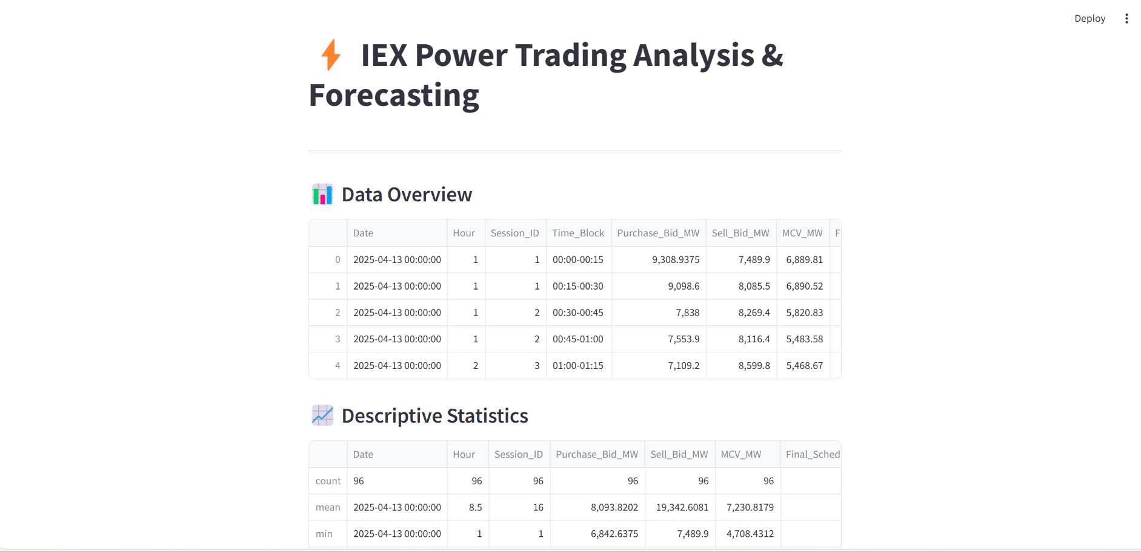
Dashboard Overview (Streamlit)

Slide 15
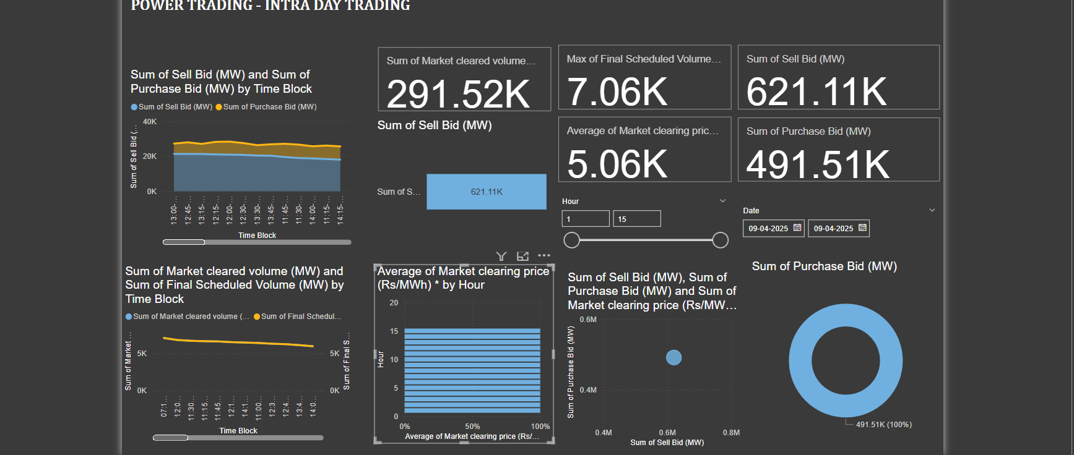
Dashboard

Slide 16
Acknowledgments
- Vaishnavi Cheera, Intern
- Tools used: Python, Streamlit, MySQL

