Slide 1
CPSC221
Introduction to Data Structures and Algorithms

Slide 2
Introductions:
US:
Cinda Heeren – cheeren@cs.ubc.ca OH: after class, usually.
Ruiyu Gou
Course staff:
Notes:
Tell which TA will be in which session
Add Emily

Slide 3
All you need to know is on Canvas!
Info on:
Staff
Communications
Lab sections
PAs
Exams
Marking
Academic Integrity
PAs – out Fri, Due Mon after 2wk
HWs – out Fri, Due Mon after 1wk
Labs – once a week, av Sun-Sun
Exams – 45min within Fri 12-3p
Class Meetings – MW 10-11a, via ZOOM
https://canvas.ubc.ca/courses/58963
Notes:
Make sure to mention that sections are NOT on for THIS week.
You are responsible for this information.
BE VERY BRIEF

Slide 4
Term Flow
Week | PA / HW due | lab | M | T | W | Th | F
1 |  |  | C | V | C
2 |  |  | L | I | L |  | E
3 |  |  | A | D | A |  | X
4 |  |  | S | E | S |  | A
5 |  |  | S | O | S |  | M
6 |  |  | READING BREAK
7 |  |  |  |  |  |  | L
8 |  |  |  |  |  |  | E
9 |  |  |  |  |  |  | T
10
11 |  |  |  |  |  |  | S
12
13 |  |  |  |  |  |  | ☺
14
Class Meetings
Mon/Wed via Zoom
Tue Videos
Programming Assignments
out Fri(ish)
due Mon after 2 weeks
Homework
out Fri(ish)
due Mon after 1 week
Labs
1/wk (av Sun-Sun)
Examlets
45min within any class time
Notes:
Mark flexibility and variability, Circle breaks

Slide 5
Today’s announcements:
HW1 available Friday, due Jan 24, 23:59.
My OH: Mon, 11a-12p, by sign-up on Canvas (not today :( )
Lab sections meet this week and are important for setup!
Today’s Plan:
1. intro to algorithm analysis – code!
2. clearing the cobwebs on asymptotics

Slide 6
What’s this course about?
Notes:
Write DATA at the top and point out that data can really be anything – including for example, programs themselves
WRITE:
Design correct and efficient programmatic solutions for dealing with data.
Sometimes primary approach will be Algorithm
Other times Arrangement
Correct and Efficient – what does this mean, and how do we measure?
Analysis
Learn classic algorithms and structures
Learn a little C++
______________________________________________________
Learn some C++ too!
All programs manipulate data 􏰀 programs process, store, display, gather data 􏰀 data can be information, numbers, images, sound
􏰀 The programmer must decide how to store and manipulate data
􏰀 This choice influences the program in many ways
􏰀 execution speed
􏰀 memory requirements
􏰀 maintenance (debugging, extending, etc.)
Become familiar with some of the fundamental data structures and algorithms in computer science
􏰀 Learn when to use them 􏰀 Improve your ability to solve problems abstractly
􏰀 Data structures and algorithms are the building blocks
􏰀 Improve your ability to analyze algorithms
􏰀 Prove correctness
􏰀 Gauge, compare, and improve time and space complexity
􏰀 Become modestly skilled with C++ and UNIX, but this is largely on your own!

Slide 7
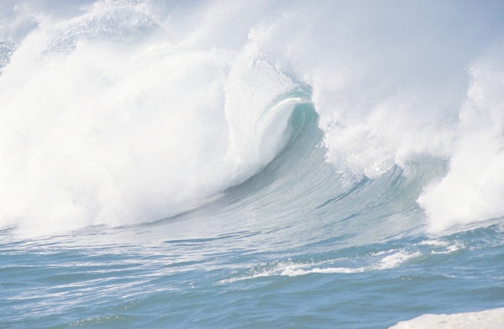
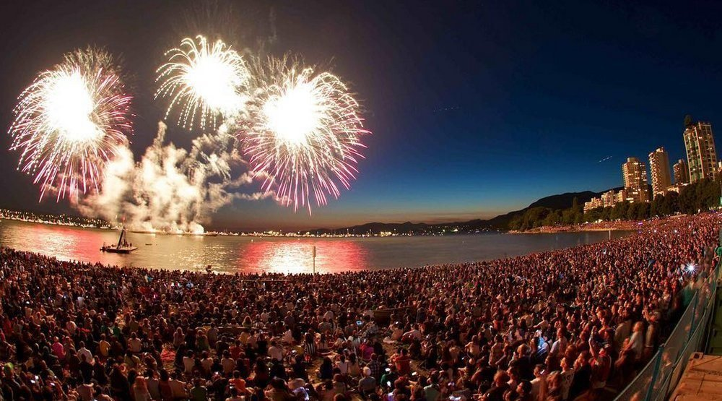
Where’s Ruiyu?
Observations:
Notes:
Might be interested in more complex searches… find 5 people that KNOW Aine, but who don’t know each other.
Algorithm – A sequence of steps to produce a solution to a problem, given a set of inputs
What’s an algorithm for finding someone in this scenario?
Broadcast, call her, ask someone and they tell two people …
The only mechanism that would really work --

Slide 8
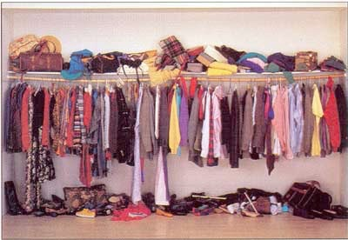
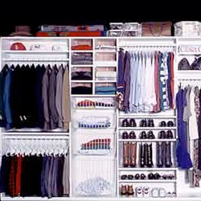
Which closet…
Notes:
Just another metaphor for what we’ll do here.
Data structures – how we arrange the data in memory can have a big effect on how we write our algorithms.
poll

Slide 9
Measuring the value of algorithms
Is value 0 if algorithm is not correct?
Use different metrics – time, space most common
Express running times as a (positive) function:
Form of function depends on structure of the algorithm:
Notes:
And algorithms.
Value is 0 if they aren’t correct actually not true → depends how far from correct they can promise to be… (PAC)
We focus on time for the moment.
T: Z0 -> R0
What’s n?
For linear search for Aine– T(n) = 5 + 2n or T(n) = 3n, n>=0.

Slide 10
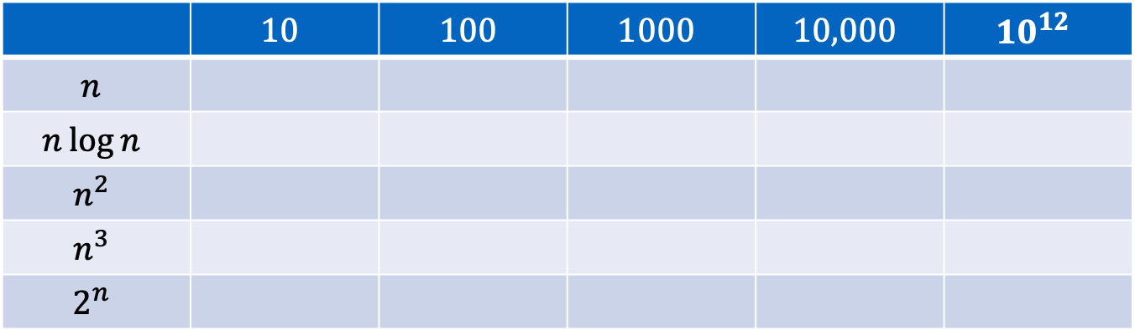
Running times
Suppose a computer executes 10¹² operations per sec.
n
 | $$10$$ | $$100$$ | $$1000$$ | $$10,000$$ | $${10}^{12}$$
$$n$$
$$n\log{n}$$
$$n^{2}$$
$$n^{3}$$
$$2^{n}$$
10⁻¹¹ s
10⁻¹¹ s
10⁻¹⁰ s
10⁻⁹ s
10⁻⁹ s
10⁻¹⁰ s
10⁻⁹ s
10⁻⁸ s
10⁻⁶ s
10¹⁸ s
10⁻⁹ s
10⁻⁸ s
10⁻⁶ s
10⁻³ s
10²⁸⁹ s
10⁻⁸ s
10⁻⁷ s
10⁻⁴ s
1 s
1 s
40 s
10¹² s
10²⁴ s
T(n)
Notes:
Pull out a few of these for discussion.
Put a line showing which of the executions you’d be willing to wait for…
Here’s the kicker – 10^4 sec = 2.8hr, 10^18 sec = 30b years.
Why does it matter?

Slide 11
Algorithmic Analysis – example 1
1
2
3
4
5
6
int ______ (vector<int> arr, int q){
for (int i = 0; i < arr.size(); i++)
if (arr[i] == q)
return i;
return -1;
}
What does it do?
How long does it take?
0 | 1 | 2 | 3 | 4 | 5 | 6 | 7 | 8 | 9 | 10 | 11 | 12 | 13 | 14 | 15
32 | 11 | 73 | 21 | 29 | 86 | 81 | 92 | 57 | 61 | 64 | 15 | 79 | 44 | 7 | 45
Notes:
Bounds -
Upper – almost always intend to talk about the least upper bound… a bound that is tight.
Lower – no correct algorithm can do better.
Worst – as if an adversary is choosing your input
Average – analysis requires some assumption about the distribution of inputs probabilistic.
Analysis is almost always worst case
Worst case == O(n), best case, average case?
TWO DIFFERENT THINGS GOING ON 1) data is a messy closet, how do we change that to analysis?
Also take a moment to change the bounds on the iteration??? As an aside??

Slide 12
Algorithmic Analysis – running time
1
2
3
4
5
6
int ______ (vector<int> arr, int q){
for (int i = 0; i < arr.size(); i++)
if (arr[i] == q)
return i;
return -1;
}
How long does it take?
What does it depend on?
Notes:
List 3 things it depends on:
Speed of the machine
Lenggth of the array
Where q is in the array (if)

Slide 13
Algorithmic Analysis Discussion
1
2
3
4
5
6
int ______ (vector<int> arr, int q){
for (int i = 0; i < arr.size(); i++)
if (arr[i] == q)
return i;
return -1;
}
0 | 1 | 2 | 3 | 4 | 5 | 6 | 7 | 8 | 9 | 10 | 11 | 12 | 13 | 14 | 15
32 | 11 | 73 | 21 | 29 | 86 | 81 | 92 | 57 | 61 | 64 | 15 | 79 | 44 | 7 | 45
What’s the best case running time?
What’s the worst case running time?
What’s the average case running time?
Notes:
Bounds -
Upper – almost always intend to talk about the least upper bound… a bound that is tight.
Lower – no correct algorithm can do better.
Worst – as if an adversary is choosing your input
Average – analysis requires some assumption about the distribution of inputs probabilistic.
Analysis is almost always worst case
Worst case == O(n), best case, average case?

Slide 14
Algorithmic Analysis Discussion
1
2
3
4
5
6
int ______ (vector<int> arr, int q){
for (int i = 0; i < arr.size(); i++)
if (arr[i] == q)
return i;
return -1;
}
How many lines are executed ________?
T(n) = ________
Discussion:
Notes:
Does the 2 matter,
does the 1 matter?

Slide 15
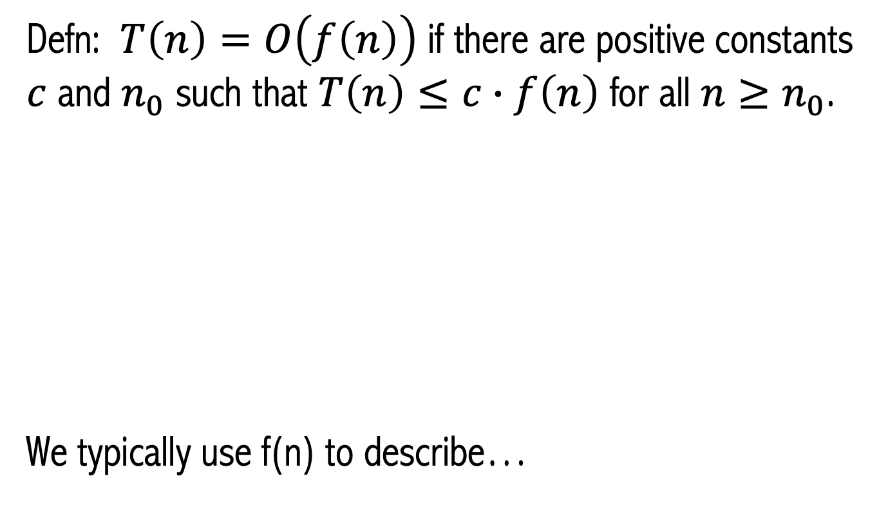
Aside on Asymptotics
Defn: $T\left(n\right)=O\left(f\left(n\right)\right)$ if there are positive constants $c$ and $n_{0}$ such that $T\left(n\right)≤c∙f\left(n\right)$ for all $n≥n_{0}$.
We typically use f(n) to describe…
Notes:
Asymptotic upper bound on the worst case running time of a function.
Mention that they can ignore the absolute values in their text, since our functions are positive functions.
This is like leq…
Also, T(n) \in O(f(n)) instead of = doesn’t matter here.
Asyptotic upper bound and we use it for worst case running time.

Slide 16
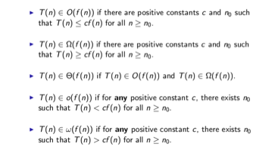
Asymptotic definitions

Slide 17
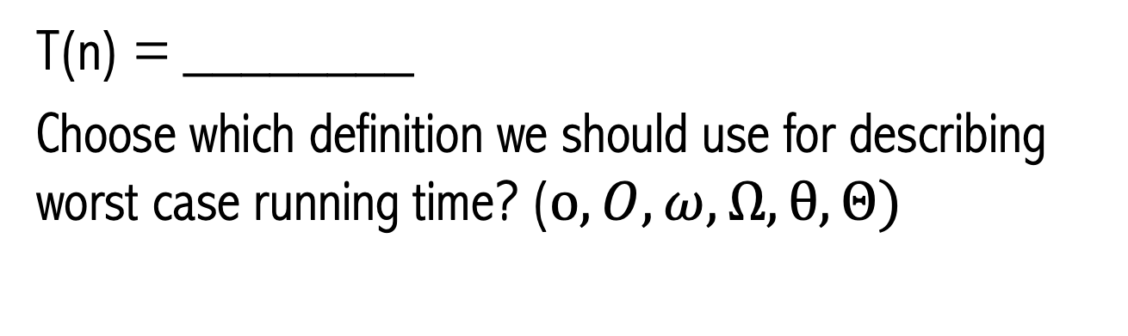
Algorithmic Analysis Discussion
1
2
3
4
5
6
int ______ (vector<int> arr, int query){
for (int i = 0; i < arr.size(); i++)
if (arr[i] == q)
return i;
return -1;
}
T(n) = ________
Choose which definition we should use for describing worst case running time? ($o, O, ω, Ω, θ, Θ)$

