Slide 1
AIMP:
Coulomb potential : M1 (M2)
Spectral Representation Operator : exchange, relativistic effect
Projection Operator
ECP:
embedding:
cluster
valence
valence
core
A
core
B
env1
env2
env3

Slide 2
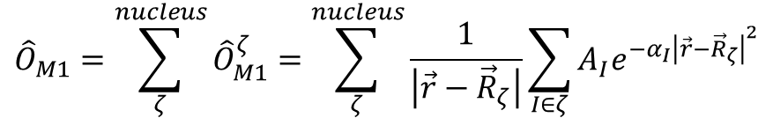
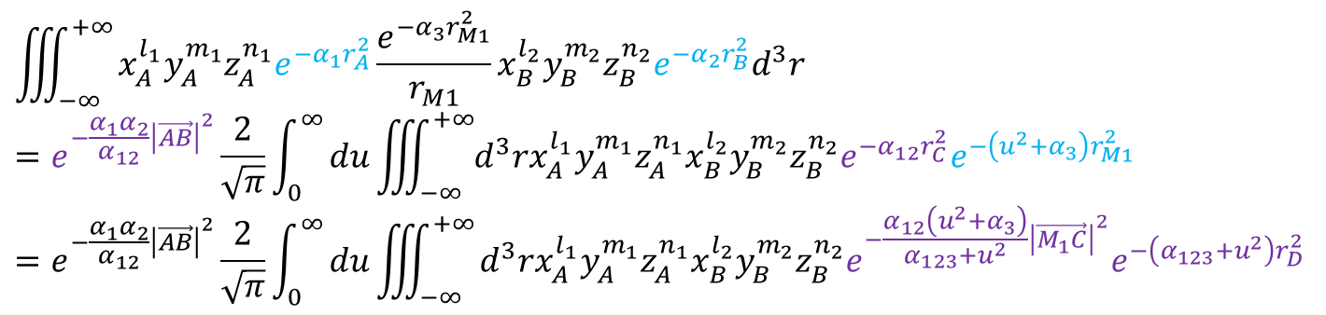

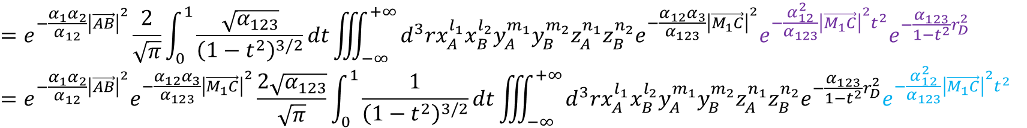
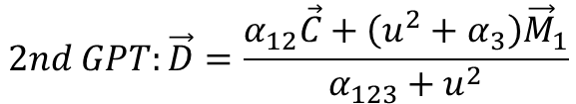
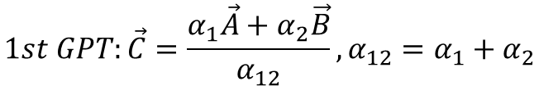
M1 coulomb model potential : s-type GTO times nuclear attraction
$${\hat{O}}_{M1}=\sum_{ζ}^{nucleus}{{\hat{O}}_{M1}^{ζ}}=\sum_{ζ}^{nucleus}{\frac{1}{\left|\vec{r}−{\vec{R}}_{ζ}\right|}\sum_{I∈ζ}{A_{I}e^{−α_{I}{\left|\vec{r}−{\vec{R}}_{ζ}\right|}^{2}}}}$$
$$\left\langle χ_{a} | \frac{1}{r_{M1}}\sum_{I}{A_{I}e^{−α_{I}r_{M1}^{2}}} | χ_{b}\right\rangle =\sum_{I}{A_{I}\iiint_{−∞}^{+∞}{x_{A}^{l_{i}}y_{A}^{m_{i}}z_{A}^{n_{i}}e^{−α_{i}r_{A}^{2}}\left[\frac{e^{−α_{I}r_{M1}^{2}}}{r_{M1}}\right]x_{B}^{l_{j}}y_{B}^{m_{j}}z_{B}^{n_{j}}e^{−α_{j}r_{B}^{2}}d^{3}r}}$$
$$\iiint_{−∞}^{+∞}{x_{A}^{l_{1}}y_{A}^{m_{1}}z_{A}^{n_{1}}e^{−α_{1}r_{A}^{2}}\frac{e^{−α_{3}r_{M1}^{2}}}{r_{M1}}x_{B}^{l_{2}}y_{B}^{m_{2}}z_{B}^{n_{2}}e^{−α_{2}r_{B}^{2}}d^{3}r}$$
$$=e^{−\frac{α_{1}α_{2}}{α_{12}}{\left|\vec{AB}\right|}^{2}}\frac{2}{\sqrt{π}}\int_{0}^{∞}{du\iiint_{−∞}^{+∞}{d^{3}rx_{A}^{l_{1}}y_{A}^{m_{1}}z_{A}^{n_{1}}x_{B}^{l_{2}}y_{B}^{m_{2}}z_{B}^{n_{2}}e^{−α_{12}r_{C}^{2}}e^{−\left(u^{2}+α_{3}\right)r_{M1}^{2}}}}$$
$$=e^{−\frac{α_{1}α_{2}}{α_{12}}{\left|\vec{AB}\right|}^{2}}\frac{2}{\sqrt{π}}\int_{0}^{∞}{du\iiint_{−∞}^{+∞}{d^{3}rx_{A}^{l_{1}}y_{A}^{m_{1}}z_{A}^{n_{1}}x_{B}^{l_{2}}y_{B}^{m_{2}}z_{B}^{n_{2}}e^{−\frac{α_{12}\left(u^{2}+α_{3}\right)}{α_{123}+u^{2}}{\left|\vec{M_{1}C}\right|}^{2}}e^{−\left(α_{123}+u^{2}\right)r_{D}^{2}}}}$$
$$1st GPT:\vec{C}=\frac{α_{1}\vec{A}+α_{2}\vec{B}}{α_{12}},α_{12}=α_{1}+α_{2}$$
$$2nd GPT:\vec{D}=\frac{α_{12}\vec{C}+\left(u^{2}+α_{3}\right){\vec{M}}_{1}}{α_{123}+u^{2}}$$
$$t^{2}=\frac{u^{2}}{α_{123}+u^{2}},du=\frac{\sqrt{α_{123}}}{{\left(1−t^{2}\right)}^{3/2}}dt$$
$$=e^{−\frac{α_{1}α_{2}}{α_{12}}{\left|\vec{AB}\right|}^{2}}\frac{2}{\sqrt{π}}\int_{0}^{1}{\frac{\sqrt{α_{123}}}{{\left(1−t^{2}\right)}^{3/2}}dt\iiint_{−∞}^{+∞}{d^{3}rx_{A}^{l_{1}}x_{B}^{l_{2}}y_{A}^{m_{1}}y_{B}^{m_{2}}z_{A}^{n_{1}}z_{B}^{n_{2}}e^{−\frac{α_{12}α_{3}}{α_{123}}{\left|\vec{M_{1}C}\right|}^{2}}e^{−\frac{α_{12}^{2}}{α_{123}}{\left|\vec{M_{1}C}\right|}^{2}t^{2}}e^{−\frac{α_{123}}{1−t^{2}}r_{D}^{2}}}}$$
$$=e^{−\frac{α_{1}α_{2}}{α_{12}}{\left|\vec{AB}\right|}^{2}}e^{−\frac{α_{12}α_{3}}{α_{123}}{\left|\vec{M_{1}C}\right|}^{2}}\frac{2\sqrt{α_{123}}}{\sqrt{π}}\int_{0}^{1}{\frac{1}{{\left(1−t^{2}\right)}^{3/2}}dt\iiint_{−∞}^{+∞}{d^{3}rx_{A}^{l_{1}}x_{B}^{l_{2}}y_{A}^{m_{1}}y_{B}^{m_{2}}z_{A}^{n_{1}}z_{B}^{n_{2}}e^{−\frac{α_{123}}{1−t^{2}}r_{D}^{2}}e^{−\frac{α_{12}^{2}}{α_{123}}{\left|\vec{M_{1}C}\right|}^{2}t^{2}}}}$$

Slide 3
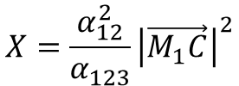
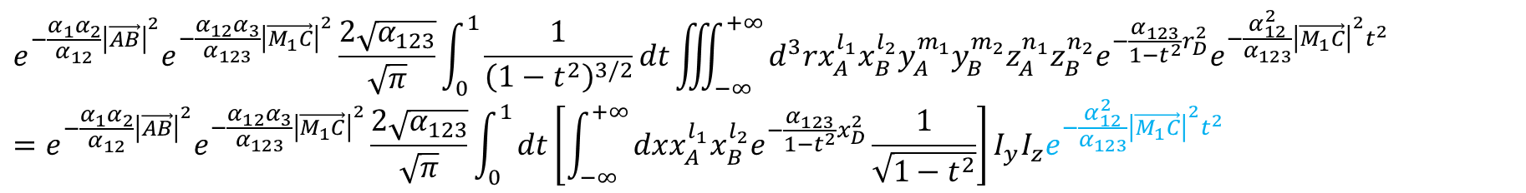
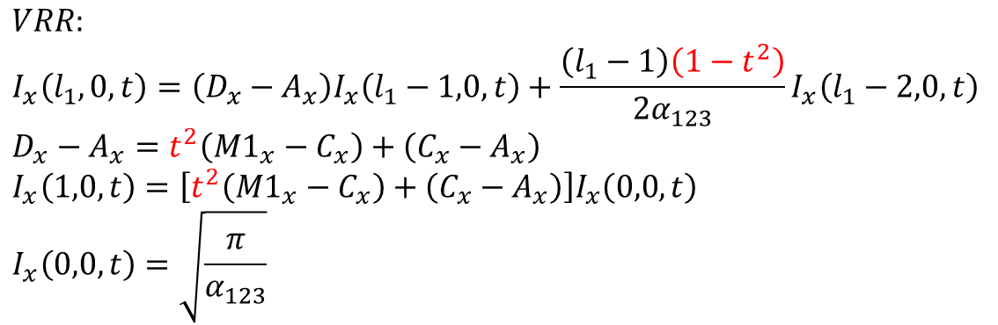

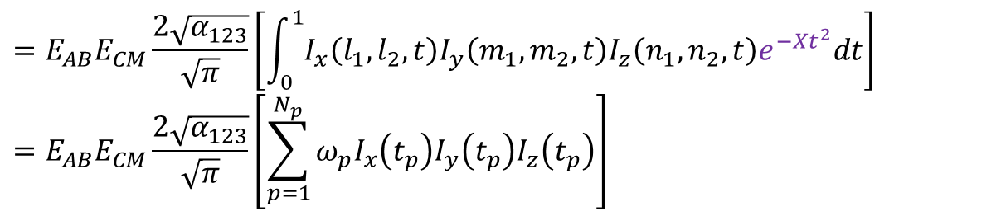
$$e^{−\frac{α_{1}α_{2}}{α_{12}}{\left|\vec{AB}\right|}^{2}}e^{−\frac{α_{12}α_{3}}{α_{123}}{\left|\vec{M_{1}C}\right|}^{2}}\frac{2\sqrt{α_{123}}}{\sqrt{π}}\int_{0}^{1}{\frac{1}{{\left(1−t^{2}\right)}^{3/2}}dt\iiint_{−∞}^{+∞}{d^{3}rx_{A}^{l_{1}}x_{B}^{l_{2}}y_{A}^{m_{1}}y_{B}^{m_{2}}z_{A}^{n_{1}}z_{B}^{n_{2}}e^{−\frac{α_{123}}{1−t^{2}}r_{D}^{2}}e^{−\frac{α_{12}^{2}}{α_{123}}{\left|\vec{M_{1}C}\right|}^{2}t^{2}}}}$$
$$=e^{−\frac{α_{1}α_{2}}{α_{12}}{\left|\vec{AB}\right|}^{2}}e^{−\frac{α_{12}α_{3}}{α_{123}}{\left|\vec{M_{1}C}\right|}^{2}}\frac{2\sqrt{α_{123}}}{\sqrt{π}}\int_{0}^{1}{dt\left[\int_{−∞}^{+∞}{dxx_{A}^{l_{1}}x_{B}^{l_{2}}e^{−\frac{α_{123}}{1−t^{2}}x_{D}^{2}}\frac{1}{\sqrt{1−t^{2}}}}\right]I_{y}I_{z}e^{−\frac{α_{12}^{2}}{α_{123}}{\left|\vec{M_{1}C}\right|}^{2}t^{2}}}$$
$$=E_{AB}E_{CM}\frac{2\sqrt{α_{123}}}{\sqrt{π}}\left[\int_{0}^{1}{I_{x}\left(l_{1},l_{2},t\right)I_{y}\left(m_{1},m_{2},t\right)I_{z}\left(n_{1},n_{2},t\right)e^{−Xt^{2}}dt}\right]$$
$$=E_{AB}E_{CM}\frac{2\sqrt{α_{123}}}{\sqrt{π}}\left[\sum_{p=1}^{N_{p}}{ω_{p}I_{x}\left(t_{p}\right)I_{y}\left(t_{p}\right)I_{z}\left(t_{p}\right)}\right]$$
$$X=\frac{α_{12}^{2}}{α_{123}}{\left|\vec{M_{1}C}\right|}^{2}$$
$$HRR:$$
$$I_{x}\left(l_{1},l_{2},t\right)=I_{x}\left(l_{1}+1,l_{2}−1,t\right)+\left(A_{x}−B_{x}\right)I_{x}\left(l_{1},l_{2}−1,t\right)$$
$$VRR:$$
$$I_{x}\left(l_{1},0,t\right)=\left(D_{x}−A_{x}\right)I_{x}\left(l_{1}−1,0,t\right)+\frac{\left(l_{1}−1\right)\left(1−t^{2}\right)}{2α_{123}}I_{x}\left(l_{1}−2,0,t\right)$$
$$D_{x}−A_{x}=t^{2}\left(M1_{x}−C_{x}\right)+\left(C_{x}−A_{x}\right)$$
$$I_{x}\left(1,0,t\right)=\left[t^{2}\left(M1_{x}−C_{x}\right)+\left(C_{x}−A_{x}\right)\right]I_{x}\left(0,0,t\right)$$
$$I_{x}\left(0,0,t\right)=\sqrt{\frac{π}{α_{123}}}$$

Slide 4
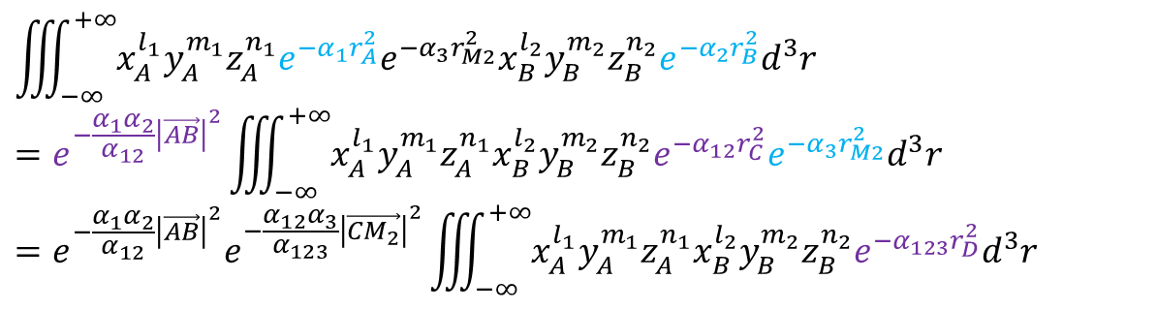
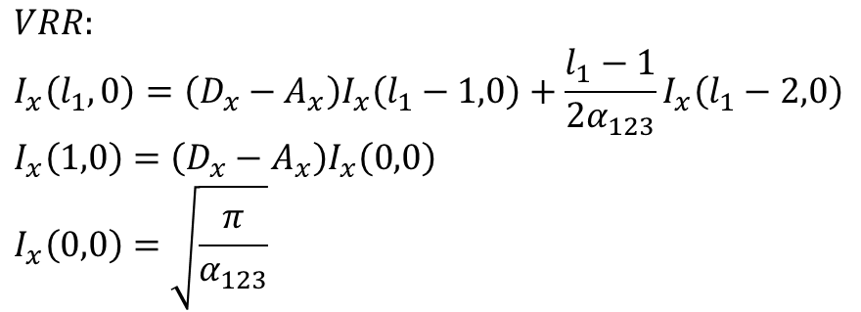
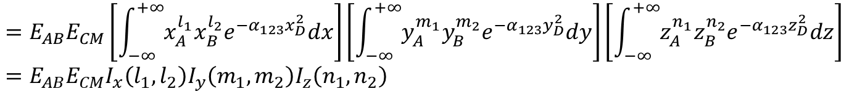
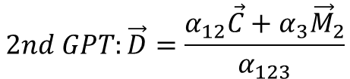
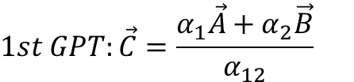
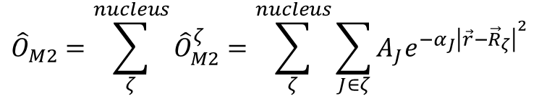
M2 coulomb model potential : s-type GTO
$${\hat{O}}_{M2}=\sum_{ζ}^{nucleus}{{\hat{O}}_{M2}^{ζ}}=\sum_{ζ}^{nucleus}{\sum_{J∈ζ}{A_{J}e^{−α_{J}{\left|\vec{r}−{\vec{R}}_{ζ}\right|}^{2}}}}$$
$$\left\langle χ_{a} | \sum_{J}{A_{J}e^{−α_{J}r_{M2}^{2}}} | χ_{b}\right\rangle =\sum_{J}{A_{J}\iiint_{−∞}^{+∞}{x_{A}^{l_{i}}y_{A}^{m_{i}}z_{A}^{n_{i}}e^{−α_{i}r_{A}^{2}}\left[e^{−α_{J}r_{M2}^{2}}\right]x_{B}^{l_{j}}y_{B}^{m_{j}}z_{B}^{n_{j}}e^{−α_{j}r_{B}^{2}}d^{3}r}}$$
$$\iiint_{−∞}^{+∞}{x_{A}^{l_{1}}y_{A}^{m_{1}}z_{A}^{n_{1}}e^{−α_{1}r_{A}^{2}}e^{−α_{3}r_{M2}^{2}}x_{B}^{l_{2}}y_{B}^{m_{2}}z_{B}^{n_{2}}e^{−α_{2}r_{B}^{2}}d^{3}r}$$
$$=e^{−\frac{α_{1}α_{2}}{α_{12}}{\left|\vec{AB}\right|}^{2}}\iiint_{−∞}^{+∞}{x_{A}^{l_{1}}y_{A}^{m_{1}}z_{A}^{n_{1}}x_{B}^{l_{2}}y_{B}^{m_{2}}z_{B}^{n_{2}}e^{−α_{12}r_{C}^{2}}e^{−α_{3}r_{M2}^{2}}d^{3}r}$$
$$=e^{−\frac{α_{1}α_{2}}{α_{12}}{\left|\vec{AB}\right|}^{2}}e^{−\frac{α_{12}α_{3}}{α_{123}}{\left|\vec{CM_{2}}\right|}^{2}}\iiint_{−∞}^{+∞}{x_{A}^{l_{1}}y_{A}^{m_{1}}z_{A}^{n_{1}}x_{B}^{l_{2}}y_{B}^{m_{2}}z_{B}^{n_{2}}e^{−α_{123}r_{D}^{2}}d^{3}r}$$
$$1st GPT:\vec{C}=\frac{α_{1}\vec{A}+α_{2}\vec{B}}{α_{12}}$$
$$2nd GPT:\vec{D}=\frac{α_{12}\vec{C}+α_{3}{\vec{M}}_{2}}{α_{123}}$$
$$=E_{AB}E_{CM}\left[\int_{−∞}^{+∞}{x_{A}^{l_{1}}x_{B}^{l_{2}}e^{−α_{123}x_{D}^{2}}dx}\right]\left[\int_{−∞}^{+∞}{y_{A}^{m_{1}}y_{B}^{m_{2}}e^{−α_{123}y_{D}^{2}}dy}\right]\left[\int_{−∞}^{+∞}{z_{A}^{n_{1}}z_{B}^{n_{2}}e^{−α_{123}z_{D}^{2}}dz}\right]$$
$$=E_{AB}E_{CM}I_{x}\left(l_{1},l_{2}\right)I_{y}\left(m_{1},m_{2}\right)I_{z}\left(n_{1},n_{2}\right)$$
$$VRR:$$
$$I_{x}\left(l_{1},0\right)=\left(D_{x}−A_{x}\right)I_{x}\left(l_{1}−1,0\right)+\frac{l_{1}−1}{2α_{123}}I_{x}\left(l_{1}−2,0\right)$$
$$I_{x}\left(1,0\right)=\left(D_{x}−A_{x}\right)I_{x}\left(0,0\right)$$
$$I_{x}\left(0,0\right)=\sqrt{\frac{π}{α_{123}}}$$
$$HRR:I_{x}\left(l_{1},l_{2}\right)=I_{x}\left(l_{1}+1,l_{2}−1\right)+\left(A_{x}−B_{x}\right)I_{x}\left(l_{1},l_{2}−1\right)$$

Slide 5
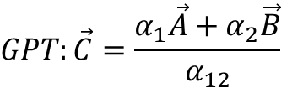
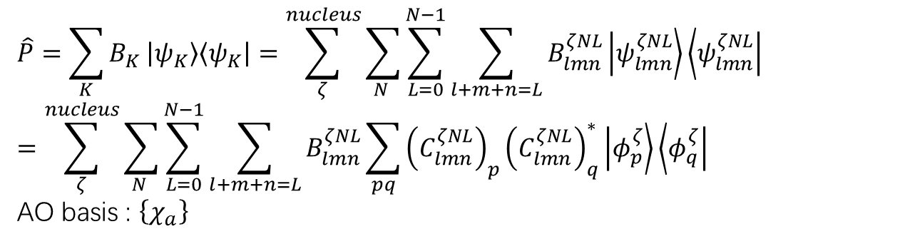
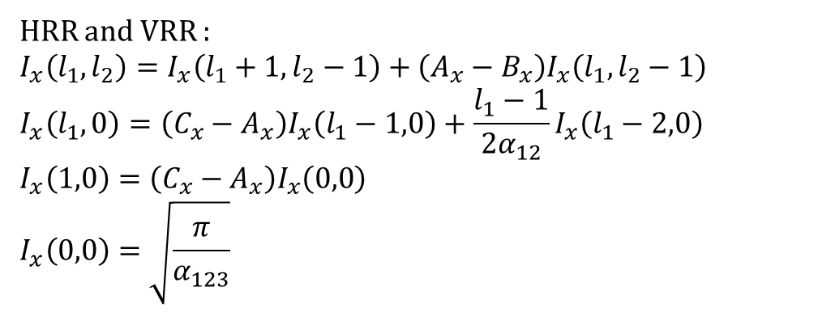
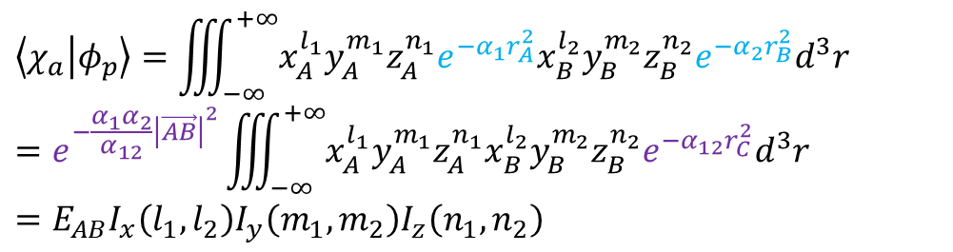
Projection operator:
$$\hat{P}=\sum_{K}{B_{K}}\left|ψ_{K}\right\rangle \left\langle ψ_{K}\right|=\sum_{ζ}^{nucleus}{\sum_{N }{\sum_{L=0}^{N−1}{\sum_{l+m+n=L}{B_{lmn}^{ζNL}\left|ψ_{lmn}^{ζNL}\right\rangle \left\langle ψ_{lmn}^{ζNL}\right|}}}}$$
$$=\sum_{ζ}^{nucleus}{\sum_{N }{\sum_{L=0}^{N−1}{\sum_{l+m+n=L}{B_{lmn}^{ζNL}\sum_{pq}{{\left(C_{lmn}^{ζNL}\right)}_{p}{\left(C_{lmn}^{ζNL}\right)}_{q}^{∗}\left|φ_{p}^{ζ}\right\rangle \left\langle φ_{q}^{ζ}\right|}}}}}$$
AO basis : $\left\{χ_{a}\right\}$
$$\left\langle χ_{a} | φ_{p}\right\rangle =\iiint_{−∞}^{+∞}{x_{A}^{l_{1}}y_{A}^{m_{1}}z_{A}^{n_{1}}e^{−α_{1}r_{A}^{2}}x_{B}^{l_{2}}y_{B}^{m_{2}}z_{B}^{n_{2}}e^{−α_{2}r_{B}^{2}}d^{3}r}$$
$$=e^{−\frac{α_{1}α_{2}}{α_{12}}{\left|\vec{AB}\right|}^{2}}\iiint_{−∞}^{+∞}{x_{A}^{l_{1}}y_{A}^{m_{1}}z_{A}^{n_{1}}x_{B}^{l_{2}}y_{B}^{m_{2}}z_{B}^{n_{2}}e^{−α_{12}r_{C}^{2}}d^{3}r}$$
$$=E_{AB}I_{x}\left(l_{1},l_{2}\right)I_{y}\left(m_{1},m_{2}\right)I_{z}\left(n_{1},n_{2}\right)$$
$$GPT:\vec{C}=\frac{α_{1}\vec{A}+α_{2}\vec{B}}{α_{12}}$$
HRR and VRR :
$$I_{x}\left(l_{1},l_{2}\right)=I_{x}\left(l_{1}+1,l_{2}−1\right)+\left(A_{x}−B_{x}\right)I_{x}\left(l_{1},l_{2}−1\right)$$
$$I_{x}\left(l_{1},0\right)=\left(C_{x}−A_{x}\right)I_{x}\left(l_{1}−1,0\right)+\frac{l_{1}−1}{2α_{12}}I_{x}\left(l_{1}−2,0\right)$$
$$I_{x}\left(1,0\right)=\left(C_{x}−A_{x}\right)I_{x}\left(0,0\right)$$
$$I_{x}\left(0,0\right)=\sqrt{\frac{π}{α_{123}}}$$

Slide 6
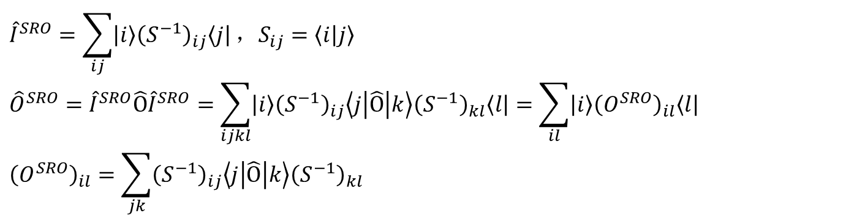
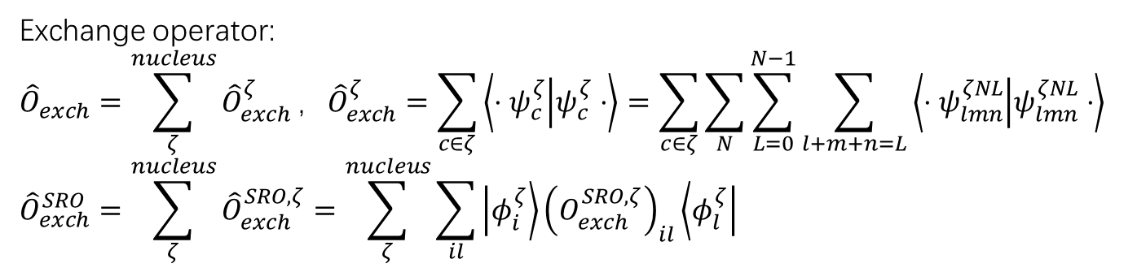
SRO : spectral representation operator
$${\hat{I}}^{SRO}=\sum_{ij}{\left|i\right\rangle {\left(S^{−1}\right)}_{ij}\left\langle j\right|}，S_{ij}=\left\langle i | j\right\rangle$$
$${\hat{O}}^{SRO}={\hat{I}}^{SRO}\hat{O}{\hat{I}}^{SRO}=\sum_{ijkl}{\left|i\right\rangle {\left(S^{−1}\right)}_{ij}\left\langle j | \hat{Ο} | k\right\rangle {\left(S^{−1}\right)}_{kl}\left\langle l\right|}=\sum_{il}{\left|i\right\rangle {\left(O^{SRO}\right)}_{il}\left\langle l\right|}$$
$${\left(O^{SRO}\right)}_{il}=\sum_{jk}{{\left(S^{−1}\right)}_{ij}\left\langle j | \hat{Ο} | k\right\rangle {\left(S^{−1}\right)}_{kl}}$$
Exchange operator:
$${\hat{O}}_{exch}=\sum_{ζ}^{nucleus}{{\hat{O}}_{exch}^{ζ}}，{\hat{O}}_{exch}^{ζ}=\sum_{c∈ζ}{\left\langle ⋅ψ_{c}^{ζ} | ψ_{c}^{ζ}⋅\right\rangle }=\sum_{c∈ζ}{\sum_{N}{\sum_{L=0}^{N−1}{\sum_{l+m+n=L}{\left\langle ⋅ψ_{lmn}^{ζNL} | ψ_{lmn}^{ζNL}⋅\right\rangle }}}}$$
$${\hat{O}}_{exch}^{SRO}=\sum_{ζ}^{nucleus}{{\hat{O}}_{exch}^{SRO,ζ}}=\sum_{ζ}^{nucleus}{\sum_{il}{\left|φ_{i}^{ζ}\right\rangle {\left(O_{exch}^{SRO,ζ}\right)}_{il}\left\langle φ_{l}^{ζ}\right|}}$$

Slide 7
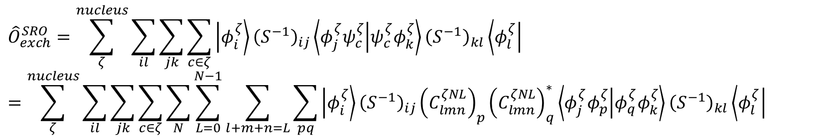
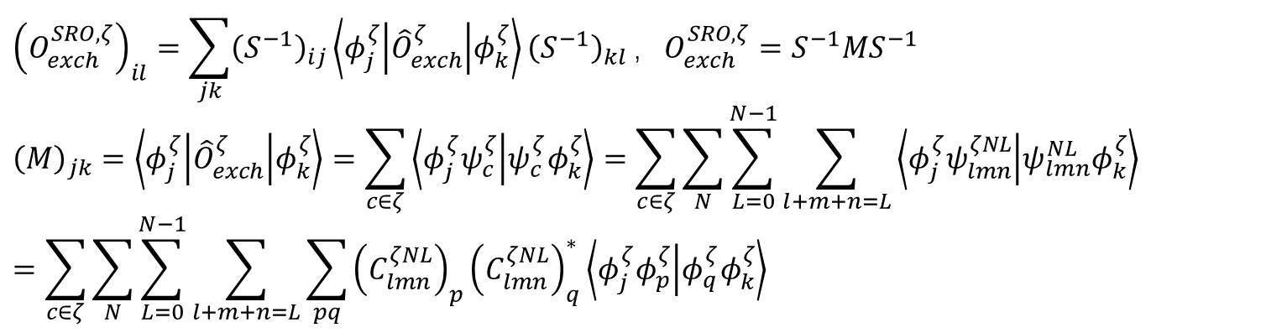
$${\left(O_{exch}^{SRO,ζ}\right)}_{il}=\sum_{jk}{{\left(S^{−1}\right)}_{ij}\left\langle φ_{j}^{ζ} | {\hat{O}}_{exch}^{ζ} | φ_{k}^{ζ}\right\rangle {\left(S^{−1}\right)}_{kl}}，O_{exch}^{SRO,ζ}=S^{−1}MS^{−1}$$
$${\left(M\right)}_{jk}=\left\langle φ_{j}^{ζ} | {\hat{O}}_{exch}^{ζ} | φ_{k}^{ζ}\right\rangle =\sum_{c∈ζ}{\left\langle φ_{j}^{ζ}ψ_{c}^{ζ} | ψ_{c}^{ζ}φ_{k}^{ζ}\right\rangle }=\sum_{c∈ζ}{\sum_{N}{\sum_{L=0}^{N−1}{\sum_{l+m+n=L}{\left\langle φ_{j}^{ζ}ψ_{lmn}^{ζNL} | ψ_{lmn}^{NL}φ_{k}^{ζ}\right\rangle }}}}$$
$$=\sum_{c∈ζ}{\sum_{N}{\sum_{L=0}^{N−1}{\sum_{l+m+n=L}{\sum_{pq}{{\left(C_{lmn}^{ζNL}\right)}_{p}{\left(C_{lmn}^{ζNL}\right)}_{q}^{∗}\left\langle φ_{j}^{ζ}φ_{p}^{ζ} | φ_{q}^{ζ}φ_{k}^{ζ}\right\rangle }}}}}$$
$${\hat{O}}_{exch}^{SRO}=\sum_{ζ}^{nucleus}{\sum_{il}{\sum_{jk}{\sum_{c∈ζ}{\left|φ_{i}^{ζ}\right\rangle {\left(S^{−1}\right)}_{ij}\left\langle φ_{j}^{ζ}ψ_{c}^{ζ} | ψ_{c}^{ζ}φ_{k}^{ζ}\right\rangle {\left(S^{−1}\right)}_{kl}\left\langle φ_{l}^{ζ}\right|}}}}$$
$$=\sum_{ζ}^{nucleus}{\sum_{il}{\sum_{jk}{\sum_{c∈ζ}{\sum_{N}{\sum_{L=0}^{N−1}{\sum_{l+m+n=L}{\sum_{pq}{\left|φ_{i}^{ζ}\right\rangle {\left(S^{−1}\right)}_{ij}{\left(C_{lmn}^{ζNL}\right)}_{p}{\left(C_{lmn}^{ζNL}\right)}_{q}^{∗}\left\langle φ_{j}^{ζ}φ_{p}^{ζ} | φ_{q}^{ζ}φ_{k}^{ζ}\right\rangle {\left(S^{−1}\right)}_{kl}\left\langle φ_{l}^{ζ}\right|}}}}}}}}$$

Slide 8
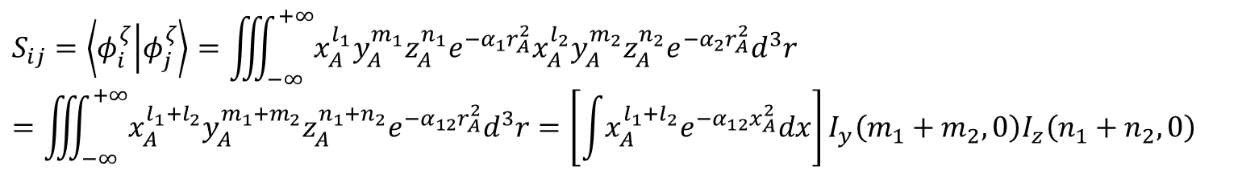
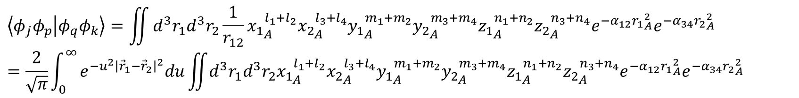
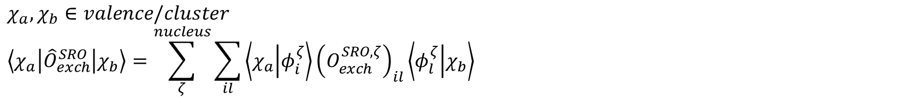
$$χ_{a},χ_{b}∈valence/cluster$$
$$\left\langle χ_{a} | {\hat{O}}_{exch}^{SRO} | χ_{b}\right\rangle =\sum_{ζ}^{nucleus}{\sum_{il}{\left\langle χ_{a} | φ_{i}^{ζ}\right\rangle {\left(O_{exch}^{SRO,ζ}\right)}_{il}\left\langle φ_{l}^{ζ} | χ_{b}\right\rangle }}$$
$$S_{ij}=\left\langle φ_{i}^{ζ} | φ_{j}^{ζ}\right\rangle =\iiint_{−∞}^{+∞}{x_{A}^{l_{1}}y_{A}^{m_{1}}z_{A}^{n_{1}}e^{−α_{1}r_{A}^{2}}x_{A}^{l_{2}}y_{A}^{m_{2}}z_{A}^{n_{2}}e^{−α_{2}r_{A}^{2}}d^{3}r}$$
$$=\iiint_{−∞}^{+∞}{x_{A}^{l_{1}+l_{2}}y_{A}^{m_{1}+m_{2}}z_{A}^{n_{1}+n_{2}}e^{−α_{12}r_{A}^{2}}d^{3}r}=\left[\int{x_{A}^{l_{1}+l_{2}}e^{−α_{12}x_{A}^{2}}dx}\right]I_{y}\left(m_{1}+m_{2},0\right)I_{z}\left(n_{1}+n_{2},0\right)$$
$$\left\langle φ_{j}φ_{p} | φ_{q}φ_{k}\right\rangle =\iint{d^{3}r_{1}d^{3}r_{2}\frac{1}{r_{12}}{x_{1}}_{A}^{l_{1}+l_{2}}{x_{2}}_{A}^{l_{3}+l_{4}}{y_{1}}_{A}^{m_{1}+m_{2}}{y_{2}}_{A}^{m_{3}+m_{4}}{z_{1}}_{A}^{n_{1}+n_{2}}{z_{2}}_{A}^{n_{3}+n_{4}}e^{−α_{12}{r_{1}}_{A}^{2}}e^{−α_{34}{r_{2}}_{A}^{2}}}$$
$$=\frac{2}{\sqrt{π}}\int_{0}^{∞}{e^{−u^{2}{\left|{\vec{r}}_{1}−{\vec{r}}_{2}\right|}^{2}}du\iint{d^{3}r_{1}d^{3}r_{2}{x_{1}}_{A}^{l_{1}+l_{2}}{x_{2}}_{A}^{l_{3}+l_{4}}{y_{1}}_{A}^{m_{1}+m_{2}}{y_{2}}_{A}^{m_{3}+m_{4}}{z_{1}}_{A}^{n_{1}+n_{2}}{z_{2}}_{A}^{n_{3}+n_{4}}e^{−α_{12}{r_{1}}_{A}^{2}}e^{−α_{34}{r_{2}}_{A}^{2}}}}$$
$$=\frac{2}{\sqrt{π}}\int_{0}^{∞}{du\left[\iint{dx_{1}dx_{2}{x_{1}}_{A}^{l_{1}+l_{2}}{x_{2}}_{A}^{l_{3}+l_{4}}e^{−α_{12}{x_{1}}_{A}^{2}}e^{−α_{34}{x_{2}}_{A}^{2}}e^{−u^{2}{\left(x_{1}−x_{2}\right)}^{2}}}\right]I_{y}\left(m_{1}+m_{2},0,m_{3}+m_{4},0,u\right)I_{z}\left(n_{1}+n_{2},0,n_{3}+n_{4},0,u\right)}$$

Slide 9
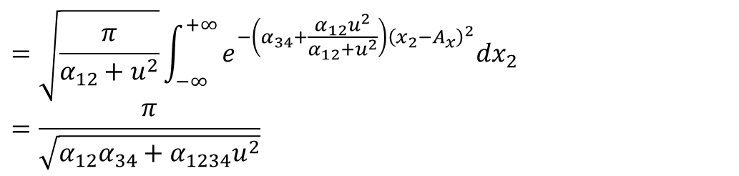
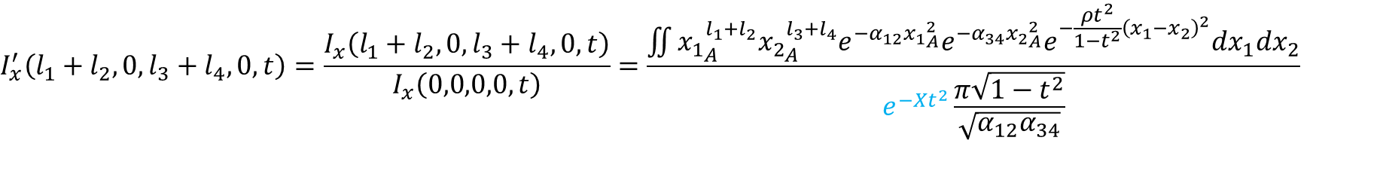
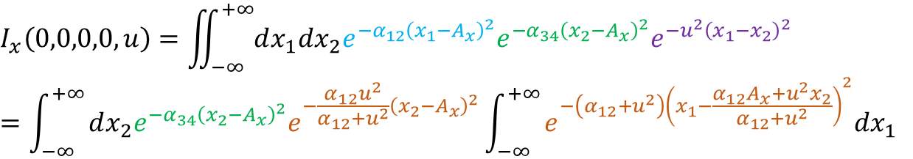

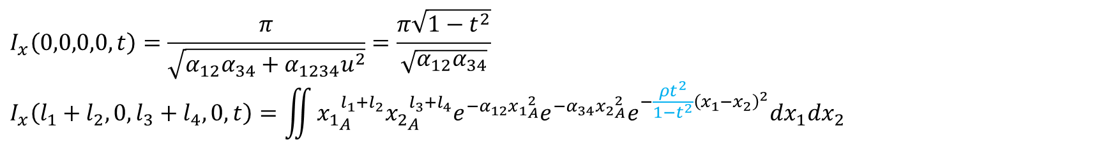
$$I_{x}\left(0,0,0,0,u\right)=\iint_{−∞}^{+∞}{dx_{1}dx_{2}e^{−α_{12}{\left(x_{1}−A_{x}\right)}^{2}}e^{−α_{34}{\left(x_{2}−A_{x}\right)}^{2}}e^{−u^{2}{\left(x_{1}−x_{2}\right)}^{2}}}$$
$$=\int_{−∞}^{+∞}{dx_{2}e^{−α_{34}{\left(x_{2}−A_{x}\right)}^{2}}e^{−\frac{α_{12}u^{2}}{α_{12}+u^{2}}{\left(x_{2}−A_{x}\right)}^{2}}\int_{−∞}^{+∞}{e^{−\left(α_{12}+u^{2}\right){\left(x_{1}−\frac{α_{12}A_{x}+u^{2}x_{2}}{α_{12}+u^{2}}\right)}^{2}}dx_{1}}}$$
$$=\sqrt{\frac{π}{α_{12}+u^{2}}}\int_{−∞}^{+∞}{e^{−\left(α_{34}+\frac{α_{12}u^{2}}{α_{12}+u^{2}}\right){\left(x_{2}−A_{x}\right)}^{2}}dx_{2}}$$
$$=\frac{π}{\sqrt{α_{12}α_{34}+α_{1234}u^{2}}}$$
$$ρ=\frac{α_{12}α_{34}}{α_{1234}}，t^{2}=\frac{u^{2}}{u^{2}+ρ}，u^{2}=\frac{ρt^{2}}{1−t^{2}}，du=\frac{\sqrt{ρ}}{{\left(1−t^{2}\right)}^{3/2}}dt$$
$$I_{x}\left(0,0,0,0,t\right)=\frac{π}{\sqrt{α_{12}α_{34}+α_{1234}u^{2}}}=\frac{π\sqrt{1−t^{2}}}{\sqrt{α_{12}α_{34}}}$$
$$I_{x}\left(l_{1}+l_{2},0,l_{3}+l_{4},0,t\right)=\iint{{x_{1}}_{A}^{l_{1}+l_{2}}{x_{2}}_{A}^{l_{3}+l_{4}}e^{−α_{12}{x_{1}}_{A}^{2}}e^{−α_{34}{x_{2}}_{A}^{2}}e^{−\frac{ρt^{2}}{1−t^{2}}{\left(x_{1}−x_{2}\right)}^{2}}dx_{1}dx_{2}}$$
$$I_{x}^{′}\left(l_{1}+l_{2},0,l_{3}+l_{4},0,t\right)=\frac{I_{x}\left(l_{1}+l_{2},0,l_{3}+l_{4},0,t\right)}{I_{x}\left(0,0,0,0,t\right)}=\frac{\iint{{x_{1}}_{A}^{l_{1}+l_{2}}{x_{2}}_{A}^{l_{3}+l_{4}}e^{−α_{12}{x_{1}}_{A}^{2}}e^{−α_{34}{x_{2}}_{A}^{2}}e^{−\frac{ρt^{2}}{1−t^{2}}{\left(x_{1}−x_{2}\right)}^{2}}dx_{1}dx_{2}}}{e^{−Xt^{2}}\frac{π\sqrt{1−t^{2}}}{\sqrt{α_{12}α_{34}}}}$$
$$X=0,e^{−Xt^{2}}=1$$

Slide 10
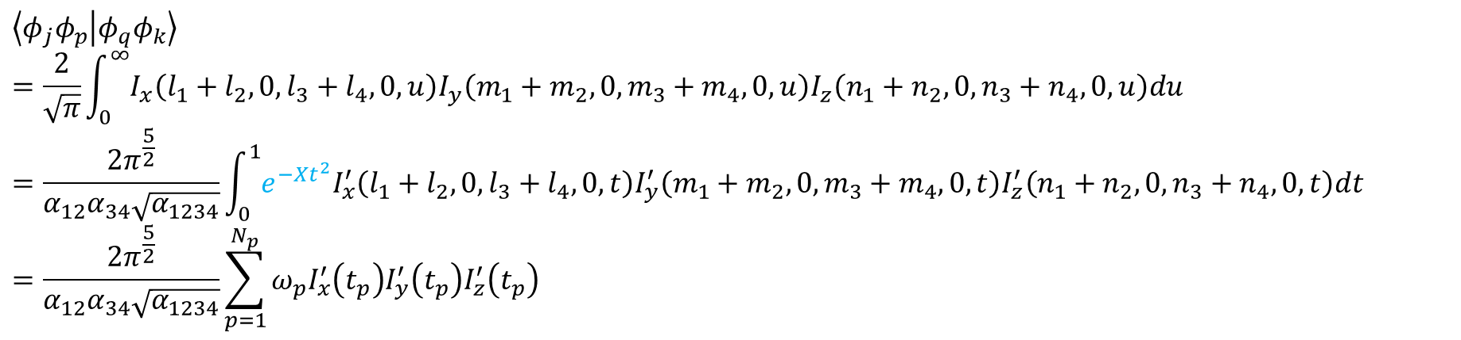
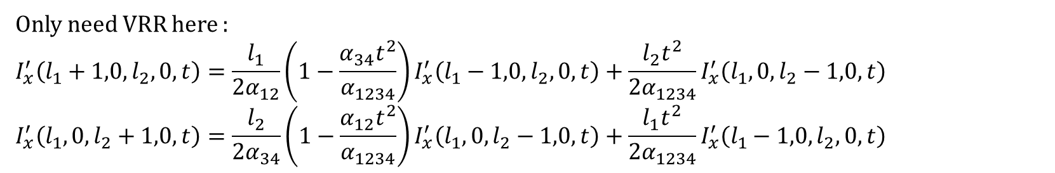

$$\left\langle φ_{j}φ_{p} | φ_{q}φ_{k}\right\rangle$$
$$=\frac{2}{\sqrt{π}}\int_{0}^{∞}{I_{x}\left(l_{1}+l_{2},0,l_{3}+l_{4},0,u\right)I_{y}\left(m_{1}+m_{2},0,m_{3}+m_{4},0,u\right)I_{z}\left(n_{1}+n_{2},0,n_{3}+n_{4},0,u\right)du}$$
$$=\frac{2π^{\frac{5}{2}}}{α_{12}α_{34}\sqrt{α_{1234}}}\int_{0}^{1}{e^{−Xt^{2}}I_{x}^{′}\left(l_{1}+l_{2},0,l_{3}+l_{4},0,t\right)I_{y}^{′}\left(m_{1}+m_{2},0,m_{3}+m_{4},0,t\right)I_{z}^{′}\left(n_{1}+n_{2},0,n_{3}+n_{4},0,t\right)dt}$$
$$=\frac{2π^{\frac{5}{2}}}{α_{12}α_{34}\sqrt{α_{1234}}}\sum_{p=1}^{N_{p}}{ω_{p}I_{x}^{′}\left(t_{p}\right)I_{y}^{′}\left(t_{p}\right)I_{z}^{′}\left(t_{p}\right)}$$
$$X=0,e^{−Xt^{2}}=1$$
Only need VRR here :
$$I_{x}^{′}\left(l_{1}+1,0,l_{2},0,t\right)=\frac{l_{1}}{2α_{12}}\left(1−\frac{α_{34}t^{2}}{α_{1234}}\right)I_{x}^{′}\left(l_{1}−1,0,l_{2},0,t\right)+\frac{l_{2}t^{2}}{2α_{1234}}I_{x}^{′}\left(l_{1},0,l_{2}−1,0,t\right)$$
$$I_{x}^{′}\left(l_{1},0,l_{2}+1,0,t\right)=\frac{l_{2}}{2α_{34}}\left(1−\frac{α_{12}t^{2}}{α_{1234}}\right)I_{x}^{′}\left(l_{1},0,l_{2}−1,0,t\right)+\frac{l_{1}t^{2}}{2α_{1234}}I_{x}^{′}\left(l_{1}−1,0,l_{2},0,t\right)$$

