Slide 1
Self awareness, self motivation, self respect and self learning - The development and factors motivating self esteem - Building self confidence- Etiquette - Common Social and professional etiquettes - Cell phone and email etiquette - Social media etiquette- The basicS of effective goals – steps to be followed to obtain optimum results from goal setting –Identifying the reasons and overcoming procrastination – priority management at home and college.
Unit 1: Self Esteem, Etiquettes and Goal Setting
Total - 6 hrs
- 2 hours
- 3 hours
- 1 hour

Slide 2
First hour

Slide 3
ETIQUETTE

Slide 4
It is the way they carry themselves in the society. Here comes the importance of manners and etiquette.
It is essential for an individual to behave in a responsible manner acceptable to the society. People around us must not feel embarrassed by our behaviour. One should not behave irrationally or illogically in public.

Slide 5
What is Etiquette ?
Etiquette in simpler words is defined as good behaviour which distinguishes human beings from animals.
Human Being is a social animal and it is really important for him to behave in an appropriate way. Etiquette refers to behaving in a socially responsible way.

Slide 6
Need for Etiquette
Etiquette makes you a cultured individual who leaves his mark wherever he goes.
Etiquette teaches you the way to talk, walk and most importantly behave in the society.
Etiquette is essential for an everlasting first impression. The way you interact with your superiors, parents, fellow workers, friends speak a lot about your personality and up- bringing.

Slide 7
Etiquette enables the individuals to earn respect and appreciation in the society. No one would feel like talking to a person who does not know how to speak or behave in the society.
Etiquette inculcates a feeling of trust and loyalty in the individuals. One becomes more responsible and mature. Etiquette helps individuals to value relationships.

Slide 8
Types of Common and professional Etiquette
Social Etiquette- Social etiquette is important for an individual as it teaches him how to behave in the society.
Bathroom Etiquette- Bathroom etiquette refers to the set of rules which an individual needs to follow while using public restrooms or office toilets. Make sure you leave the restroom clean and tidy for the other person.
Corporate Etiquette- Corporate Etiquette refers to how an individual should behave while he is at work. Each one needs to maintain the decorum of the organization. Don’t loiter around unnecessary or peep into other’s cubicles.

Slide 9
Eating Etiquette- Individuals must follow certain decorum while eating in public. Don’t make noise while eating. One should not leave the table unless and until everyone has finished eating.
Business Etiquette- Business Etiquette includes ways to conduct a certain business. Don’t ever cheat customers. It is simply unethical.
Mobile Etiquette
Netiquette
E-Mail Etiquette

Slide 10
EMAIL ETIQUETTE

Slide 11
Keep your tone professional
Avoid vague subject lines
Use proper email punctuation
Practice good grammar
Resist emojis in email
Keep subject lines descriptive and short
Choose your email salutation carefully
Leave the right impression with your email sign-off
Triple-check your recipient's name
Use sentence case
Always use standard fonts and formatting
Shorten your URLs
Call out attachments
Perfect your email signature
Fill out your email fields properly
Use Bcc appropriately
Use 'Reply all' sparingly
Think before forwarding
Respond in a timely manner
Don't add that 'Sent from my phone' caveat

Slide 12
To make sense
Plan your email before hand
Note down what you want to convey
Prepare yourself by writing a rough draft
Present in a readable manner…
Be clear, concise and Coherent….

Slide 13
Make sense
Avoid using worn out phrases that does not make any sense in the context
Idiomatic expressions, metaphors and similes, not used properly, may confuse the reader and lead to miscommunication.
Use simple words with short sentence constructions
Avoid flowery, poly-syllabic words, long complicated sentences.

Slide 14
Spend an extra minute to save an hour of the receiver
Editing the text
Check spelling
Inserting emoticons
Making use of punctuation marks,
Dividing lengthy matter into readable paragraphs,
Type descriptive subject line

Slide 15
Keep it short
Keep your email focused in content and short in length
People generally do not have time to read long mails
Some by default delete lengthy mails!

Slide 16
Pay attention to subject lines
Tell me the subject lines that you keep sending, I can tell you who you are!
Subject lines apart from describing the inner content of the matter, have much to tell about you as a person weather you are
Sloppy, casual, flippant, uncouth, lazy or sincere, serious, meticulous, dedicated, professional, sophisticated and stylish.

Slide 17
The worst subject line that an email can have is “[no subject]”.
Because the email is either sent in a hurry without subject line or the subject is just not thought of!
Indicates that the sender is unmindful of the precious time the receiver has to spend in opening, reading and understanding the subject and quite often realize that it is an irrelevant message that need to be deleted.

Slide 18
SECOND HOUR

Slide 19
Should not use tempting subject lines like:”free trip to Goa”;”open and become bill gates!”; “permanent cure for diabetes”, “no hair fall forever”.
Should not over emphasize the subject by capitalizing them or by creating a false sense of urgency.
“Urgent matter” , “respond immediately” – use wisely

Slide 20
What , when and where -descriptive phrase indicating the core idea of the e-mail.
If it a meeting mention time, date and venue
Do not use re:re:re:re:
No random CCing/Do not reply All
Use abbreviations which are universally recognizable. (ASAP, LOL, WRT)
Bad spelling and frequent typographical errors reflect illiteracy and lack of professionalism

Slide 21
Choose your email salutation carefully
Casual email greetings include:
Hi
Hey
Hey/hi there
Good [morning, afternoon]
[Name]
Formal email greetings include:
Dear [first name]
Dear Mr./Ms. [last name]

Slide 22
And which ones should you never use
Yo: Too informal
Hey!: Too intimate and eager
[Name]!: Too off-putting
To whom it may concern: Too impersonal
Dear sir or madam: Too stiff
Hi friend: Too creepy
Gentlemen: Too old-fashioned
All: Too cold

Slide 23
Leave the right impression with your email sign-off
The right sign-off will complement the tone and content of your email. Since it’s the last thing your recipient reads, this line influences their lasting impression.
Informal sign-offs:
Thanks
Thanks again
Best
Cheers
Happy [day of the week]
Enjoy the weekend
Talk soon
Talk to you [tomorrow, on Wednesday, when you get back]
Looking forward to working together
Looking forward to our next conversation
Excited to hear your thoughts
If your tone is more reserved, your sign-off should be as well.
Formal sign-offs:
Thank you
Thank you for your time
Have a wonderful [day, weekend]

Slide 24
Here are the closing lines you shouldn’t be using:
Sincerely: Too outdated
Regards: Too unfriendly
Kind regards: Too unnatural
Warmly: Too relaxed
Respectfully: Too random
Xoxo: Too intimate
Cordially: Too stilted
- [Your name]: Too abrupt

Slide 25
Assignment for Internals – 10 marks
You are former student of Mr. Matt, your professor. Write an email (with proper etiquette) with a minimum of 70 words and a maximum of 100 words using the following phrases to Mr. Matt thanking him for his guidance that contributed to your overall development. Sign the email as peter.
Outline: Successful - Placed - grateful - help - advice - grooming - values - shaping my future - sincere - professional
Submit next week before the class, late submission will get reduced marks.

Slide 26
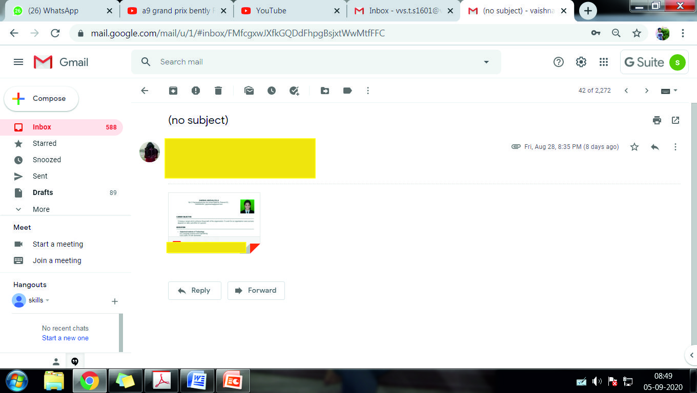

Slide 27
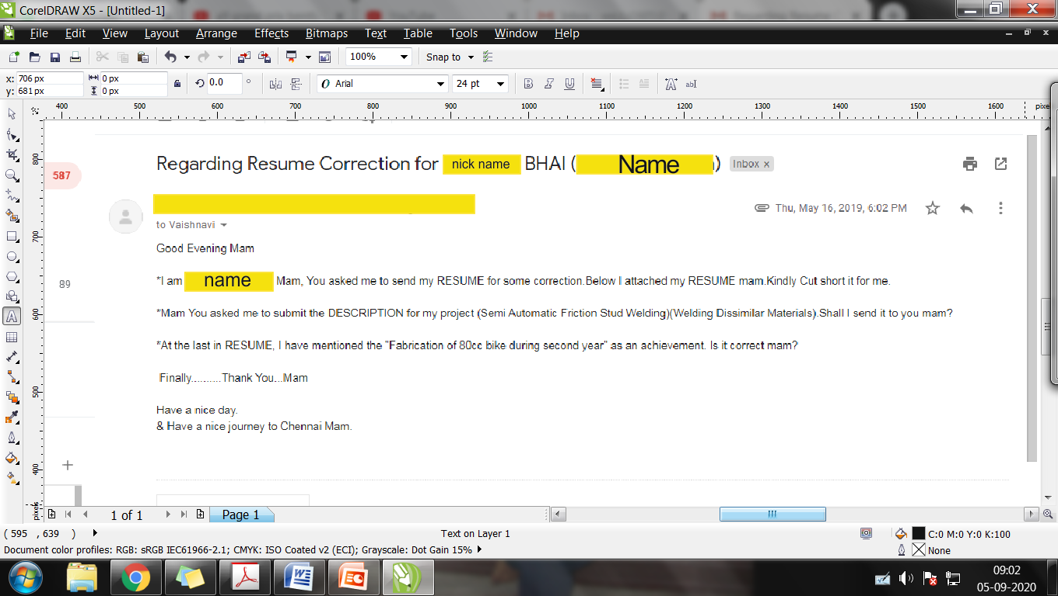

Slide 28
Hi mam this is xxxxxxx .from xxx 3rd year it department .As u told me to send my resume to you I had attached to this mail . please make correction and send me the same mam. mam i had not written about the project in detail .
THANK YOU
G.SHYAAM KANNA 3rd YEAR

Slide 29
Mam When is Byjus coming ?We got info that in December some marketing companies are coming!but some companies are keeping their eligibility as 7.5cgpa...so when is byjus kind of companies company!! Do I have to prepare anything for it!
- Regards

Slide 30
Why Netiquette?
People become insensitive while using computers
No formal training is given for using the internet and social media.
The 5Ps of soft skills are often ignored
Notes:
Planning, Preparedness, Persuasiveness, Presentability, Perseverance,

Slide 31
THIRD HOUR

Slide 32
SOCIAL MEDIA ETIQUETTE

Slide 33
SOCIAL MEDIA ETIQUETTE NORMS
The Receiver is human being fully alive and kicking!
Its all about showing emotions, indicating you are not a robot by using emoticons and apt language
Be careful in choosing right words since they can be stored permanently.
Receiver controls emails, comments, post etc. sent
Be correct ethically

Slide 34
Don't Mix Business and Pleasure. ...
Use Caution Posting and Tagging Photos. .
Be Self-Centered in Small Doses. ...
Don't Be Reactive. ...
Avoid Over-Sharing. ...
Build a Legacy for the Future. ...
Don't Misrepresent Yourself.

Slide 35
CELL PHONE ETIQUETTE
Avoid when face-to-face communication is possible;
be empathetic about others time;
use apt caller/ringtone,
use silent mode/switch off;
Check the availability of the receiver to continue your call
Don’t not call back to back if the receiver disconnects the call.

Slide 36
When calling someone, be prepared. Identify yourself and the purpose of your call.
When leaving a voice mail message, include your name, phone number and briefly mention the purpose of your call. Speak clearly.
Answer voice mail messages promptly - within one business day.
When answering calls, identify yourself immediately.
Do not place callers on hold for more than a few seconds.
Keep your personal voice mail message current (ideally, identify yourself, your department name, the date and why you cannot be reached). When on holiday, identify an alternate number where someone can receive assistance.
Avoid personal calls during office hours.

Slide 37
The greatest polluting element in the earth’s environment is the proliferation of eletro magenetic fields. I consider that to be a far greater on a global scale than warming, or the increase of chemical elements in the environment”. –
Dr.Robert Becker, two-time nobel prize nominee

Slide 38
Etiquette Transforms A Man Into A Gentleman.

