Slide 1
A shortest-path graph kernel for estimating gene product semantic similarity Marco A Alvarez1, Xiaojun Qi1 and Changhui Yan2*

Slide 2
Research Problem:
Existing methods for calculating semantic similarity between gene products using the Gene Ontology (GO) often rely on external resources, which are not part of the ontology.
Consequently, changes in these external resources will affect the calculation of semantic similarity.

Slide 3
Background
Gene Ontology (GO): The framework for the model of biology. The GO defines concepts/classes used to describe gene function, and relationships between these concepts. It classifies functions along three aspects: MF BP CC.
GOA (Gene Ontology Annotation): Annotations are statements describing the functions of specific genes, using concepts in the Gene Ontology

Slide 4
Previous Method For GO Term Similarities
Information Content(IC) of the nearest common ancestor(NCA) or most informative common ancestor(MICA).
Problem: The IC is calculated based on external resources like GOA databases. External resource change as knowledge is updated. However, semantic similarities between GO terms should not be affected by such changes.
Distance Measure Method
Problem: The edges in the GO do not imply equal length in semantics.

Slide 5
Shortest-Path Graph Kernel(spgk)
Each gene product is represented as a graph, which is an induced subgraph of the GO. Then a graph kernel method is used to calculate the semantic similarity between the graphs.
Spgk is intrinsic to the GO, it does not rely on external resources to calculate the semantic similarity

Slide 6
Graph Representation of Proteins
represented a protein using a subgraph of the ontology that consisted of all the GO terms annotating the protein and their ancestors in the ontology. Each edge of the graph corresponds to a relationship between two terms in the ontology.
There are three types of relations in the GO: is-a, part-of, and regulates. Since the GO includes three different ontologies, the resulting graph will be different when a different ontology is used.

Slide 7
Shortest-path graph kernel
Shortest-path graph: Given a graph G = (V, E), its shortest-path graph is Gsp = (V, E’), where E’ = {e’1,...,e’l} such that e’i = (u, v), where u Î V, v Î V, and path(u, v)≠0. That is, Gsp has the same vertices as G and the edge (u, v) in Gsp has the same length as the shortest distance between u and v in G.
Floyed-Warshall algorithm to construct shortest path graph O(n^3) time.

Slide 8

Calculate Similarity
By comparing every pair of edges in their shortest-path graphs. For example, Let G1 = (V1, E1) and G2 = (V2, E2) be two graphs and G1sp = (V1, E’1) and G2sp = (V2, E’2) be their shortest-path graphs respectively. The similarity between G1 and G2 can be
calculated using Eq. 1.
where kwalk is a positive definite kernel for comparing two walks. In this case, a walk includes an edge and its two end nodes. Let e1 be the edge connecting nodes v1 and w1, and e2 be the edge connecting nodes v2 and w2, then kwalk(e1, e2) is defined by Eq. 2.
kwalk(e1, e2) = knode(v1, v2) ∗ kedge(e1,e2) ∗ knode(w1,w2)

Slide 9
where knode is a kernel function for comparing two nodes, which returns 1 when the two nodes are identical and 0 otherwise, and kedge is a kernel function for comparing two edges. kedge is a Brownian bridge kernel that returns the largest value when two edges have identical length, and 0 when the edges differ in length more than a constant c as shown in Eq. 3. In this study, they use c = 2 as suggested.
kedge (e, f ) = max(0, c − |length(e) − length(f )|) (3)

Slide 10
Evaluation Approach
Previous study shows that having more annotations per protein in the dataset leads to more reliable functional similarity estimation from the GO.
Thus, for the purpose of evaluation, selected a set of 100 proteins from GOA, such that they were the top 100 proteins with the highest numbers of annotations.

Slide 11
Evaluation Approach
First, the graph kernel was used to calculate pairwise semantic similarities for a set of proteins.
Second, pairwise functional similarities between the proteins were calculated based on the Pfam database annotations.
Last, the Pearson’s Correlation Coefficient between the semantic and functional similarities was calculated.

Slide 12
Evaluation Approach
If two proteins have similar function, then a good semantic similarity method should detect high semantic similarity between them. Thus, higher values of Pearson’s Correlation Coefficient indicate better performance in the calculation of the semantic similarity.
This procedure was repeated for each of the three ontologies in the GO, namely, BP, MF, and CC.

Slide 13
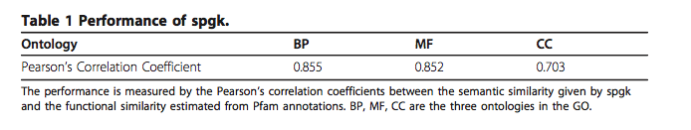
Performance of spgk
First, spgk produces semantic similarities that are highly correlated with functional similarities for all three ontologies.
Second, when the CC ontology is used, the correlation coefficients are lower than when the MF and BP ontologies are used. This is because the MF and BP ontologies are directly related to functions while the CC ontology is related to cellular components and locations.

Slide 14
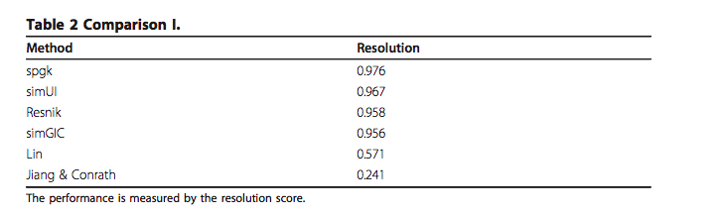
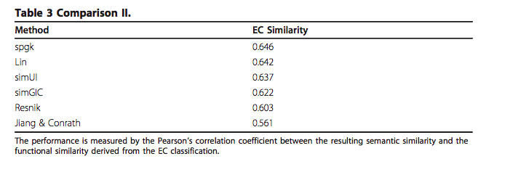
Comparison of spgk with state-of-the-art methods
For the purpose of comparisons, CESSM provides a standard dataset and implements 11 states-of-the-art semantic similarity methods, namely simGIC and simUI, and three versions(the average, the maximum and best-match average)

Slide 15
Conclusion:
The spgk method achieves the best results in tables 2 and 3, and is the second best in table 4.
In addition to the better performance, the key advantage of spgk is that it is intrinsic to the ontology, i.e., it does not rely on external resources in the calculation of the semantic similarity.
In contrast, all the other methods (except simUI) shown in tables 2, 3 and 4, rely on external resources, i.e., the annotations in GOA

Slide 16
Future Development
Each node in the GO is associated with a text definition, which contains rich information that is useful for deriving biological relationship between nodes.
Thus, one direction for future improvement is to take into account the semantics of the text definition when comparing nodes.
Furthermore, the k(edge) function only considers the length difference between two paths. In GO, the edges are associated with different types of relationship. Since different types of relationship have different biological meanings, they should be given different weights.
Thus, another direction for improvement is to systematically explore weighting methods that assign different weights to the edges based on the biological relationships.

Slide 17
Thank you!

