Slide 1


Evaluation of the security of smartwatch communication
Security of Systems & Networks
James Gratchoff, Harm Dermois, Florian Ecard

Slide 2
Evaluation of the security of smartwatch communication
Research question
- How secure is the communication ?
- Is it possible to eavesdrop any data?
- Is it possible to change the content of the data?
- How the vulnerabilities found (if any) could be addressed?

Slide 3
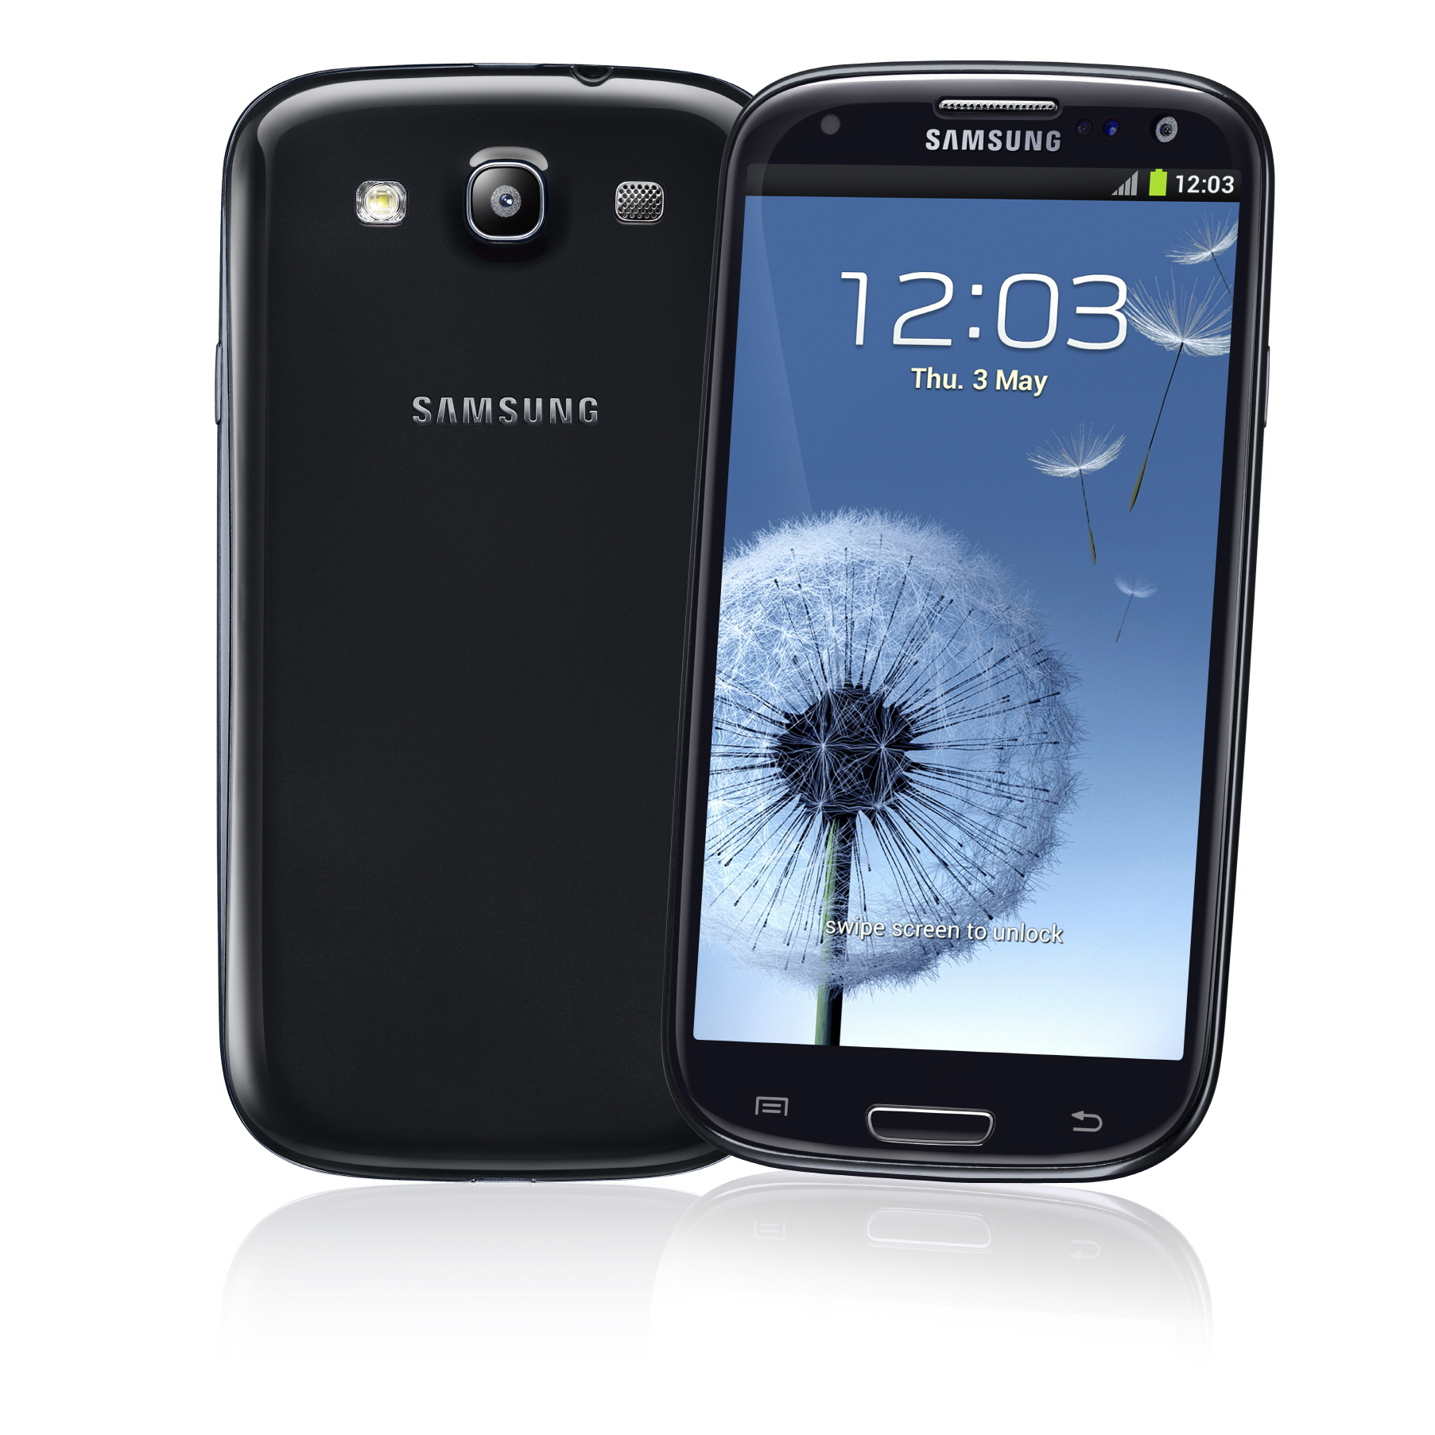
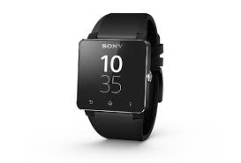
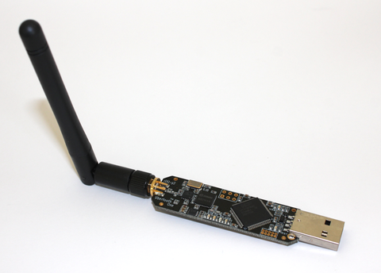
Devices used during the investigation

Slide 4
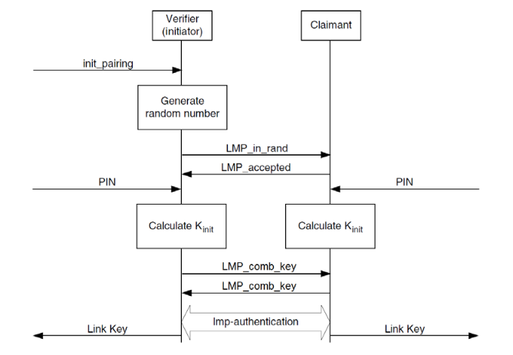
Bluetooth security and pairing process
LMP & its limitations

Slide 5
Bluetooth security and pairing process
SSP & MiTM protection
Uses Elliptic curve & DH
Four association models:
- Numeric comparison
- OOB
- PassKey
- JustWorks

Slide 6
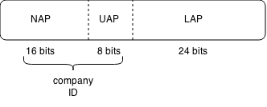
Ubertooth
Kickstarter
Passive/promiscuous
Following devices
Decrypting packets

Slide 7
Smartwatch and apps
Bluetooth 3.0
Smart connect
Pre-installed apps
SDK

Slide 8
Android device
Android 4.2/4.4
BT snoop
Most apps do not work

Slide 9
Traffic analysis from the Ubertooth
Only discovery
Poll and Null
Link control

Slide 10
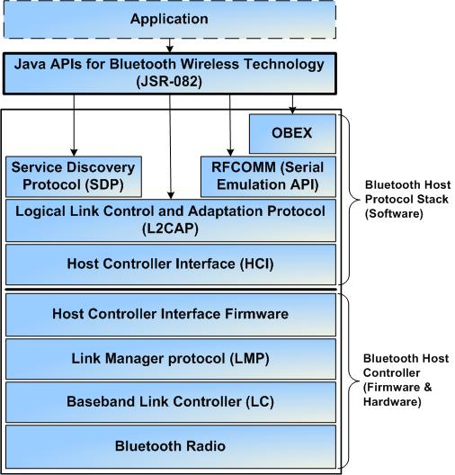
Bluetooth stack

Slide 11
Traffic analysis from the HCI
All the traffic is in clear text
Many parameters can be output from here
No correlation possible from what we saw at the RF level

Slide 12
Pairing process analysis
Input/Output capabilities
LMP parameters
Link Keys

Slide 13
What can you do in BT 3.0 HS and a smartwatch?
 | Ubertooth | Expensive sniffer
Eavesdropping | no | Yes
Packet decryption | no | Yes (if link keys are known)
MiTM | no | Possible
Is Bluetooth secure????

Slide 14
Evaluation of the security of smartwatch communication
Conclusion
Ubertooth useless for now on BT 3.0+HS
JustWork implementation
Communication secured

