Slide 1
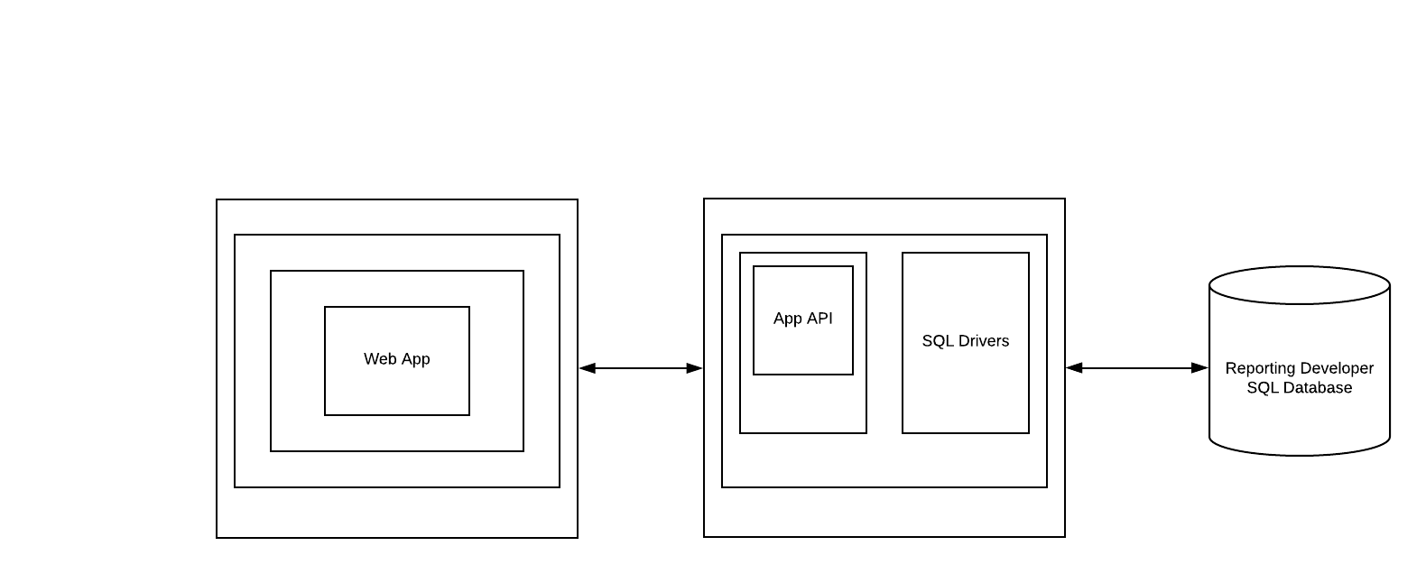
Express.JS
Bootstrap
Browser
Node.JS
Client Machine
Back-end Sever

