Slide 1
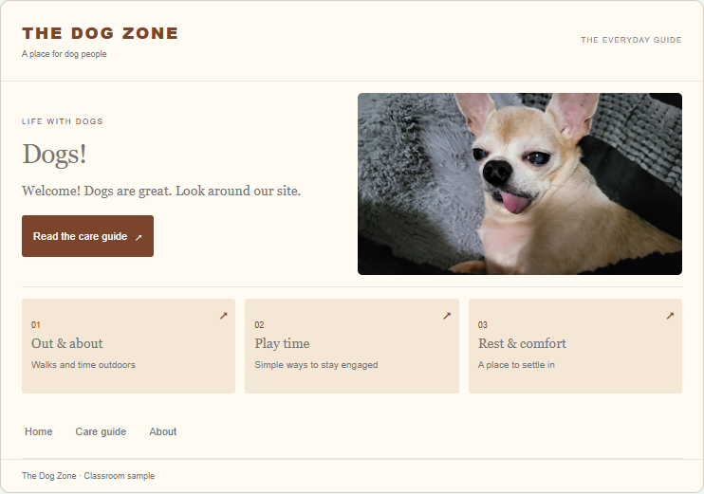
Do Now
CSSA review
Which design change helps a visitor most?
Notes:
0–9 min. Lab page 1. Students match CSSA features, adjust the sample site, and explain one change. 5 min work, 2 min partner explanation, 2 min share. Accept overlap if justified.
Source: user-supplied observation lesson plan and Cheesestick Labs design notes. Fictional classroom examples adapted from supplied rough lab.

Slide 2
Why Websites Exist
How Design Demonstrates Purpose
Notes:
Essential question: How does a website’s purpose influence its design? The lab now has a short Purpose overview on page 2. Fold it into the first guided cycle within the 15-minute block.
Source: user-supplied observation lesson plan and Cheesestick Labs design notes. Fictional classroom examples adapted from supplied rough lab.

Slide 3
Today’s goal
Identify a site’s primary purpose.
Use a specific CSSA choice to explain how its design supports that purpose.
Notes:
Success criteria: a defensible purpose, a specific numbered annotation, accurate CSSA category, and an explanation of the connection.
Source: user-supplied observation lesson plan and Cheesestick Labs design notes. Fictional classroom examples adapted from supplied rough lab.

Slide 4
CSSA review
Content: what it contains
Structure: how it is organized
Style: how it looks
Accessibility: how people can use it
Notes:
Discuss why navigation is structure and captions support accessibility. Style and accessibility can overlap, as with contrast.
Source: user-supplied observation lesson plan and Cheesestick Labs design notes. Fictional classroom examples adapted from supplied rough lab.

Slide 5
Purpose
What does the visitor come to do?
The purpose helps explain the design choices.
Notes:
Purpose is a goal. CSSA gives us the design features we can use as evidence. Three common purposes today, not an exhaustive classification.
Source: user-supplied observation lesson plan and Cheesestick Labs design notes. Fictional classroom examples adapted from supplied rough lab.

Slide 6
Three common purposes
Information: learn or find answers
Entertainment: enjoy an experience
Sales: buy a product or service
Notes:
Do not assign extra time beyond the 15-minute cycle. Fold this introduction into the first information cycle.
Source: user-supplied observation lesson plan and Cheesestick Labs design notes. Fictional classroom examples adapted from supplied rough lab.

Slide 7
Checkpoint
What number begins the title of Kubrick’s A Space Odyssey?
Notes:
Answer: 2001. Opens Information and prior pages. Introduce the movie-title theme verbally. Do not show all answers to students.
Source: user-supplied observation lesson plan and Cheesestick Labs design notes. Fictional classroom examples adapted from supplied rough lab.

Slide 8
Information
Purpose: learn or find answers
Examples: Wikipedia, weather websites, school information pages
Notes:
Guided cycle 1, minutes 9–14. About 2 min teaching including purpose intro, 2 min annotation and written check, 1 min share.
Source: user-supplied observation lesson plan and Cheesestick Labs design notes. Fictional classroom examples adapted from supplied rough lab.

Slide 9
Information design
Clear headings organize a topic.
Search helps visitors find an answer.
Articles explain ideas in detail.
Notes:
Point to World Atlas in the lab. Ask which feature makes the task easier and why. A photograph alone does not establish purpose.
Source: user-supplied observation lesson plan and Cheesestick Labs design notes. Fictional classroom examples adapted from supplied rough lab.

Slide 10
Evidence and explanation
A topic menu is Structure.
It helps visitors find the information they want.
Notes:
Worked example from World Atlas. Point to Topics, Maps, and Articles. The menu groups information by subject, so visitors can move toward a question they want answered. Then show Highlight in the lab and model a numbered comment that explains this connection.
Source: user-supplied observation lesson plan and Cheesestick Labs design notes. Fictional classroom examples adapted from supplied rough lab.

Slide 11
Information check
How does your highlighted feature help someone learn or find an answer?
Notes:
Students complete the quick definition check and one evidence explanation. Ask 1–2 students to name an annotation and explain the connection.
Source: user-supplied observation lesson plan and Cheesestick Labs design notes. Fictional classroom examples adapted from supplied rough lab.

Slide 12
Checkpoint
Which four-digit movie title follows two British soldiers during World War I?
Notes:
Answer: 1917. Opens Entertainment and prior pages.
Source: user-supplied observation lesson plan and Cheesestick Labs design notes. Fictional classroom examples adapted from supplied rough lab.

Slide 13
Entertainment
Purpose: enjoy an experience
Examples: video, music, and browser-game websites
Notes:
Guided cycle 2, minutes 14–19. Two minutes teach, two minutes work, one minute share.
Source: user-supplied observation lesson plan and Cheesestick Labs design notes. Fictional classroom examples adapted from supplied rough lab.

Slide 14
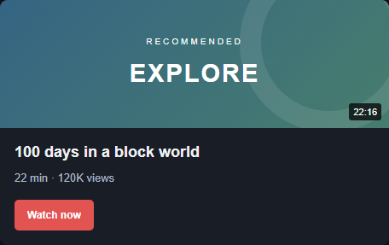
Entertainment design
A title and preview are Content.
They help visitors choose something to watch.
Notes:
Worked example from ClipStream. Ask what the preview and title help a visitor decide. Then explain how presenting another appealing video can encourage continued viewing. Model Connect between two features and explain their relationship. Captions support access to the experience.
Source: user-supplied observation lesson plan and Cheesestick Labs design notes. Fictional classroom examples adapted from supplied rough lab.

Slide 15
Entertainment check
Which feature encourages visitors to keep exploring?
How does it work?
Notes:
Students use Connect to link a video preview to another feature that encourages further viewing. Two clicks or a drag place the red string. Add a CSSA category and comment explaining the connection. Every annotation creates a draggable numbered pin linked to its comment card. Listen for reasoning beyond “it is entertaining.”
Source: user-supplied observation lesson plan and Cheesestick Labs design notes. Fictional classroom examples adapted from supplied rough lab.

Slide 16
Checkpoint
Which four-digit movie title comes from George Orwell’s story about Big Brother?
Notes:
Answer: 1984. Opens Sales and prior pages.
Source: user-supplied observation lesson plan and Cheesestick Labs design notes. Fictional classroom examples adapted from supplied rough lab.

Slide 17
Sales
Purpose: buy a product or service
Examples: online shops and ticket websites
Notes:
Guided cycle 3, minutes 19–24. Two minutes teach, two minutes work, one minute share.
Source: user-supplied observation lesson plan and Cheesestick Labs design notes. Fictional classroom examples adapted from supplied rough lab.

Slide 18
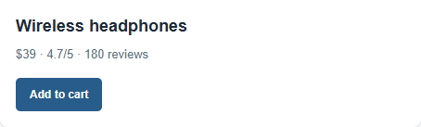
Sales design
Prices and reviews are Content.
They help visitors compare options before buying.
Notes:
Worked example from ShopSpace. The price and review count help a customer evaluate the product. The nearby purchase button supplies the next step. Model an Arrow pointing to the feature and connect the design choice to sales.
Source: user-supplied observation lesson plan and Cheesestick Labs design notes. Fictional classroom examples adapted from supplied rough lab.

Slide 19
Sales check
Which feature would help a customer decide to buy?
Why?
Notes:
Students use Arrow: click the tail, then the tip, or click and drag. A numbered pin and linked comment appear. Add a CSSA category and explain how the feature supports sales. Drag the pin to reposition the arrow tip. A secondary purpose introduction fits the final minute.
Source: user-supplied observation lesson plan and Cheesestick Labs design notes. Fictional classroom examples adapted from supplied rough lab.

Slide 20
More than one purpose
A video site may sell subscriptions.
A shop may publish a helpful guide.
Which goal does most of the design support?
Notes:
Primary purpose is the main goal supported by the strongest pattern of evidence. A secondary purpose needs evidence too.
Source: user-supplied observation lesson plan and Cheesestick Labs design notes. Fictional classroom examples adapted from supplied rough lab.

Slide 21
Primary and secondary
Primary: the main goal
Secondary: an additional goal
Both claims need design evidence.
Notes:
Weigh the whole site rather than counting one button. A site selling a subscription can still primarily provide entertainment.
Source: user-supplied observation lesson plan and Cheesestick Labs design notes. Fictional classroom examples adapted from supplied rough lab.

Slide 22
Questions?
Notes:
Brief clarification. Keep the guided block at 15 minutes total.
Source: user-supplied observation lesson plan and Cheesestick Labs design notes. Fictional classroom examples adapted from supplied rough lab.

Slide 23
Checkpoint
What number titles the movie about Jackie Robinson?
Notes:
Answer: 42. Opens Investigate and prior pages.
Source: user-supplied observation lesson plan and Cheesestick Labs design notes. Fictional classroom examples adapted from supplied rough lab.

Slide 24
Website investigation
What is your assigned site’s primary purpose?
Which design choices provide the strongest evidence?
Notes:
24–39 min. Lab page 6. Assign six sites by table. The current investigation sites remain fictional placeholders until real-site references are supplied. Table reasoning, individual annotations and written answers. Directions remain in lab.
Source: user-supplied observation lesson plan and Cheesestick Labs design notes. Fictional classroom examples adapted from supplied rough lab.

Slide 25
A strong explanation
“It is sales because it has products.”
Which feature? Which CSSA category?
How does it help someone buy?
Notes:
Let students improve the weak claim. Example: Annotation #4 shows a price and purchase button (Content/Structure), helping customers evaluate a product and buy it. Do not demand identical wording.
Source: user-supplied observation lesson plan and Cheesestick Labs design notes. Fictional classroom examples adapted from supplied rough lab.

Slide 26
Evidence you can defend
Annotation #4 shows the price and reviews.
These Content choices help visitors compare products and decide what to buy.
Notes:
A model of a specific explanation, not an answer to copy. Students discuss the primary purpose, annotate one example for each CSSA category on their own page, and answer questions 1–2. Then read the separate red box: independently add evidence for a possible secondary purpose and answer question 3.
Source: user-supplied observation lesson plan and Cheesestick Labs design notes. Fictional classroom examples adapted from supplied rough lab.

Slide 27
Checkpoint
What number titles the movie about the Spartans at Thermopylae?
Notes:
Answer: 300. Opens Discuss (page 7) and prior pages.
Source: user-supplied observation lesson plan and Cheesestick Labs design notes. Fictional classroom examples adapted from supplied rough lab.

Slide 28
Discussion
Which piece of evidence best supports your table’s claim?
Show the feature. Explain how it helps the site achieve its purpose.
Notes:
Page 7: Discuss. The 300 checkpoint opens this page. Tables share their strongest annotation. Everyone can open the matching clean site in the discussion gallery to follow along. Student annotations remain on their own investigation page.
Source: user-supplied observation lesson plan and Cheesestick Labs design notes. Fictional classroom examples adapted from supplied rough lab.

Slide 29
Checkpoint
Which mathematical constant names the thriller about a mathematician searching for patterns?
Notes:
Answer: pi. Accept π, 3.14, or 3,14. Opens Big Idea, Exit Ticket, and Submit together.
Source: user-supplied observation lesson plan and Cheesestick Labs design notes. Fictional classroom examples adapted from supplied rough lab.

Slide 30
The big idea
CSSA tells us what goes into designing a website.
Purpose tells us why designers make those choices.
Notes:
CSSA tells us what goes into designing a website. Purpose tells us why designers make those choices. Page 8 includes the central statement and one sales example for each CSSA category. There is no written transfer question on this page.
Source: user-supplied observation lesson plan and Cheesestick Labs design notes. Fictional classroom examples adapted from supplied rough lab.

Slide 31
Same feature, different goals
An article. A video. A product.
The search bar is similar.
The visitor’s goal is different.
Notes:
This context now appears on Exit Ticket page 9. Explain the broad idea without answering the independent Wikipedia/Amazon comparison for students.
Source: user-supplied observation lesson plan and Cheesestick Labs design notes. Fictional classroom examples adapted from supplied rough lab.

Slide 32
Accessibility and purpose
Captions help more people enjoy a video.
Image descriptions help more people understand an image.
Notes:
Accessibility supports the visitor’s task across all purposes. A site does not become accessible just by listing one feature.
Source: user-supplied observation lesson plan and Cheesestick Labs design notes. Fictional classroom examples adapted from supplied rough lab.

Slide 33
Exit Ticket
Wikipedia and Amazon both use search bars.
How does the same feature help each website achieve a different purpose?
Notes:
48–51 min. Independent response. Look for Wikipedia: information/find articles and knowledge. Amazon: sales/find and compare products to purchase. Full explanation connects the feature to both goals.
Source: user-supplied observation lesson plan and Cheesestick Labs design notes. Fictional classroom examples adapted from supplied rough lab.

Slide 34
Submit
Download your complete work.
Attach it where your teacher directs.
Keep your copy until receipt is confirmed.
Notes:
Local autosave preserves the browser draft. No backend is configured. Do not claim automatic or online submission. Download includes responses and numbered annotation comments. Remaining 9 min in a 60-minute period support transitions and delays.
Source: user-supplied observation lesson plan and Cheesestick Labs design notes. Fictional classroom examples adapted from supplied rough lab.

