Slide 1
THE LONG GAME
Live Room
A walkthrough for consultants — how each screen works,
and the thinking behind it.
A personal project · interactive investing game

Slide 2
HOW A SESSION FLOWS
Six moments, book-ended by setup and a shared reveal.
1
Join & allocate
Players scan in, pick a nickname, and choose how much of their money starts invested vs. in cash.
2
Six moments
For each: read a real (unnamed) crisis, decide Buy / Hold / Sell on the phone, then the host reveals what the market did.
3
Checks & a windfall
A live leaderboard after moments 2 and 4; a cash bonus lands at moment 3.
4
The finish
Everyone's result, side by side, against simply staying invested.
5
Explore
The same lesson replayed through past crises — 1973 to 2018.
THE LONG GAME · LIVE ROOM · HOW IT WORKS, AND WHY

Slide 3
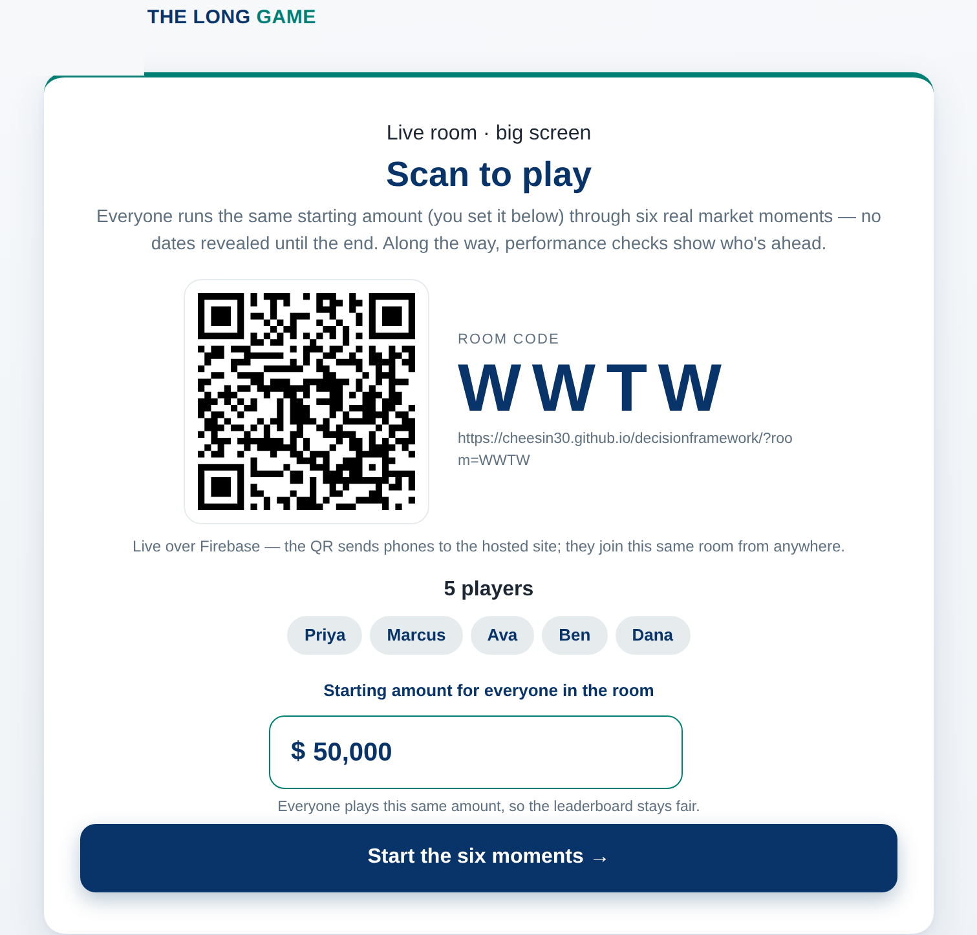
SETUP · THE BIG SCREEN
The host screen
WHAT HAPPENS
The host opens the game on the big screen. It creates a room, a QR code, and one starting amount for the whole room. Players scan to join and their names appear.
THE THINKING
One shared amount means the leaderboard reflects decisions, not who started with more. The QR points at the hosted site, so any phone — on any network — can join.
THE LONG GAME · LIVE ROOM · HOW IT WORKS, AND WHY

Slide 4
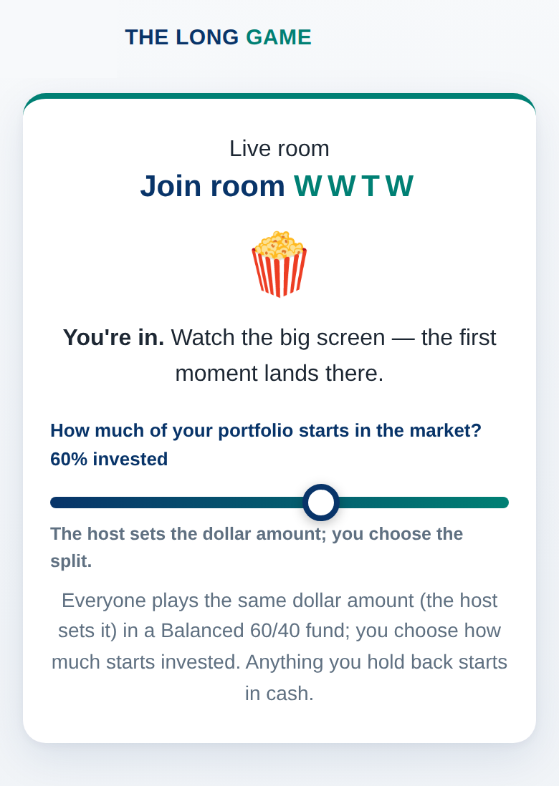
SETUP · EACH PHONE
The starting split
WHAT HAPPENS
After joining, each player sets how much of their money starts invested versus held in cash — their own choice, on their own phone.
THE THINKING
Cash feels safe, but the benchmark stays fully invested from day one, so holding back is measured as a real cost later. It makes allocation a live decision, not an assumption.
THE LONG GAME · LIVE ROOM · HOW IT WORKS, AND WHY

Slide 5
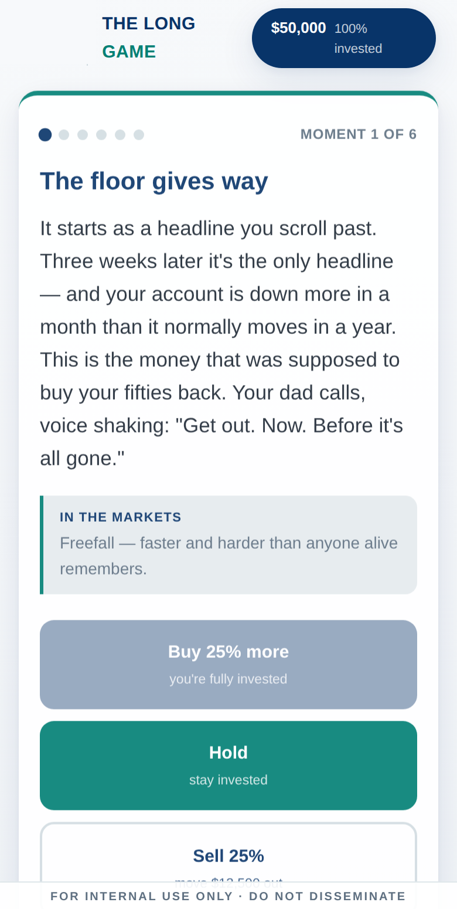
EACH MOMENT · THE PHONE
The decision
WHAT HAPPENS
Every moment is a real month of 2020–2025, shown only as a short, tense story — never named or dated. The player chooses Buy, Hold, or Sell.
THE THINKING
Hiding the date forces a gut reaction — the way an investor actually experiences a crisis in the moment, without the comfort of hindsight.
THE LONG GAME · LIVE ROOM · HOW IT WORKS, AND WHY

Slide 6
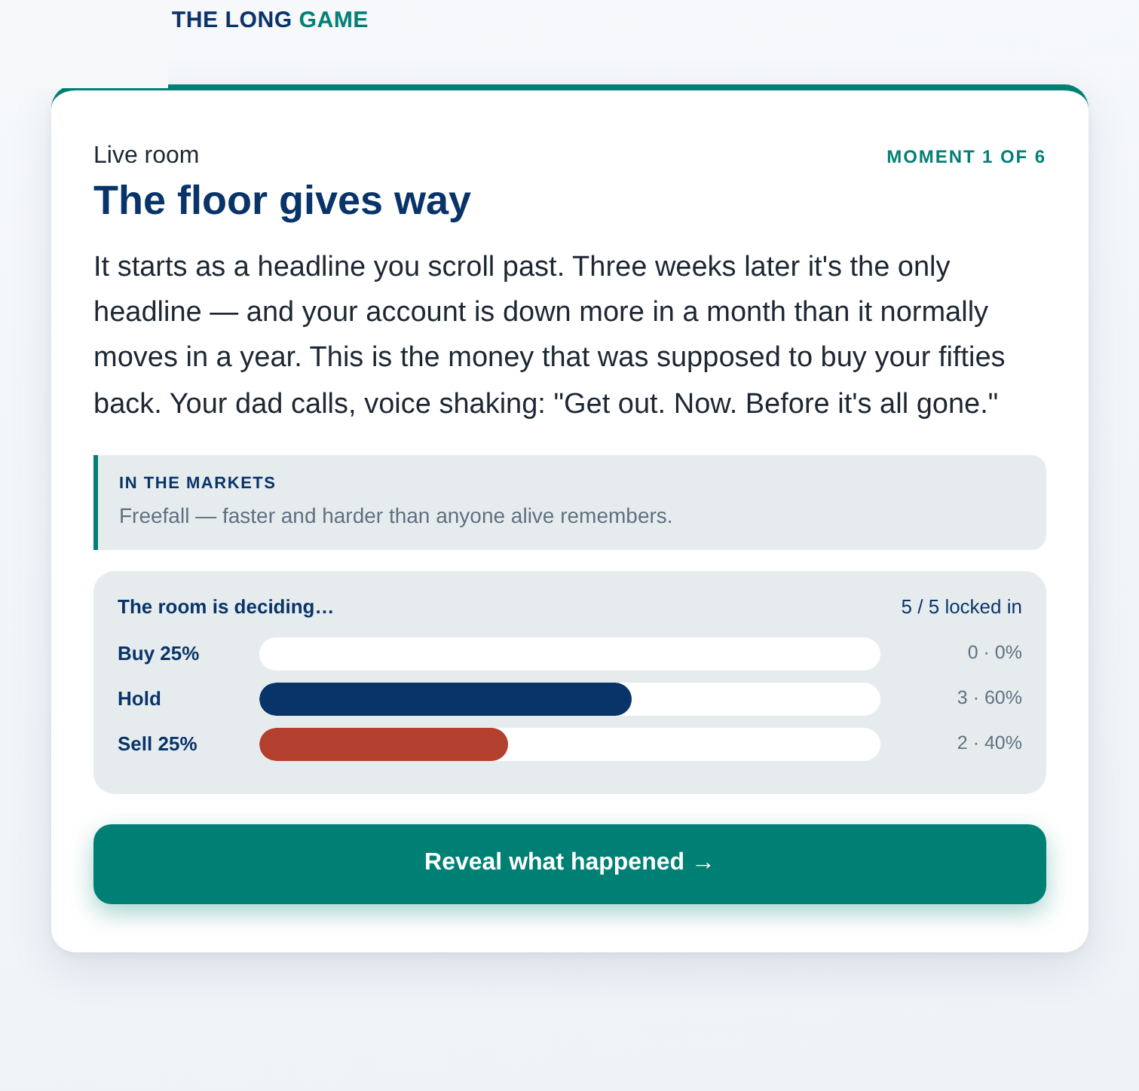
EACH MOMENT · BIG SCREEN
While the room decides
WHAT HAPPENS
The big screen shows the room leaning Buy / Hold / Sell in real time. The outcome stays hidden until the host chooses to reveal it.
THE THINKING
Surfacing the crowd's instinct — and withholding the result — lets the room commit to a decision before they know whether it paid off.
THE LONG GAME · LIVE ROOM · HOW IT WORKS, AND WHY

Slide 7
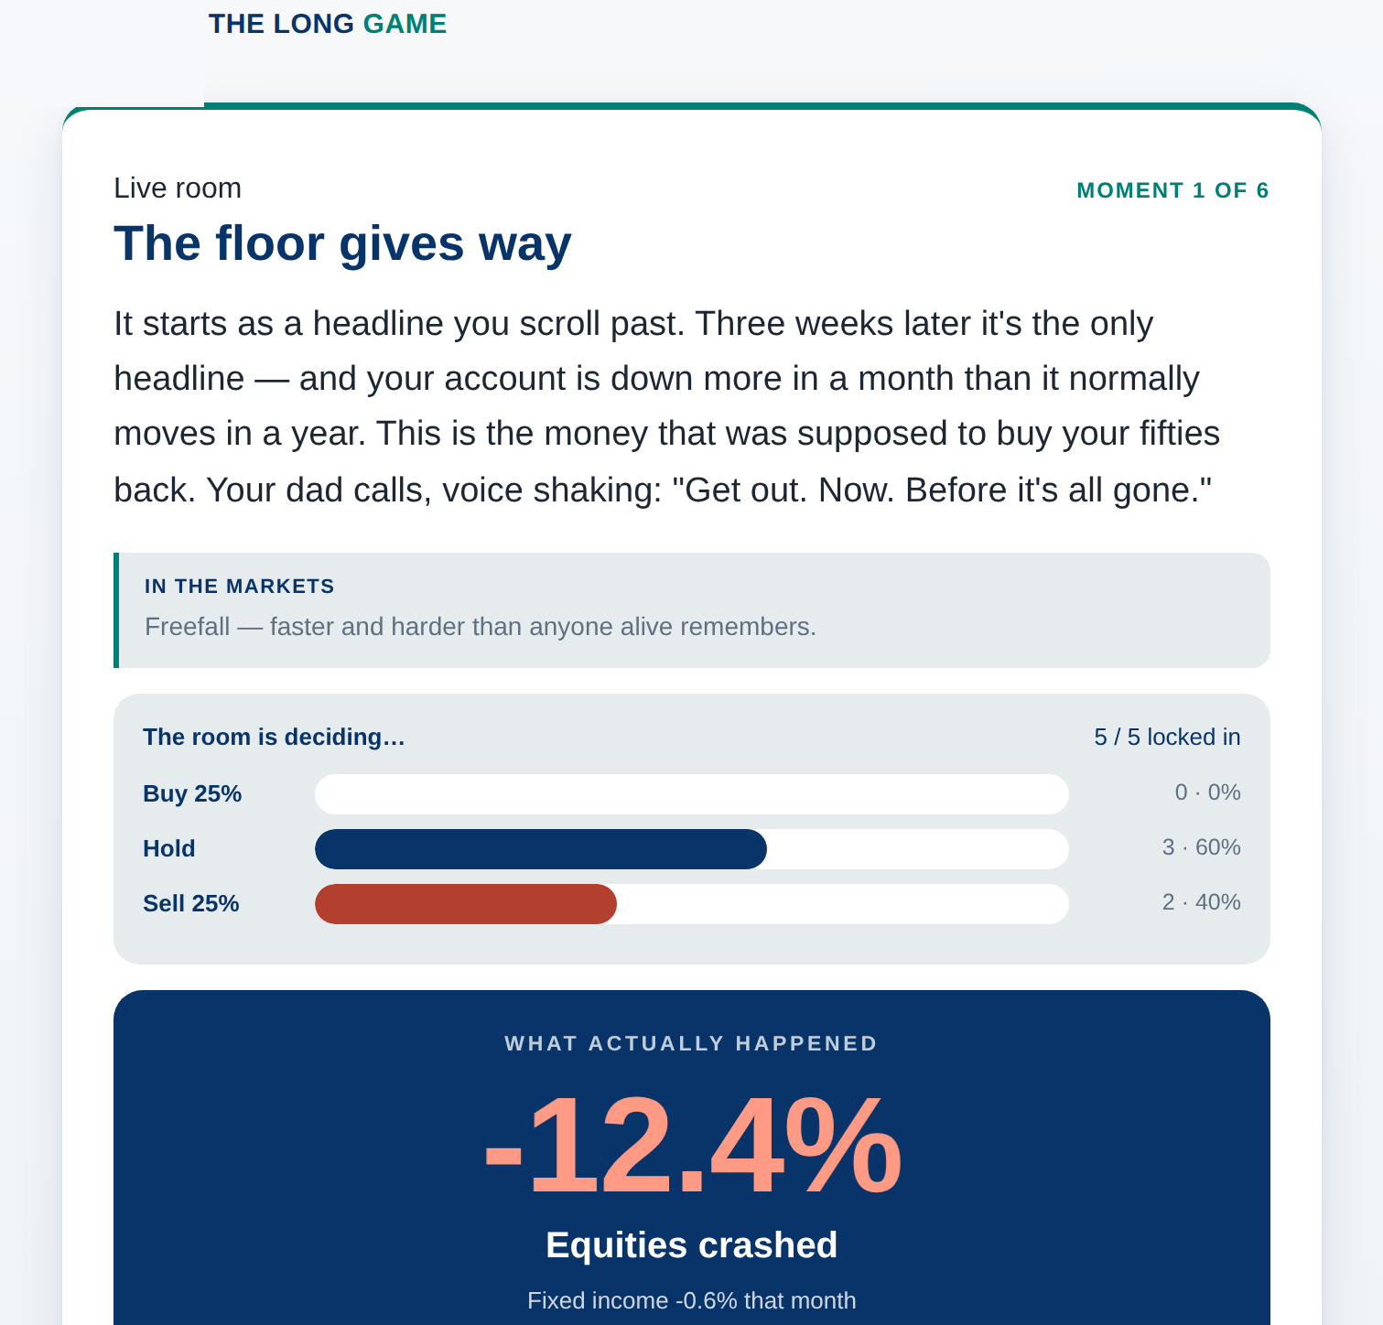
EACH MOMENT · THE REVEAL
What actually happened
WHAT HAPPENS
On reveal, the big screen shows one number — the market's real move that month — with a plain-language read of what it meant.
THE THINKING
The market's move is separated from the drama of the story, so the takeaway is the data itself, not the fear the headline created.
THE LONG GAME · LIVE ROOM · HOW IT WORKS, AND WHY

Slide 8
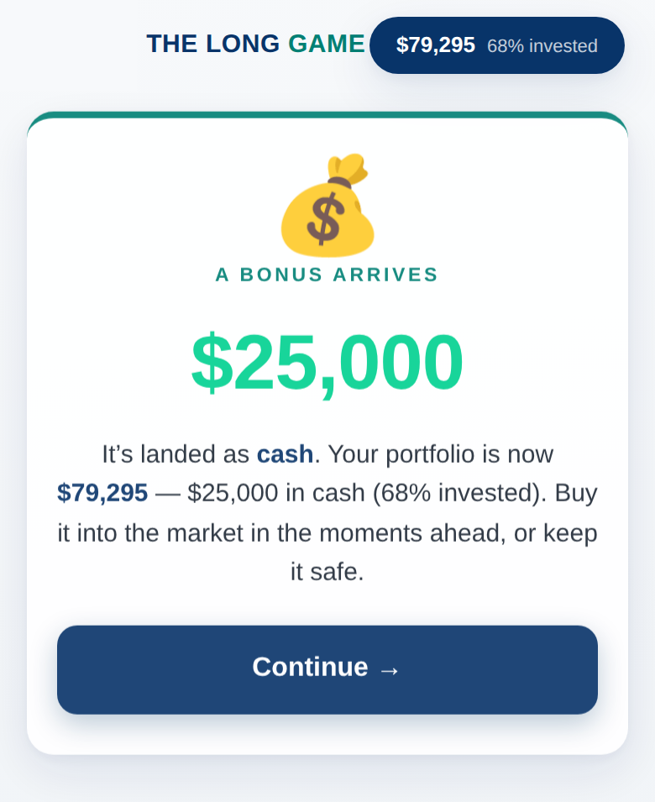
MOMENT 3 · ITS OWN SCREEN
The cash windfall
WHAT HAPPENS
Partway through, a cash bonus lands in every portfolio — as cash, announced on its own screen before the moment continues.
THE THINKING
New money often arrives at unsettling times. Deploying it or leaving it idle is a real decision, and idle cash is measured against putting it to work.
THE LONG GAME · LIVE ROOM · HOW IT WORKS, AND WHY

Slide 9
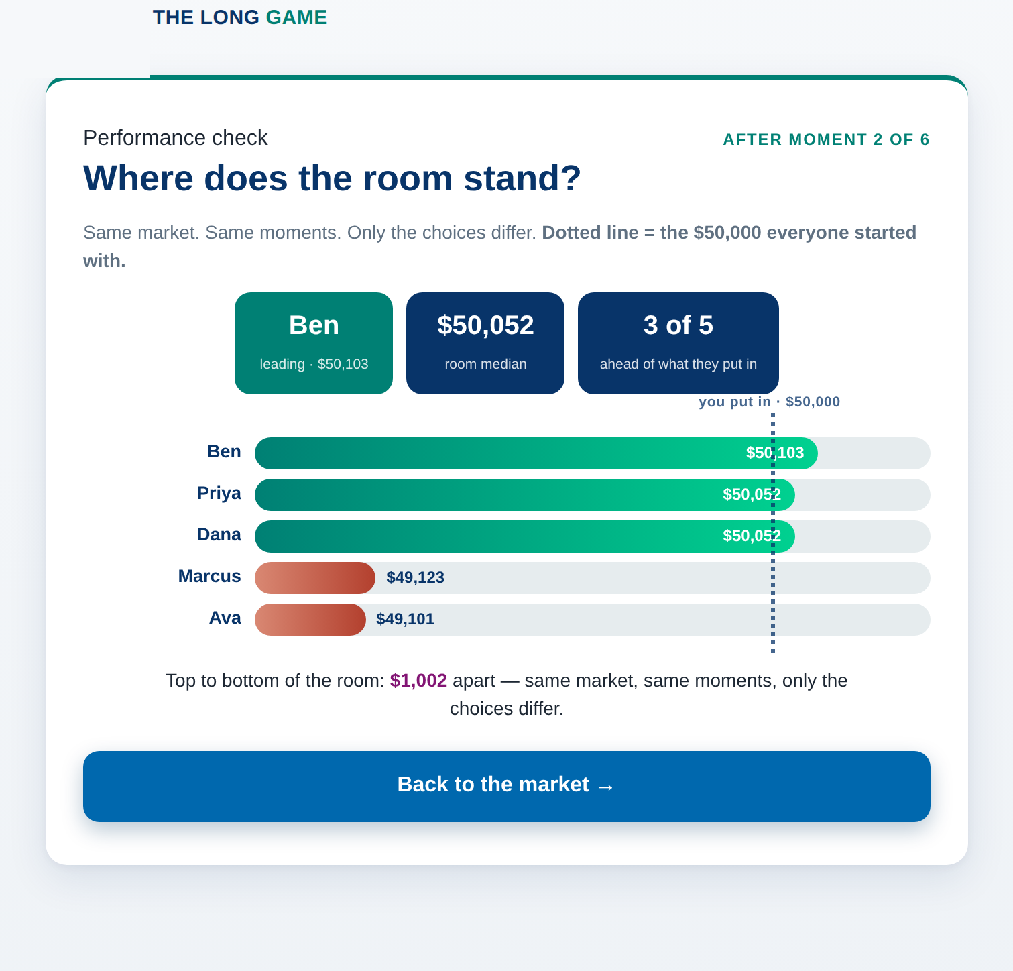
AFTER MOMENTS 2 & 4
The performance check
WHAT HAPPENS
A live leaderboard shows every player against what they put in. At the same time, each phone shows that player their own rank.
THE THINKING
A mid-game standing keeps the room engaged and makes the final lesson personal — you were in it, and this is where you stood.
THE LONG GAME · LIVE ROOM · HOW IT WORKS, AND WHY

Slide 10
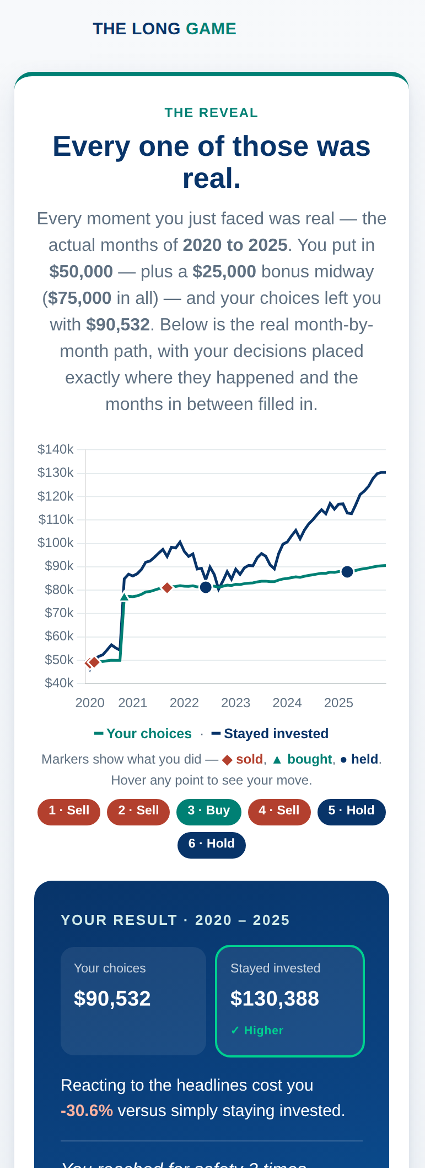
THE RESULT · READING THE CHART
The two lines
WHAT HAPPENS
Teal “Your choices” is the path your Buy / Hold / Sell timing produced. Navy “Stayed invested” is the whole amount put in on day one and never touched. Markers show where you acted.
THE THINKING
The gap between the two lines is the whole point — what reacting cost, or (rarely) gained, versus simply holding on. The card states it in dollars and percent. (The Sales edition adds a third line: the fund.)
THE LONG GAME · LIVE ROOM · HOW IT WORKS, AND WHY

Slide 11
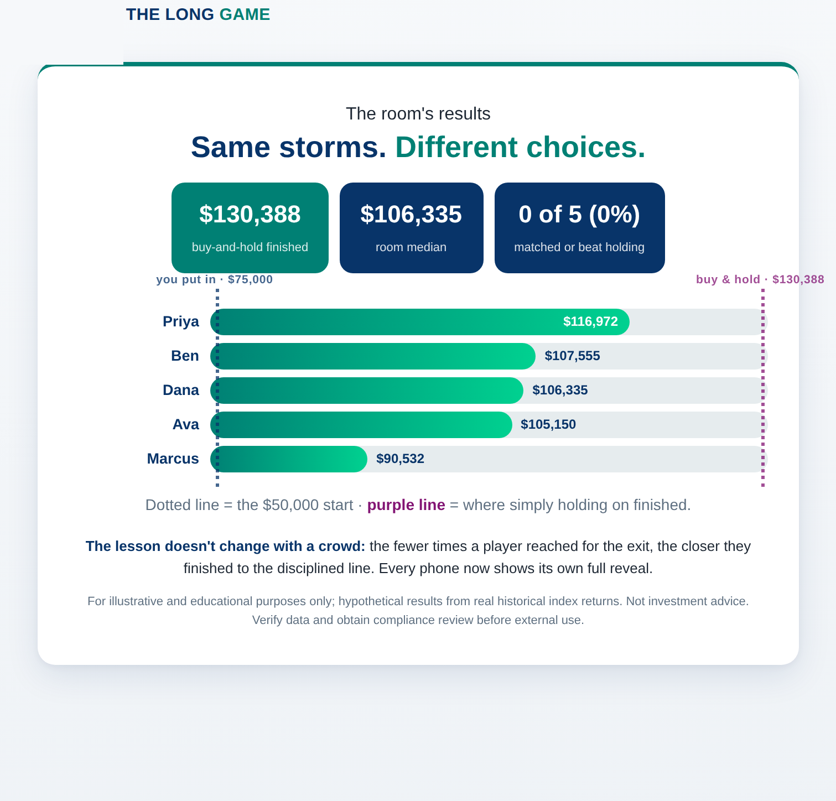
THE FINISH · BIG SCREEN
Everyone vs. holding on
WHAT HAPPENS
Every player's final value as a bar, against the line for total money put in and the line for simply staying invested the whole time.
THE THINKING
The room sees one shape together: the fewer times a player stepped out, the closer they finished to the disciplined, stayed-invested line.
THE LONG GAME · LIVE ROOM · HOW IT WORKS, AND WHY

Slide 12
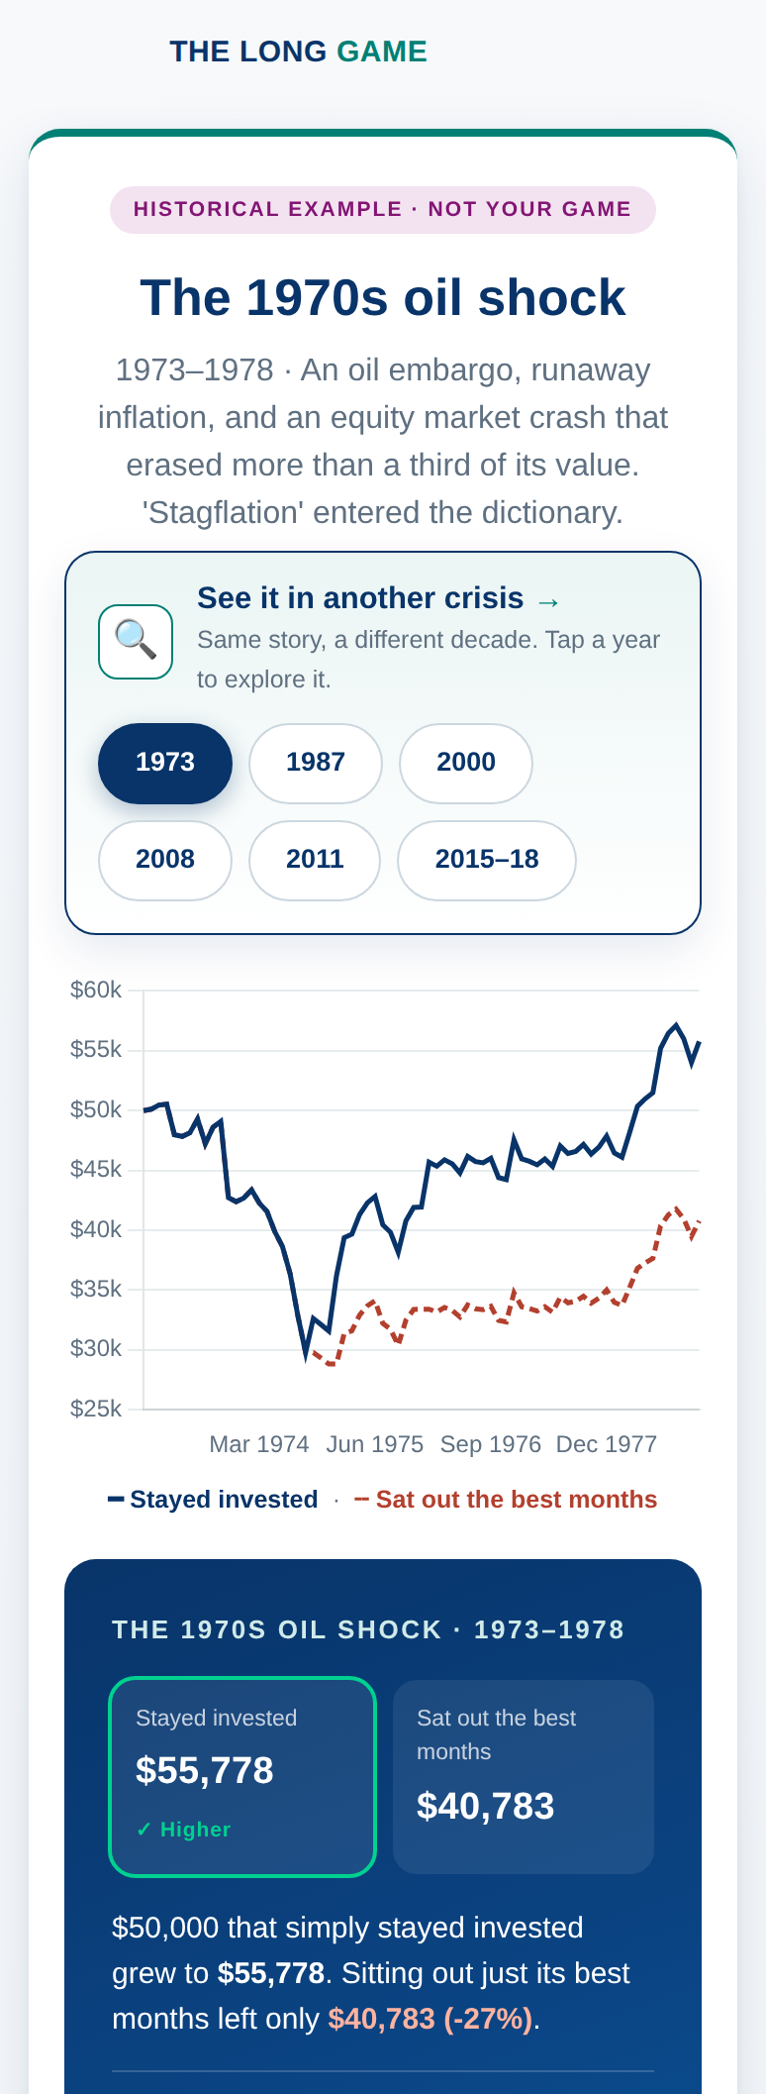
AFTER THE GAME
Explore other crises
WHAT HAPPENS
Players can replay the same comparison through earlier crises — 1973, 1987, 2000, 2008 — each showing staying invested versus sitting out the best months.
THE THINKING
It shows the pattern isn't a 2020 fluke. The best days cluster next to the worst, so stepping out to avoid the pain usually means missing the recovery.
THE LONG GAME · LIVE ROOM · HOW IT WORKS, AND WHY

Slide 13
WHY IT'S BUILT THIS WAY
Three ideas hold the whole game together.
Emotion, not math
Real data, hidden dates
Benchmarked to holding
It recreates fear, FOMO and regret so the room feels why investors sell at the wrong time — the real reason returns get missed.
Real monthly returns make it credible; hiding the dates keeps it honest — every decision is made without hindsight.
Every choice — timing, cash, the windfall — is measured against simply staying fully invested, so the cost of reacting is explicit.
THE LONG GAME · LIVE ROOM · HOW IT WORKS, AND WHY

Slide 14
RUNNING IT
What a consultant actually does.
1
Host from the official link
Open the game on the big screen — it creates the room and QR. Set the starting amount.
2
The audience scans
Any phone, any network. Names appear as they join; press start when the room is in.
3
Pace the six moments
You control reveal and next; the checks, windfall and finish run themselves. 5–50 players, ~15 min.
Internal / pre-approval. Confirm data + compliance sign-off before any client-facing use.
THE LONG GAME · LIVE ROOM · HOW IT WORKS, AND WHY

